Slide 1


Hand Vasculature Image Analysis and Gender/Age Classifications
Team members: Mona Ahmed Hussein & Amr Mohamed Ashour
Supervisor: Dr. Ahmed Badawi

Slide 2
Content
Problem Definition
Introduction & literature survey
Materials and Methods
Results and Discussion
Conclusion
GUI System
Acknowledgment

Slide 3
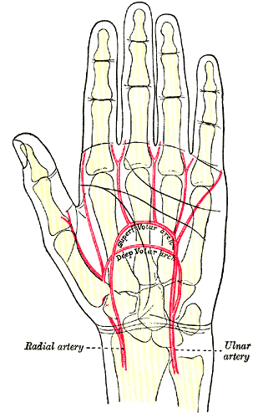
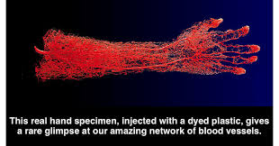
Problem Definition
https://28oa9i1t08037ue3m1l0i861-wpengine.netdna-ssl.com/wp-content/uploads/2014/05/Hand-blood-vessles-FB.png
https://fpnotebook.com/_media/orthoArmHandArteryVolarArchGrayBB1237.gif

Slide 4
Introduction
What is Biometrics ?

Slide 5
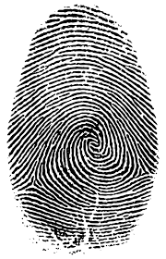
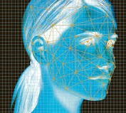
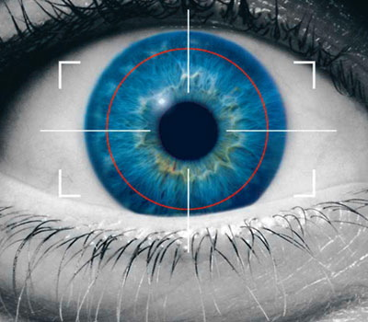
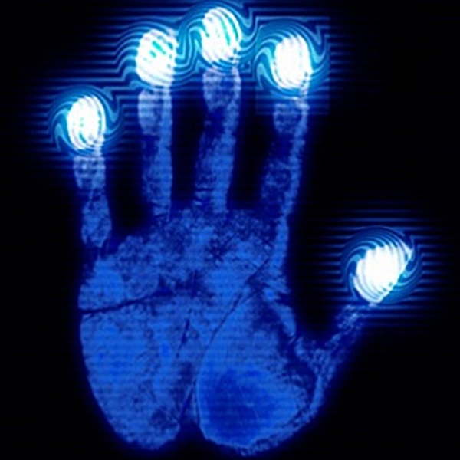
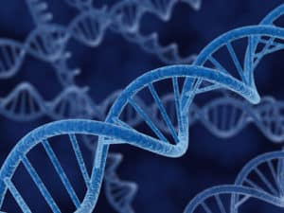
Introduction Cont.
Biometric Modalities Characteristics:
Physiological Characteristics:
Fingerprint Face Iris Hand DNA

Slide 6
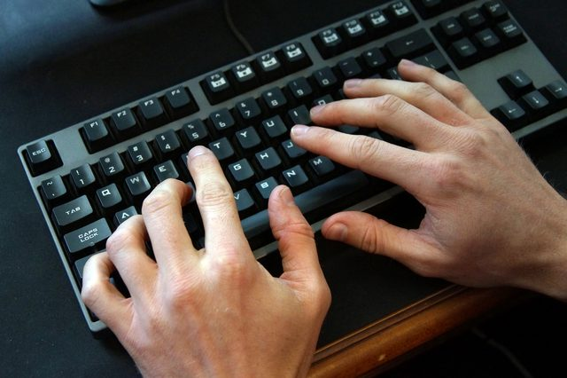
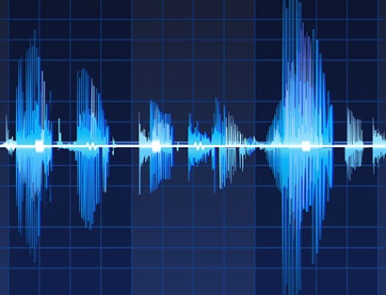
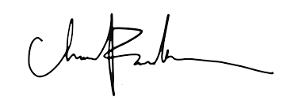
Introduction Cont.
Behavioral Characteristics:
Keystroke Signature Voice

Slide 7
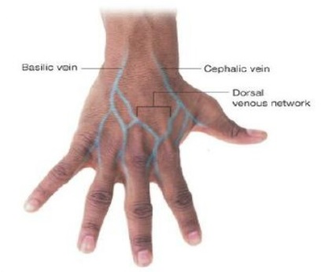
Introduction Cont.
Dorsal View of Hand:

Slide 8
Introduction Cont.
Why Hand Veins ?
Hidden characteristic
Difficult to forge for intruders
Not affected by dryness or roughness of skin
Non-intrusive

Slide 9
Literature Survey
Previous Studies:
“Peripheral veins: influence of gender, body mass index, age and varicose veins on cross-sectional area” ,2003. K Kröger, et al
"Biometric Authentication Using Fast Correlation of Near Infrared Hand Vein Patterns”, 2008. Ahmed Badawi, et al
"Minutiae feature analysis for infra-red hand vein pattern biometric", 2013.International Journal of Engineering and Technology
"Age and gender classification from finger vein patterns", 2016. Wafa Damak1, et al
“An Analysis of Human Dorsal Hand Skin Texture Using Hyperspectral Imaging Technique for Assessing the Skin Aging Process”, 2016.

Slide 10
Block Diagram of the Project
Data Preparation
Image Pre-Processing
Image Processing
Image Classification
Fusion of Classifiers/
Features
Feature Extraction
Notes:
Features & classifiers

Slide 11
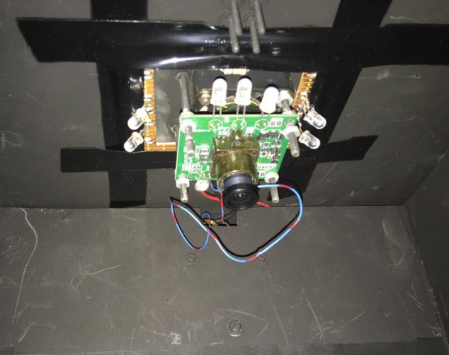
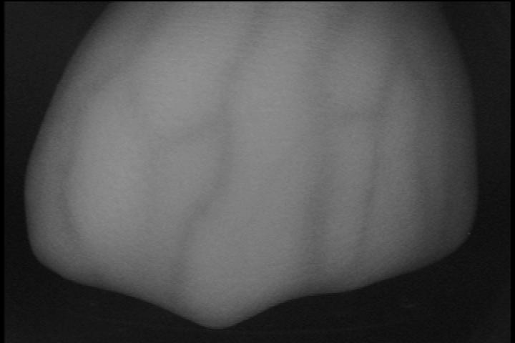
Materials and Methods
Data Set-Up and Acquisition:
Near Infrared (NIR) Camera with surrounded by IR LEDs.
Spectral sensitivity characteristics of used silicon based CCD sensor
The Camera & Its image
Notes:
Clear original image

Slide 12
Dataset & Its Preparation
160 persons/1000 Images
80 Males ,80 Females/500 Images
110 Young ,50 Old/800, 200 Images
5-7 Images for each person
5-7 Images for each person
For Left/Right hand but we selected left

Slide 13
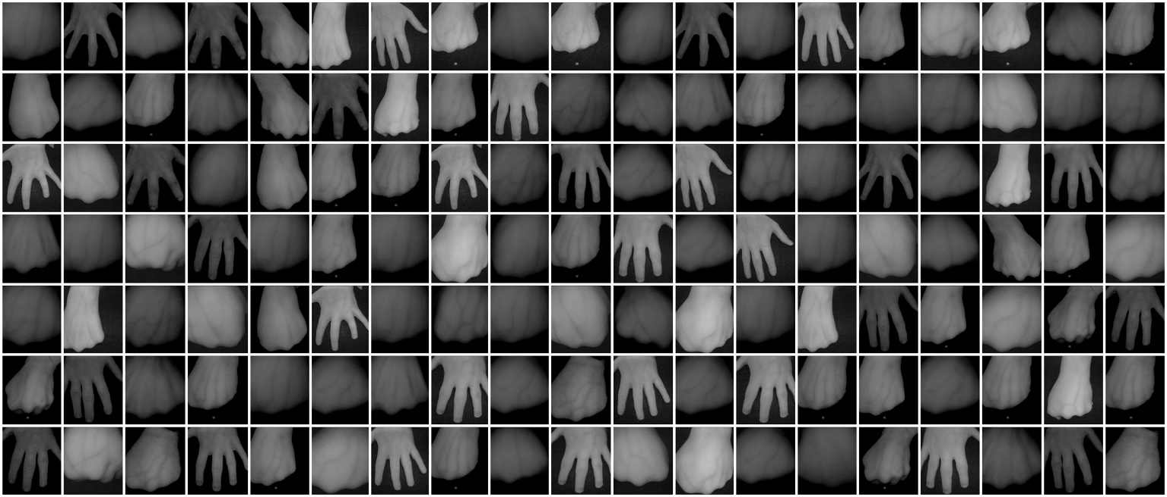
Samples from The Grand Dataset 17 (HV, HG, L/R, Fisted and Whole Hand)

Slide 14
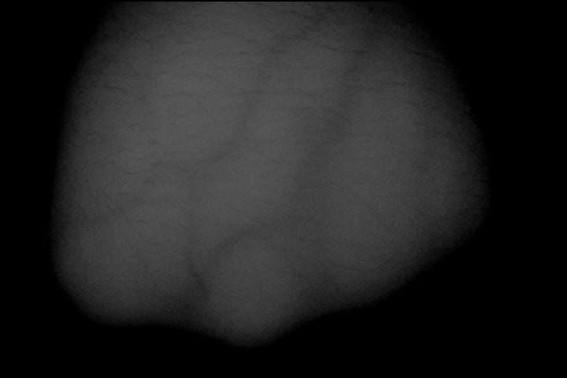
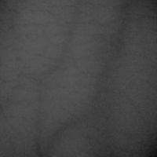
Materials and Methods
Image Preprocessing (ROI Extraction):
Original Image
ROI Image
Notes:
Otsu thresholding of ROI

Slide 15
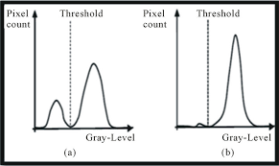
Materials and Methods
Otsu Thresholding:
https://encrypted-tbn0.gstatic.com/images?q=tbn:ANd9GcQ-MQPTyzxDzR5qFxQOaxdrvn9YM0QD6anRCOp88bRfUNxOro40

Slide 16

Materials and Methods
Image Preprocessing (ROI Extraction):
Original image Otsu threshold Get max rectangle ROI
Notes:
1- original image 2- Otsu threshold of ROI (Black & white) 3- get max rectangular on 2 4- ROI

Slide 17



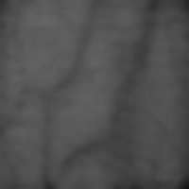
Materials and Methods
Image Processing (Enhancement):
Morphology Filter
Bilateral Filter
Median Filter
CLAHE

Slide 18
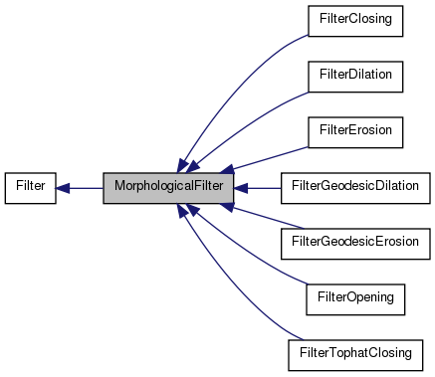
Morphology Filter
https://trac.fawkesrobotics.org/doxygen/classMorphologicalFilter__inherit__graph.png

Slide 19
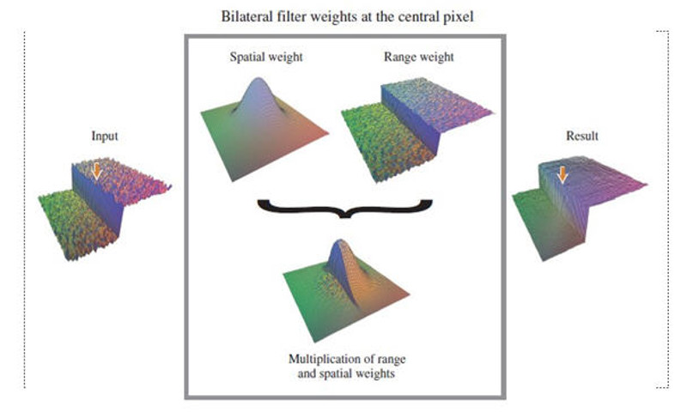
Bilateral Filter
http://www.coldvision.io/wp-content/uploads/2016/01/bilateral_filter.jpg

Slide 20
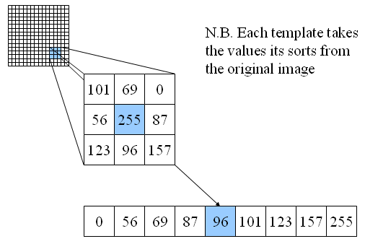
Median Filter
http://users.ecs.soton.ac.uk/msn/book/new_demo/median/

Slide 21
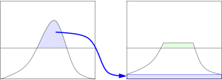
Contrast Limited Adaptive Histogram Equalization (CLAHE)
https://en.wikipedia.org/wiki/Adaptive_histogram_equalization

Slide 22
Feature Extraction (Spatial Information, Texture Information, Vessels tree shape and Shape Information of order structures)
1- Local Binary Pattern (LBP)
2- Local Ternary Pattern (LTP)
3- Gray Level Co-occurrence Matrix (GLCM)

Slide 23
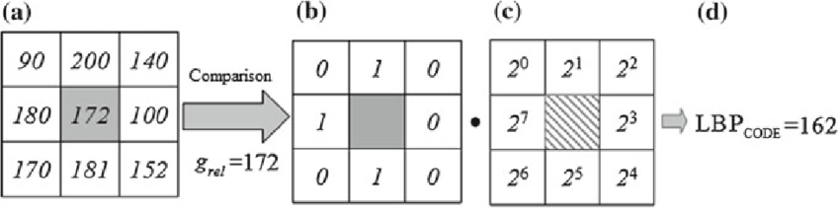
Feature Extraction
Local Binary Pattern (LBP)
https://www.google.com.eg/search?safe=strict&biw=1366&bih=662&tbm=isch&sa=1&ei=Zg5OW-CYJYmC6AS

Slide 24
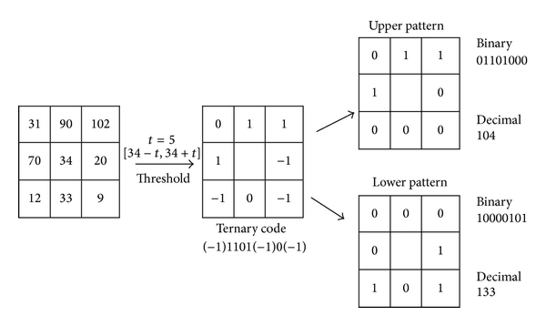
Feature Extraction
Local Ternary Pattern (LTP)
https://www.google.com.eg/search?safe=strict&biw=1366&bih=613&tbm=isch&sa=1&ei=whxOW8SRJaqLmgWG

Slide 25
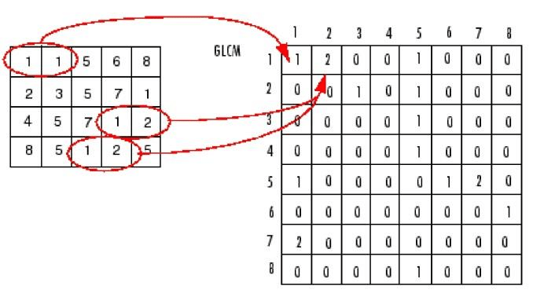
Feature Extraction
Gray Level Co-occurrence Matrix (GLCM)
https://www.researchgate.net/figure/Computation-of-Co-occurrence-matrix_fig1_315653921
Notes:
How often co matrix separated
Horizontal, diagonal, vertical

Slide 26
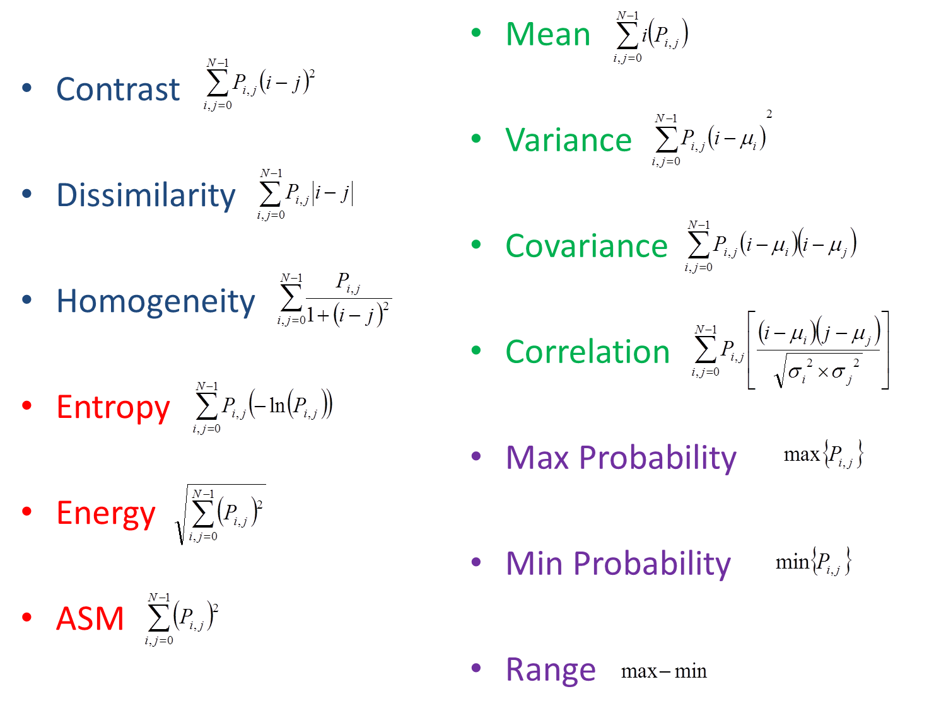
GLCM features
https://collab.firelab.org/software/projects/rmrsraster/repository/raw/esriUtil/esriUtil/Help/HTML/GLCM.html

Slide 27
Features, Categories, and Its Fusion
LBP Histogram
LTP Histogram
GLCM Features

Slide 28
Age and Gender Classification Methods
KNN
K Nearest Neighbor
SVM
Support vector machine

Slide 29
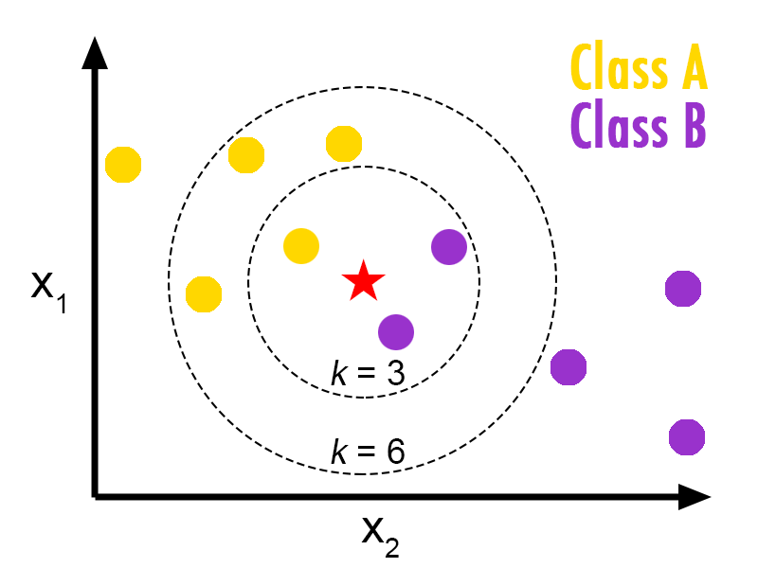
k nearest neighbor (KNN) 5
5
https://helloacm.com/a-short-introduction-to-k-nearest-neighbors-algorithm/

Slide 30
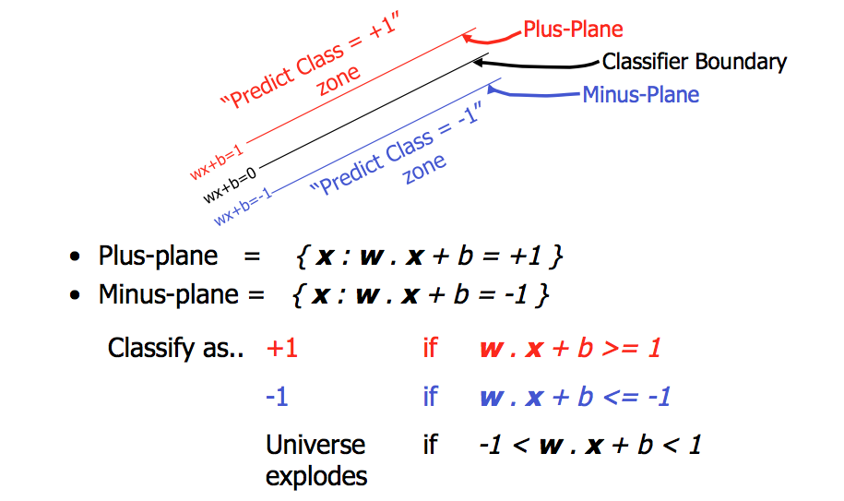
Support vector machine (SVM)
https://stackoverflow.com/questions/21053582/support-vector-machine-geometrical-intuition

Slide 31
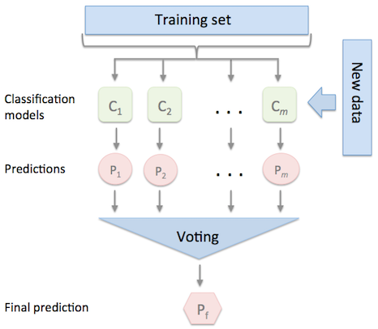
Fusion on Classifiers Level
https://rasbt.github.io/mlxtend/user_guide/classifier/EnsembleVoteClassifier_files/majority_voting.png

Slide 32
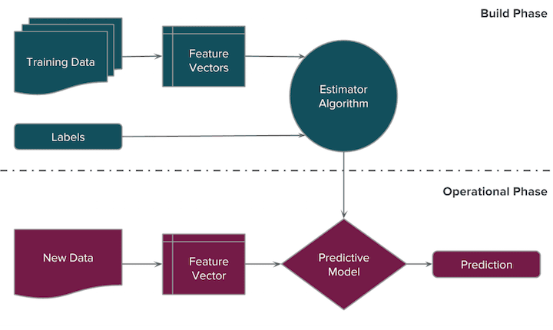
Fusion on Features Level

Slide 33
Training/Testing Classifiers
Train 50 %
Train 70 %
C-cross validation 3 times
Average the Results

Slide 34
Results and Discussion: Gender (Classifiers)
 | Cross Validation/Feature vectors | 1 | 2 | 3 | Best K
Gender Fusion KNN-SVM Dataset (50%) | Dissimilarity | 50 | 52 | 56 | 1-5-11
 | Correlation | 51 | 53 | 55 | 11-7-3
 | Contrast | 54 | 54 | 56 | 5-3-9
 | ASM | 57.5 | 61.5 | 63 | 9-13-9
 | LBP | 79 | 83 | 87 | 47-37-35
 | LTP | 63 | 70 | 80 | 5-47-25
Gender Fusion KNN-SVM Dataset (70%) | Dissimilarity | 50 | 52 | 56 | 1-5-11
 | Correlation | 51 | 53 | 55 | 11-7-3
 | Contrast | 54 | 54 | 56 | 5-3-9
 | ASM | 79.8 | 72.5 | 87 | 11-13-13
 | LBP | 64.7 | 70 | 72 | 47-37-37
 | LTP | 67.5 | 72.6 | 72 | 9-47-25

Slide 35
Results and Discussion: Age (Classifiers)
 | Cross Validation/Feature vectors | 1 | 2 | 3 | Best K
Age Fusion KNN-SVM Dataset (50%) | Dissimilarity | 80 | 80 | 79.8 | 1-5-11
 | Correlation | 80 | 80 | 79.8 | 11-7-3
 | Contrast | 80 | 80 | 79.8 | 5-3-9
 | ASM | 80 | 80 | 79.8 | 11-13-13
 | LBP | 85 | 81 | 82 | 41-45-33
 | LTP | 85 | 82 | 81 | 47-49-49
Age Fusion KNN-SVM Dataset (70%) | Dissimilarity | 80 | 80 | 79.8 | 1-5-11
 | Correlation | 80 | 80 | 79.8 | 11-7-3
 | Contrast | 80 | 80 | 79.8 | 5-3-9
 | ASM | 80 | 80 | 79.8 | 11-13-13
 | LBP | 86 | 82 | 81 | 41-45-33
 | LTP | 86 | 81 | 82 | 47-49-49

Slide 36
Results and Discussion: Gender (Features)
 | N times/ Classifiers | 1 | 2 | 3 | Best K
Gender GLCM | KNN | 78.5 | 81.5 | 82 | 3-3-3
 | SVM | 57 | 63 | 65 | ---
Gender LBP/LTP | KNN | 74 | 76 | 79 | 49-49-41
 | SVM | 57 | 62 | 63.5 | ---
Gender GLCM/LBP | KNN | 75 | 77 | 78 | 49-37-49
 | SVM | 56 | 61 | 62 | ---
Gender GLCM/LTP | KNN | 65 | 68 | 69 | 3-45-25
 | SVM | 56 | 61 | 65 | ---
Gender GLCM/LBP/LTP | KNN | 74 | 76 | 79 | 49-37-49
 | SVM | 54 | 60 | 63 | ---

Slide 37
Results and Discussion: Age (Features)
 | N times/ Classifiers | 1 | 2 | 3 | Best K
Age GLCM | KNN | 86 | 85 | 87 | 21-21-21
 | SVM | 80 | 81 | 79.8 | ---
Age LBP/LTP | KNN | 79 | 83 | 84 | 43-49-47
 | SVM | 78 | 79 | 78.5 | ---
Age GLCM/LBP | KNN | 78 | 81 | 82 | 41-49-49
 | SVM | 78.5 | 79.5 | 79 | ---
Age GLCM/LTP | KNN | 76 | 78.5 | 79 | 43-47-49
 | SVM | 79 | 80 | 79.5 | ---
Age GLCM/LBP/LTP | KNN | 80 | 82.5 | 83 | 41-49-49
 | SVM | 79 | 80 | 82 | ---

Slide 38
Age-Training set (50%)
Gender-Training set (70%)
Age-Training set (70%)
Gender-Training set (50%)
N_Trials/ Features | 1 | 2 | 3 | 4 | 5
Dissimilarity | 67.5 | 66 | 69 | 66 | 63
Correlation | 72 | 67 | 65 | 67 | 67.5
Contrast | 71 | 69 | 71 | 67 | 69
ASM | 68 | 69 | 69 | 67 | 69
Homogeneity | 71 | 69 | 69 | 68 | 68
Energy | 69 | 69 | 69 | 65 | 70
LBP | 71 | 70 | 70 | 69 | 69
LTP | 61 | 69 | 65 | 67 | 70
Comatrix | 82 | 80 | 80 | 79 | 81
LBP/LTP | 79 | 80 | 78 | 80 | 80
Comatrix/LBP/LTP | 77 | 79 | 75 | 78 | 77
N_Trials/ Features | 1 | 2 | 3 | 4 | 5
Dissimilarity | 66 | 67 | 66 | 66 | 68
Correlation | 67 | 71 | 67 | 70 | 71
Contrast | 68 | 73 | 67 | 68 | 72
ASM | 69 | 73 | 67 | 67 | 68
Homogeneity | 71 | 72 | 66 | 68 | 67
Energy | 71 | 68 | 67 | 70 | 72
LBP | 70 | 70 | 69 | 70 | 70
LTP | 62 | 70 | 69 | 69 | 64
Comatrix | 87 | 81 | 80 | 80 | 81
LBP/LTP | 80 | 80 | 79 | 80 | 80
Comatrix/LBP/LTP | 80 | 78 | 77 | 80 | 82
N_Trials/ Features | 1 | 2 | 3 | 4 | 5
Dissimilarity | 62.5 | 60 | 62 | 60 | 65
Correlation | 62.5 | 61 | 66 | 64 | 64
Contrast | 61 | 64 | 64 | 61 | 64
ASM | 61 | 61 | 63 | 63 | 61
Homogeneity | 63 | 66 | 69 | 62.5 | 68
Energy | 62 | 64 | 63 | 65 | 64
LBP | 60 | 61 | 60 | 61 | 62
LTP | 64 | 65 | 64 | 61 | 62
Comatrix | 77 | 79 | 82 | 78 | 79
LBP/LTP | 77 | 78 | 78 | 77 | 77
Comatrix/LBP/LTP | 78 | 83 | 81 | 80 | 79
N_Trials/ Features | 1 | 2 | 3 | 4 | 5
Dissimilarity | 61 | 62 | 62 | 63 | 61
Correlation | 61 | 62.5 | 66 | 64 | 67
Contrast | 61 | 65 | 64 | 61 | 69
ASM | 61 | 64 | 61 | 67 | 62
Homogeneity | 61 | 68 | 70 | 62.5 | 72
Energy | 61 | 69 | 61 | 61 | 70
LBP | 61 | 62 | 62 | 62 | 62
LTP | 64 | 68 | 60 | 61 | 61
Comatrix | 79 | 83 | 78 | 82 | 83
LBP/LTP | 79 | 78 | 79 | 77 | 77
Comatrix/LBP/LTP | 80 | 88 | 80 | 81 | 82

Slide 39
Gender-Confusion Matrix (70%)
 | Female | Male
Female | 71 | 9
Male | 10 | 70
Age-Confusion Matrix (50%)
 | Young | Old
Young | 101 | 9
Old | 20 | 30
Age-Confusion Matrix (70%)
 | Young | Old
Young | 100 | 10
Old | 10 | 40
 | Female | Male
Female | 67 | 13
Male | 13 | 67
Gender-Confusion Matrix (50%)

Slide 40
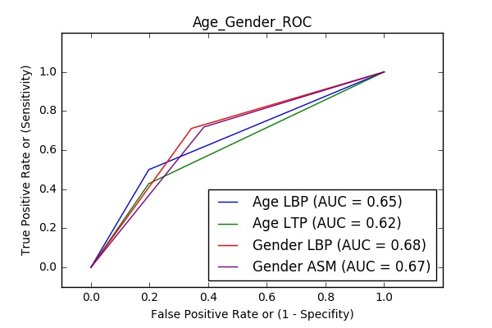
Gender & Age Receiver Operating Characteristics (ROC)

Slide 41





Our Tools

Slide 42
Conclusion
Data Preparation
Image Pre-Processing
Image Processing
Image Classification
Fusion of Classifiers/
Features
Feature Extraction
Notes:
Features & classifiers

Slide 43
Our Contributions
Get ROI
Applying new filters
Fusion on classifiers level
Fusion on features level
Fusion on decision level
Propose the co-occurrence matrix and fuse it.
Enhancing the Accuracy of age and gender
Designing a new GUI System

Slide 44
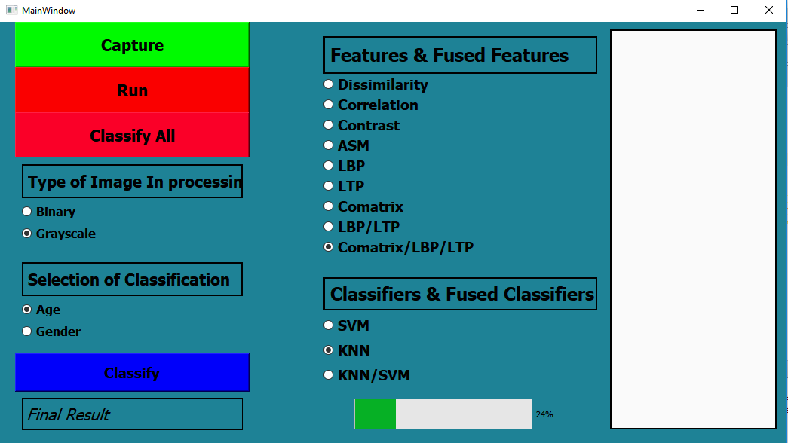
GUI System

Slide 45
Acknowledgment
Special Thanks to:
Dr. Ahmed M. Badawi
Dr. AbdElmonem Alsharqawy
Dr. Mohamed Khairy
Eng. Menna Essam
Eng. Marina F. Emil
Eng. Sarah M. Ragab
Eng. Yasmin M. Khattab

Slide 46
Thank You
Any Questions?

