Slide 1

Three-stage FMD diet effect on aging
D-HEST
19 April 2024
Semester Project
Amro Abdrabo

Slide 2
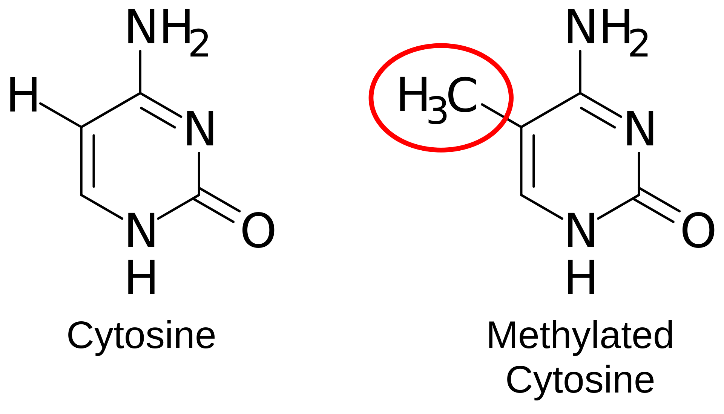
Introduction – DNA Methylation and Aging
D-HEST
Recent studies have shown that DNA methylation is indicative of aging and age-related diseases [1, 2, 3, 4, 5, 6].
DNA methylation inhibits gene expression in animal cells [4]. Biological aging plays a role in age-related diseases since the ratio of lymphoid-to-myeloid is associated with transcriptional upregulation of genes [6].
Hier steht der Untertitel

Slide 3
Milestones
D-HEST

Slide 4
1. Concept definition and literature review (3 weeks) 2. Extract CPG sites which are indicative of biological aging using the Horvath and GKM age and compare to those found in literature (2 weeks) 3. Train model dependent on lifestyle characteristics (smoking, alcohol consumption, and more) and the biomarkers found for aging in step 1 (3 weeks) 4. Examine the cofounding effects from the lifestyle-relate variables (3 weeks) 5. Compare the performance of the model found in step 2 to a model trained using only biomarkers (1 week) 6. Create a Python package that analyzes and visualizes DNA methylation and age (3 weeks)
D-HEST

Slide 5
References
Maegawa, S., Lu, Y., Tahara, T., Lee, J. T., Madzo, J., Liang, S., Jelinek, J., Colman, R. J., & Issa, J.-P. (2017). Caloric restriction delays age-related methylation drift. Nature Communications. https://doi.org/10.1038/s41467-017-00607-3halt 2
Salameh, Y., Bejaoui, Y., & El Hajj, N. (2020). DNA Methylation Biomarkers in Aging and Age-Related Diseases. Frontiers in Genetics, 11. https://doi.org/10.3389/fgene.2020.00171
Zemach, A., McDaniel, I. E., Silva, P., & Zilberman, D. (2010). Genome-Wide Evolutionary Analysis of Eukaryotic DNA Methylation. Science, 328(5980), 916-919. https://doi.org/10.1126/science.1186366
Razin, A., & Cedar, H. (1991). DNA methylation and gene expression. Microbiological Reviews, 55(3), 451-458. https://doi.org/10.1128/mr.55.3.451-458.1991
Brandhorst, S., Levine, M. E., Wei, M., Shelehchi, M., Morgan, T. E., Nayak, K. S., Dorff, T., Hong, K., Crimmins, E. M., Cohen, P., & Longo, V. D. (2024). Fasting-mimicking diet causes hepatic and blood markers changes indicating reduced biological age and disease risk. Nature Communications. https://doi.org/10.1038/s41467-024-45260-9
Wei, M., Brandhorst, S., Shelehchi, M., Mirzaei, H., Cheng, C. W., Budniak, J., Groshen, S., Mack, W. J., Guen, E. L., ... Longo, V. D. (2017). Fasting-mimicking diet and markers/risk factors for aging, diabetes, cancer, and cardiovascular disease. Science Translational Medicine, 9(377), eaai8700. https://doi.org/10.1126/scitranslmed.aai8700

