Slide 1
TDM Nexus
Capabilities, Gains, & Reflections
Professional Web Application for Technical Delivery Managers

Slide 2
Introduction to TDM Nexus
What is TDM Nexus?
A comprehensive dashboard and management tool tailored for Technical Delivery Managers (TDMs).
Centralized platform for tracking releases, finances, quality, and governance.
Replaces fragmented tools with an interactive, responsive, and dynamic user interface.
Features 3D visualizations and real-time tracking.

Slide 3
Core Capabilities (1/2)
Key features that drive efficiency:
Release Planning & Governance:
Dedicated modules for Release Planning Meetings (RPM).
POAP and full lifecycle tracking.
Financial Management & Approvals:
End-to-end tracking of budgets.
Monitoring ICAR movements and domain cross-charges.

Slide 4
Core Capabilities (2/2)
Ensuring quality and seamless operation:
Quality Assurance:
Integrated defect tracking.
Testing quality metrics.
Hypercare (ELS) monitoring.
Seamless Workflows:
Contextual tools including walkthrough wizards.
Implementation tracking and data analyzing dashboards.

Slide 5
User Experience & Design
Designed for modern workflows:
Fully responsive design accommodating desktop, tablet, and mobile views to keep TDMs connected.
Contextual views with adaptable layouts, split-modes, and data-rich tables.
Immersive data visualization powered by ThreeJS 3D canvas.
Optimized GPU performance dynamically based on the device.
Theming support, intelligent breakpoints, and accessible touch targets.

Slide 6
Key Gains from Using TDM Nexus
Measurable improvements in daily operations:
Process Efficiency: Streamlined planning to delivery processes via a 'single pane of glass'.
Real-Time Visibility: Immediate insight into RAG statuses (Red, Amber, Green).
Platform Synchronization: Seamlessly bridges the gap between Planning and Release Management.
Robust Cost Control: Enhanced visibility into VROMs, budgets, and domain timesheet tracking.

Slide 7


EXECUTIVE PRESENTATION • TECHNICAL DELIVERY MANAGEMENT
TDM Nexus: AI-Driven Portfolio Delivery
Transforming Technical Delivery Oversight into Predictive Steering & Measurable ROI.
The Executive Friction: According to PMI, project leaders spend up to 54% of their working hours on manual status updates and tracking. While many deploy generic AI, McKinsey research confirms that up to 300% ROI is realized only when AI is embedded directly into core delivery governance.

Slide 8




The Strategic Shift: Reactive vs Predictive
Traditional Delivery Governance
TDM Nexus AI Paradigm
→
54% Admin Waste: PMs spend half their time collecting manual updates across tools.
→
Automated Synthesis: Real-time delivery data transformed into executive updates instantly.
→
Late Risk Detection: Technical blockers are discovered only during milestone failures.
→
Predictive Risk Engine: Early alerts flag delivery velocity drops before deadline slips.
→
Fragmented Visibility: Cross-project dependency collisions remain hidden in siloes.
→
Unified Governance: Centralized technical delivery nerve center for portfolio leaders.
→
Disconnected AI: Standalone chatbots offer generic summaries without operational context.
→
Embedded ROI: Up to 3x productivity gains built directly into team workflows.

Slide 9


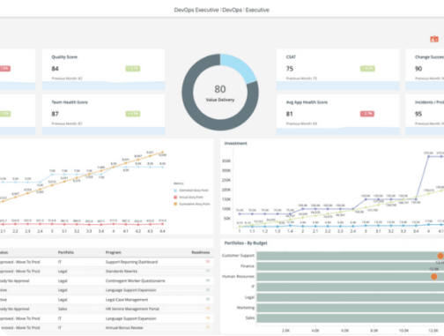
TDM Nexus Feature Spotlight
Centralized Delivery Hub
Aggregates technical metrics, tickets, and release pipelines into a unified executive dashboard.
AI Risk & Blocker Engine
Automatically flags dependency bottlenecks, resource burn spikes, and potential milestone delays.
1-Click Executive Briefings
Generates tailored, concise narrative summaries for senior portfolio managers in seconds.

Slide 10



Measurable Portfolio Impact
54%
300%
72%
Time Recovered
Targeted ROI
Risk Avoidance
Reduction in manual status collection and deck compilation for project leads.
Achieved by embedding AI natively into delivery governance workflows.
Proactive mitigation of cross-project dependency collisions before milestone breach.

Slide 11








Portfolio Rollout Strategy
Phase 1: Pilot
Phase 2: Integrate
Phase 3: AI Tuning
Phase 4: Scale
Onboard 2 key technical delivery streams into TDM Nexus hub.
Connect CI/CD pipelines, issue trackers, and automated telemetry.
Configure custom risk thresholds and automated executive reporting.
Expand across full portfolio with standardized governance dashboards.

Slide 12

Image Sources
https://digital.ai/wp-content/uploads/2022/09/RC-SS-AI-2023-4-intelligence-product-screenshot.png
Source: digital.ai

