Slide 1


Slide 2
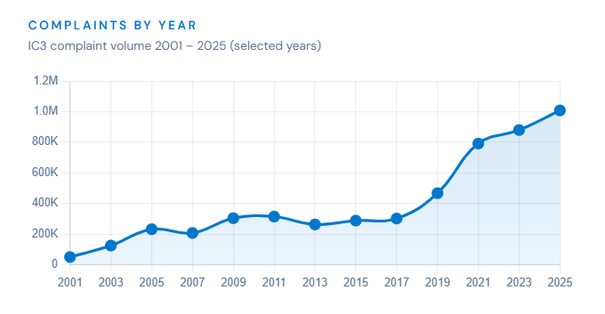
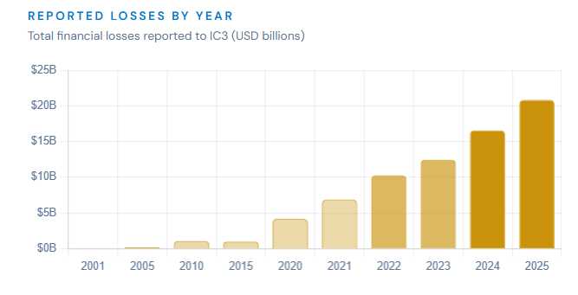
FBI INTERNET CRIME COMPLAINT CENTER
CYBER-ENABLED FRAUD 2025
Source: IC3 Annual Report 2025
Federal Bureau of Investigation
25th Anniversary Report · ic3.gov
Total Complaints
1,008,597
First time exceeding 1M/year
Total Losses
$20.88B
vs. $16.6B in 2024
Average Loss
$20,699
Per complaint reported
Daily Complaints
~3,000
Up from a few thousand/month in 2000

Slide 3


(7arth)
AI-Powered
Network Intrusion Detection System
Supervised by
Dr. Waleed Gaballah
Dr. Shaimaa Elsabbahi
Eng. Amira Basuoni
Eng. Shrouk Abdelnaser

Slide 4
Team Members
Mahmoud Magdi Elbahi
Doaa Ibrahim Saad
Hager Ibrahim Abdullah
Ahmed Mostafa Eid
Ahmed Mohamed Abdelaziz
Amr Tarek Mabrouk
Diaa Mohamed Abdelaziz
Fatma Mohamed Anas
Israa Ibrahim Ali
Merna Elsayed Morad

Slide 5
Motivition
Increasing number of cyber threats targeting networks across sectors.
Traditional security systems struggle to detect novel or evolving attacks.
Our Vision:
Build an intelligent, efficient, and user-friendly Network Intrusion Detection System (NIDS).
Empower security teams with a tool that combines AI detection with a visual dashboard (7arth) for easy monitoring.

Slide 6

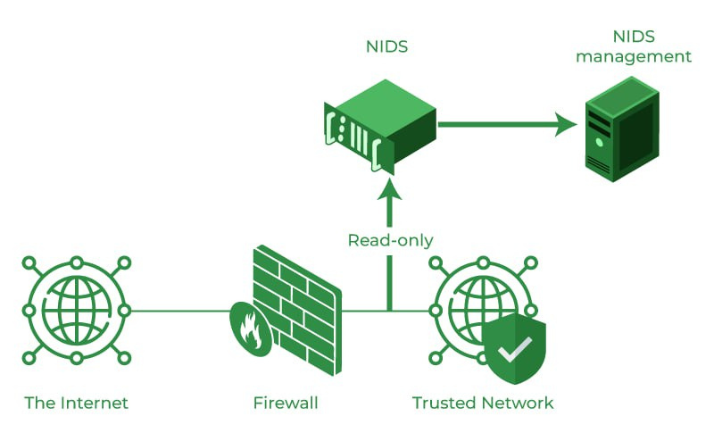
Introduction
What is a NIDS?
A Network Intrusion Detection System (NIDS) is
a system that monitors network traffic for malicious activity or policy violations.
Key Functions:
Monitors data flowing through the network.
Identify attack type.
Alerts system administrators when threats are detected.

Slide 7
Our Proposal: 7arth NIDS
AI-based detection to identify unknown threats (solves zero-day issue)
User-friendly dashboard for real-time monitoring
Low-cost design — open-source and lightweight
minimal setup and system requirements
High accuracy with tuned ML models
Modular and scalable for future growth

Slide 8
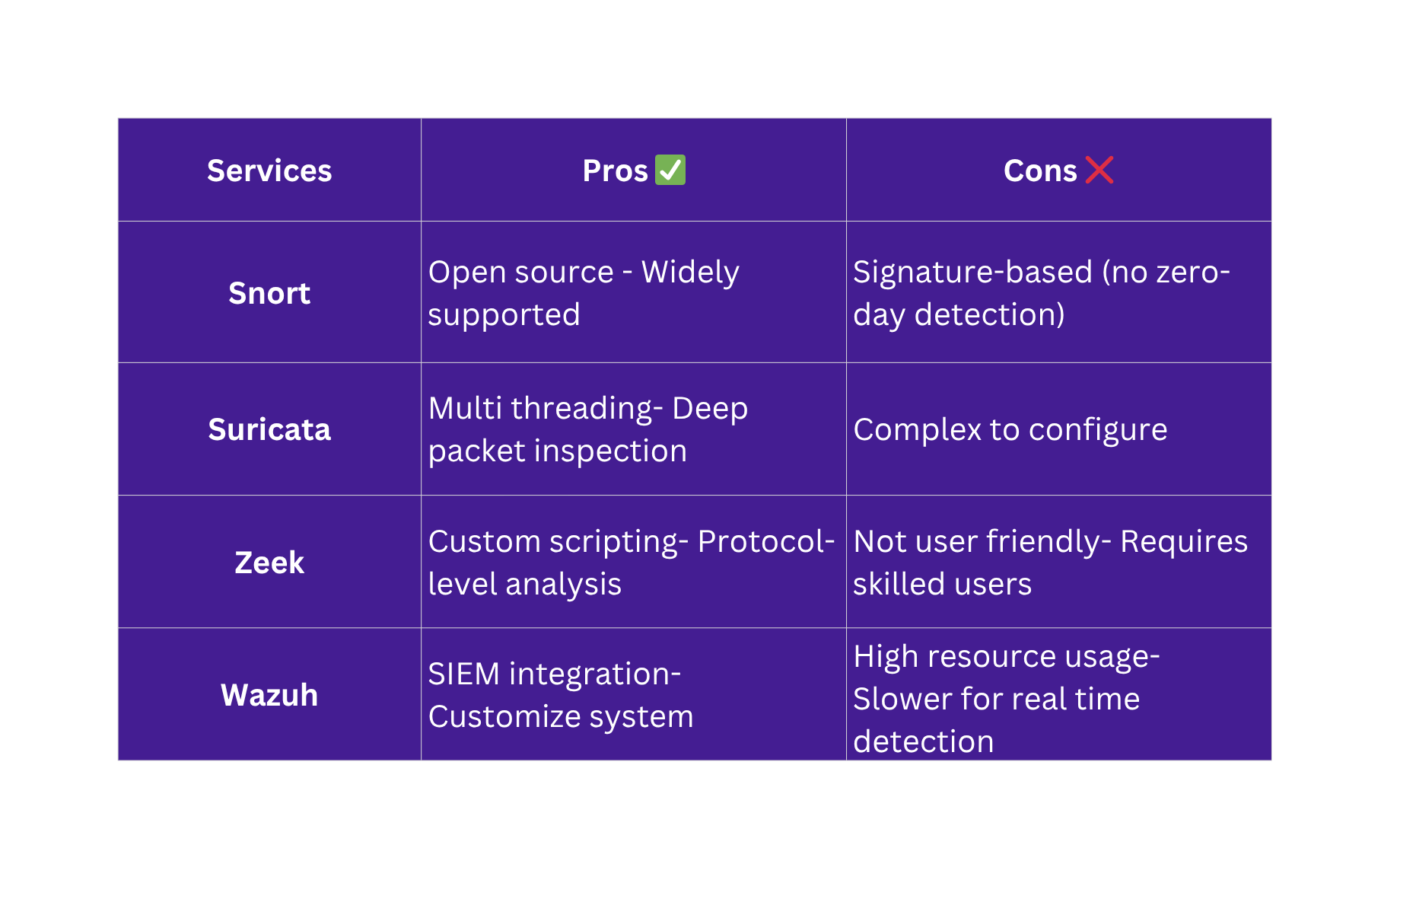
Related NIDS Solutions

Slide 9







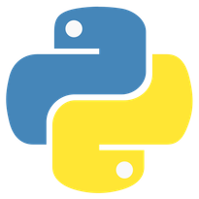

Tools
THE TOOLS ARE DIVIDED INTO SEVERAL DIVISIONS, WHICH ARE
1. NETWORKING: GNS3, CISCO PACKET TRACER, WIRESHARK.
2. AI & DATA: KAGGLE, GOOGLE COLAB.
3. DESIGN: FIGMA.
4. DEVELOPMENT: PYTHON, VS CODE, REACT.

Slide 10
The Backbone of Defense: Network Infrastructure Design
Design Philosophy:
Building a secure environment is the first line of defense before deploying the AI detection engine.
Core Objectives:
Traffic Segmentation: Dividing the institute's network into logical zones (VLANs) to limit the "Blast Radius" in case of a breach.
Strategic Placement: Implementing Layer 3 switching at the distribution level to ensure efficient routing and monitoring.
Hardening: Applying industry-standard security protocols (Port Security, ACLs) to the physical and logical layers.
Simulation Environment:
The entire topology was designed and stress-tested using Cisco Packet Tracer and GNS3 to validate security policies before deployment.

Slide 11
Network Architecture
Infrastructure Layout
Hierarchical Design: Access and Layer 3 Distribution/Core architecture for optimal traffic flow.
VLAN Segmentation: Logical isolation of Admin (10), Wireless (20), and Labs (30) to contain threats.
Inter-VLAN Routing: Multilayer switches utilizing SVIs for secure communication between departments.
802.1Q Trunking: Aggregated traffic monitoring to ensure full NIDS visibility across physical links.

Slide 12
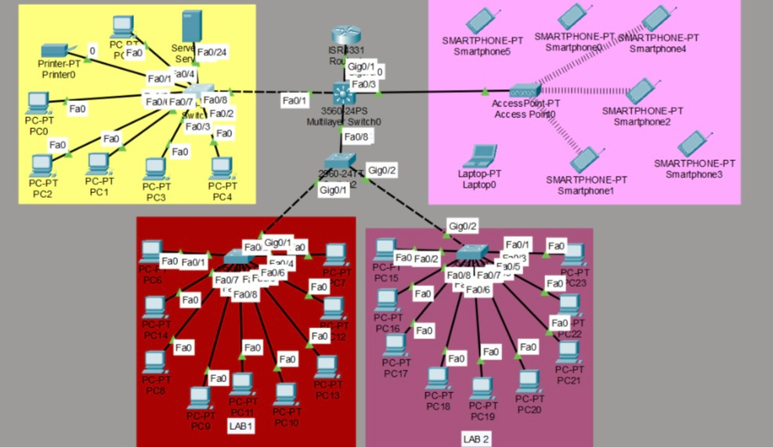
Network Architecture
Network design and topology

Slide 13
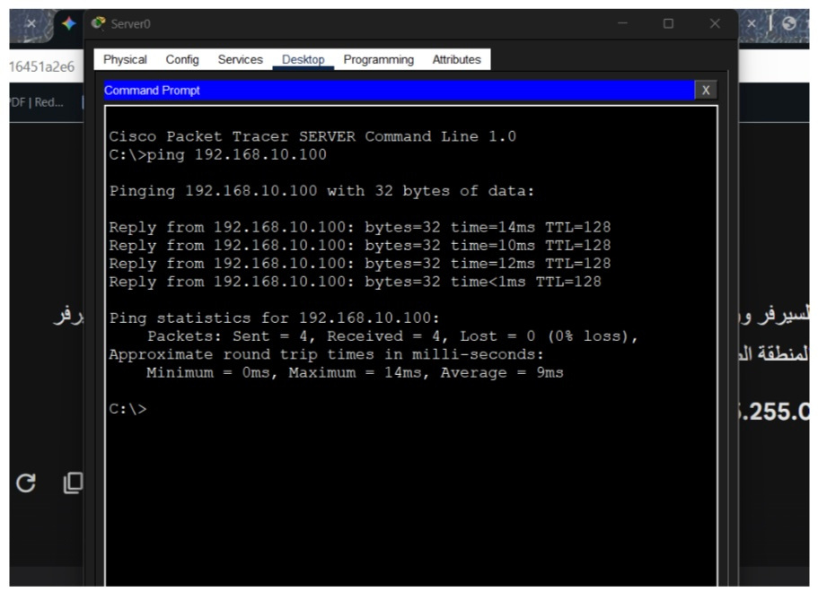
Network Architecture
Verifying using the Ping command

Slide 14

Methodology
Select Dataset & Preprocessing
Response Features
1
2
3
4
Model Comparison
Model Selection

Slide 15
DATASETS
URL Phishing Datasets
RT-IOT2022 Dataset
1
2
3
UNSW-NB15 Dataset

Slide 16
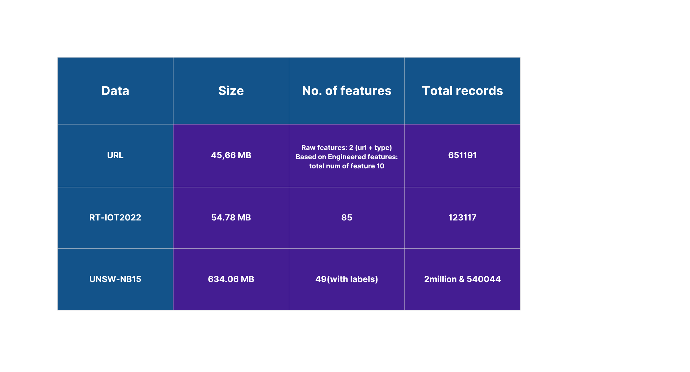
DATASETS

Slide 17
Malicious URLs dataset
These datasets contain lists of URLs, often accompanied by features extracted from the URL string itself (e.g., length, number of special characters, presence of IP addresses, domain age, lexical features).
Role in 7arth: While the primary focus is on network traffic, the integration of URL phishing detection allows 7arth to identify malicious links that might be embedded in network communications (e.g., HTTP requests). This provides an additional layer of defense, particularly against social engineering attacks delivered via web links.

Slide 18
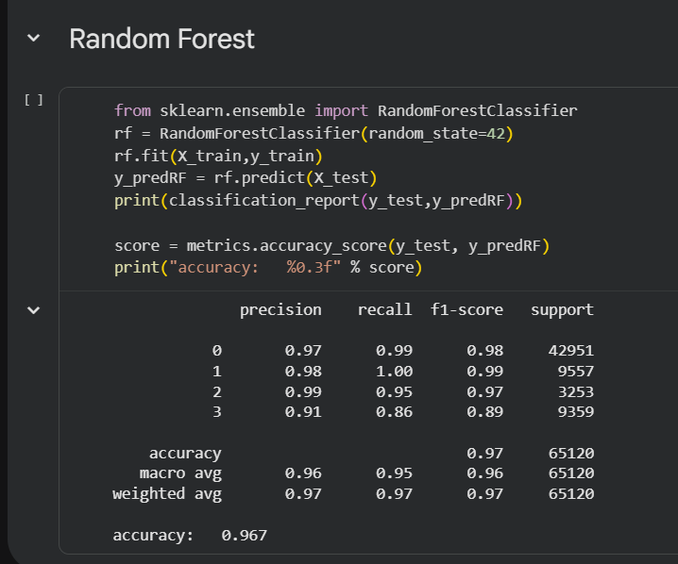
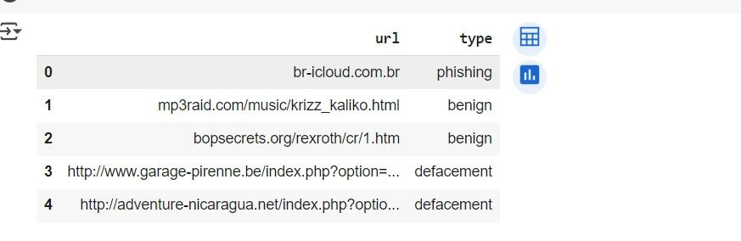
Malicious URLs dataset
After we found dataset in kaggle that provide 651191 rows × 2 columns we start to get this data in google collab and we worked with XGBoost and Random Forest Models and those pictures provide sample of data , parameters and accuracy.
Random Forest model have got 96.7% accuracy.

Slide 19
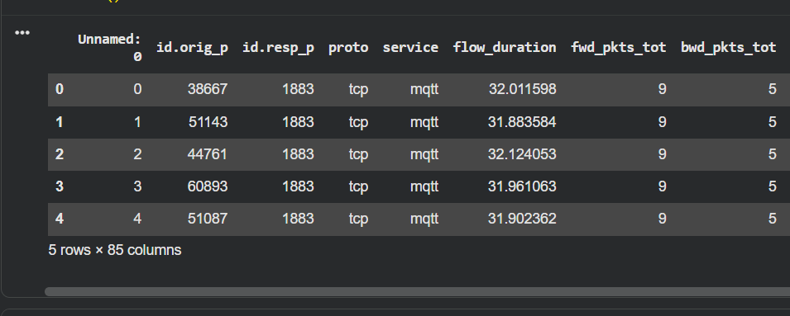
RT-IOT2022 Dataset
This dataset captures traffic from diverse IoT devices (e.g., smart home devices, sensors) under normal operating conditions , it contains features relevant to IoT protocols (e.g., MQTT, CoAP) and device-specific behaviors.
Role in 7arth: By incorporating RT-IOT2022, 7arth significantly enhances its ability to detect intrusions in rapidly expanding IoT networks. This dataset ensures that our models are trained on contemporary and relevant IoT attack patterns, making 7arth a more comprehensive solution for securing smart environments.

Slide 20
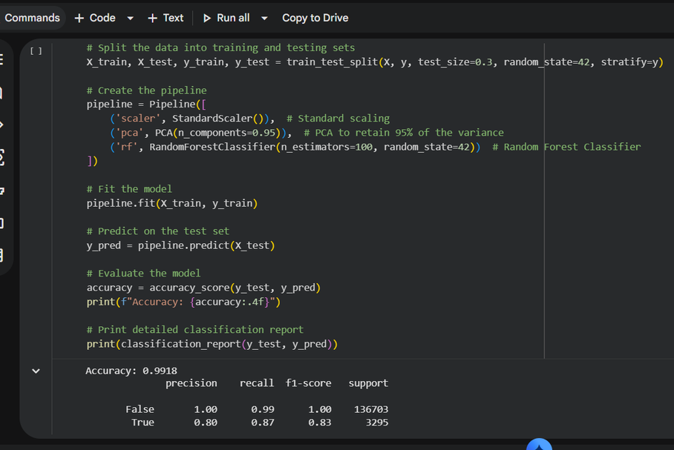
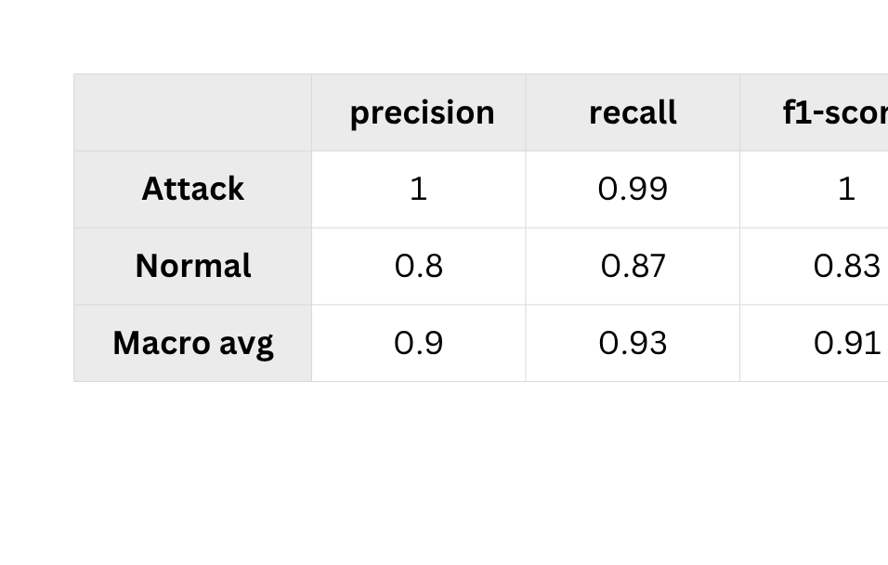
RT-IOT2022 Dataset
After we found dataset in kaggle that provide 123117 rows × 85 columns we start to get this data in google collab and we worked with Fandom Forest and those pictures provide sample of data , parameters and accuracy.
There are two features have been dropped like unbalanced_feat and unclear_feat, we have got 99% for random forest model.

Slide 21
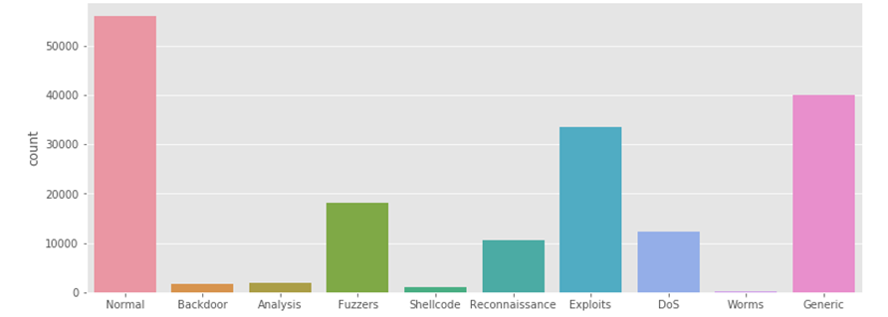
UNSW-NB15 Dataset
The UNSW-NB15 dataset, created by the IXIA Perfect Storm tool in the Cyber Security Lab of UNSW Canberra, is one of the most widely recognized and challenging datasets for evaluating NIDS. It was generated to address the limitations of older datasets (e.g., KDD99) by featuring contemporary real-world normal activities and synthetic attack scenarios.
Role in 7arth: This dataset is primarily used for training and evaluating the core intrusion detection capabilities of both the Random Forest (binary classification) and Neural Network (multi-class classification) models

Slide 22
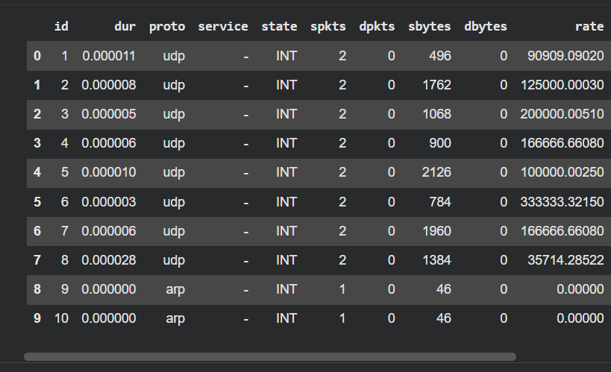
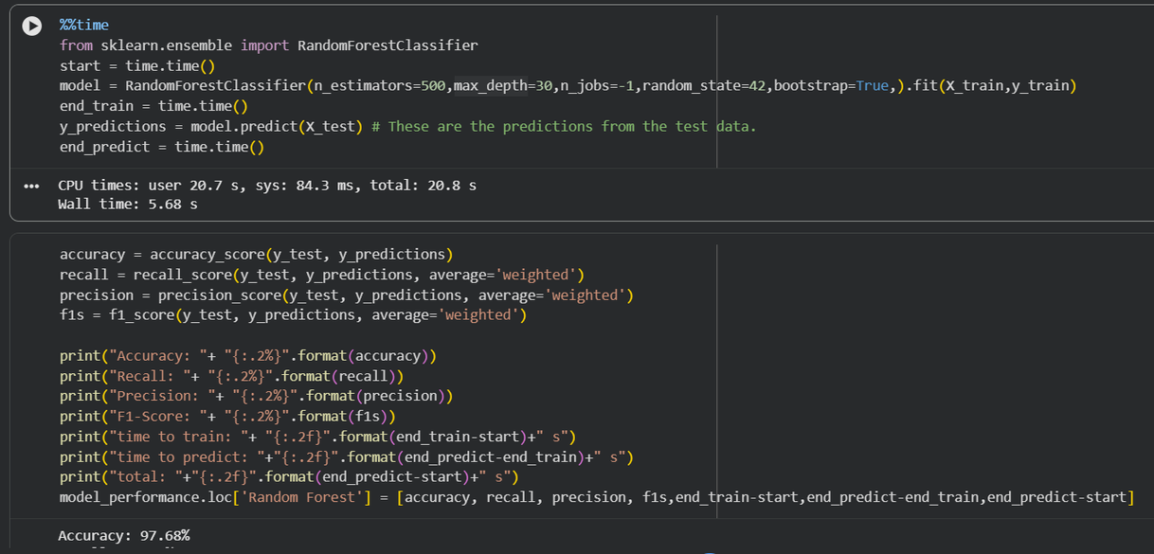
UNSW-NB15 Dataset
After we found dataset in kaggle that provide 2540044 rows × 49 columns and we try several models to get the highest accuracy and those pictures provide sample of data , parameters and accuracy.

Slide 23
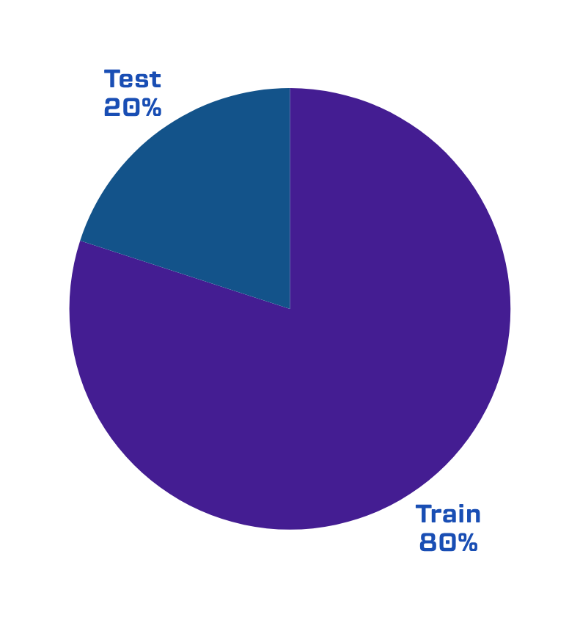
Data Split

Slide 24
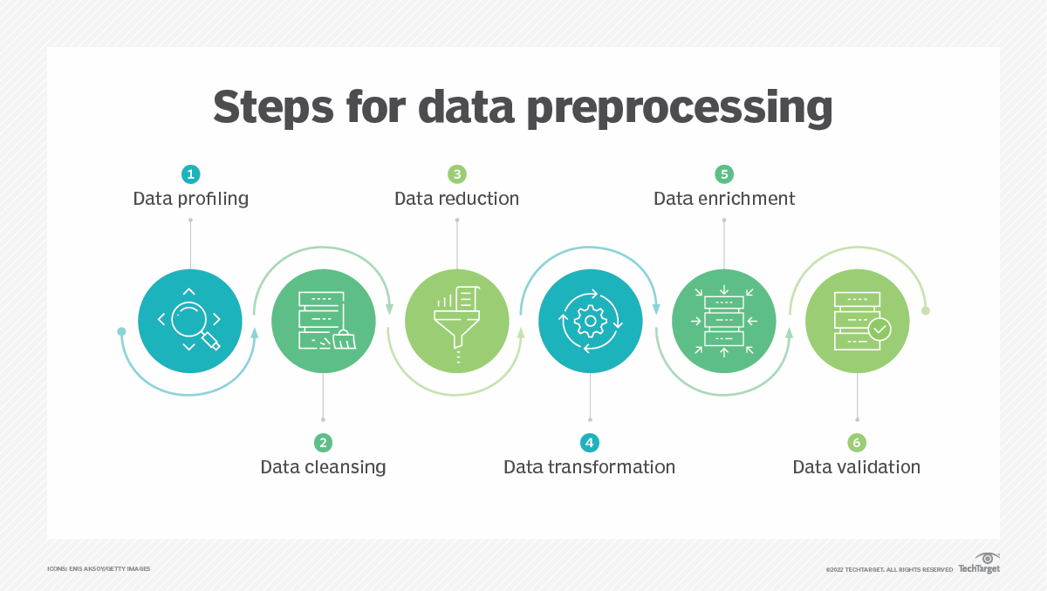
Data Preprocessing:

Slide 25
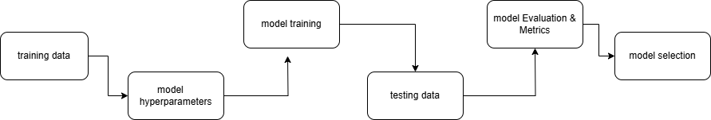
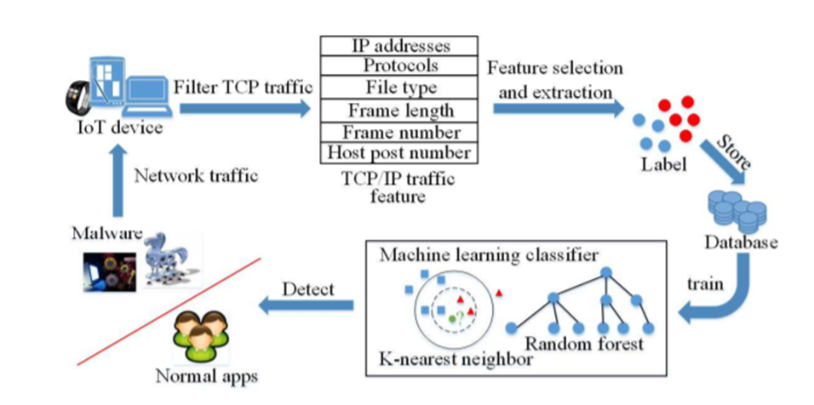
Overall Architecture

Slide 26
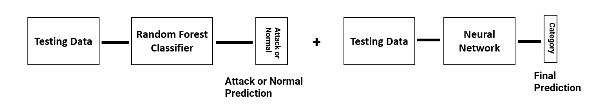
How it work
Using a random forest and feed-forward neural network.
The model uses the random forest that classifies data normal or attack.
This information is then used to train a neural network to further classify the attack data to different attack categories using the previous classification as a feature.

Slide 27
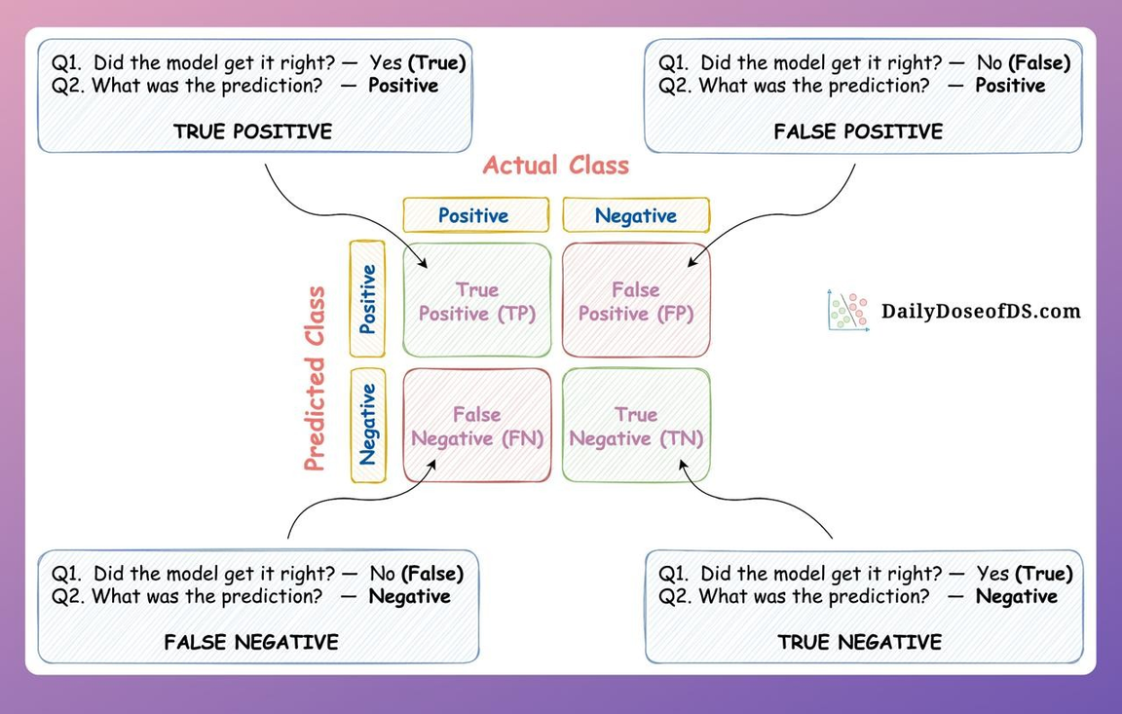
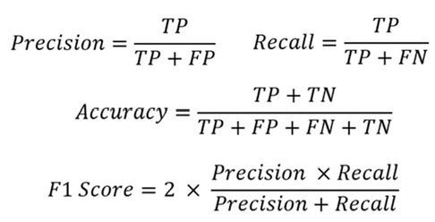
About Those Measures
Precision tells us how many of the instances predicted as “attacks” were actually attacks.
Recall (also known as Sensitivity) tells us how many of the actual attacks were correctly identified by the model.
The F1-score is the harmonic mean of precision and recall.

Slide 28
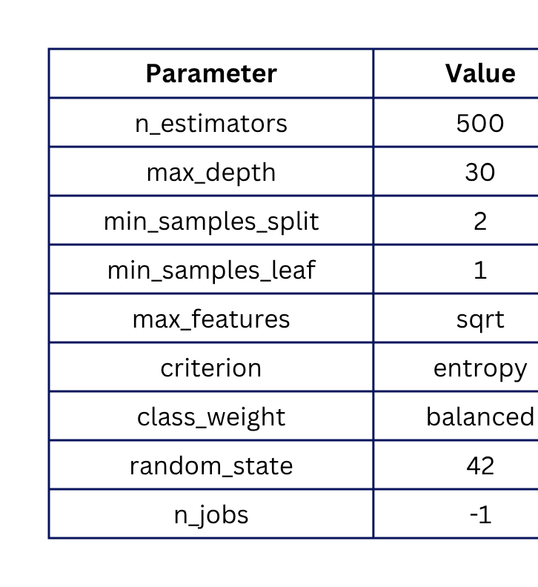
step 1
predicut Attack or normal
Randem Forest
Model

Slide 29
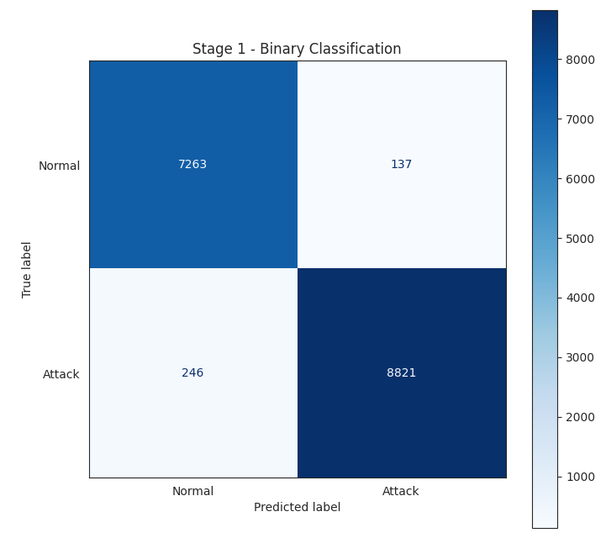
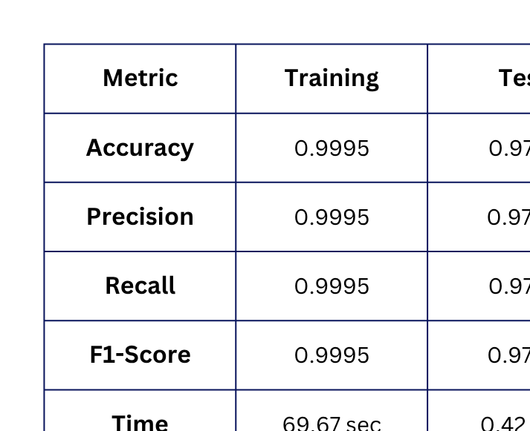
step 1
predicut Attack or normal

Slide 30
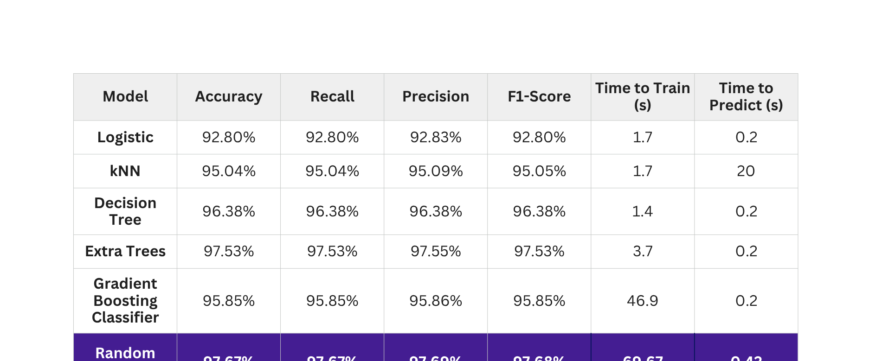
Compare between different models of ML
Results that we reached to for different models and its turn out that Random Forest and Extra Trees had the best results

Slide 31
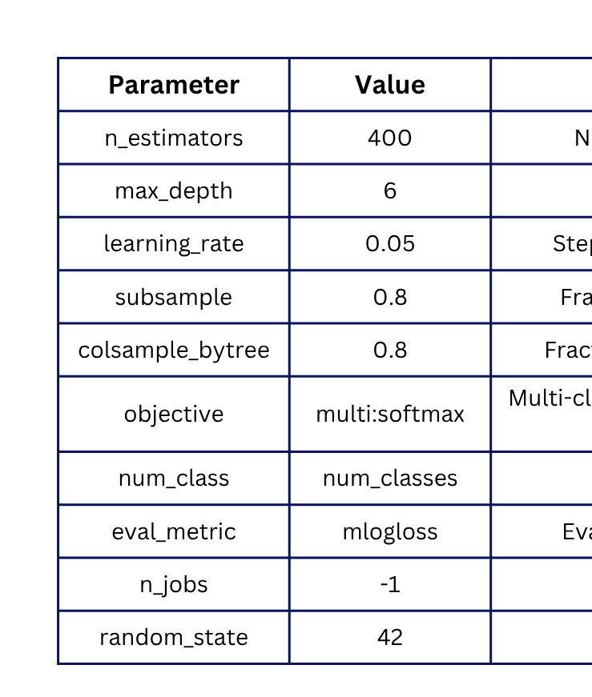
step 2
Classifying different types of attacks
XGBoot
Model

Slide 32
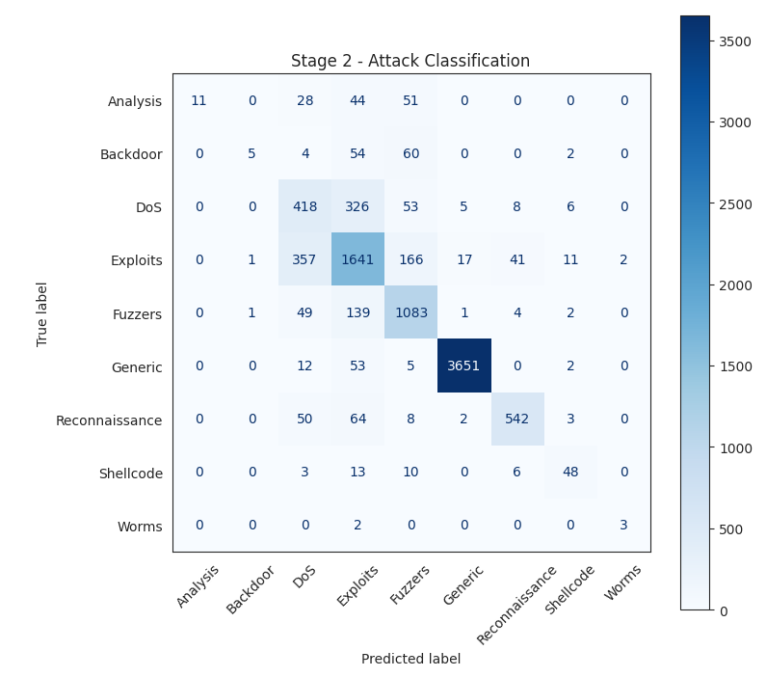
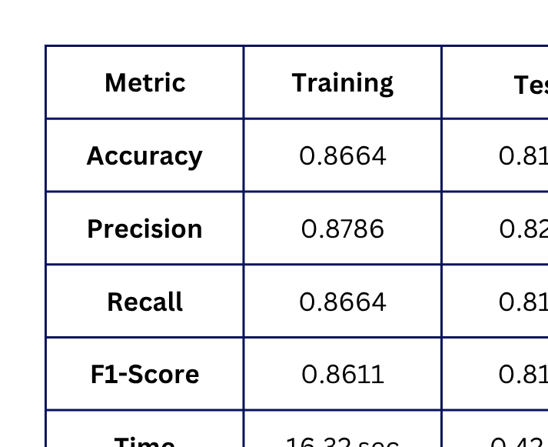
step 2
Classifying different types of attacks

Slide 33
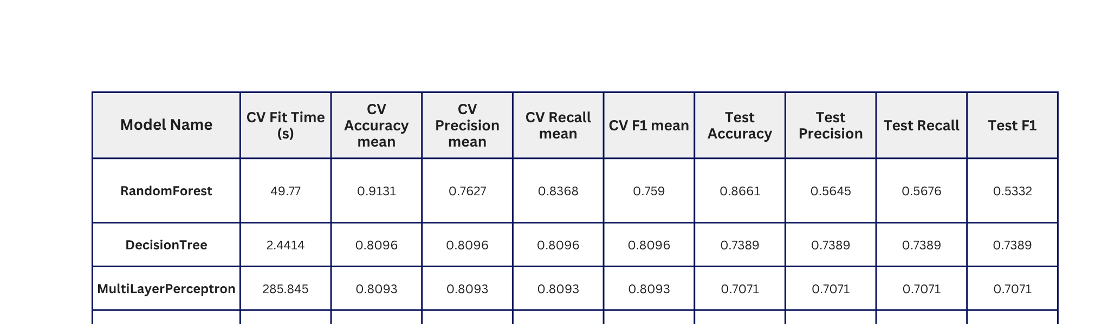
Model Comparison

Slide 34

Our services
Managed Security Services
AI-Driven Threat Detection
Detects major network attacks, monitors critical traffic, and automates alerts and responses
Security Dashboard & Analytics
Real-time AI-driven detection of anomalies and advanced threats.
Real-time dashboard with analytics and tool integration.

Slide 35
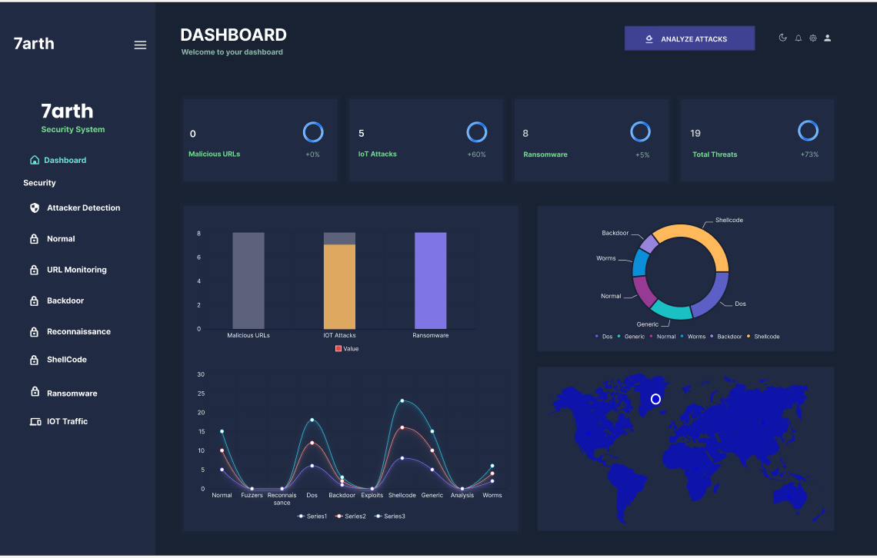
UI Material
After we got our final results for data we moved to dashboard design and we done it by figma and we had searched for dashboard suitable to Intrusion Detection System and we got inspiration from that.

Slide 36
System Development
The user interface for security administrators, providing a real-time visual representation of network activity, detecting threats, and system performance.
Main Technology:
Python Dash framework, leveraging its integration with Flask for backend data serving
React.js for interactive UI components, and Plotly.js for dynamic visualizations

Slide 37
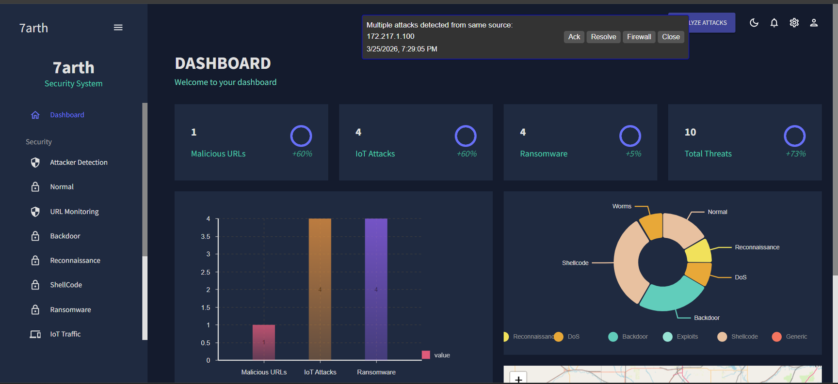
Dashboard

Slide 38
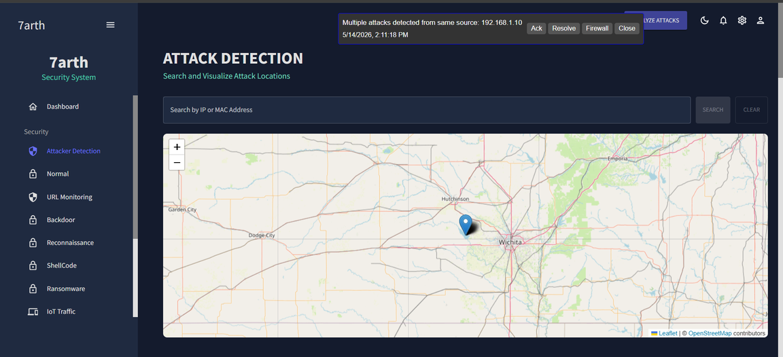
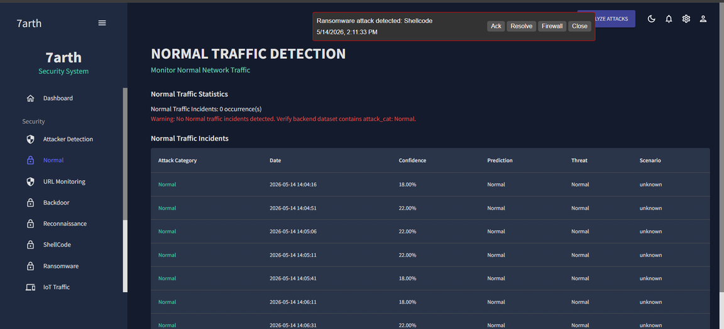
Dashboard

Slide 39
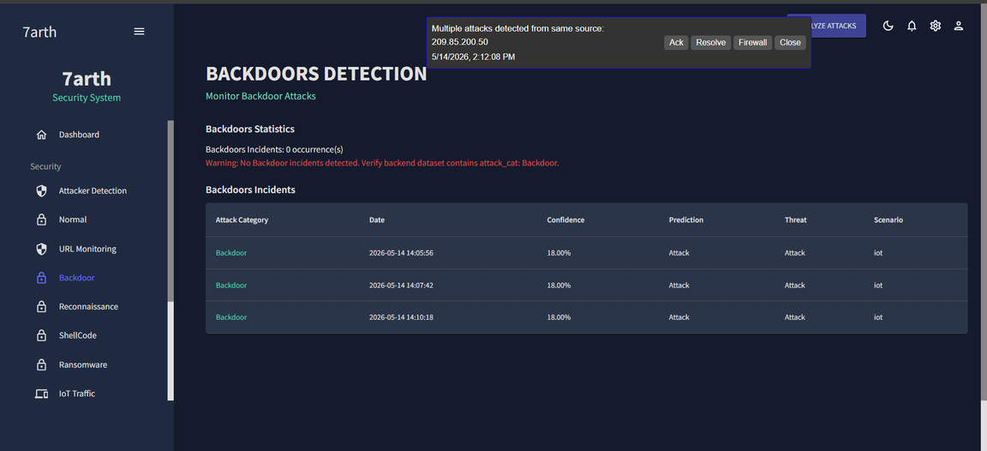
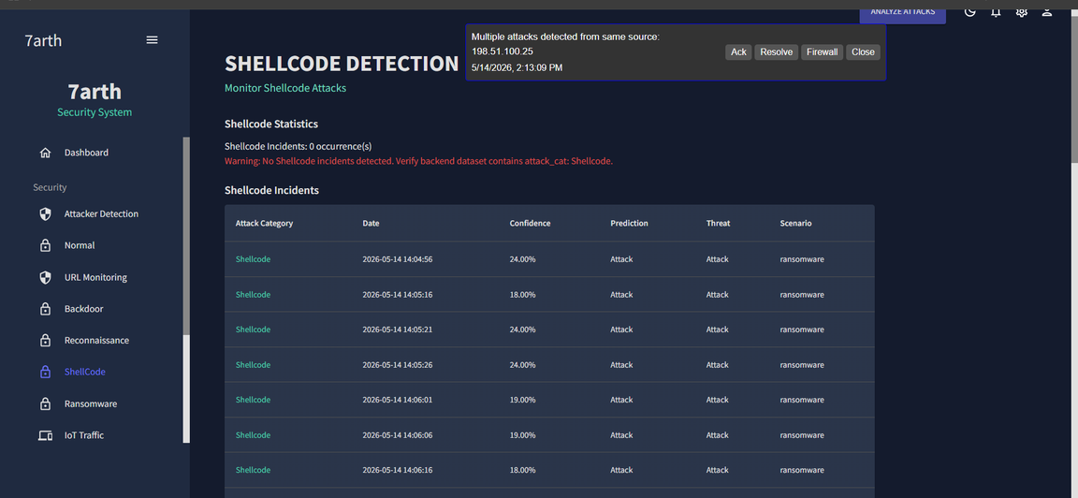
Dashboard

Slide 40
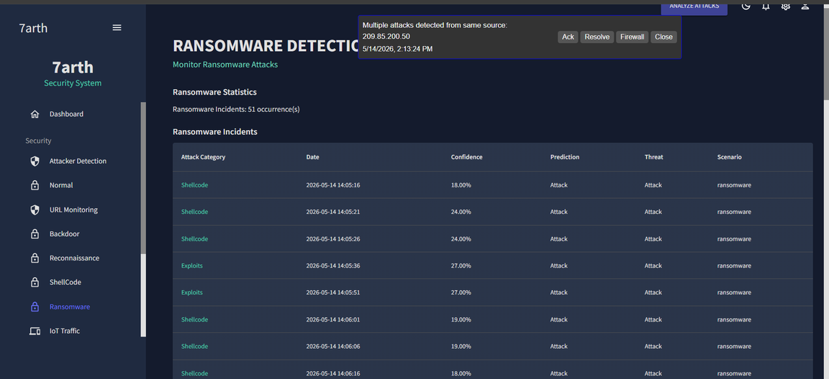
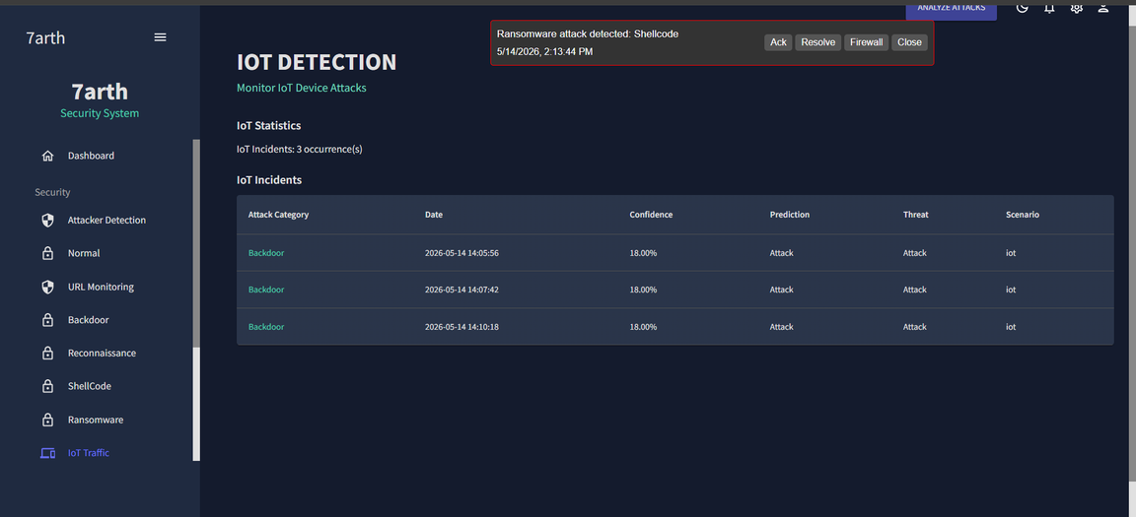
Dashboard

Slide 41
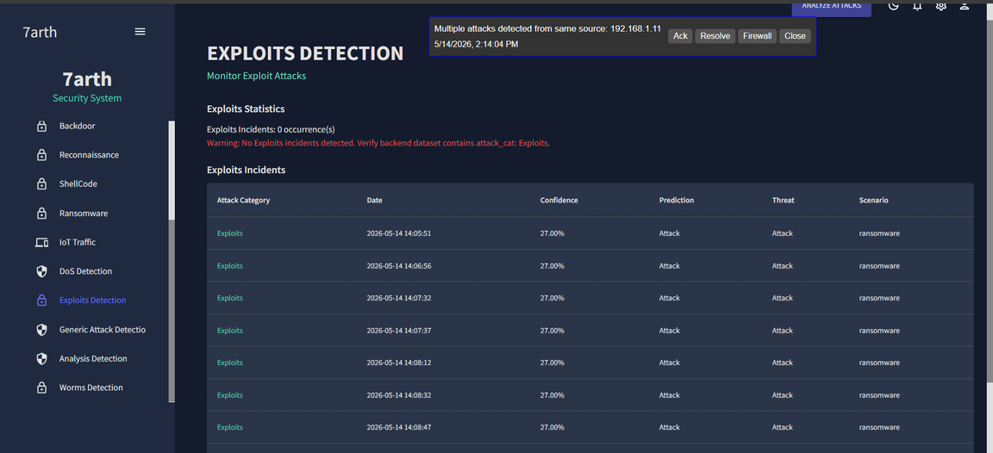
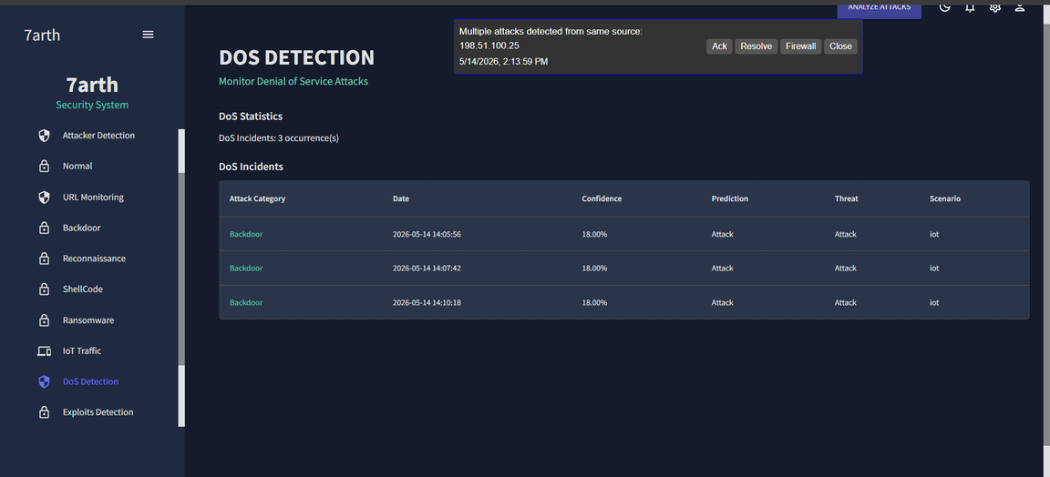
Dashboard

Slide 42
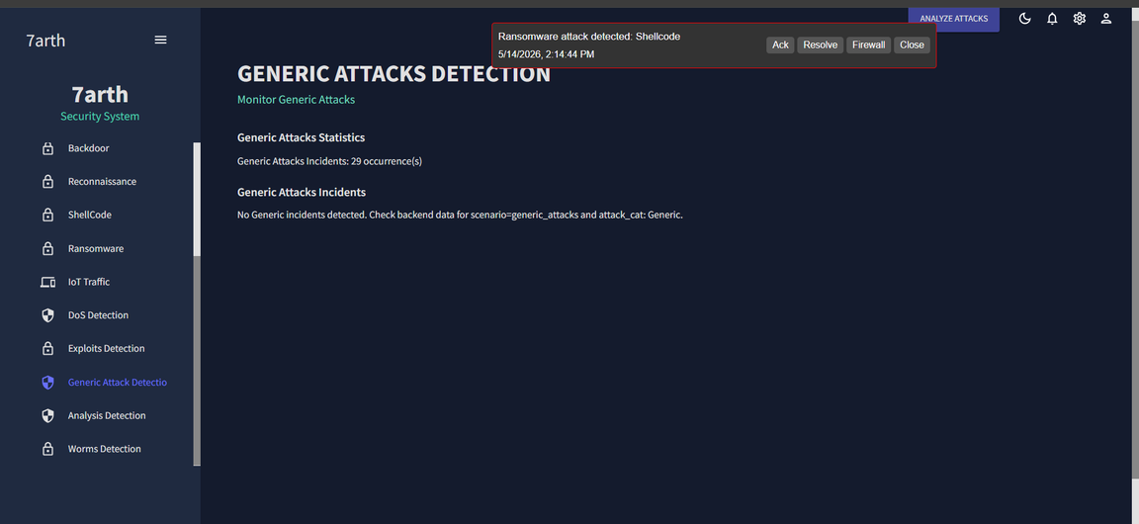
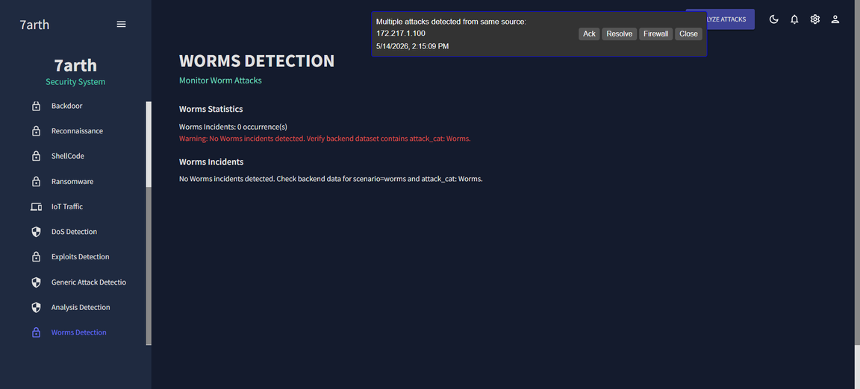
Dashboard

Slide 43
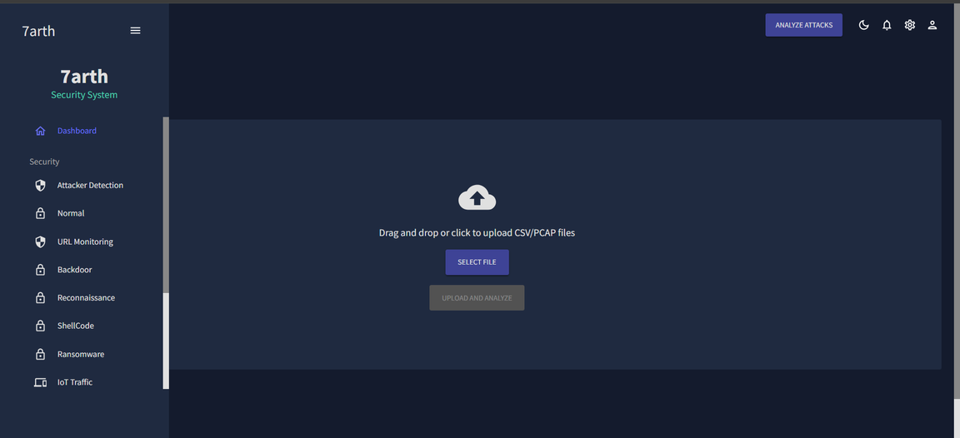
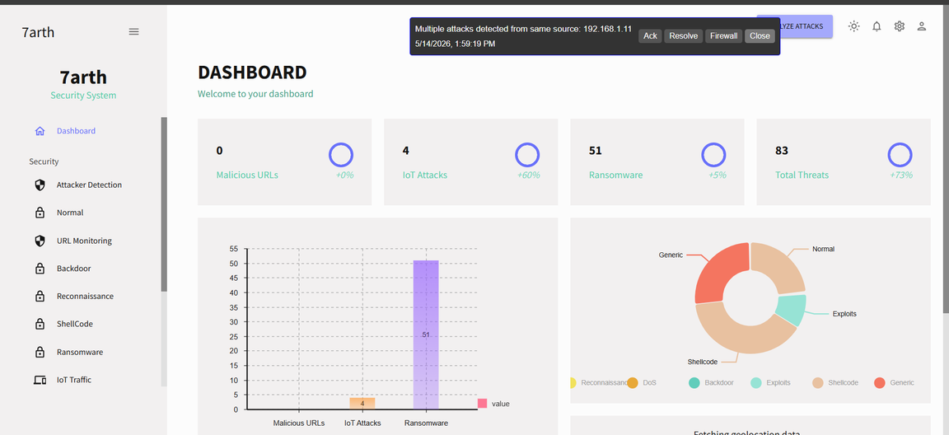
Dashboard

Slide 44

System Outcomes
Easy to Understand: It changes complex network data into simple charts and colors.
Real-Time Alerts: It shows threats exactly when they happen with "Instant Alerts".
Knowing the Attack: It doesn't just say "Danger"; it tells you the exact type of attack (like Ransomware or Phishing).
Knowing the Attacker: It shows where the attack is coming from and the attacker's IP address.
Fast Action: It helps the admin take a quick decision to stop the threat, like using a "Firewall" button.

Slide 45
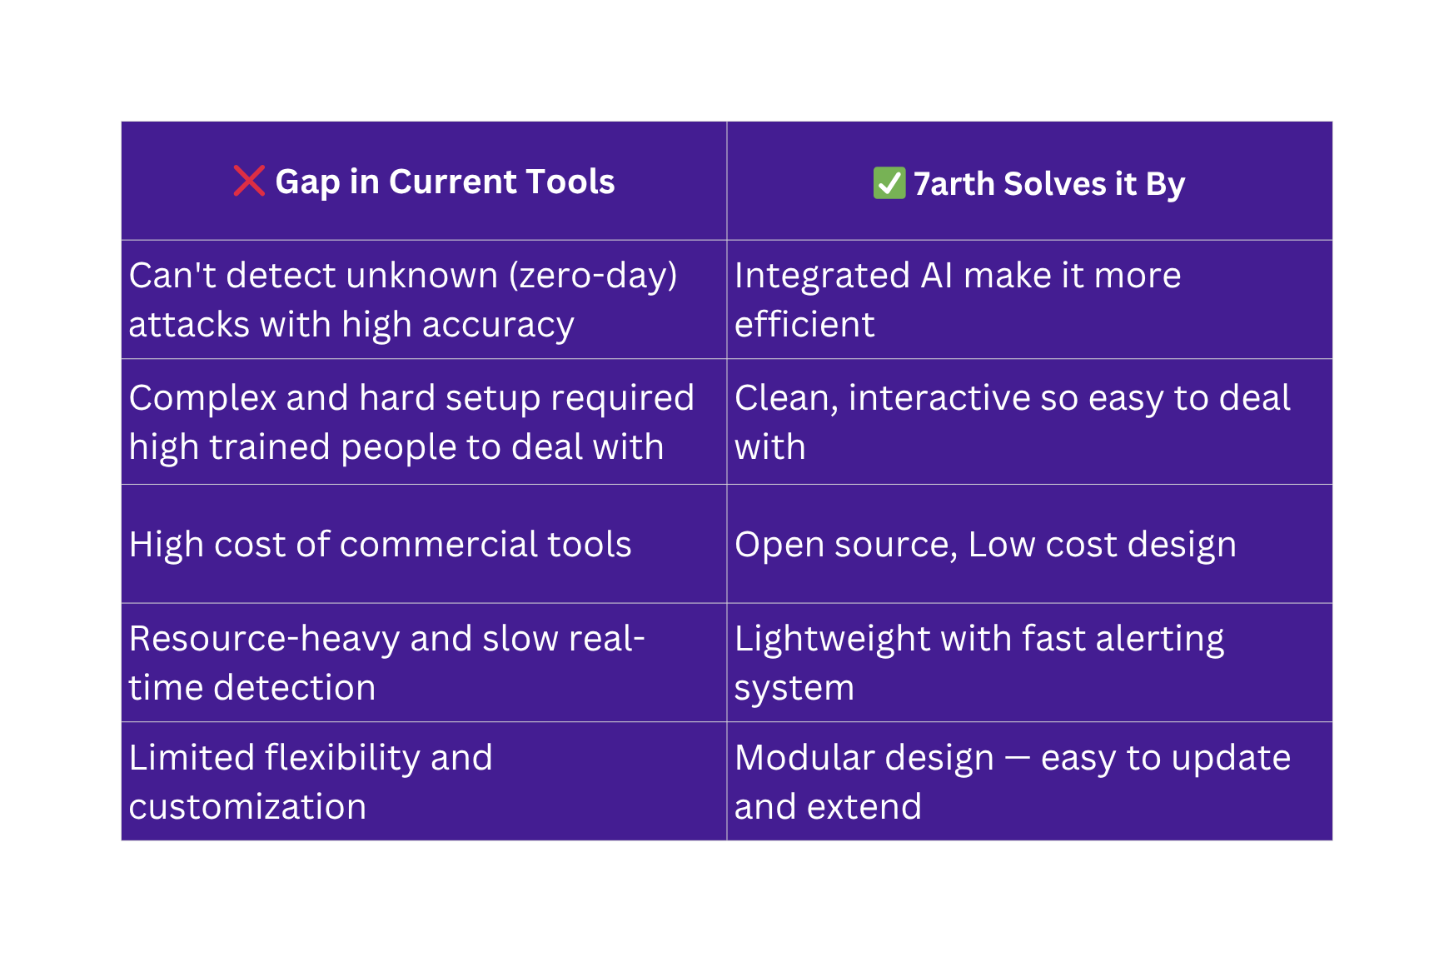
Gaps We Solve

Slide 46
S
O
W
T
A TOOL FOR DEVELOPING THE RIGHT BUSINESS STRATEGY

Slide 47
S
O
W
T
STRENGTHS
OPPORTUNITIES
ADVANCED AI INTEGRATION
SCALABLE WEB UI
REAL-TIME THREAT MONITORING
GROWING DEMAND IN CYBERSECURITY
IOT INTEGRATION
AI DEVELOPMENT
WEAKNESSES
THREATS
FALSE POSITIVES/NEGATIVES
LIMITED RESOURCES
RAPID EVOLUTION OF ATTACKS
OUTDATED DATA

Slide 48



Future Work
NETWORK INTEGRATION
SCALING FROM LAB TO ENTERPRISE. SEAMLESS REAL-TIME TRAFFIC MONITORING ACROSS COMPLEX, LIVE NETWORK ENVIRONMENTS.
CHATBOT INTEGRATION
TRANSFORMING SECURITY LOGS INTO CONVERSATIONS. A RAG-POWERED ASSISTANT THAT MAKES COMPLEX SECURITY DATA UNDERSTANDABLE FOR EVERYONE.
AGENTIC AI
MOVING BEYOND SIMPLE DETECTION. AUTONOMOUS AGENTS WILL ACTIVELY ISOLATE THREATS AND MITIGATE RISKS IN REAL-TIME WITHOUT HUMAN INTERVENTION.

Slide 49
References
HTTPS://LINK.SPRINGER.COM/BOOK/10.1007/978-3-031-54497-2
HTTPS://WWW.KAGGLE.COM/DATASETS/MRWELLSDAVID/UNSW-NB15?SELECT=UNSW_NB15_TRAINING-SET.CSV
HTTPS://WWW.KAGGLE.COM/DATASETS/SUPPLEJADE/RT-IOT2022REAL-TIME-INTERNET-OF-THINGS
HTTPS://WWW.KAGGLE.COM/DATASETS/SID321AXN/MALICIOUS-URLS-DATASET/DATA
HTTPS://WWW.SCIENCEDIRECT.COM/SCIENCE/ARTICLE/PII/S1877050924008871?FR=RR-2&REF=PDF_DOWNLOAD&RR=9F317F25BFF5DEFA
HTTPS://WWW.NETACAD.COM/CISCO-PACKET-TRACER
HTTPS://WWW.GNS3.COM/
HTTPS://WWW.IC3.GOV/ANNUALREPORT/REPORTS/2025_IC3REPORT.PDF

Slide 50

7ARTH TEAM

