Slide 1
ENSE 470, Milestone 2
HELL’s Tech Support
Shawn Clake, Nikolas Lendvoy, Amruo Hasnoon
January 25,2018

Slide 2
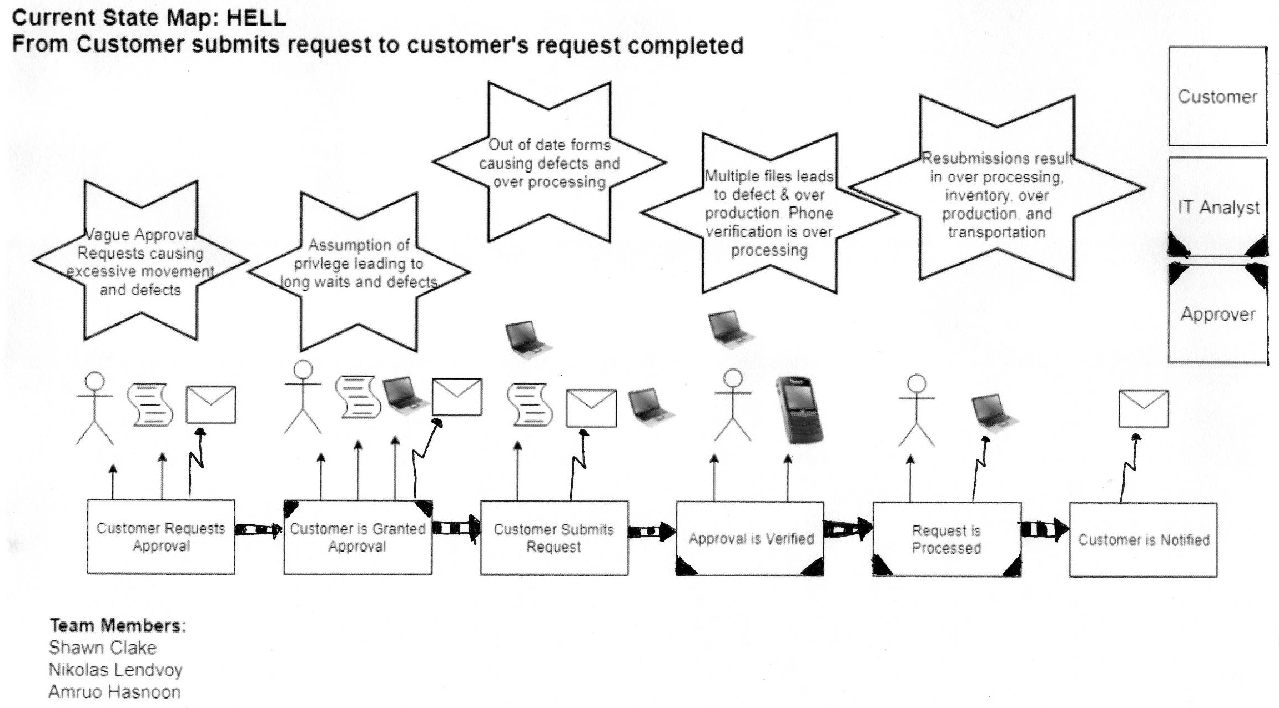
Current state Value Stream Map (VSM)

Slide 3
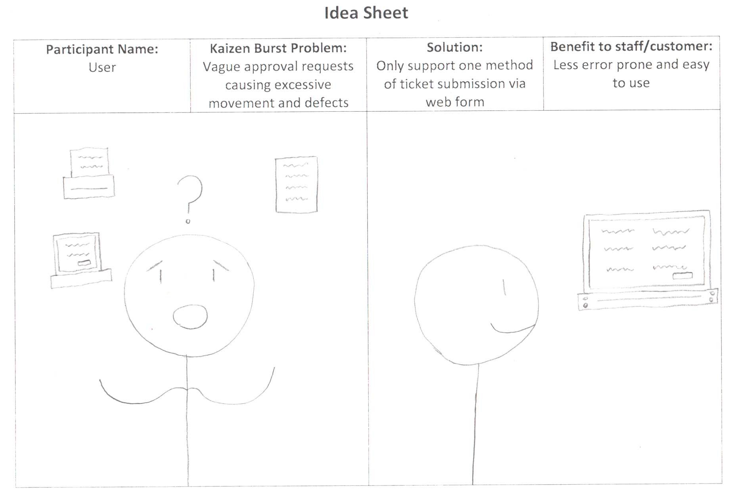
Idea Sheet 1

Slide 4
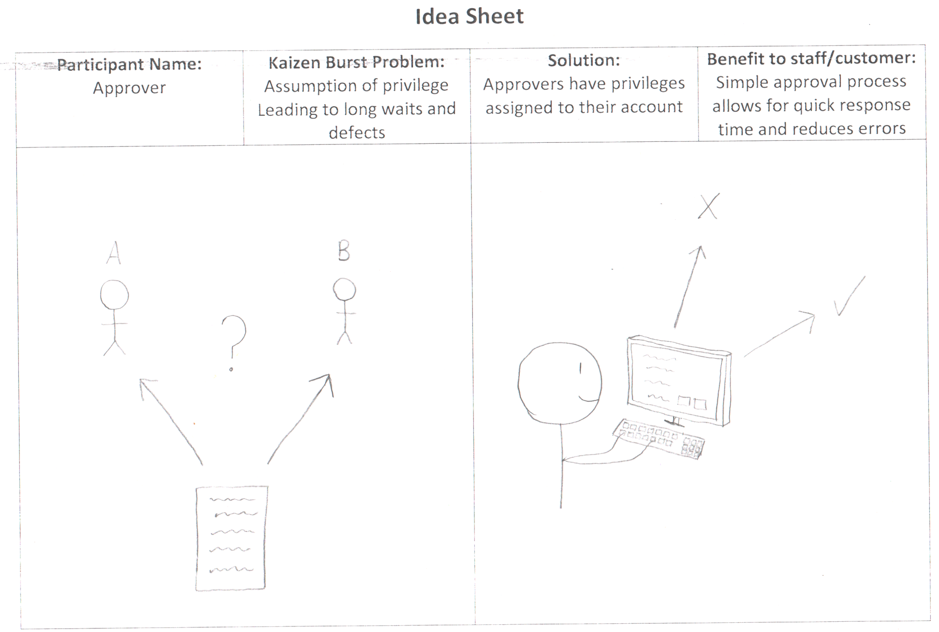
Idea Sheet 2

Slide 5
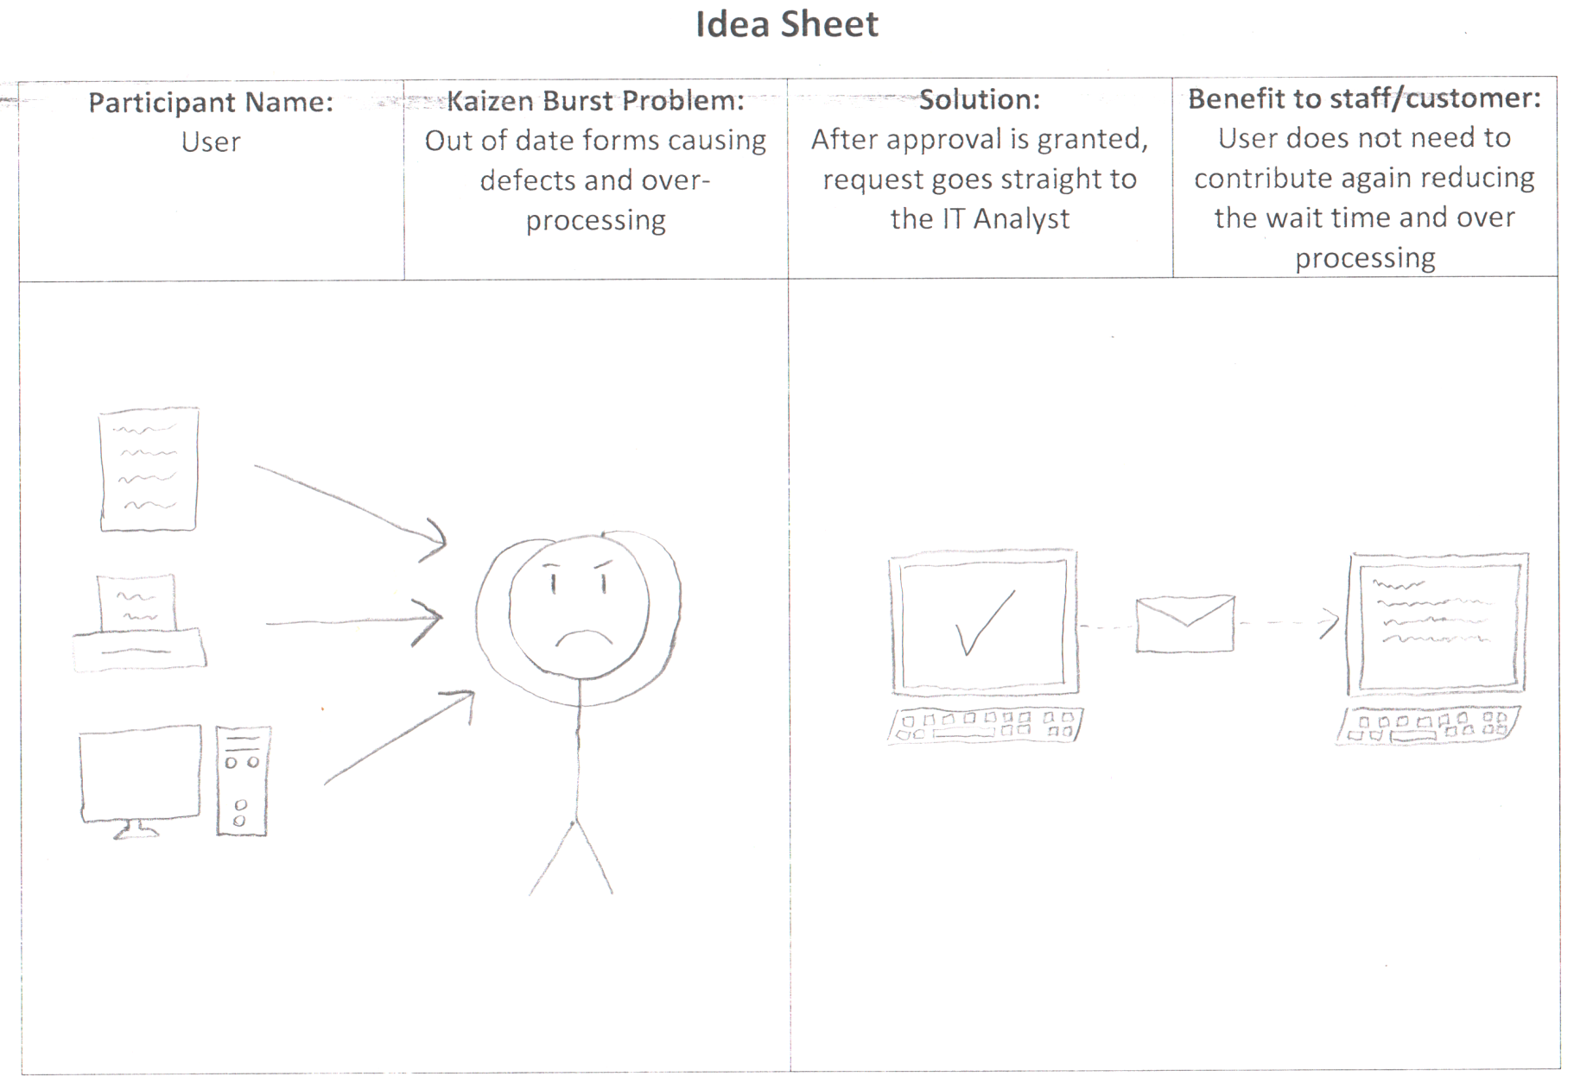
Idea Sheet 3

Slide 6
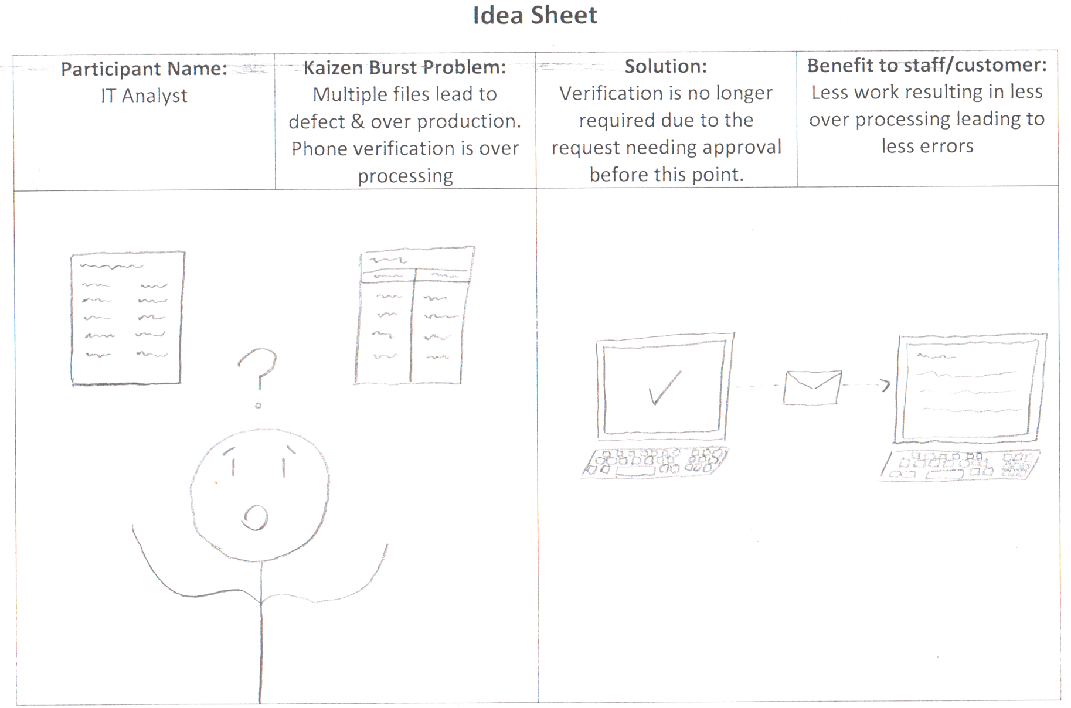
Idea Sheet 4

Slide 7
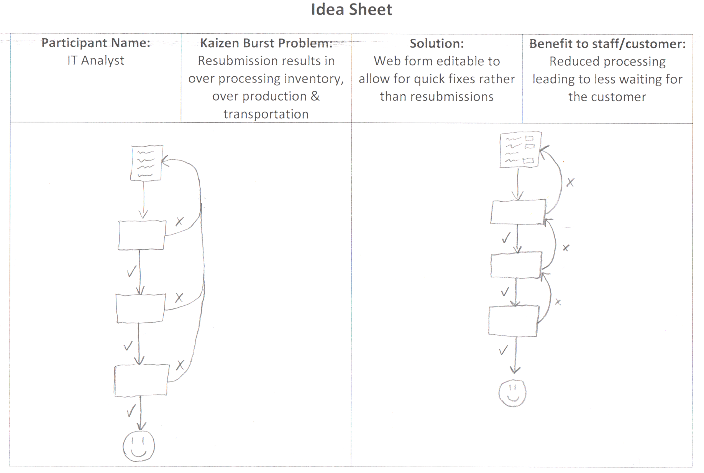
Idea Sheet 5

Slide 8
Themes
Ticket Submission
Ticket Processing
Ticket Fixing
1
2
5
3
4

Slide 9
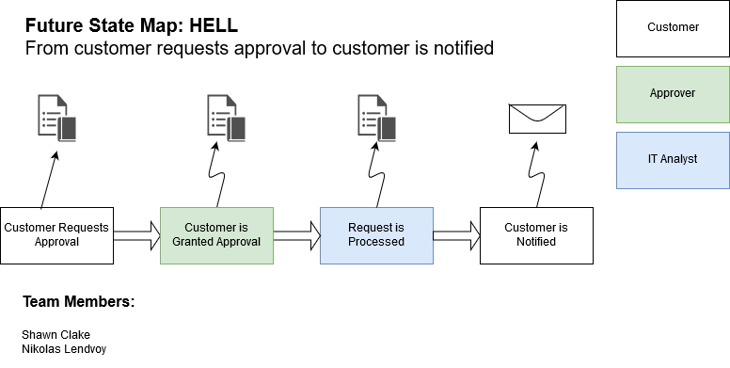

Slide 10
Current state Value Stream Map (VSM)

Slide 11
Group reflection
How did you feel about this milestone? What did you like about it? What did you dislike?
This milestone allowed us to further expand on the ideas we had during the last milestone, and we enjoyed planning out our ideas in more detail.
What did you learn about yourself as you collaborated and worked through this milestone?
We learned that using better software is a more effective use of our time. We also learned how to effectively distribute tasks among our members.
Some member’s artwork is better than others.

Slide 12
Group reflection
How will you use what you have learned going forward?
We will use these new ideas to efficiently work on future milestones and develop overall improved products.
What “stuff & things” related to this milestone would you want help with?
Upload the Idea Sheet word file (.docx) as well as the PDF such that the top boxes can easily be typed in for readability/clarity

