Slide 1
ENSE 470: Milestone 3
Team: Hell's Tech Support
Shawn Clake, Nikolas Lendvoy, Amruo Hasnoon
February 1, 2018

Slide 2
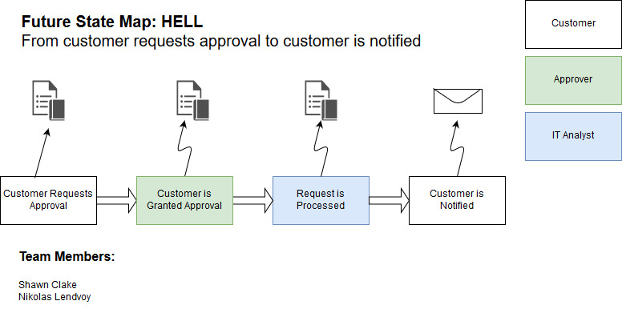

Slide 3
User stories::Ticket Submission
Create Ticket: As a user I want to be able to create a ticket such that I can be approved for and receive new software.
List Tickets: As a user I want to see a list of all the tickets I've submitted such that it is easy to see their current status.
Edit Ticket: As a user I want to be able to edit a ticket to fix any mistakes or typos I made during the submission process.
Remove Ticket: As a user I want to be able to remove a ticket in case I no longer need the software or I made a mistake which can't be edited. (E.g. Software type)

Slide 4
User stories::Ticket Processing
Ticket List: As an approver or IT Analyst, I want to view a list of tickets which I am responsible for, so that I can easily find and manage those tickets.
Approve Ticket: As an approver, I want to be able to approve or deny the ticket such that users don't gain unauthorized access to software which they should not use.
Update Ticket Status: As an IT Analyst I want to be able to update the status of a ticket to reflect where it is in the process such that the customer understands the status of their ticket

Slide 5
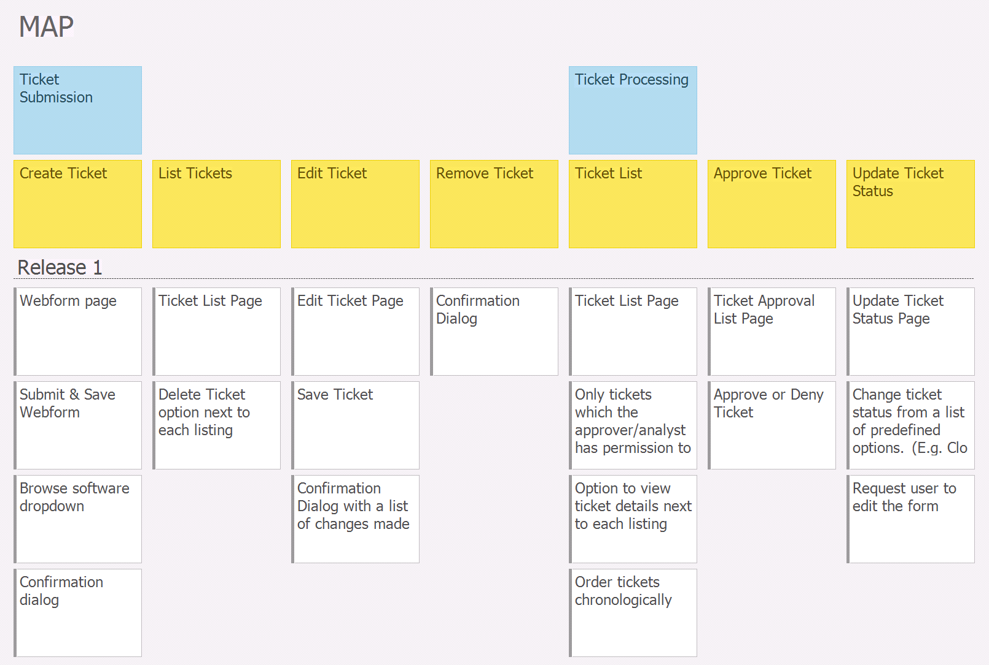

Slide 6
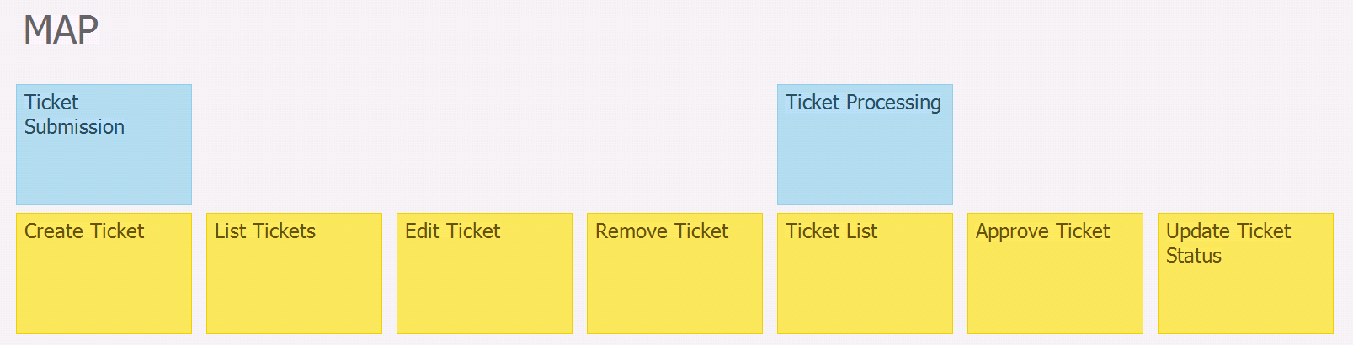
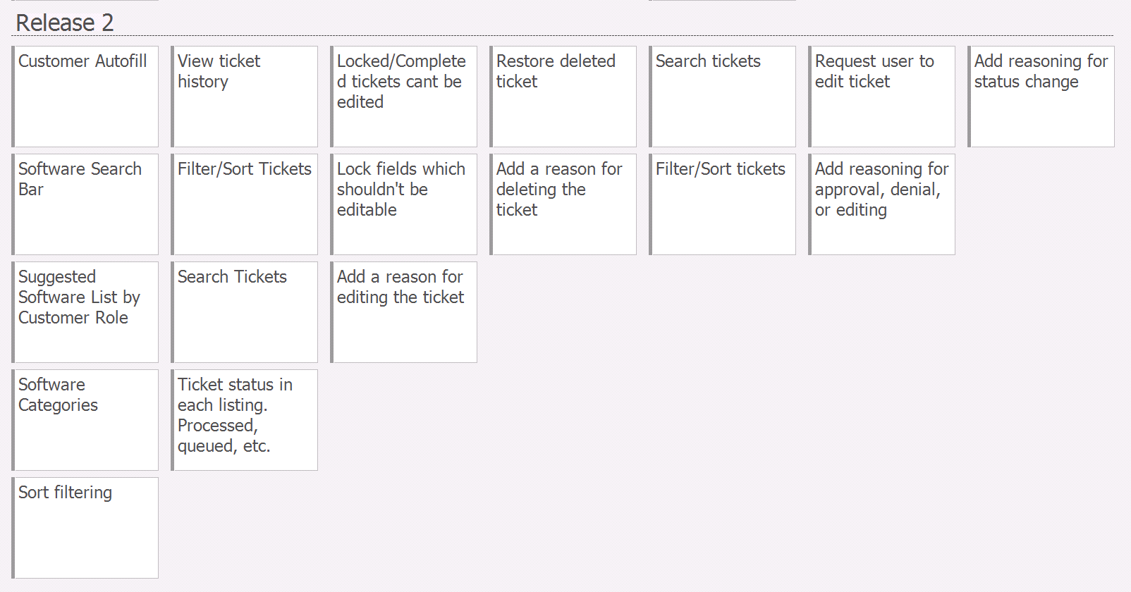

Slide 7
Changes & Misc.
Have your plans changed since your group's initial conception and
project evolution ?

Slide 8
Group reflection
How did you feel about this milestone? What did you like about it? What did you dislike?
- We expanded our knowledge and thoughts while making the user story mapping and that's
was an enjoyable work
What did you learn about yourself as you collaborated and worked through this milestone?
- An individual ideas can be improved with team collaboration.
- Collaboration is a good way to get everyone up to speed.
How will you use what you have learned going forward?
- user story mapping give a better understanding to what the user want to do
Which will be a good reference as we go further.
What “stuff & things” related to this milestone would you want help with?
- User story mapping reflect the user view of the feature of the product which is an
An important role in project design.

Slide 9
Any Questions ???

