Slide 1
ENSE 470: Milestone 3
Team: Hell's Tech Support
Shawn Clake, Nikolas Lendvoy, Amruo Hasnoon
February 1, 2018

Slide 2
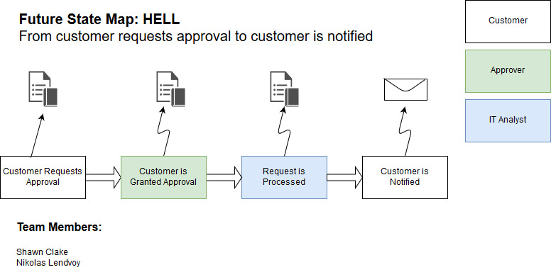

Slide 3
User stories::Ticket Submission
Create Ticket: As a user I want to be able to create a ticket such that I can be approved for and receive new software.
List Tickets: As a user I want to see a list of all the tickets I've submitted such that it is easy to see their current status.
Edit Ticket: As a user I want to be able to edit a ticket to fix any mistakes or typos I made during the submission process.
Remove Ticket: As a user I want to be able to remove a ticket in case I no longer need the software or I made a mistake which can't be edited. (E.g. Software type)

Slide 4
User stories::Ticket Processing
Ticket List: As an approver or IT Analyst, I want to view a list of tickets which I am responsible for, so that I can easily find and manage those tickets.
Approve Ticket: As an approver, I want to be able to approve or deny the ticket such that users don't gain unauthorized access to software which they should not use.
Update Ticket Status: As an IT Analyst I want to be able to update the status of a ticket to reflect where it is in the process such that the customer understands the status of their ticket

Slide 5
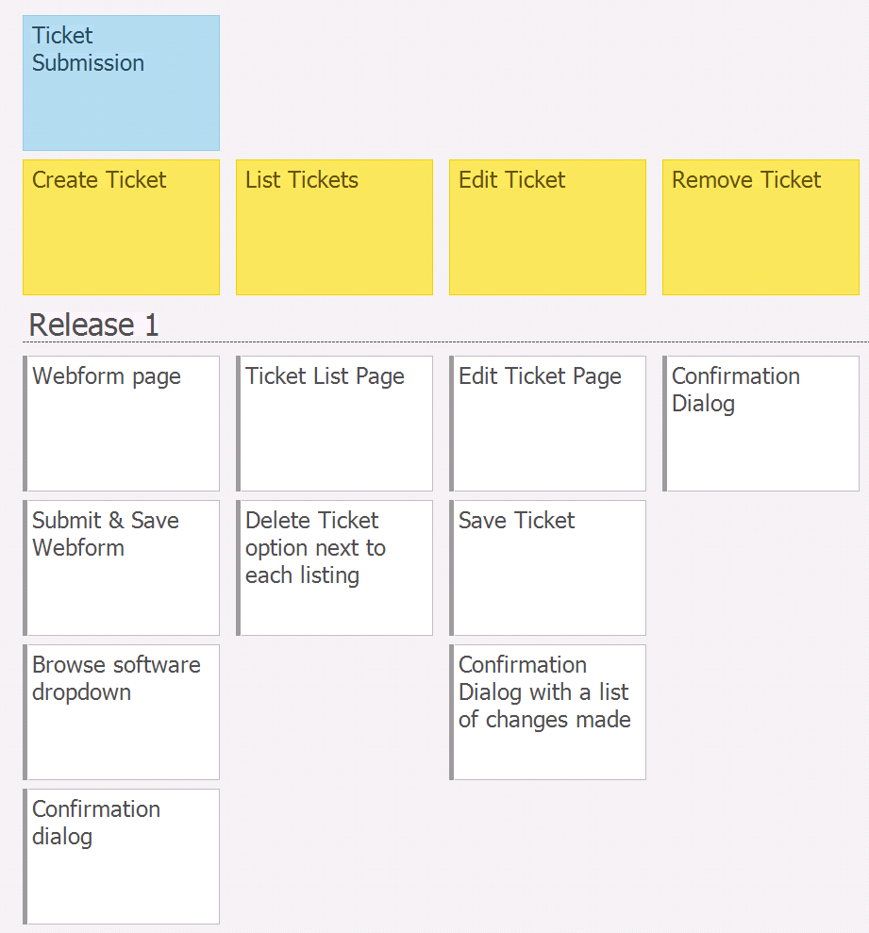
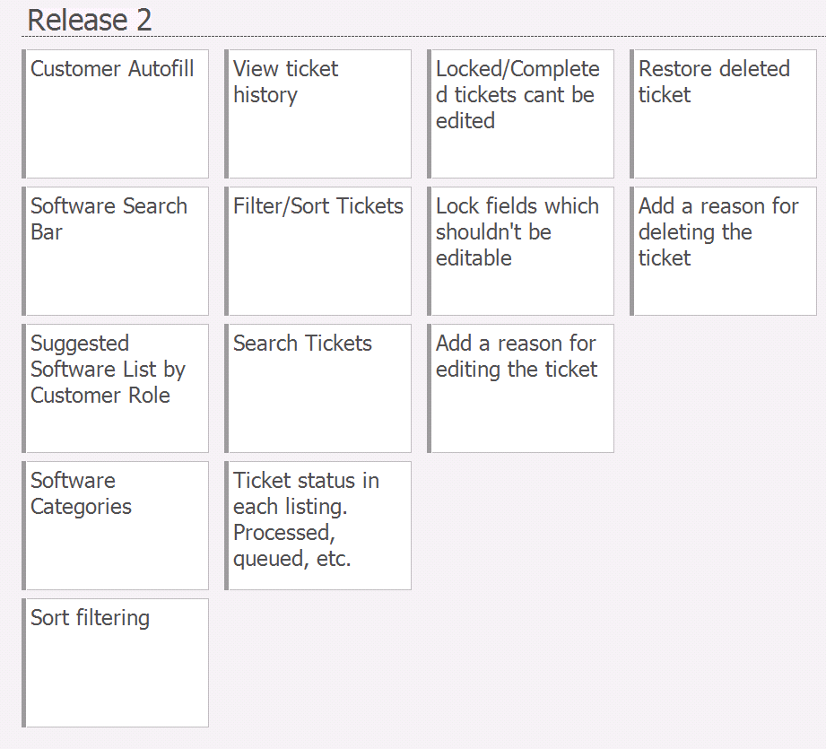

Slide 6
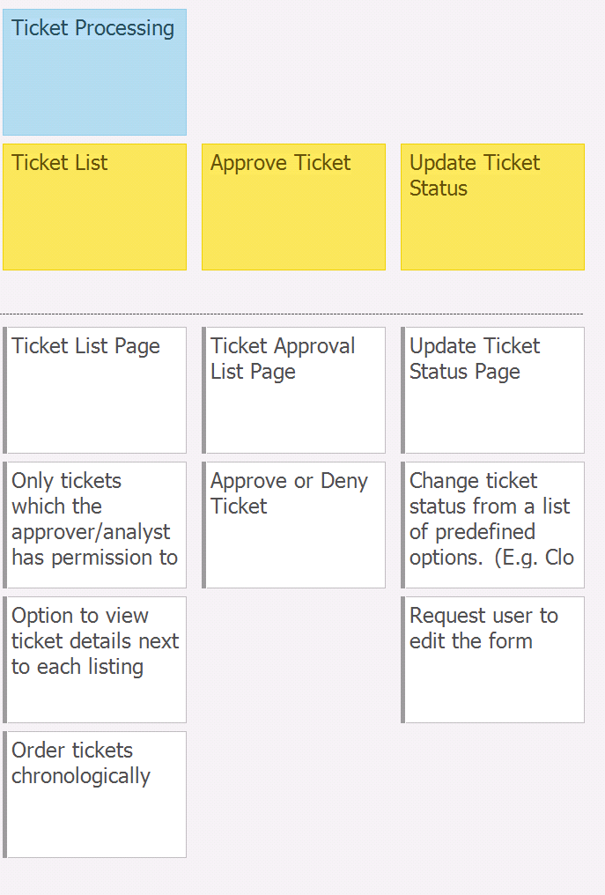
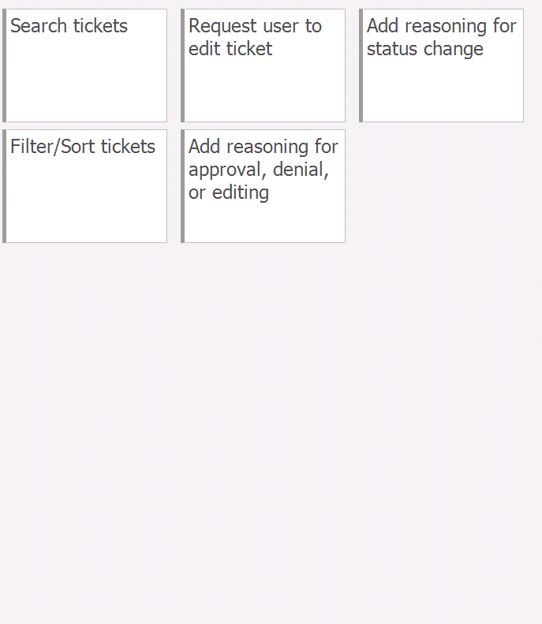

Slide 7
Changes & Misc.
Have your plans changed since your group's initial conception and
project evolution ?
- At every step, we seem to find a way to reduce the complexity of the project in one way or another. Some ideas we’ve had have come partially from other groups.
- Most of the ideas involve how to organize our thoughts better rather than anything about the project itself.

Slide 8
Group reflection
How did you feel about this milestone? What did you like about it? What did you dislike?
- The user story map allowed us to start creating specific functions. Organizing our thoughts this way gave us a feeling of greater control over the ideas we’ve had.
What did you learn about yourself as you collaborated and worked through this milestone?
- An individual ideas can be improved with team collaboration.
- Collaboration is a good way to get everyone up to speed.
How will you use what you have learned going forward?
- User story mapping give a better understanding to what each function will do
which will be a good reference as we go further.
What “stuff & things” related to this milestone would you want help with?
- We did not find anything difficult involving this milestone.

Slide 9
Any Questions ???

