Slide 1
DECCAN SPORTS CLUB
Team:
Akhil Darge
Hrishikesh Dalimbkar
Sarang Raool
Namita Kautkar

Slide 2
Problem Statement
Main goal is to develop web based system for Deccan Sport club.
Club offers various sports like cricket, badminton, swimming, basketball, etc.
Club runs various batches with offers for available sports.
User can register into system and view various offers for sports.
User can enroll into centralize membership online.

Slide 3
ROLES
ADMIN
MANAGER
USER
MANAGER
MANAGER
Flying impression graphic design thank you for buying this template, we mainly engaged in various types of advertising graphic design.
Flying impression graphic design thank you for buying this template, we mainly engaged in various types of advertising graphic design.
Flying impression graphic design thank you for buying this template, we mainly engaged in various types of advertising graphic design.

Slide 4
ADMIN FUNCTIONALITY
A
Add/update/delete managers. Provide login credentials to them by e-mail.
B
Add/update/delete sports. Assign manager to sports.
C
Lock and Unlock Users.
D
View Enrolled Users
E
View Feedbacks

Slide 5
MANAGER FUNCTIONALITY
A
Add/update/delete batches and offers for respective sports.
B
Add/update/delete price of sports.
C
Approve and Reject users.

Slide 6
USER FUNCTIONALITY
A
Like and comment on offers of respective batches.
B
Apply and renew club membership.
C
Enroll in sports.
D
Give feedback

Slide 7
TECHNOLOGIES
ANGULAR
MYSQL
TYPESCRIPT, HTML, SCSS
Relational Database
SPRINGBOOT
J2EE, Spring Data JPA, Rest Template

Slide 8
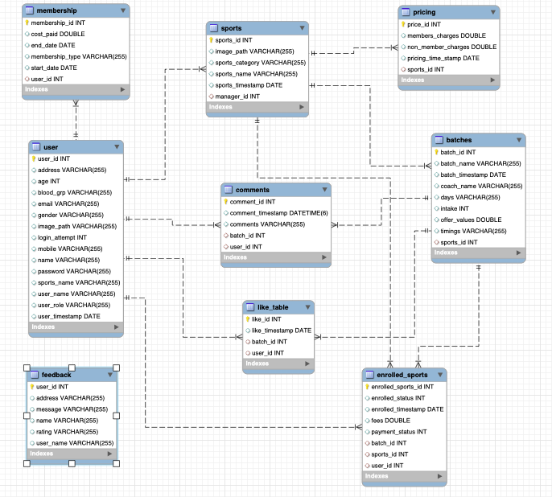
ER-MODEL

Slide 9
SECURITY ASPECTS
Token based Spring security
2FA
Authentication and Session management
Two step verification while user login.
Encrypt password in DB
Route guard
Base64 encoder to encrypt password
Have access to only authorized urls.

Slide 10
DEVOPS
GITHUB
DOCKER
JIRA
AWS
JENKINS
SONARQUBE

Slide 11
PAYMENT GATEWAY
BENCHMARK
FUTURE
SCOPE
USER ACTIVITY TRACE
LOGICAL VALIDATIONS

Slide 12
DEMO

Slide 13
THANK YOU

