Slide 1

MARKET BASKET ANALYSIS
Team - 2

Slide 2
The Problem
Instacart, a grocery ordering and delivery company, aims to make it easy for you to shop for staples when you need them. The company allows customers to select groceries through an online application platform from various retailers.
Being in this business for a long time, Instacart wanted to increase their performance in customer service areas and increase their revenue.
Instacart announced their first public dataset release and wanted members to use this anonymized data on customer orders over time to predict which previously purchased products will be in a user’s next order and build the best model.

Slide 3
The Approach
We started with data collection and cleaning phase
Then we did data exploration where we checked the data set individually and gather insights on possible business problems.
We used descriptive data analytics to represent descriptive graphs of the dataset focusing on our primary metric points and prescriptive analytics to implement a Market Basket Analysis using Apriori algorithm.
Finally, we implemented Apriori algorithm to find the association between products and aisle.

Slide 4
The Data
The dataset used for this analysis is anonymized and contains a sample of over 3 million grocery orders from more than 200,000 Instacart users
This dataset consists of customers’ purchase history as well as the time of the orders
For each user, the dataset provides between 4 and 100 of their orders, with the sequence of products purchased in each order.
The dataset also provides the week and hour of day the order was placed.

Slide 5
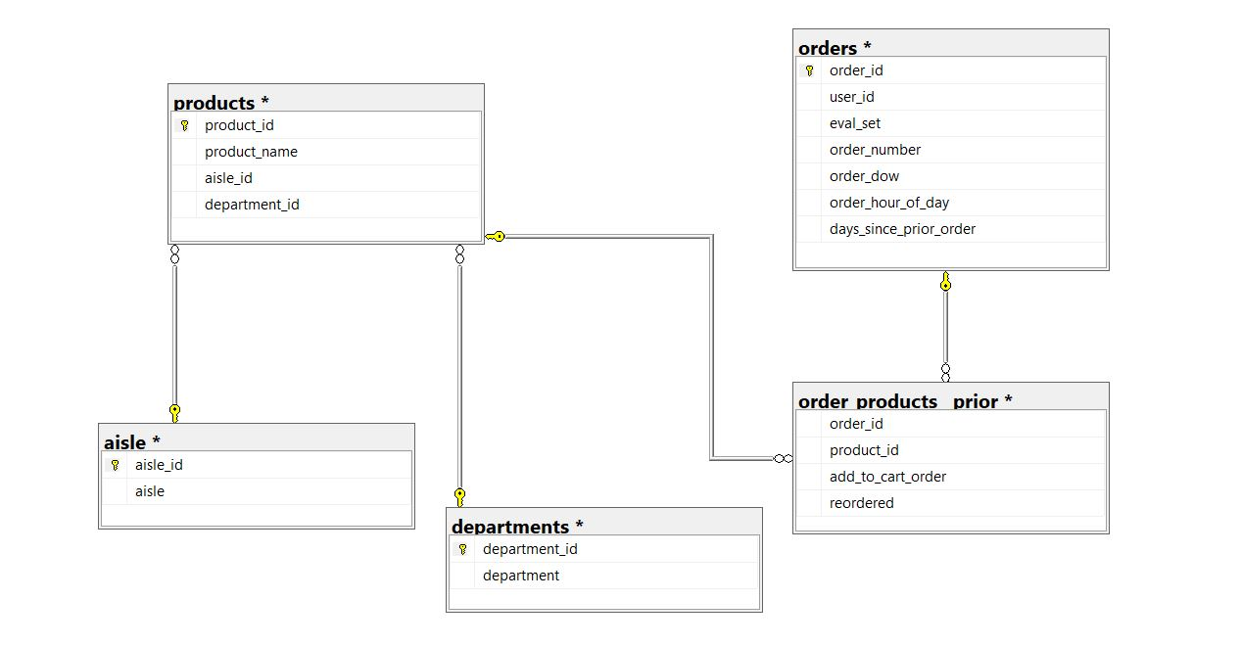
ER Diagram
This ER diagram shows relation between different datasets that we are using for our model.
The link shows the common key value pairs between two datasets

Slide 6
The Model - Theory
The Apriori algorithm that we used for our market basket analysis is the most simple and straightforward approach. The key concept here is that it assumes all subsets of a frequent itemset to be frequent and, for any infrequent itemset, all its supersets must also be infrequent.
There are three major components of the Apriori algorithm:
Support – Fraction of transactions that contain an itemset.
Confidence – Measures how often items in Y appear in transactions that contain X.
Lift – Shows increase in the ratio of the sale of Y when X is sold.
Where an Itemset – {X, Y} is a representation of the list of all items which form the association rule.

Slide 7
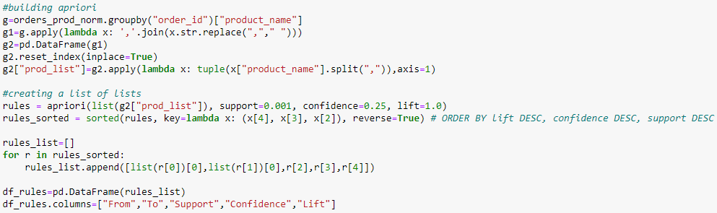
The Model – Implementation (Association by Product)

Slide 8
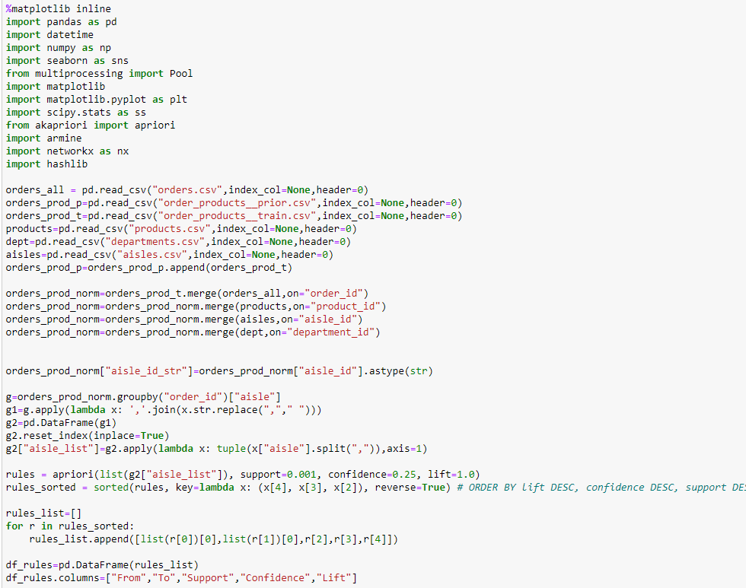
The Model – Implementation (Association by Aisle)

Slide 9
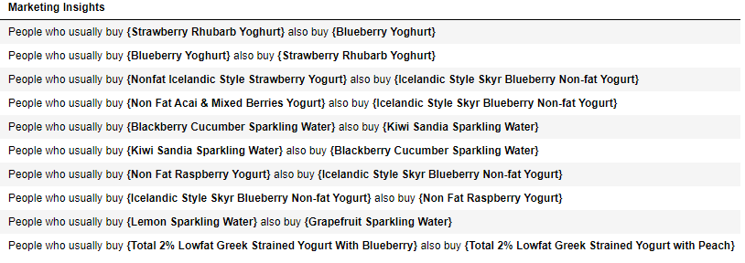
Results – (Association by Products)
Results – (Association by Products)

Slide 10
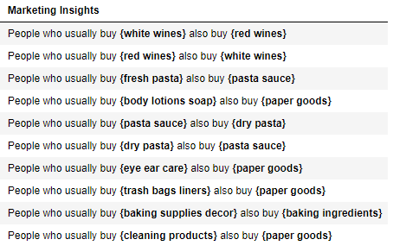
Results – (Association by Aisle)

Slide 11
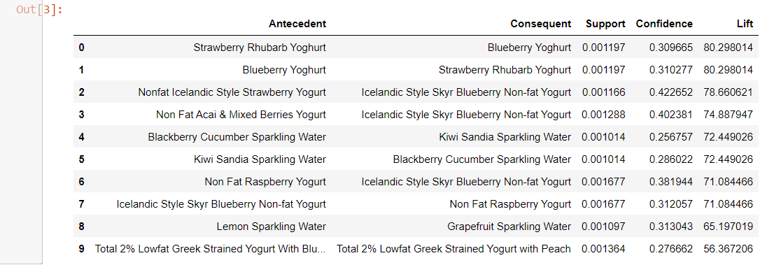
Validation Evaluation
With association rules we have implicit validation when choosing the required support and confident values to generate the rules. In a way, Confidence, support and lift are the validation in association rules.

Slide 12
Improvements
Our model validation can be improved with calculating leverage and conviction for the top 10 rules that we calculated.
We can also take multiple samples from our dataset to test the accuracy of association.
Our model is built on historical data, so even if demand outweighs supply that will not be a problem if captured correctly in transactional database.
Our model perfectly fits the current business problem and can be used to determine other kinds of associations.
We are not able to show the percent of purchase of the various products since the functions are not covered by the python module that we used.

Slide 13
Thank You!

