Slide 1


Slide 2
STATISTICS FOR DATA SCIENCE
MINI PROJECT
-PRAMATHA GAJANAN BHAT - PES1UG19CS339
-RAJESHWARI R - PES1UG19CS375
-RAMYA C - PES1UG19CS379
-RUSHAB PRAKASH KULKARNI - PES1UG19CS399

Slide 3
INTRODUCTION
Dataset chosen – loan.xlsx
Domain of the dataset – Banking Sector
Purpose - Banks wants to automate the loan eligibility process based on customer profile provided while filling online application form.
To automate this problem, data is used to identify the customers who are eligible for loan amount so that they can be specifically targeted.

Slide 4
Problem Statement
Exploratory data analysis of the loan dataset involving data cleaning, data preparation and data visualization using numpy, pandas, matplotlib and seaborn library.
Hypothesis testing on loan amount

Slide 5
EXPLORATORY DATA ANALYSIS
Features of the data set :
loan_amnt - This is the amount of loan applied for by the borrower this can be reduced by the credit department.
term - the number of payments on the loan. They can either be 36 or 60 months.
int_rate - interest loan on the loan.
emp_length - employment length in years. Possible values are between 0 and 10 where 0 means less than a year and 10 means ten or more years.
home_ownership - the home ownership status provided by the borrower during registration. Our values are rent own mortgage other.
annual_inc - the self reported annual income provided by the borrower.
purpose - a category provided by the borrower for the loan request.

Slide 6
EXPLORATORY DATA ANALYSIS
addr_state - the state provided by the borrower in the loan application.
dti:- a ratio calculated using the borrower’s total monthly debt payments on the total debt obligations, excluding mortgage and the requested loan , divided by the borrowers self reported monthly income.
delinq_2yrs:- the number of 30+ days past-due incidences of delinquency in the borrowers credit file for the past 2 years.
revol_util:- revolving line utilization rate or the amount of credit the borrower is using relative to all available revolving credit.
Total_acc - the total number of credit lines currently in borrowers credit file

Slide 7
DATA CLEANING
Library used – Pandas
Shape of the data set – (11780, 15 )
Columns
Loan_amnt
term
int_rate,
emp_length,
home_ownership,
annual_inc,
purpose,
addr_state,
dti,
delinq_2yrs,
revol_util,
total_acc,
bad_loan,
longest_credit_length,
verification_status .

Slide 8
DATA CLEANING
Categorical columns
Numerical columns
purpose
addr_state
Term
home_ownership
bad_loan
verification_status
longest_credit_length,
revol_util,
total_acc
dti
delinq_2yrs
Loan_amnt
int_rate
emp_length
annual_inc

Slide 9
DATA CLEANING
Percentage of null values – 3.44538766270515 %
Columns with null values –
'emp_length’,
'annual_inc’,
'delinq_2yrs’,
'revol_util’,
'total_acc’,
'longest_credit_length'

Slide 10
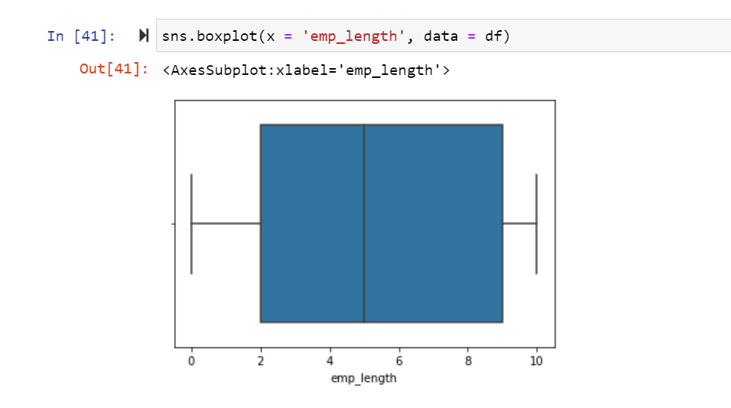
DATA CLEANING
Boxplot for emp_length has been plotted and null values were replaced with median since it is left skewed
No of null values : 5804

Slide 11
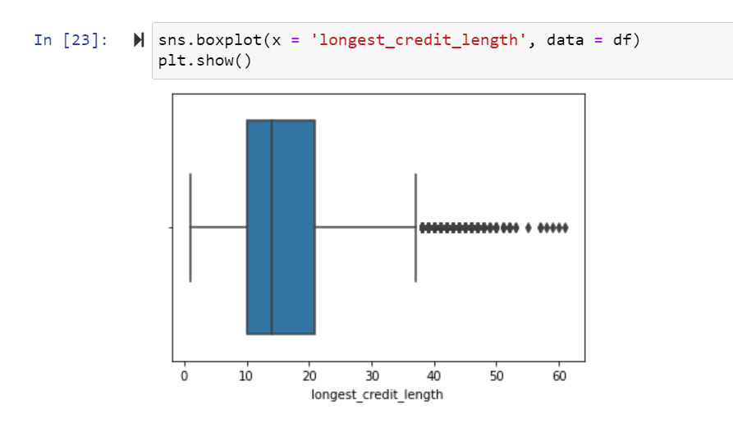
DATA CLEANING
Boxplot for longest_credit_length has been plotted and null values were replaced with median since it is left skewed
No of null values : 29

Slide 12
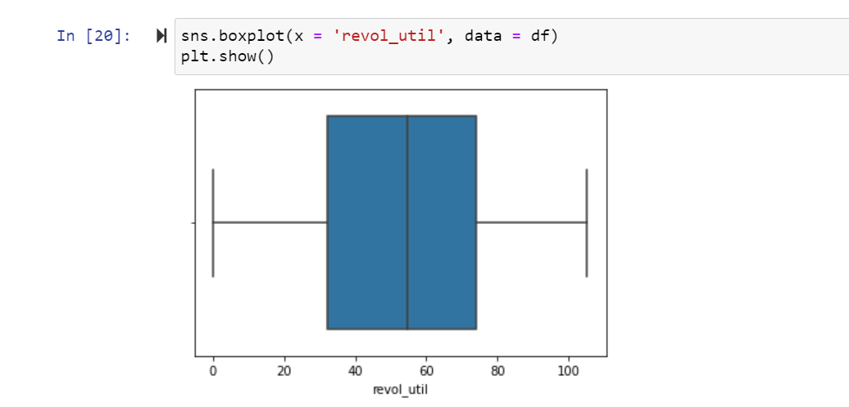
DATA CLEANING
Boxplot for revol_util has been plotted and null values were replaced with median since it is normal
No of null values : 193

Slide 13
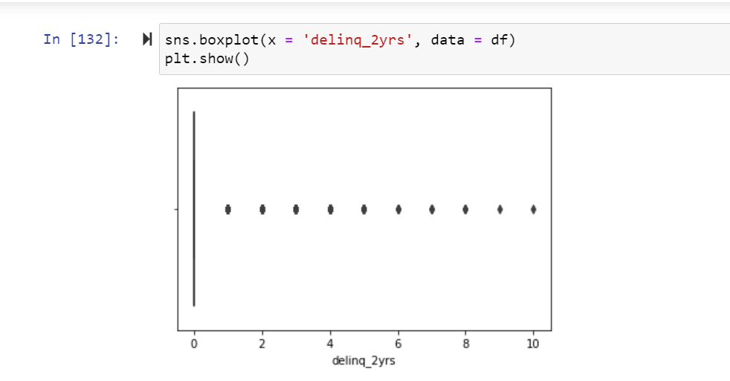
DATA CLEANING
Boxplot for delinq_2yrs has been plotted and null values were replaced with mean since it is normal
No of null values : 29

Slide 14
GRAPH VISUALIZATION
Visualization of data using Histogram, Boxplot, Scatterplot and Bar chart
Analyzing the graph and drawing insights from it

Slide 15
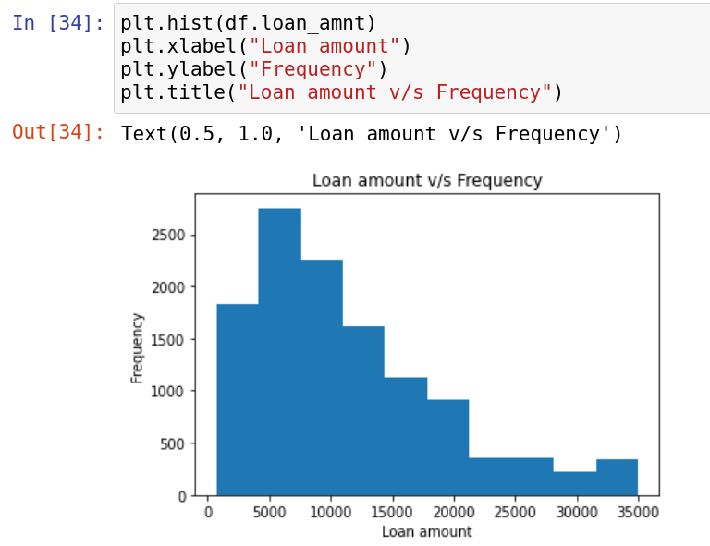
GRAPH VISUALIZATION
1. Histogram
Histogram for loan amount
From the above histogram, it can be observed that most of the people have taken loan between 1000 and 15000
The number of people who have taken loan amount more than 15000( frequency ) is lesser

Slide 16
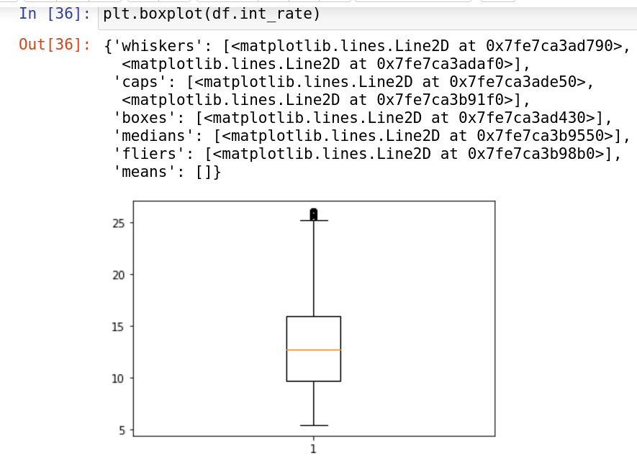
DATA VISUALIZATION
2. Boxplot
Boxplot of interest rate using matplotlib library
The minimum (Q1 - 1.5*IQR ) lies at around 5.5
The maximum (Q3 + 1.5*IQR ) lies at around 25.5
Q1 (25th percentile) is at around 8.5
Q3 (75th percentile) is at around 16.0
Median (50th percentile) is at around 12

Slide 17
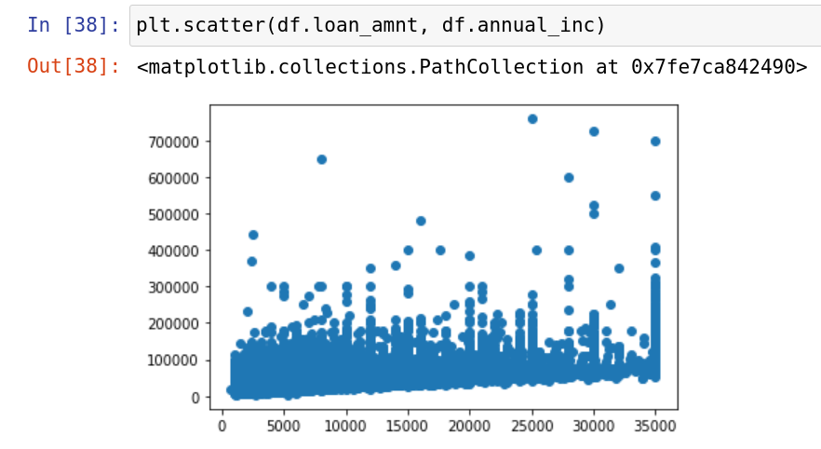
DATA VISUALIZATION
3. Scatterplot
Scatterplot of loan amount and annual income
It shows how X and Y vary relatively

Slide 18
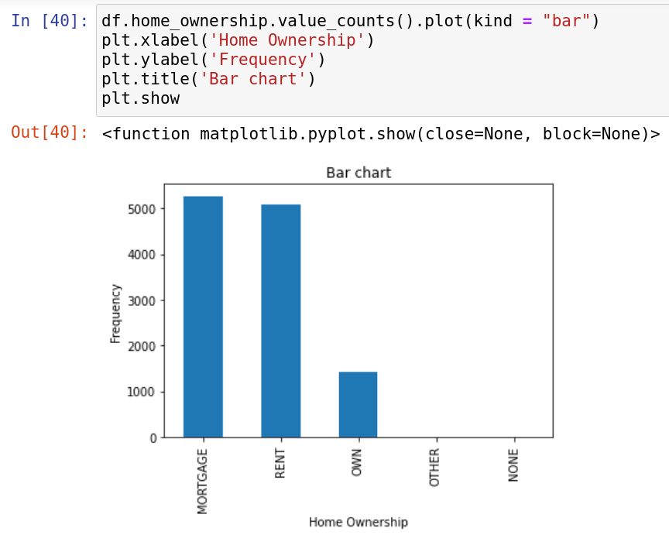
DATA VISUALIZATION
4. Bar Chart
The above bar chart shows, nearly 6000 people have mortgaged their house for loan
Around 5000 people have rented home
1500 people own a home

Slide 19
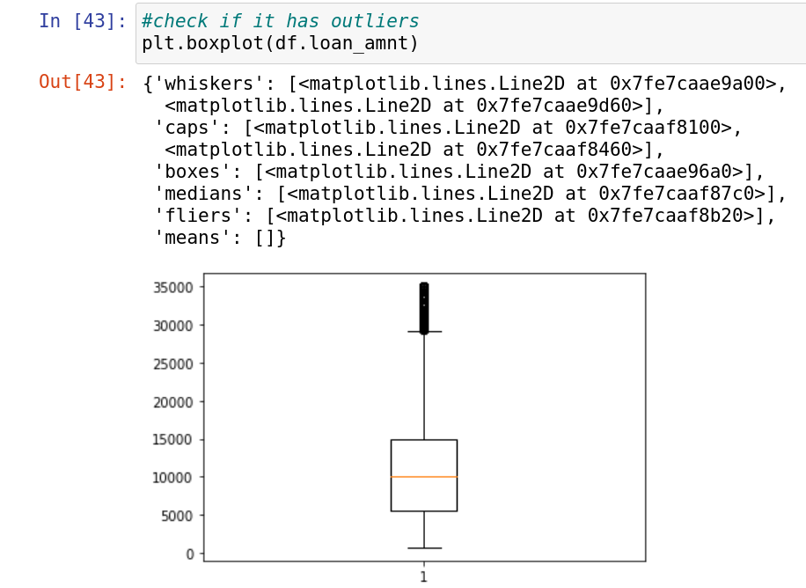
FILTERING UNWANTED OUTLIERS
From the boxplot, many outliers are seen. Since there are not many, as compared to the sample, they are unwanted.
They are to be removed

Slide 20
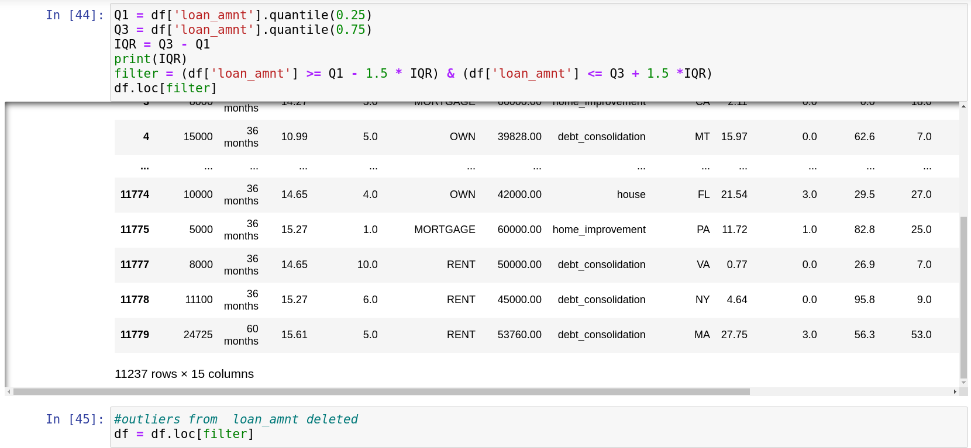
The reduction in the number of rows shows that unwanted outlier values have been removed.

Slide 21
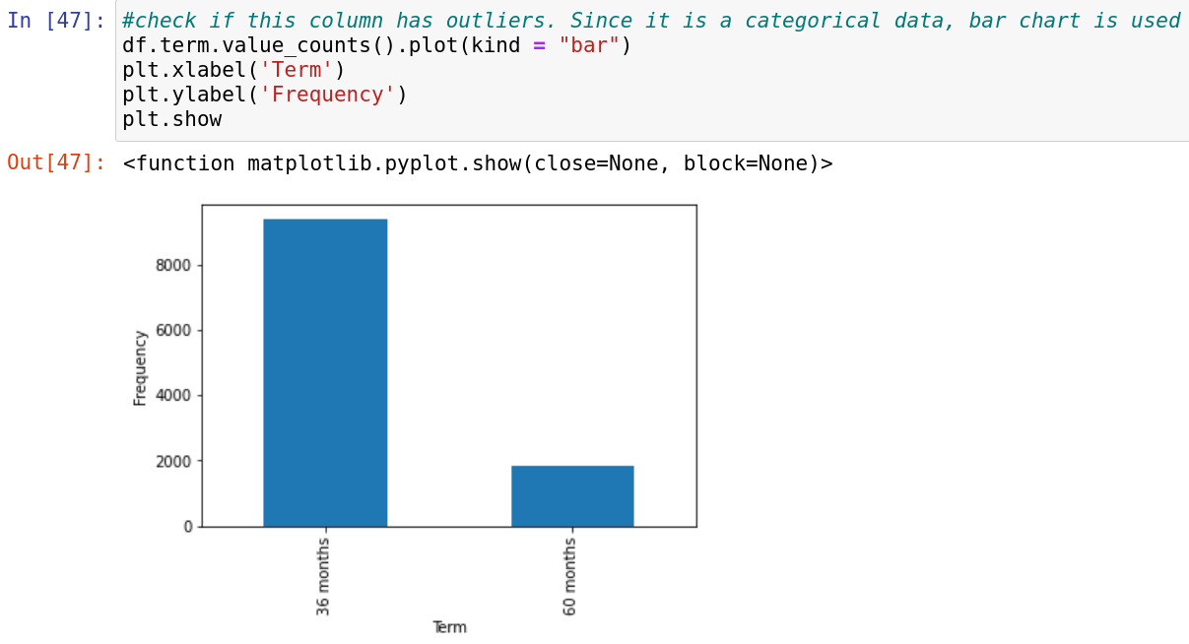
Term is a categorical data.
There are no outliers in them

Slide 22
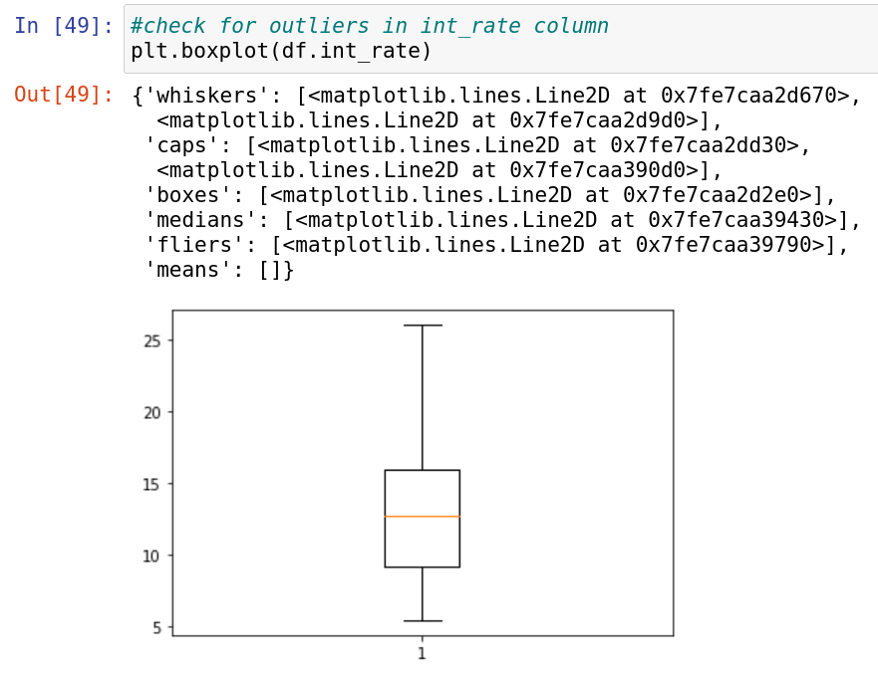
There seem to be no outliers in interest rate values

Slide 23
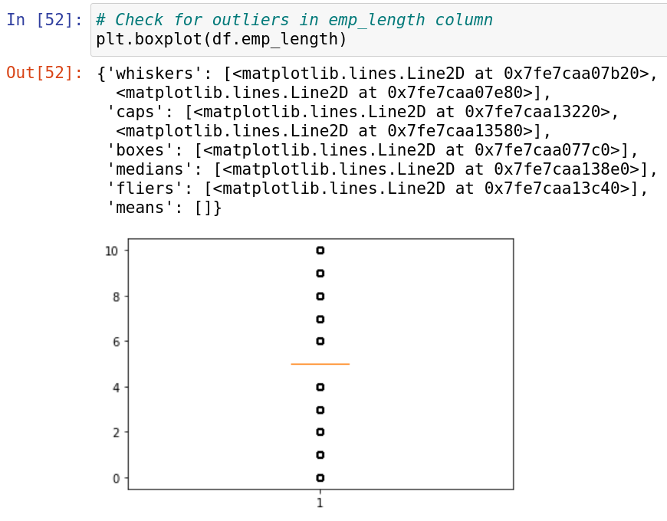
There are many values distributed above and below median which numerically are out of maximum and minimum but form a bigger part of distribution. So, they are not unwanted outliers

Slide 24
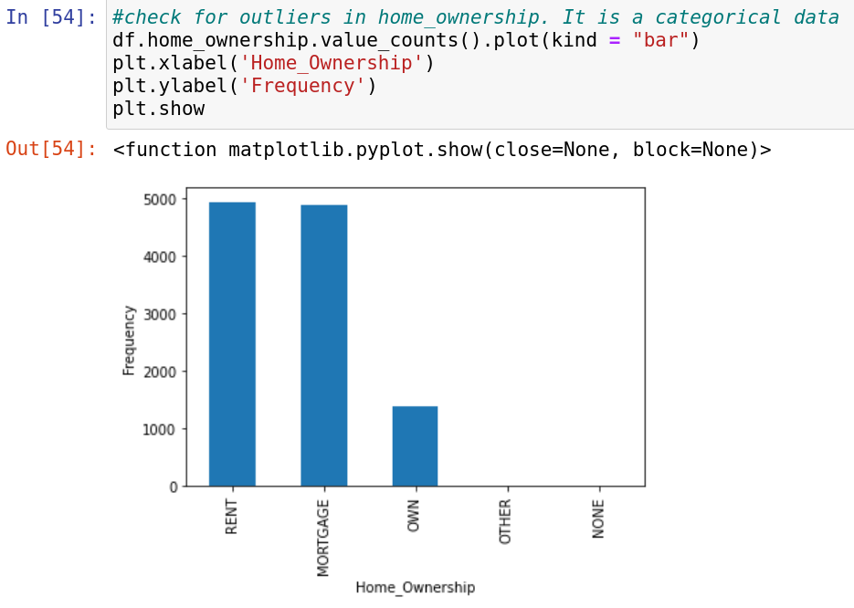
This is a categorical data
It has no outliers

Slide 25
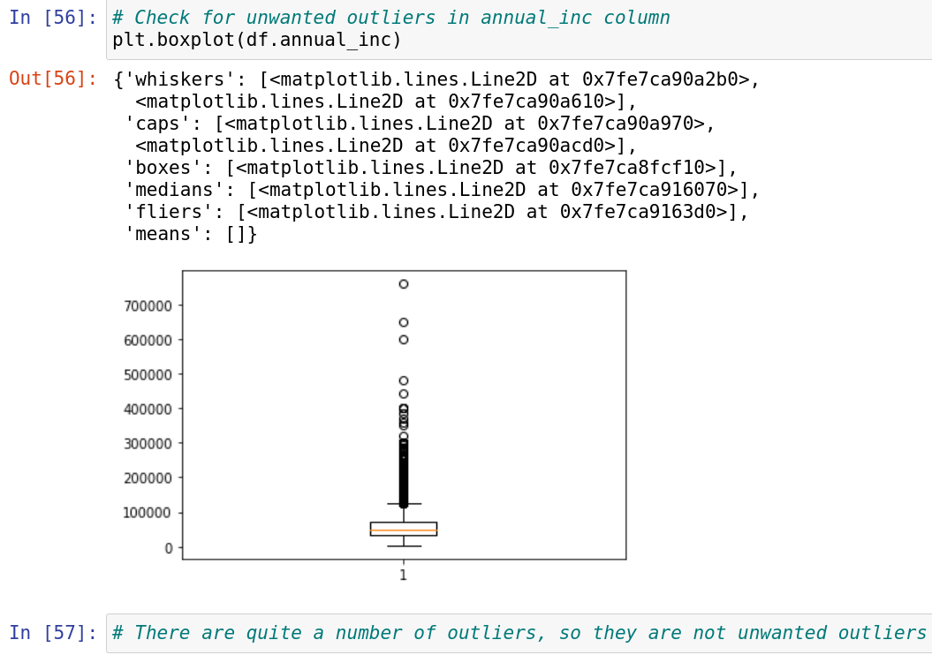

Slide 26
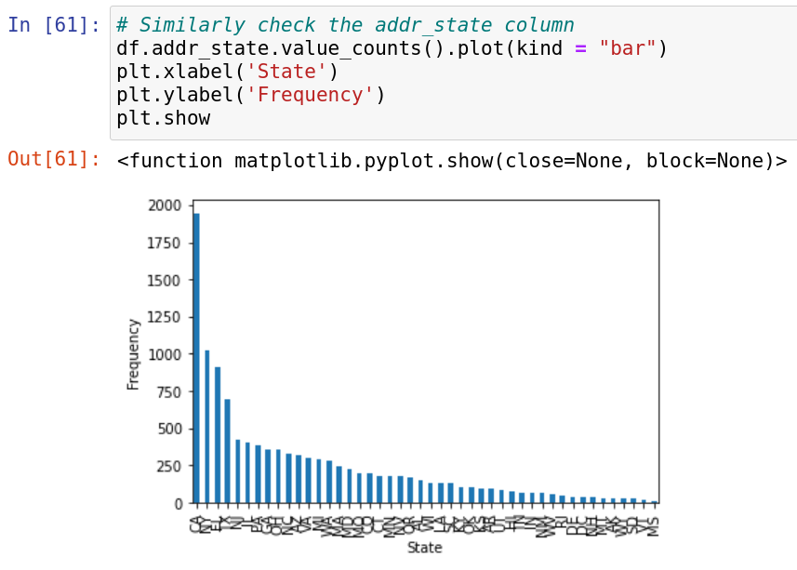
This is also a categorical data
No unwanted outliers seen

Slide 27
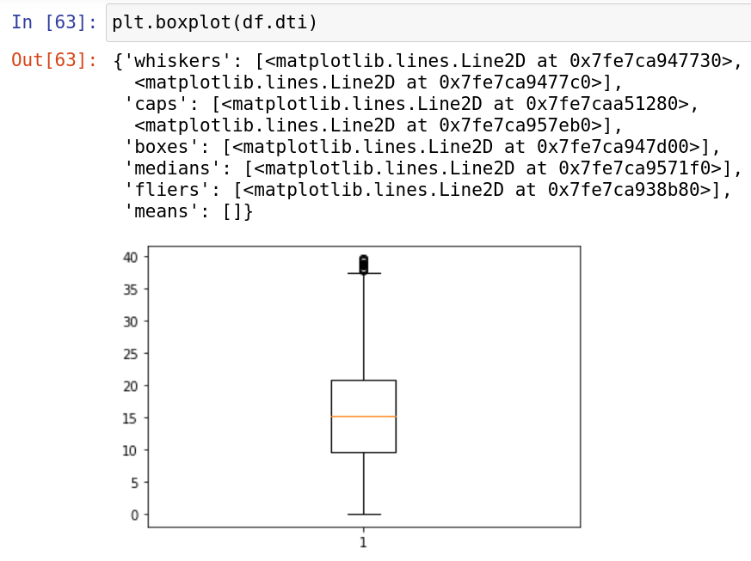
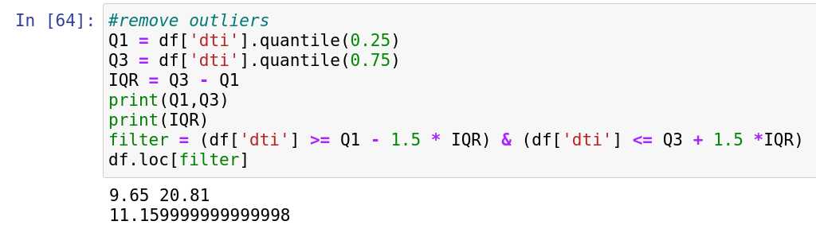
There are a few unwanted outliers
They are removed

Slide 28
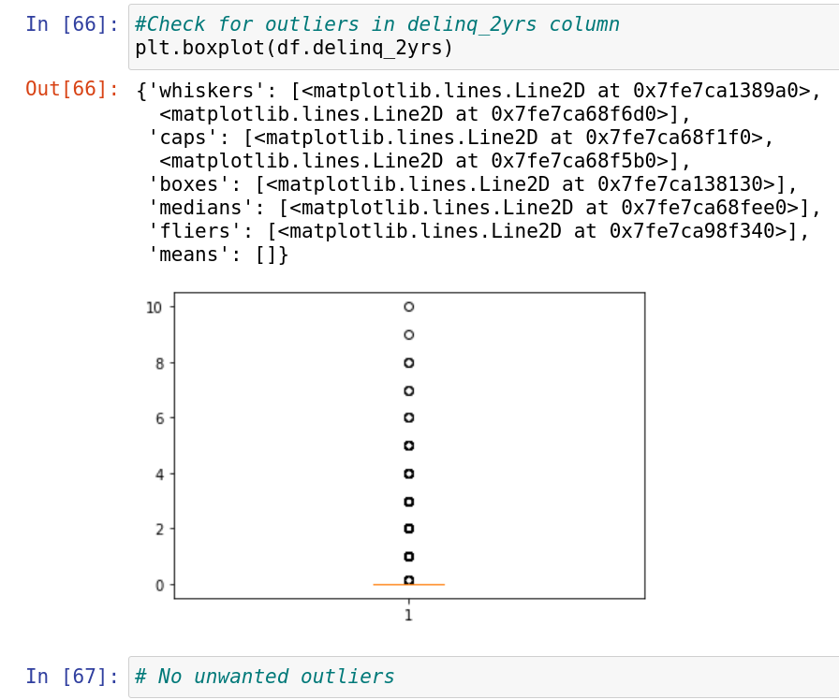

Slide 29
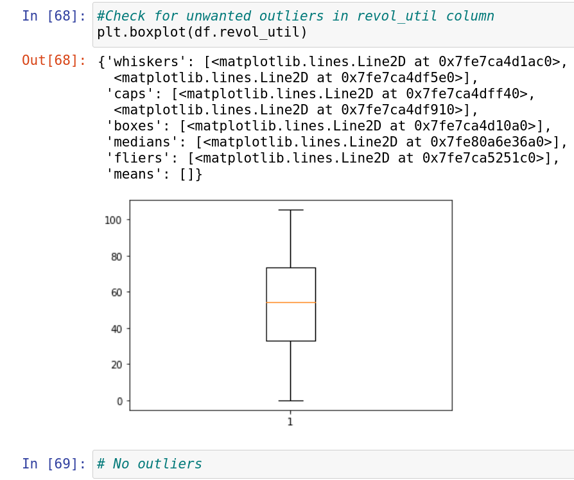

Slide 30
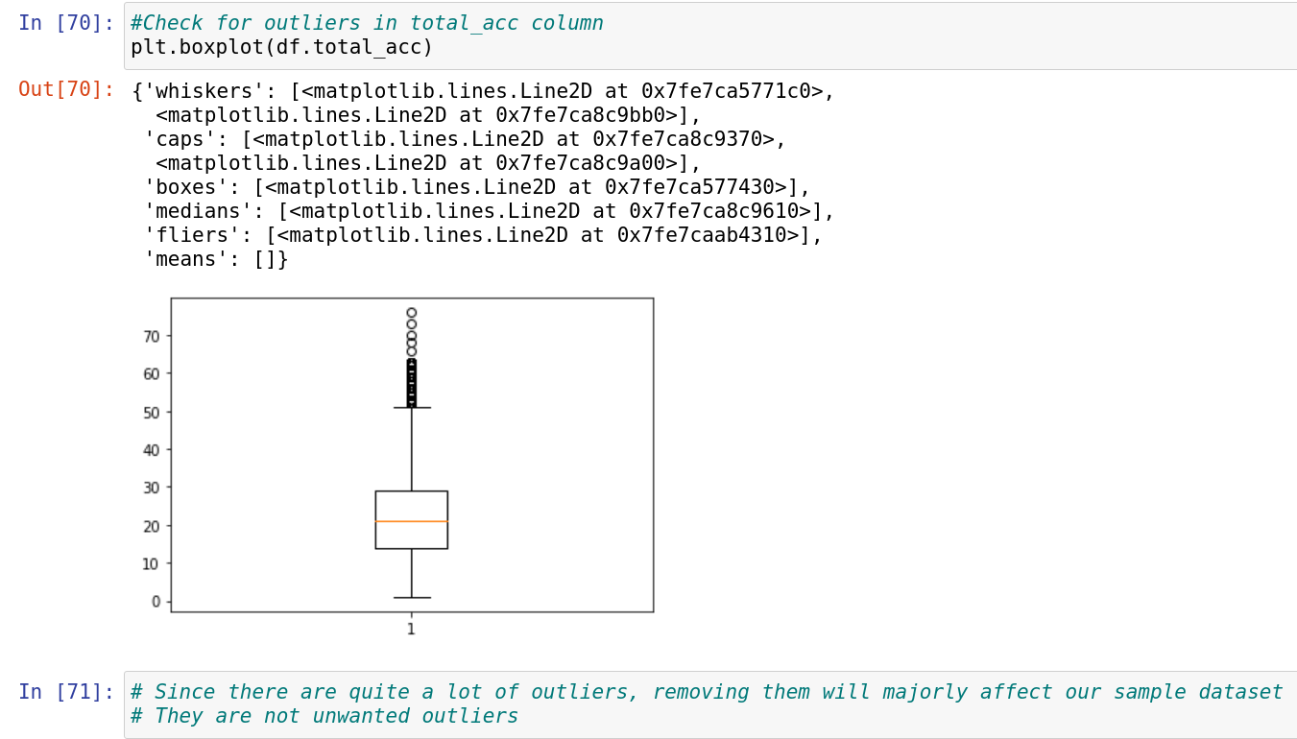

Slide 31
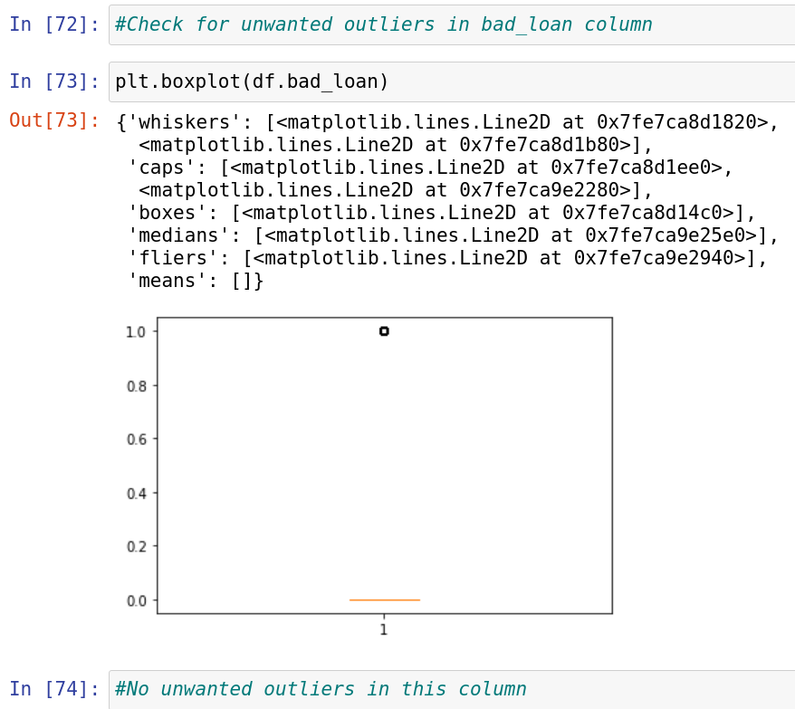

Slide 32
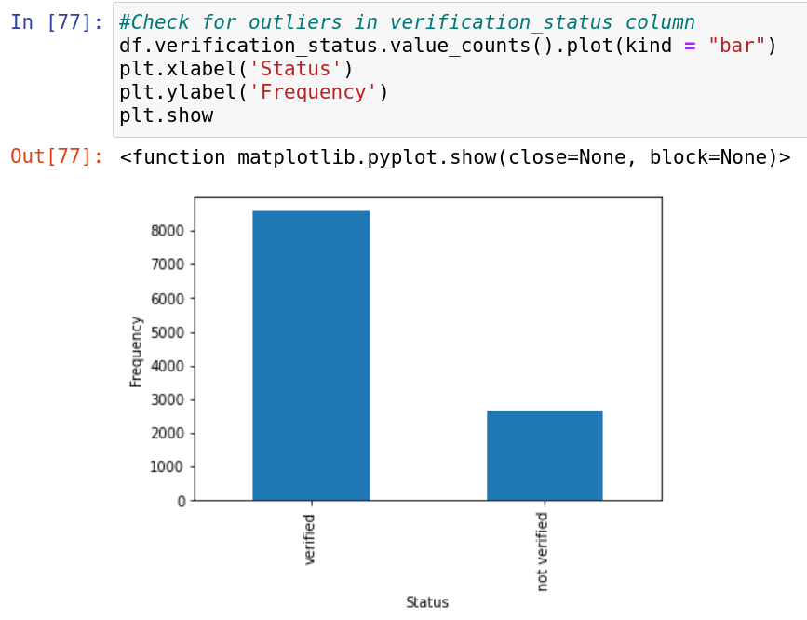
This is categorical data
No unwanted outliers seen

Slide 33
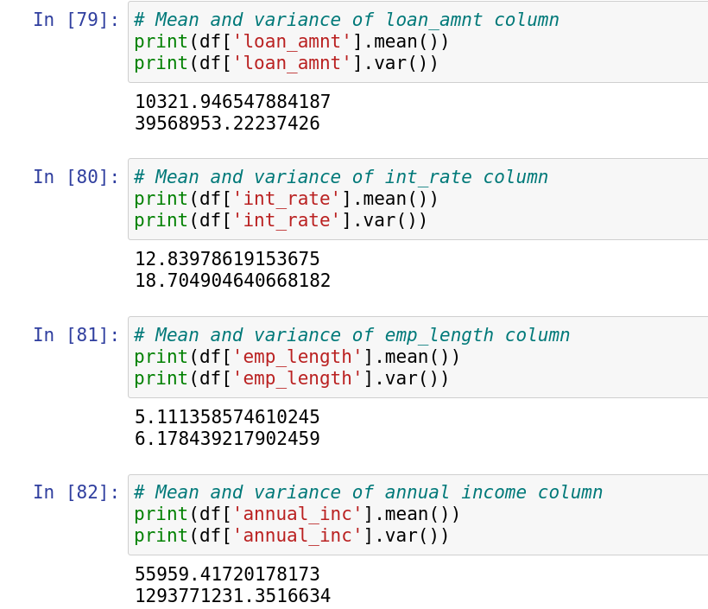
MEAN AND VARIANCE OF NUMERICAL COLUMNS

Slide 34
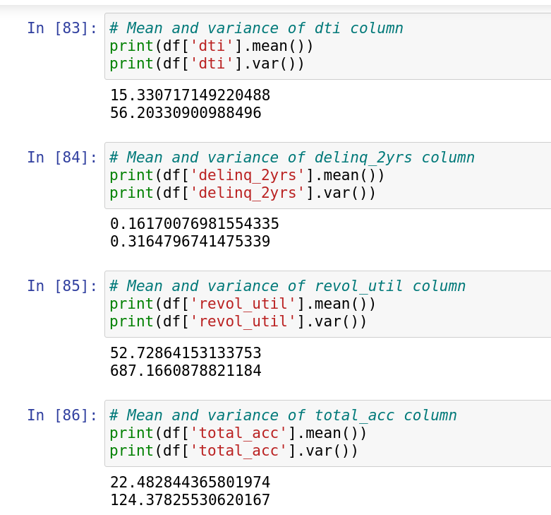
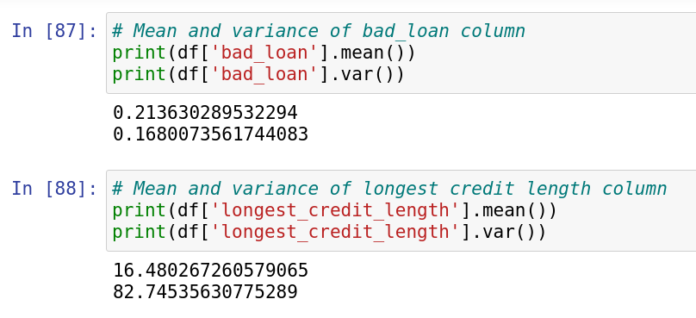

Slide 35
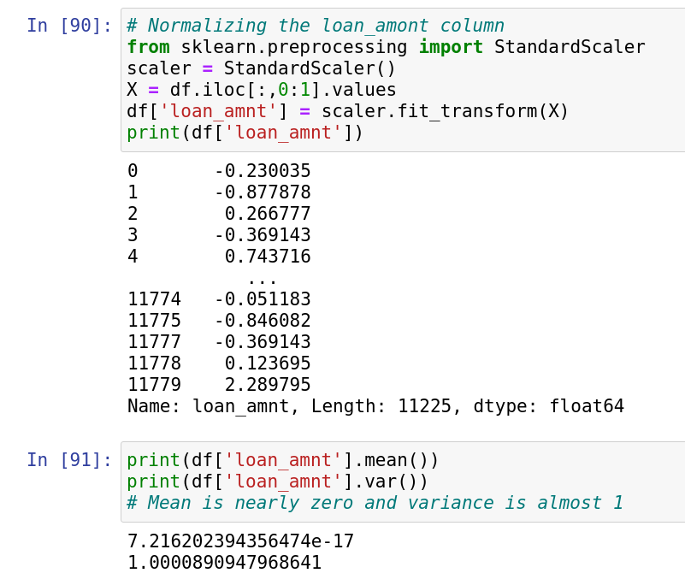
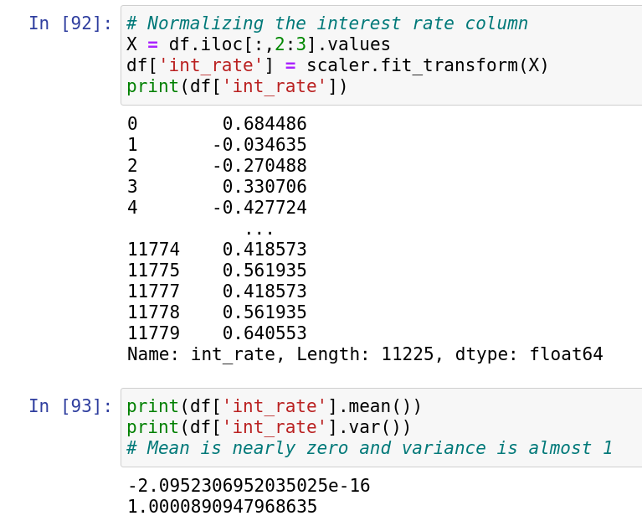
NORMALIZING MEAN TO 0 AND VARIANCE TO 1

Slide 36
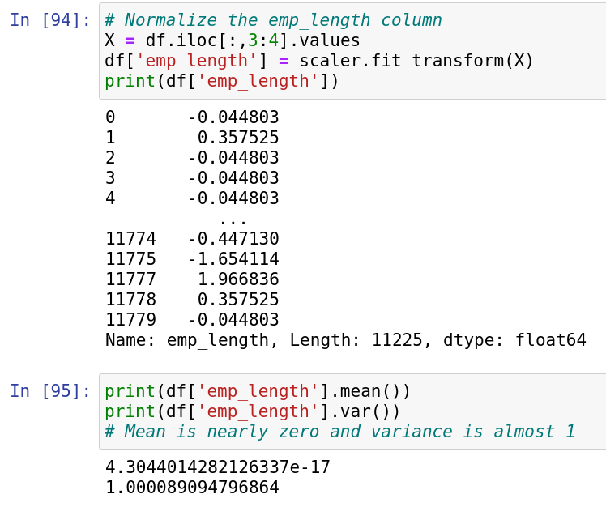
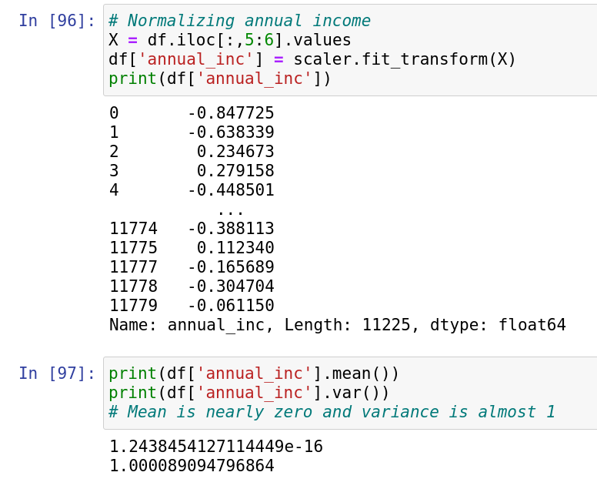

Slide 37
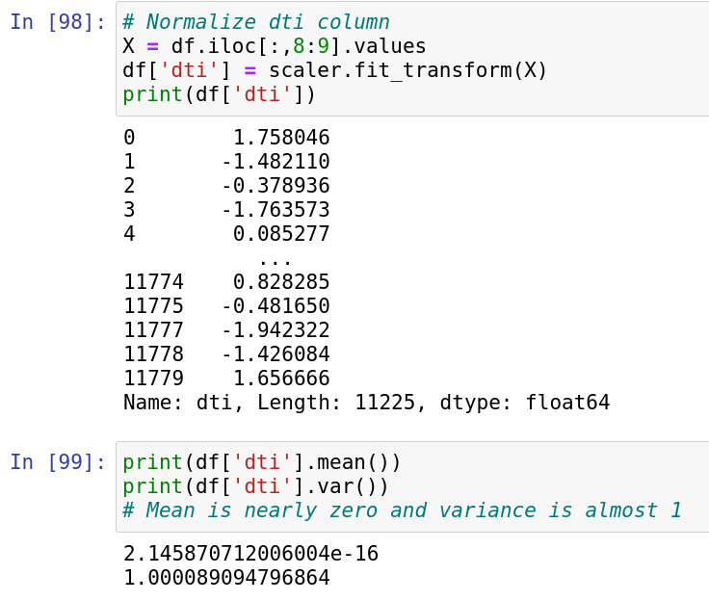
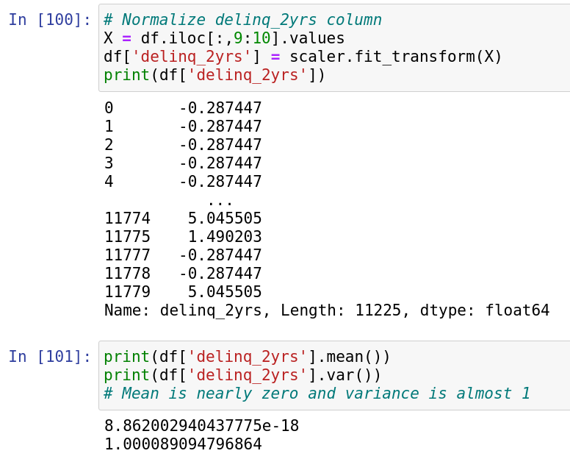

Slide 38
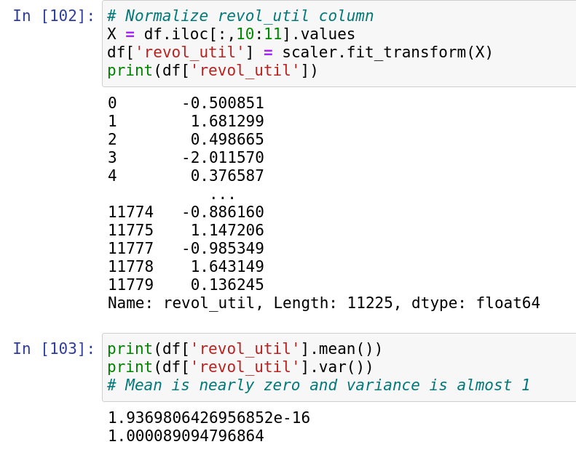
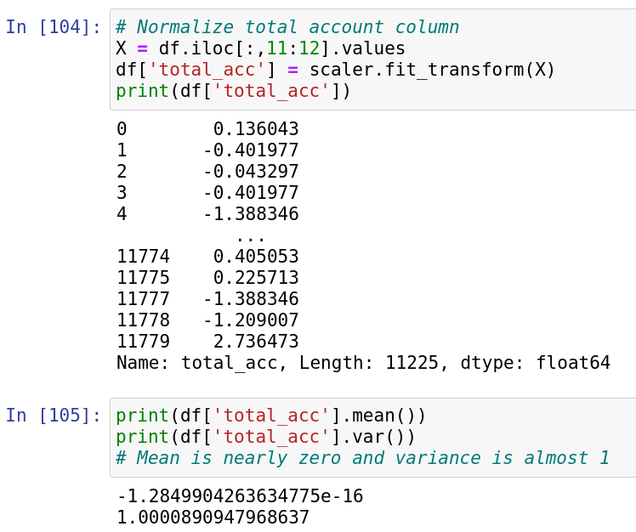

Slide 39
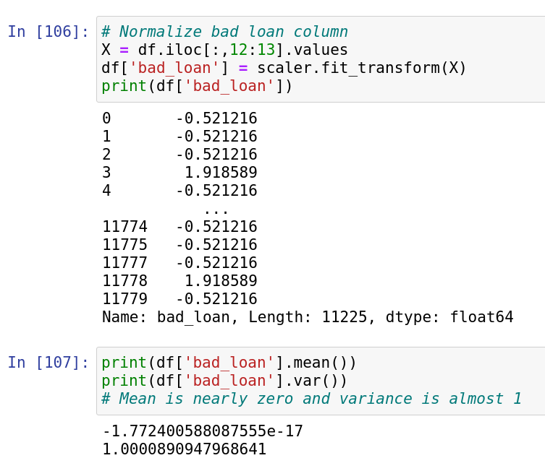
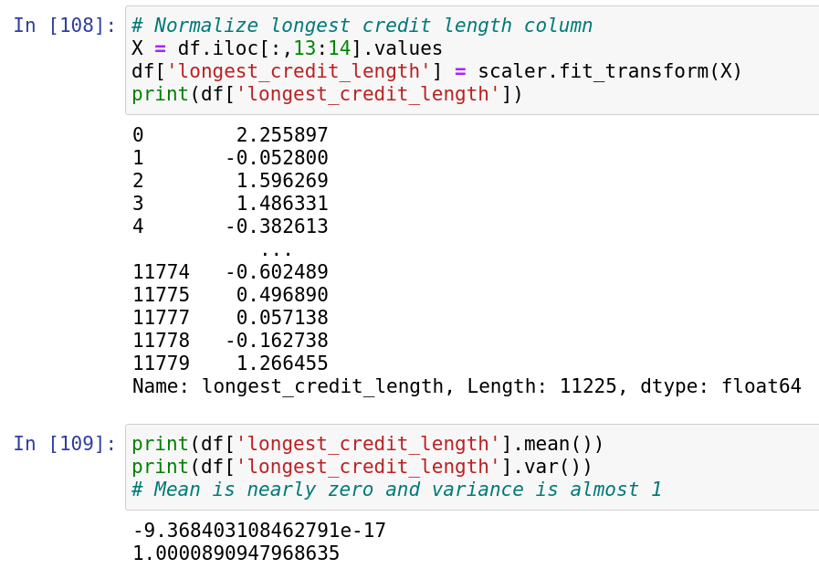

Slide 40
NEED OF NORMALIZATION
Normalization is removing unwanted or redundant data from the table in order to improve storage efficiency ,scalability and data integrity.
It is used in order to eliminate anomalies like insertion, deletion and update in the tables.
It helps in dividing a large table into multiple small normalized tables that are connected and linked using a relationship to reduce redundancy

Slide 41
EFFECT OF NORMALIZATION ON DATASET
In normalization mean is set to 0 and variance is made 1.
Elements can take negative values while originally they may not be negative
This is to make the mean zero and variance 1, so that the relation between values is also sustained

Slide 42
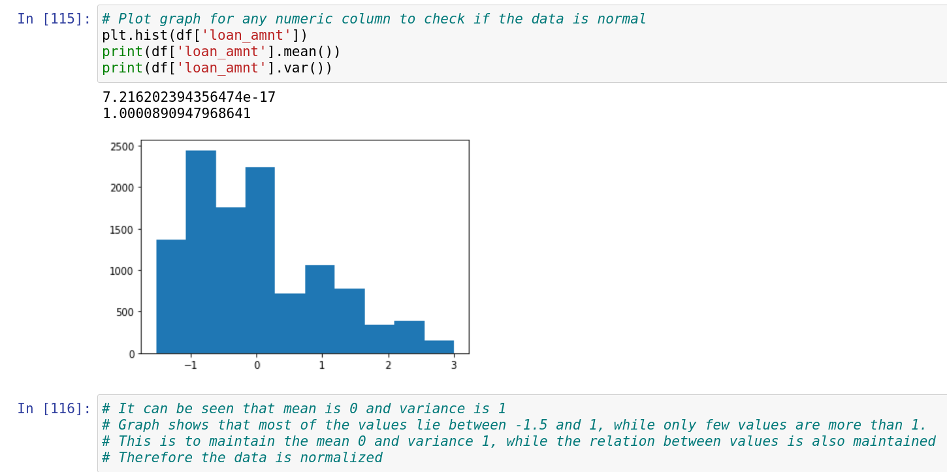
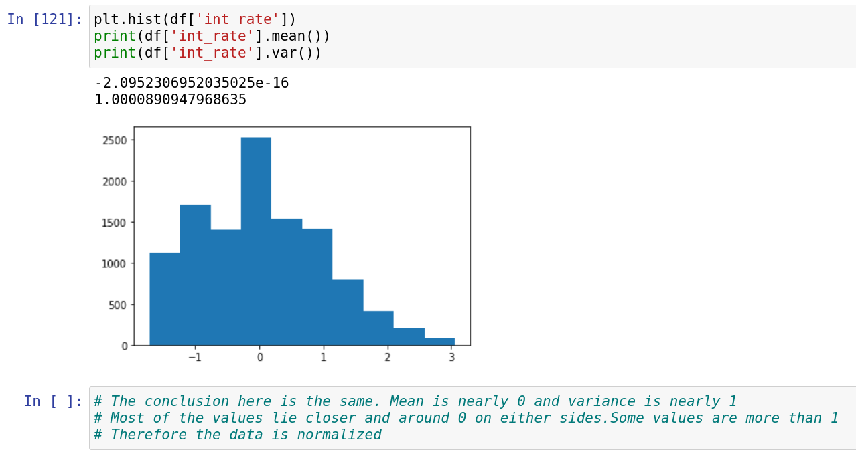
NORMALITY CHECK USING GRAPH AND ANALYSIS

Slide 43
HYPOTHESIS TESTING
Definition:Hypothesis testing is a formal procedure for investigating our ideas about the world using statistics.
It is most often used by scientists to test specific predictions, called hypothesis, that arise from theories.
We have used p value approach for hypothesis testing.
Since the data sample is very large we use z test.
For this test we use population proportion
Steps for Hypothesis testing:-
->State your research hypothesis as a null (Ho) and alternate (Ha) hypothesis.
->Check if the given test is one-tailed-test or two-tailed-test and allocate the alpha value accordingly
->Check for the conditions n*p0 > 10 and n*(1-p0)>10
->Find the z_score and p_value.
->Decide whether the null hypothesis is supported or rejected.

Slide 44
CORRELATION
Correlation: statistical measure that indicates the extent to which two or more variables fluctuate in relation to each other.
Types
1]Positive Correlation:-
A positive correlation indicates the extent to which those variables increase or decrease in parallel
2]Negative Correlation:-
A negative correlation indicates the extent to which one variable increases as the other decreases
Correlation coefficient:-
statistical measure, of the degree to which changes to the value of one variable predict change to the value of another.
Correlation values range between -1 and 1.
There are two key components of a correlation value:
->magnitude – The larger the magnitude (closer to 1 or -1), the stronger the correlation
->sign – If negative, there is an inverse correlation. If positive, there is a regular correlation.

Slide 45
There are 3 methods from which we can find the correlation between the variables:-
1]Pearson Correlation
2]Spearman Correlation
3]Kendall Correlation
Inferences
->The correlation coefficient, r, tells us about the strength and direction of the linear relationship between x and y.
->However, the reliability of the linear model also depends on how many observed data points are in the sample.
->There is insufficient evidence to conclude that there is a significant linear relationship between
x and y because the correlation coefficient is not significantly different from zero.
->Therefore, we CANNOT use the regression line to model a linear relationship between x and y in the population.

