Slide 1
Scenario 1:
An Engineering Pod has created a POC video streaming service that runs on a single compute instance in a development environment. The company now wants to look at marketing this as a service to potential customers around the world. They are asking for a presentation on what this would look like architecturally, what technologies should be considered, what are the challenges around creating and supporting this service at scale in a production environment.
Considerations for the service:
• Must be able to support 100’s of simultaneous users and scale accordingly
• What would the authentication layer look like?
• This is a global product
o Performance and regional implications?
• Must have redundancy built in
• Support 99.99% uptime
• Enable maintenance and patching with zero downtime
• Does the service have/need rate limits?
• Key metrics that would show the health of the service
• Storage considerations
• Solution needs to consider only the streaming and not the uploading of media

Slide 2
Video Streaming Service
Functional Requirements
View Video
Non-Functional Requirements
High Availability
Scalability
Secure
Cost-Effective

Slide 3





WORKFLOW
A
W
S
L
O
A
D
B
A
L
A
N
C
E
R
AWS LAMBDA
AWS CLOUDWATCH
AWS LAMBDA
AWS ELEMENTAL MEDIA CONVERT
AMAZON S3
AMAZON
CLOUDFRONT
AMAZON S3
DISPLAY DEVICES..

Slide 4
TECHNOLOGIES
Storage: Amazon S3 buckets
File Based Conversion: AWS Elemental Media Convert
Organisation and Distribution: Amazon S3 and CloudFront with CDN
Logging and Notification: AWS Cloudwatch
Watch Folder/Publish: AWS Lambda Function
Authentication: CloudFront Signed URL/Cookies
Application Server: EC2 instances with ALB

Slide 5
Scenario 2:
A company still has challenges around some of its legacy solutions and has several database solutions that are still on premise and hosted on physical hardware. The goal is to migrate these to the ‘cloud’. The current databases are a mixture of SQL and NoSQL solutions, some of these are on unsupported versions. The company at this stage is looking for ideas, considerations and challenges before deciding on proceeding to the next phase
Considerations for the service:
• How would we verify and build confidence in the migration?
• What issues might arise from migrating end of life versions?
• Currently it’s costly to scale, what would cloud give us and why?
• We can’t afford downtime or an outage window
o How would we achieve that?

Slide 6
Challenges of On-Prem Applications and Databases
Costly to maintain/upgrade is high
Difficult to scale-up/scale-down
Risk of data loss
Requires huge capital investment
Needs extra IT support

Slide 7
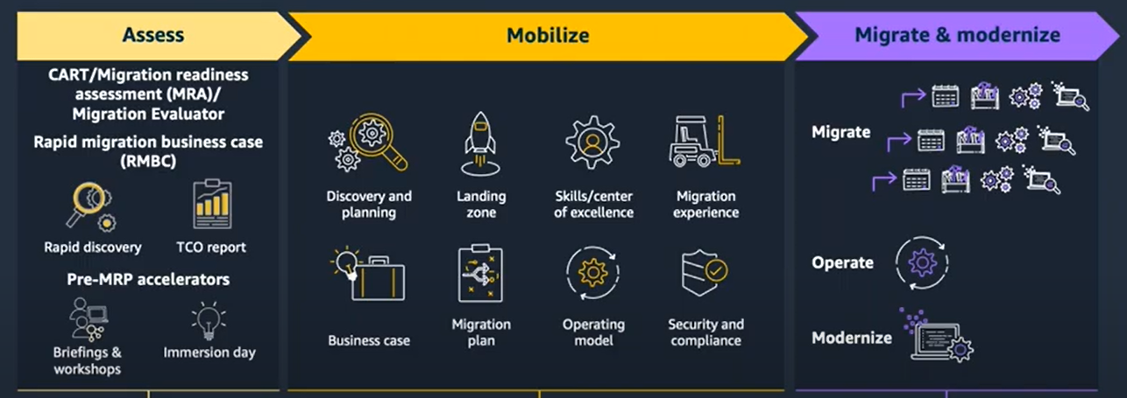
Migration to the Cloud Approach
Assess: Discover how the current application looks like and how components works together
Mobilize: Create a plan for migration after evaluating/studying all supported methods of migration to the cloud
Accelerate: Migrate and enhance to support only cloud infrastructure

Slide 8
Different Strategies for Migration
Strategy | Description | Use Case
Rehost | Move application without any change or very minimal changes
Re-platform | Minimal changes to system and then migrate using AWS managed services
Re-purchase | Replace on-prem application with a new application hosted on cloud
Re-factor | Redevelop application to use cloud features
Retire | Withdraw the services which are no longer in use
Retain | Reconsider few of the servers/applications to be cost-effective or not supported by cloud

Slide 9
AWS Migration Services Choices
Application Migration Platform Choices:
AWS Elastic Beanstalk
Containers: Amazon ECS, AWS Fargate & Amazon ECR
Lambda Function which is serverless option
Database Migration Platform Choices:
AWS Database Migration Service for Oracle, MySQL, PostgreSQL

Slide 10
Challenges of Migration to Cloud
No Downtime while migration:
For SQL/NoSQL:
Offline copy migration
Master/read replica switch migration
Master/master migration
Application Servers:
Migrate servers in slots
Migration of End Of Life Versions:
1. Refactoring of End Of Life Versions platform e.g Windows 2K3/2K8/R2 servers
2. AWS Compatibility Package Builder

Slide 11
Migration to cloud is cost-effective
Customers no longer have to worry about high upgrade and development costs, expensive usage fees, and increasing skill gaps as aging technology experts leave the workforce. Instead, customers can enhance their critical applications and data portfolios by taking advantage of the agility, ease of access, and community that exist on the cloud across the globe.

