Slide 1

Project P12
Insurance Analytics
Mentor : Mr. Adam Shafi
Date : March 2021

Slide 2
Team 2
Deepali E Borse
Amruta Kumbar
Agalya Selve
Saipreetham Sai
Durgesh Ahire

Slide 3
Business Objective
The data set is about Insurance.
We have to prepare the Dashboard and story for the total analysis.

Slide 4
Project Flow
Week 1 – Data set Details
Week 2 – Data Analysis using Excel
Week 3 & 4 – Data Visualization using Tableau
Week 5 - Final presentation

Slide 5
Week - 1
Dataset details

Slide 6
Data Details
Variable | Description
ID | Unique ID of applicant
Gender | Applicant is male or female
Marital Status | Applicant is married or not
Dependents | A person who is eligible to be covered by you for insurance.
Education | Applicant is graduated or not
Self Employed | Applicant is having self business or not
Applicant Income | Applicant’s monthly income
Premium Amount | Premium is an amount paid periodically to the insurer by the insured for covering his risk
Maturity Term | The period during which its owner will receive interest payments on the investment
Credit History | The record of how a person has managed his or her credit in the past.
Branch | At which region/branch the applicant is applying for loan
Benefit | The amount an insurance company agrees to pay for a specific covered benefit
Loan Status | Loan approved or not

Slide 7
Data Insights
Variable | Datatype | Missing Values
ID | String | 0
Gender | String | 13
Marital Status | String | 3
Dependents | String | 15
Education | String | 0
Self Employed | String | 32
Applicant Income | Integer | 0
Premium Amount | Float | 22
Maturity Term | Float | 14
Credit History | Float | 50
Branch | String | 0
Benefit | Float | 0
Loan Status | String | 22

Slide 8
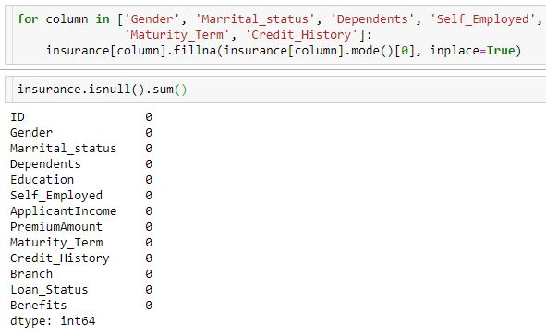
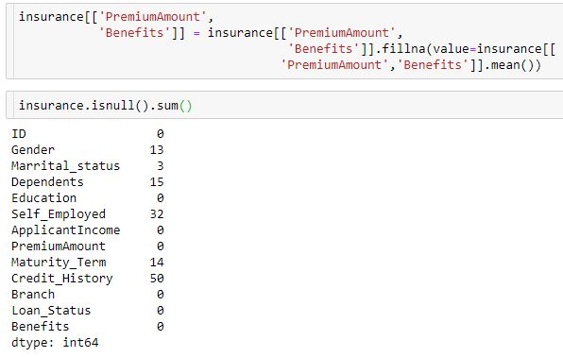
Data Cleaning
Categorical Data:
- Imputing missing values by mode() method using python.
Integer/Float data:
- Imputing missing values by mean() method using python.

Slide 9
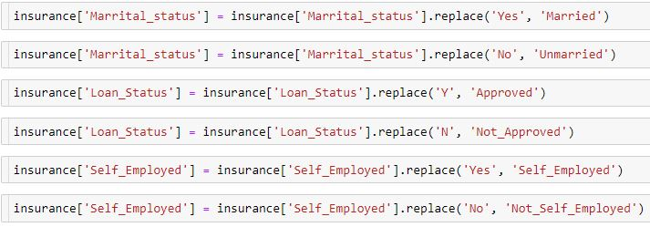
Data Cleaning
Renaming column values:
- For better understanding, we renamed values by replace() function using python.
Saving preprocessed file:
- Changes made on original data are saved in csv file by df.to_csv() function using python.

Slide 10
Week - 2
Data Analysis using Excel

Slide 11
Univariate Analysis
Loan_status /Gender | Male | Female
Approved | 347 | 75
Not_Approved | 155 | 37
Total | 502 | 112
Loan status/ Marital status | Married | Unmarried
Approved | 288 | 134
Not_Approved | 113 | 79
Total | 401 | 213

Slide 12
Univariate Analysis
Loan status/ Dependents | 0 | 1 | 2 | 3+
Approved | 247 | 66 | 76 | 33
Not_Approved | 113 | 36 | 25 | 18
Total | 360 | 102 | 101 | 51
Loan status/ Education | Graduate | Not Graduate
Approved | 340 | 82
Not Approved | 140 | 52
Total | 480 | 134

Slide 13
Univariate Analysis
Loan status/ Self Employed | Self_Employed | Not Self_Employed
Approved | 56 | 366
Not Approved | 26 | 166
Total | 82 | 532
Loan status/ Applicant Income | <1500 | <5000 | <7000 | <10000 | >=10000
Approved | 6 | 282 | 62 | 37 | 35
Not_Approved | 5 | 125 | 31 | 11 | 20
Total | 11 | 407 | 93 | 48 | 55

Slide 14
Univariate Analysis
Loan status / Premium Amount | <70 | <120 | <200 | >=200
Approved | 34 | 136 | 198 | 49
Not_Approved | 14 | 62 | 85 | 31
Total | 48 | 198 | 283 | 80
Loan status/ Maturity Term | 3 | 6 | 12 | 18 | 24 | 36 | 48 | 84
Approved | 8 | 2 | 4 | 29 | 3 | 367 | 6 | 3
Not_Approved | 5 | 0 | 0 | 15 | 1 | 161 | 9 | 1
Total | 13 | 2 | 4 | 44 | 4 | 528 | 15 | 4

Slide 15
Univariate Analysis
Loan status/ Credit History | 1 | 0
Approved | 415 | 7
Not_Approved | 110 | 82
Total | 525 | 89
Loan status/ Branch | Urban | Semi urban | Rural
Approved | 133 | 179 | 110
Not_Approved | 69 | 54 | 69
Total | 202 | 233 | 179

Slide 16
Univariate Analysis
Loan status/ Benefit | <20000 | <50000 | <70000 | >=70000
Approved | 91 | 314 | 10 | 7
Not_Approved | 44 | 137 | 6 | 5
Total | 135 | 451 | 16 | 12

Slide 17
Week – 3 & 4
Data Visualization using Tableau

Slide 18
Interactive Dashboard
Filters / Criteria:
Loan Status
Education
Credit History
Branch
Dependents
Maturity Term

Slide 19
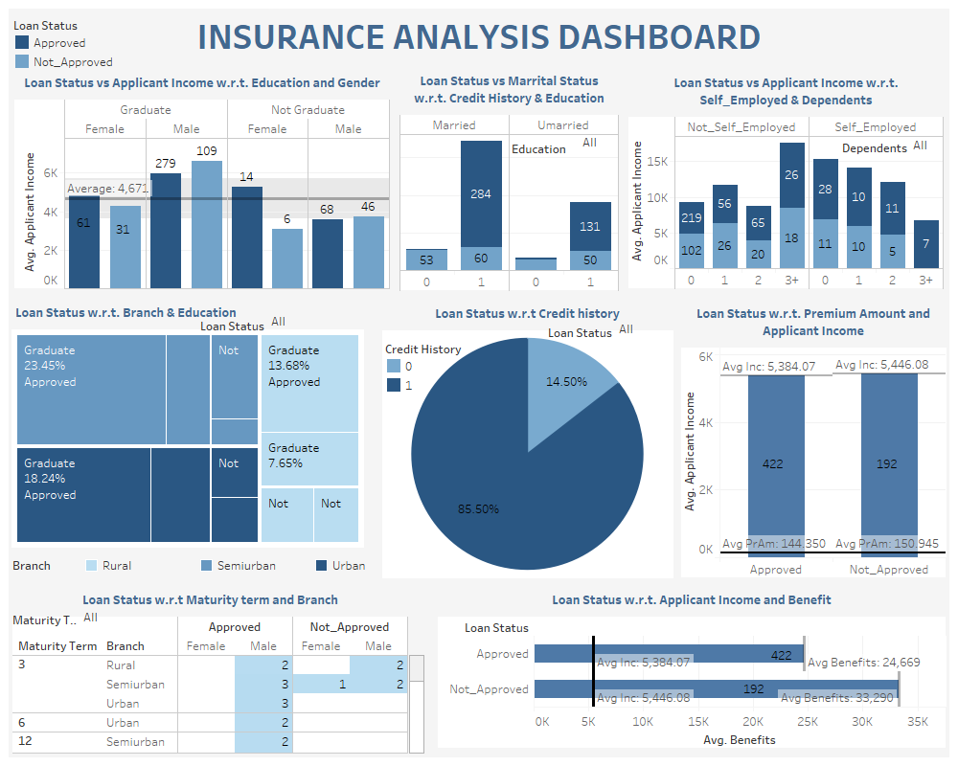
Original Dashboard without filtering:

Slide 20
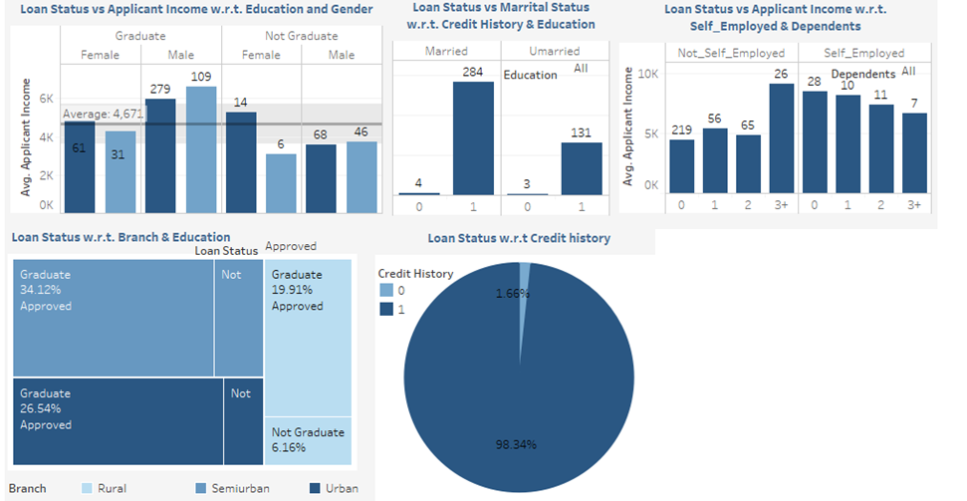
Criteria 1A - Loan Status : Approved
People who got loan approved:
Count of Graduate Male > Count of Graduate Female
Max Population is married with good credit history
Only 7 people had bad credit history
Majority of population is Not self employed and max population has 0 dependents
Count of loan applications at Semi urban branch is more than other branches

Slide 21
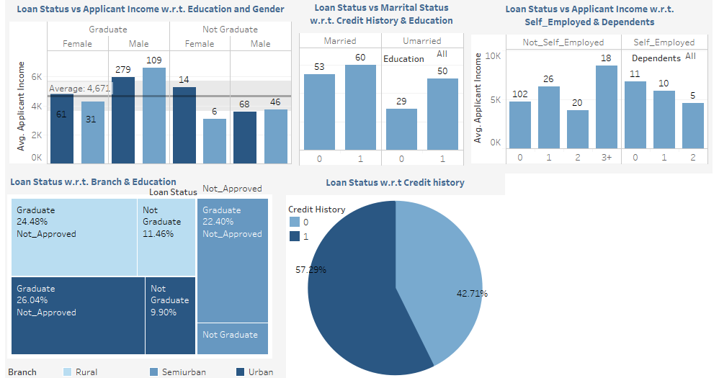
Criteria 1B - Loan Status : Not Approved
People who didn’t got loan approved:
Count of Non self employed with 0 dependents is much higher than other categories of people
Max % of loan applications got rejected at Rural branch
Approximately half of population with bad credit history didn’t got loan approved.

Slide 22
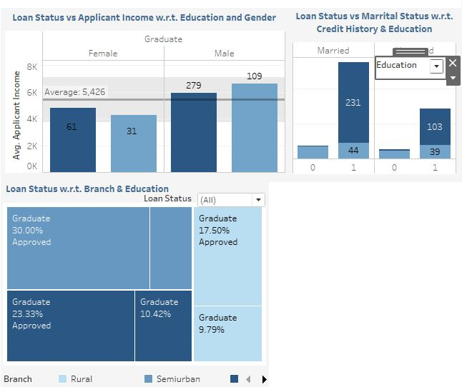
Criteria 2A - Education : Graduate
People who are graduate:
Count of Male > Count of Female
Their average income is around 5.4k
Max Population is married and has a good credit history
Count of people applied for loan at Semi urban branch is more than other branches

Slide 23
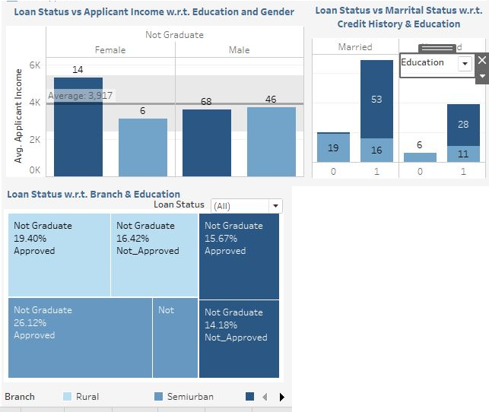
Criteria 2A - Education : Not Graduate
People who are not graduate:
Average income is around 4k
25 people had bad credit history
Max people applied at rural branch
Very less difference between % of loan getting approved and getting rejected.

Slide 24
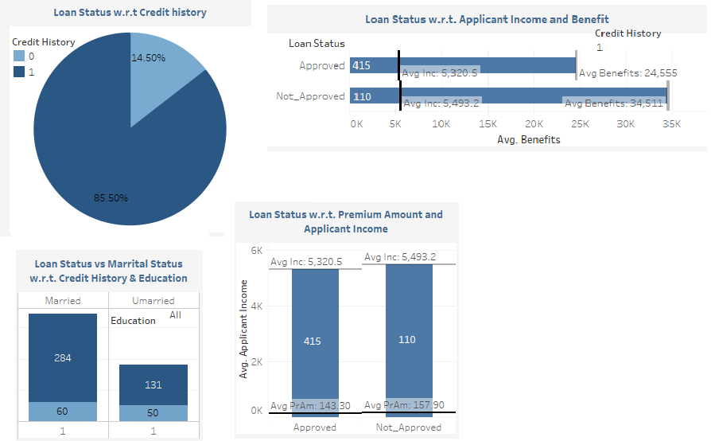
Criteria 3A - Credit History : 1 (Good)
People having credit history as 1:
Majority of population has good credit history
Half of the population is married and many had good credit history
Very few got their loan application rejected
Significant difference in benefit w.r.t. loan status
No significant difference in applicants income irrespective of their loan status

Slide 25
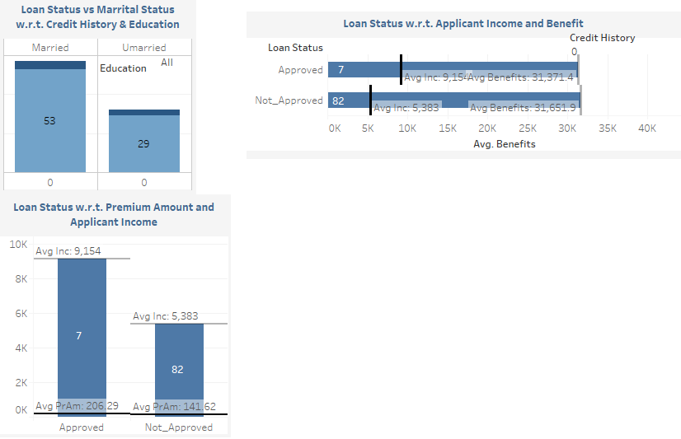
Criteria 3B - Credit History : 0 (Bad)
People having credit history as 0:
Only 7 people with bad credit history got loan approved
4 were married and 3 were unmarried got loan approved
Average income of people with approved loan status is more than compared to other loan status category people
Majority of people who’s loan application got rejected had bad credit history

Slide 26
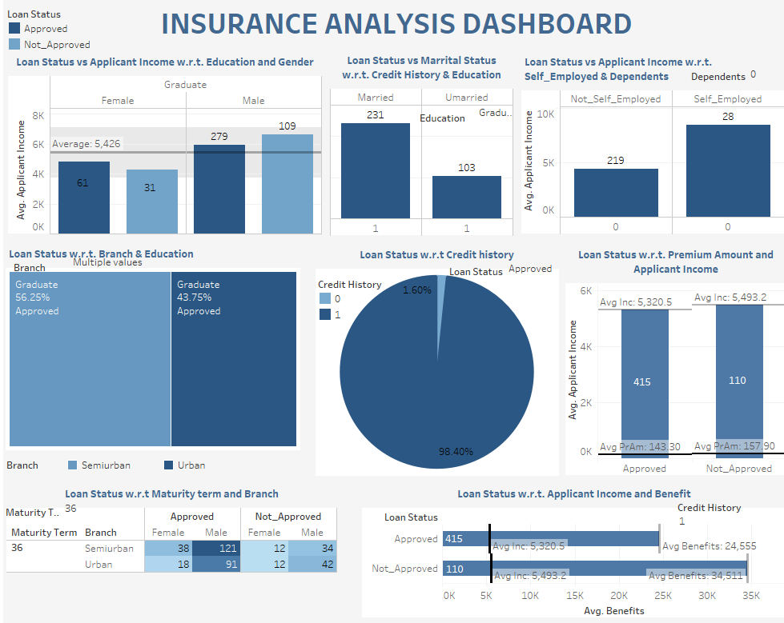
Multiple action filters: Example 1
Information on dashboard is filtered by:
Loan status : Approved
Education : Graduate
Credit history : 1
Dependents : 0
Branch : Semi urban, Urban
Maturity Term : 36
Factors influencing Loan status:
Credit history
Education
Self Employed
Branch
Dependents

Slide 27
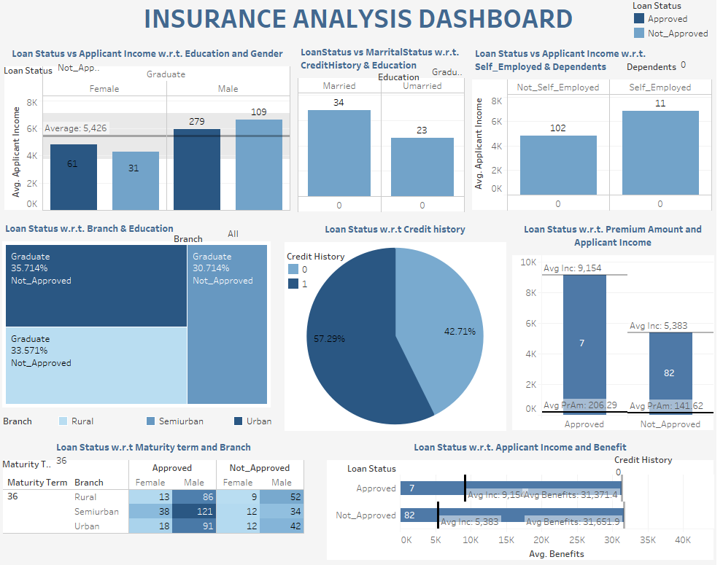
Multiple action filters: Example 2
Information on dashboard is filtered by:
Loan status : Not Approved
Education : Graduate
Credit history : 0 (Bad)
Dependents : 0
Branch : All
Maturity Term : 36
Factors influencing Loan status:
Credit history
Education
Self Employed
Branch
Dependents

Slide 28
Final Inference

Slide 29
Inferences:
Count of male population is more than count of female, but the ratio of their loan status is almost same. Same goes with self employed factor.
Count of graduate people is more than non-graduates, but % of graduate people not getting loan is less than non-graduates.
The most influential factor was credit history. Out of all the population having bad credit approximately 92% population’s loan application got rejected.
% of loan applications getting rejected was most at rural branch and least at Semi urban branch.
Average income of overall population was approximately around 4,500 Rs but people with approved loan status got less benefit as compared to people with not approved loan status.
Maximum population is paying less than 200 Rs monthly as premium amount.
Majority of population having maturity term as 36 or dependents as 0 applied for loan.

Slide 30
Thank You

