Slide 1

Cucumber Framework: Intro

Slide 2
Cucumber Framework:
Learnt About TestNG : TDD (Test Driven Development)
Cucumber BDD : Behavior Driven Development
Gherkin Language: It’s a feature language not programming language
BDD is all about behavior.

Slide 3
Cucumber Framework:
Cucumber is available with Java & Ruby
In BDD, Tests are written in plain descriptive English type grammar.

Slide 4
Cucumber Framework:
Cucumber is a testing framework which supports Behavior Driven Development (BDD). It lets us define application behavior in plain meaningful English text using a simple grammar defined by a language called Gherkin. Cucumber itself is written in Ruby, but it can be used to “test” code written in Ruby or other languages including but not limited to Java, C# and Python.

Slide 5
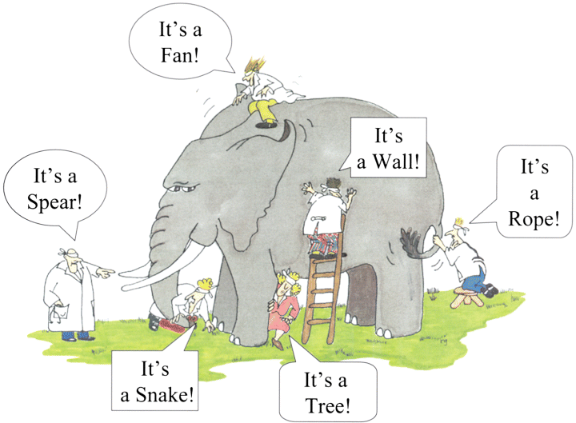
Why BDD:

Slide 6
Example of Cucumber Test:
Feature: Sign up
Sign up should be quick and friendly.
Scenario: Successful sign up New users should get a confirmation email and be greeted personally by the site once signed in.
Given I have chosen to sign up When I sign up with valid details Then I should receive a confirmation email And I should see a personalized greeting message
Scenario: Duplicate email
Where someone tries to create an account for an email address that already exists.
Given I have chosen to sign up But I enter an email address that has already registered Then I should be told that the email is already registered And I should be offered the option to recover my password

Slide 7


