Slide 1
Core Java
Day 3
Ankur Bag's Tutorial
Notes:
Ankur Bag
Ankur Bag's Tutorial

Slide 2
Agenda
Today we will cover the following three modules:
Collections
Java 1.5 features
Exceptions and Error handling
Ankur Bag's Tutorial

Slide 3

Day 3: Objectives
At the end of Day 3, you should be able to:
Define collections
Explain features of Java 1.5
Describe exceptions as well as error handling
Ankur Bag's Tutorial

Slide 4
Core Java
Day 2
Module 1: Collections
Ankur Bag's Tutorial

Slide 5

Module 1: Objectives
After completion of this module, you should be able to:
Explain the limitations of array.
Understand Java framework hierarchy.
Interpret hoe to use iterator interface to traverse a collection.
Set interface, Hashset, and Treeset.
List interface, ArrayList, and LinkedList
Explain vector and stack.
Define map, hashmap and treemap.
Differentiate between collections and array classes.
Ankur Bag's Tutorial
Notes:
Ankur Bag
Ankur Bag's Tutorial

Slide 6
Limitations of array
Arrays do not grow while applications demand otherwise.
Inadequate support for
  inserting,
  deleting,
  sorting, and
  searching operations.
Ankur Bag's Tutorial
Notes:
Ankur Bag
Ankur Bag's Tutorial
Instructor notes:

Slide 7
Collections
A collection is an object that contains a group of objects within it. These objects are called the elements of the collection.
The elements of a collection are objects of same class.
Collections can grow to any size unlike arrays.
Java Collection Framework supports two types of collections named collections maps.
Ankur Bag's Tutorial
Notes:
Ankur Bag
Ankur Bag's Tutorial

Slide 8
Collection framework
Collections Framework provides a unified system for organizing and handling collections and is based on four elements:
Interfaces that characterize common collection types
Abstract Classes which can be used as a starting point for custom collections and which are extended by the JDK implementation classes.
Classes which provide implementations of the Interfaces.
Algorithms that provide behaviors commonly required when using collections i.e. search, sort, iterate, etc.
Another item in collections framework is the Iterator interface.
An iterator gives you a general-purpose, standardized way of accessing the elements within a collection, one at a time.
Ankur Bag's Tutorial
Notes:
A collections framework is a unified architecture for representing and manipulating collections. All collections frameworks contain the following:
Interfaces: These are abstract data types that represent collections. Interfaces allow collections to be manipulated independently of the details of their representation. In object-oriented languages, interfaces generally form a hierarchy.
Implementations: These are the concrete implementations of the collection interfaces. In essence, they are reusable data structures.
Algorithms: These are the methods that perform useful computations, such as searching and sorting, on objects that implement collection interfaces. The algorithms are said to be polymorphic: that is, the same method can be used on many different implementations of the appropriate collection interface. In essence, algorithms are reusable functionality.
Ankur Bag
Ankur Bag's Tutorial

Slide 9
Collection framework hierarchy
Collection
Interface
Class
Set
List
Queue
Interface
Implementation
Inheritance
HashSet
ArrayList
Vector
SortedSet
LinkedList
Stack
TreeSet
Ankur Bag's Tutorial
Notes:
Oval box indicates Interfaces.
Rectangle Box indicates Class.
Ankur Bag
Ankur Bag's Tutorial

Slide 10
Collection framework hierarchy (continued)
Map
HashMap
TreeMap
Ankur Bag's Tutorial
Notes:
Oval box indicates Interfaces.
Rectangle Box indicates Class.
Ankur Bag
Ankur Bag's Tutorial

Slide 11
Collection interface
The Collection interface is the root interface for
  storing a collection of objects, and
  processing a collection of objects
Ankur Bag's Tutorial
Notes:
Ankur Bag
Ankur Bag's Tutorial

Slide 12
Collection interface methods
+add(element: Object): boolean
+addAll(collection: Collection): boolean
+clear(): void
+contains(elment: Object): boolean
+containsAll(collection: Collection):boolean
+equals(object: Object): boolean
+hashcode(): int
+isEmpty(): boolean
+iterator(): Iterator
+remove(element: Object): boolean
+removeAll(collection: Collection): boolean
+retainAll(collection: Collection): boolean
+size(): int
+toArray(): Object[]
+toArray(array: Object[]): Object[]
Ankur Bag's Tutorial
Notes:
Ankur Bag
Ankur Bag's Tutorial

Slide 13
Collection interface mostly used methods
boolean add (Object o)
  Ensures that this collection contains the specified element (optional operation).
boolean addAll(Collection c)
  Adds all of the elements in the specified collection to this collection (optional operation).
void clear()
  Removes all of the elements from this collection (optional operation).
boolean contains(Object o)
  Returns true if this collection contains the specified element.
Boolean containsAll(Collection c)
  Returns true if this collection contains all of the elements in the specified collection.
boolean equals(Object o)
  Compares the specified object with this collection for equality.
Ankur Bag's Tutorial
Notes:
Ankur Bag
Ankur Bag's Tutorial

Slide 14
Set interface
Mathematically a set is a collection of non-duplicate elements
The Set interface is used to represent a collection which does not contain duplicate elements
The Set interface extends the Collection interface.
No new methods or constants
Stipulates that an instance of Set contains no duplicate elements.
The classes that implement Set must ensure that no duplicate elements can be added to the set.
That is no two elements e1 and e2 can be in the set such that e1.equals(e2) is true.
Ankur Bag's Tutorial
Notes:
Ankur Bag
Ankur Bag's Tutorial
These implementation is not synchronized. If multiple threads access a set concurrently, and at least one of the threads modifies the set, it must be synchronized externally. This is typically accomplished by synchronizing on some object that naturally encapsulates the set. If no such object exists, the set should be "wrapped" using the Collections.synchronizedSet method. This is best done at creation time, to prevent accidental unsynchronized access to the set:
Set s = Collections.synchronizedSet(new HashSet(...));
SortedSet s = Collections.synchronizedSortedSet(new TreeSet(...));

Slide 15
Set interface (continued)
public interface Set<E> extends Collection<E> {
// Basic operations
int size();
boolean isEmpty();
boolean contains(Object element);
boolean add(E element); //optional
boolean remove(Object element); //optional
Iterator<E> iterator();
Ankur Bag's Tutorial
Notes:
Ankur Bag
Ankur Bag's Tutorial
These implementation is not synchronized. If multiple threads access a set concurrently, and at least one of the threads modifies the set, it must be synchronized externally. This is typically accomplished by synchronizing on some object that naturally encapsulates the set. If no such object exists, the set should be "wrapped" using the Collections.synchronizedSet method. This is best done at creation time, to prevent accidental unsynchronized access to the set:
Set s = Collections.synchronizedSet(new HashSet(...));
SortedSet s = Collections.synchronizedSortedSet(new TreeSet(...));

Slide 16
Set interface (continued)
// Bulk operations
boolean containsAll(Collection<?> c);
boolean addAll(Collection<? extends E> c); //optional
boolean removeAll(Collection<?> c); //optional
boolean retainAll(Collection<?> c); //optional
void clear(); //optional
// Array Operations
Object[] toArray();
<T> T[] toArray(T[] a);
}
Ankur Bag's Tutorial
Notes:
Ankur Bag
Ankur Bag's Tutorial
Notes:

Slide 17
Set interface (continued)
The Java platform contains three general-purpose Set implementations: HashSet, TreeSet, and LinkedHashSet.
HashSet:This is an unsorted, unordered Set. This may be chosen when order of the elements are not important .
LinkedHashSet:This is ordered. The elements are linked to one another (Double-Linked). This will maintain the list in the order in which they were inserted.
TreeSet:This is a sorted set. The elements in this will be in ascending order in the natural order. You can also define a custom order by means of a Comparator passed as a parameter to the constructor.
Ankur Bag's Tutorial
Notes:
Ankur Bag
Ankur Bag's Tutorial
Notes:

Slide 18
Example: HashSet, LinkedHashSet, TreeSet
import java.util.*;
public class SetInterfaceEx{
public static void main(String[] args) {
int a[] = {5,2,9,4,1};
Set <Integer> hs = new HashSet<Integer>();
for(int i=0;i<a.length;i++) hs.add(new Integer(a[i]));
System.out.println(hs.size() + " The HashSet is " + hs);
Set <Integer> lhs = new LinkedHashSet<Integer>();
for(int i=0;i<a.length;i++) lhs.add(new Integer(a[i]));
System.out.println(hs.size() + " The LinkedHashSet is " + lhs);
Set <Integer> ts = new TreeSet<Integer>();
for(int i=0;i<a.length;i++) ts.add(new Integer(a[i]));
System.out.println(hs.size() + " The TreeSet is " + ts);
}
}
Ankur Bag's Tutorial
Notes:
Ankur Bag
Ankur Bag's Tutorial
Notes:

Slide 19
What to choose and when
HashSet is a good choice for representing sets if you don't care about element ordering. But if ordering is important, then LinkedHashSet or TreeSet are better choices. However, LinkedHashSet or TreeSet come with an additional speed and space cost.
Iteration over a LinkedHashSet is generally faster than iteration over a HashSet.
Tree-based data structures get slower as the number of elements get larger
HashSet and LinkedHashSet do not represent their elements in sorted order
Because TreeSet keeps its elements sorted, it can offer other features such as the first and last methods,i.e the lowest and highest elements in a set, respectively.
Ankur Bag's Tutorial
Notes:
Ankur Bag
Ankur Bag's Tutorial
Notes:

Slide 20
Enumeration interface
The Enumeration interface defines a way to traverse all the members of a collection of objects.
The hasMoreElements() method checks to see if there are more elements and returns a boolean.
If there are more elements, nextElement() will return the next element as an Object.
If there are no more elements when nextElement() is called, the runtime NoSuchElementException will be thrown.
Ankur Bag's Tutorial

Slide 21
Enumeration interface in action
import java.util.Enumeration;
import java.util.Vector;
public class MainClass {
public static void main(String args[]) throws Exception {
Vector v = new Vector();
v.add("a");
v.add("b");
v.add("c");
Enumeration e = v.elements();
while (e.hasMoreElements()) {
Object o = e.nextElement();
System.out.println(o);
}
}
}
Ankur Bag's Tutorial

Slide 22
Iterator interface
Iterator is a special object to provide a way to access the elements of a collection sequentially.
Iterator implements one of two interfaces: Iterator or ListIterator
An Iterator is similar to the Enumeration interface, Iterators differ from enumerations in two ways:
  Iterators allow the caller to remove elements from the underlying collection during the iteration with well-defined semantics.
  Method names have been improved.
    boolean hasNext()
    Returns true if the iteration has more elements.
    Object next()
    Returns the next element in the iteration.
    void remove()
    Removes from the underlying collection the last element returned by the iterator (optional operation).
Ankur Bag's Tutorial
Notes:
The functionality of this interface is duplicated by the Iterator interface. In addition, Iterator adds an optional remove operation, and has shorter method names. New implementations should consider using Iterator in preference to Enumeration.
Ankur Bag
Ankur Bag's Tutorial

Slide 23
Iterator interface in action
import java.util.ArrayList;
import java.util.Collection;
import java.util.Iterator;
public class MainClass {
public static void main(String[] a) {
Collection c = new ArrayList();
c.add("1");
c.add("2");
c.add("3");
Iterator i = c.iterator();
while (i.hasNext()) {
System.out.println(i.next());
}
}
}
Ankur Bag's Tutorial
Notes:
Ankur Bag
Ankur Bag's Tutorial

Slide 24
The SortedSet interface and the TreeSet class
SortedSet is a subinterface of Set, which guarantees that the elements in the set are sorted.
TreeSet is a concrete class that implements the SortedSet interface. You can use an iterator to traverse the elements in the sorted order.
The elements can be sorted in two ways.
  One way is to use the Comparable interface. Objects can be compared using by the compareTo() method. This approach is referred to as a natural order.
  The other way is to specify a comparator for the elements in the set if the class for the elements does not implement the Comparable interface, or you don’t want to use the compareTo() method in the class that implements the Comparable interface. This approach is referred to as order by comparator
Ankur Bag's Tutorial
Notes:
Ankur Bag
Ankur Bag's Tutorial

Slide 25
Using TreeSet to sort elements in a set
Using HashSet
Set hashSet = new HashSet();
hashSet.add(“Yellow”);
hashSet.add(“White ”);
hashSet.add(“Green”);
hashSet.add(“Orange”);
System.out.println(“An unsorted set of strings”);
System.out.println(hashSet + “\n”);
Output: An unsorted set of strings
[Orange, Green, White, Yellow]
Using TreeSet
Set treeSet = new TreeSet(hashSet);
System.out.println(“Sorted set of strings”);
System.out.println(treeSet + “\n”);
Output: A sorted set of strings
[Green, Orange, White, Yellow]
Ankur Bag's Tutorial
Notes:
Ankur Bag
Ankur Bag's Tutorial

Slide 26
The list interface
A list allows duplicate elements in a collection
Where duplicate elements are to be stored in a collection, list can be used.
A list also allows to specify where the element is to be stored.
The user can access the element by index.
The List interface allows to create a list of elements
The List interface extends the Collection interface
Ankur Bag's Tutorial
Notes:
Ankur Bag
Ankur Bag's Tutorial
Notes:

Slide 27
The list interface (continued)
A List interface has the following methods
+add(index: int, element: Object) : boolean
+addAll(index: int, collection: Collection) : boolean
+get(index: int) : Object
+indexOf(element: Object) : int
+lastIndexOf(element: Object) : int
+listIterator() : ListIterator
+listIterator(startIndex: int) : ListIterator
+remove(index: int) : int
+set(index: int, element: Object) : Object
+subList(fromIndex: int, toIndex: int) : List
Ankur Bag's Tutorial
Notes:
Ankur Bag
Ankur Bag's Tutorial
Notes:

Slide 28
Using ArrayList and LinkedList
ArrayList and LinkedList are two implementations of List interface.
This example creates an array list filled with numbers, and inserts new elements into the specified location in the list.
The example also creates a linked list from the array list, inserts and removes the elements from the list.
Finally, the example traverses the list forward and backward.
Ankur Bag's Tutorial
Notes:
Ankur Bag
Ankur Bag's Tutorial

Slide 29
Using ArrayList and LinkedList (continued)
ArrayList arrayList = new ArrayList();
arrayList.add(new Integer(1));
arrayList.add(new Integer(2));
arrayList.add(new Integer(3));
arrayList.add(0, new Integer(10));
arrayList.add(3, new Integer(20));
System.out.println(arrayList);
Output:
[10,1,2,20,3]
Ankur Bag's Tutorial
Notes:
Ankur Bag
Ankur Bag's Tutorial

Slide 30
Using ArrayList and LinkedList (continued)
LinkedList linkedList = new LinkedList(arrayList);
linkedList.add(1, “A”); //[10,“A”, 1, 2, 20]
linkedList.removeLast(); //[10,“A”, 1, 2]
linkedList.addFirst(“B”); //[“B”, 10,“A”, 1, 2]
System.out.println(linkedList);
Output:
[“B”, 10, “A”, 1, 2, 20]
Ankur Bag's Tutorial
Notes:
Ankur Bag
Ankur Bag's Tutorial

Slide 31
ArrayList vs. LinkedList
ArrayList provides support random access through an index without inserting or removing elements from any place other than an end.
LinkedList provides support for random access through an index with inserting and deletion elements from any place .
If your application does not require insertion or deletion of elements, the Array is the most efficient data structure.
Ankur Bag's Tutorial
Notes:
Ankur Bag
Ankur Bag's Tutorial

Slide 32
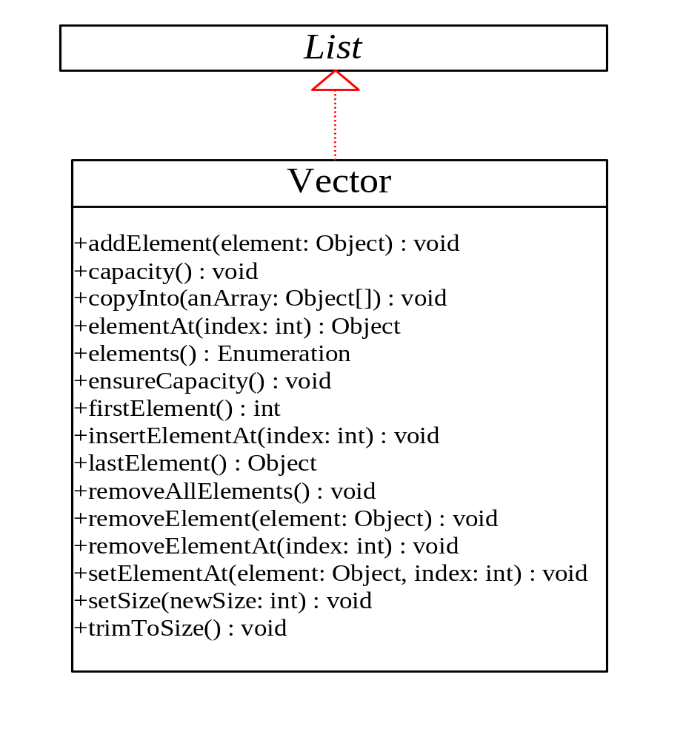
The Vector class
The Vector class implements a growable array of objects.
Like an array, it contains components that can be accessed using an integer index.
However, the size of a Vector can grow or shrink as needed to accommodate adding and removing items after the Vector has been created.
Ankur Bag's Tutorial
Notes:
Ankur Bag
Ankur Bag's Tutorial
Notes:

Slide 33
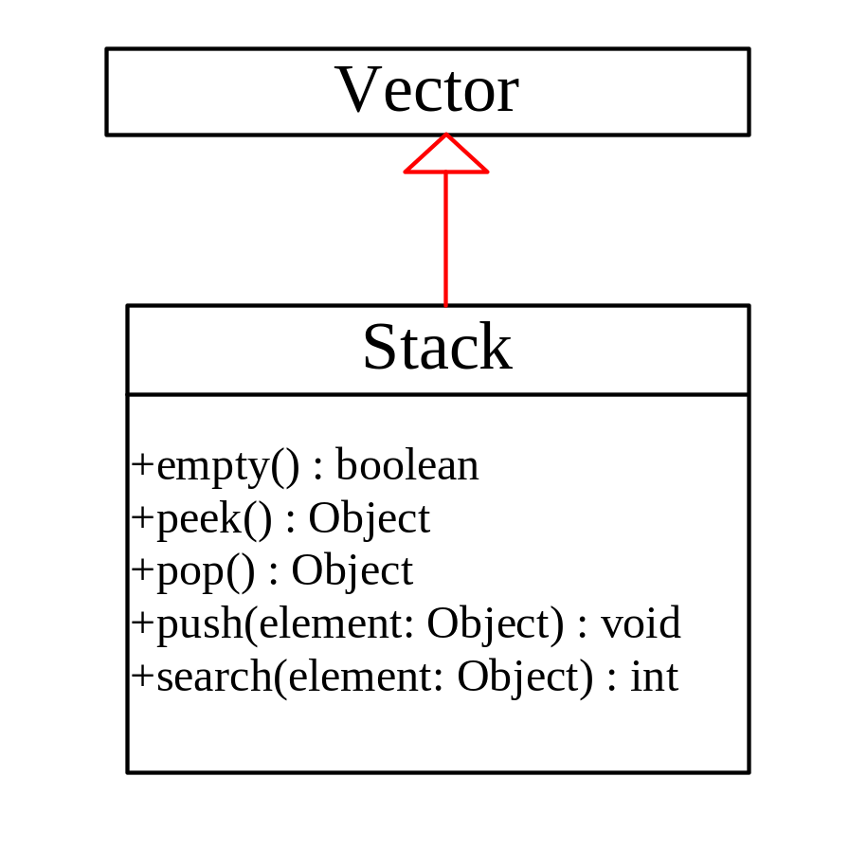
The Stack class
The Stack class represents a last-in-first-out (LIFO) stack of objects. The elements are accessed only from the top of the stack. You can retrieve, insert, or remove an element from the top of the stack.
Ankur Bag's Tutorial
Notes:
Ankur Bag
Ankur Bag's Tutorial
Notes:

Slide 34
Using vector and stack
This example presents two programs to rewrite Example 5.2, using a vector and a stack instead of an array, respectively.
The program reads student scores from the keyboard, stores the scores in the vector, finds the best scores, and then assigns grades for all the students.
A negative score signals the end of the input.
Ankur Bag's Tutorial

Slide 35
Map interface
A Map is a storage that maps keys to values. There cannot be duplicate keys in a Map and each key maps to at most one value.
The Map interface is not an extension of Collection interface. Instead the interface starts of it’s own interface hierarchy.
for maintaining key-value associations. The interface describes a mapping from keys to values, without duplicate keys, by definition.
The Map interface maps keys to the elements. The keys are like indexes. In List, the indexes are integer. In Map, the keys can be any objects.
Ankur Bag's Tutorial

Slide 36
Map interface (continued)
void clear()
  Removes all mappings from this map (optional operation).
boolean containsKey(Object key)
  Returns true if this map contains a mapping for the specified key.
boolean containsValue(Object value)
  Returns true if this map maps one or more keys to the specified value.
Set<Map.Entry<K,V>> entrySet()
  Returns a set view of the mappings contained in this map.
boolean equals(Object o)
  Compares the specified object with this map for equality.
V get(Object key)
  Returns the value to which this map maps the specified key.
int hashCode()
  Returns the hash code value for this map.
Ankur Bag's Tutorial

Slide 37
Map interface (continued)
boolean isEmpty()
  Returns true if this map contains no key-value mappings.
Set<K> keySet()
  Returns a set view of the keys contained in this map.
V put(K key, V value)
  Associates the specified value with the specified key in this map (optional operation).
void putAll(Map<? extends K,? extends V> t)
  Copies all of the mappings from the specified map to this map (optional operation).
V remove(Object key)
  Removes the mapping for this key from this map if it is present (optional operation).
int size()
  Returns the number of key-value mappings in this map.
Collection<V> values()
  Returns a collection view of the values contained in this map.
Ankur Bag's Tutorial

Slide 38
HashMap and TreeMap
The HashMap and TreeMap classes are two concrete implementations of the Map interface. Both will require key &value. Keys must be unique.
The HashMap class is efficient for locating a value, inserting a mapping, and deleting a mapping.
The TreeMap class, implementing SortedMap, is efficient for traversing the keys in a sorted order.
HashMap allows null as both keys and values
TreeMap is slower than HashMap
TreeMap allows us to specify an optional Comparator object during its creation. This comparator decides the order by which the keys need to be sorted.
Ankur Bag's Tutorial

Slide 39
Example: Map interface
import java.util.*;
class MapEx{
public static void main(String args[]) {
Map<String,String> map = new HashMap<String,String>();
map.put ("1", "one");
map.put ("2", "two");
System.out.println(map.size() ); //print 2
System.out.println(map.get("1") ); //print "one"
Set keys = map.keySet(); // print the keys
for (Object object : keys) { System.out.println(object); }
}
}
Ankur Bag's Tutorial

Slide 40
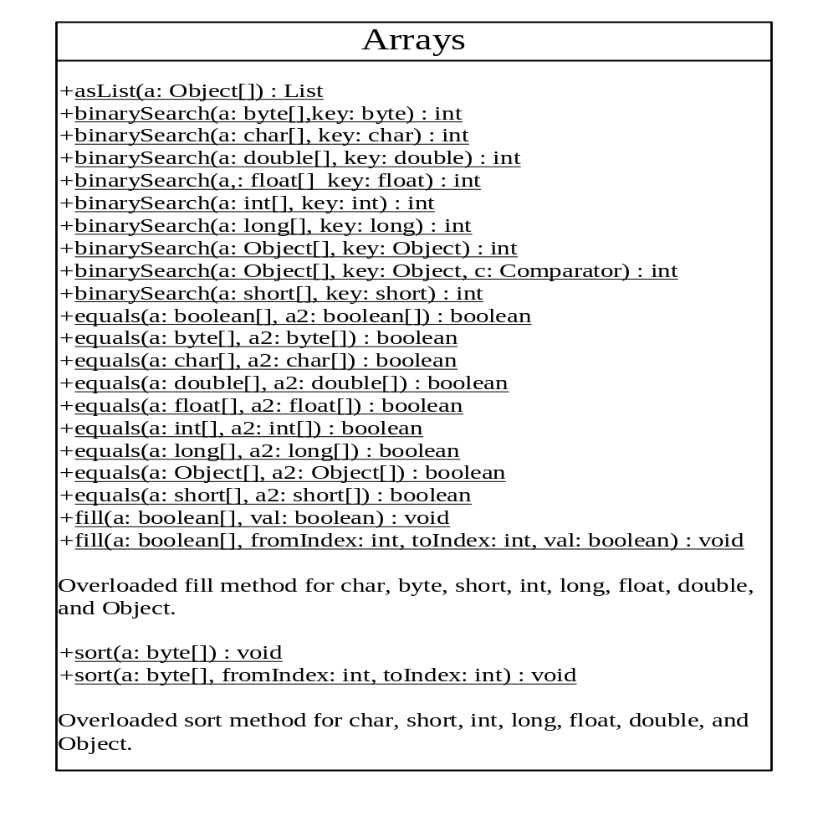
The array class
The Collections class contains various static methods for operating on collections and maps, for creating synchronized collection classes, and for creating read-only collection classes.
Ankur Bag's Tutorial

Slide 41
Example: Using the array class
This example demonstrates using the methods in the Arrays class. The example creates an array of int values, fills part of the array with 50, sorts it, searches for an element, and compares the array with another array.
(See the Companion site)
TestArrays
Ankur Bag's Tutorial

Slide 42
Ordering the objects
Comparable interface and Comparator Interface
Ankur Bag's Tutorial

Slide 43
Comparable and comparator
Objects in applications do appear in collections
Object collections in application may need sorting /ordering
The equal method of the Object class does not help in comparing the objects
To provide for ordering/sorting of the objects Java API provides two interfaces Comparable and Comparator
  Comparable interface is in java.lang
  Comparator interface is in java.util
Ankur Bag's Tutorial

Slide 44
Implementing comparable interface
public class Student implements Comparable {
public Student(String name, int score) {...}
public int compareTo(Object o)
throws ClassCastException {...}
public static void main(String args[]) {...}
}
Ankur Bag's Tutorial

Slide 45
Constructor for students
This is the same for both methods—nothing new here
  public Student(String name, int score) {
  this.name = name;
  this.score = score;
  }
Sorting students according to their score
Comparisons happen between two objects
Whatever kind of collection they may or may not be in
Ankur Bag's Tutorial

Slide 46
The main method: Version 1
public static void main(String args[]) {
TreeSet<Student> set = new TreeSet<Student>();
set.add(new Student("Ann", 87));
set.add(new Student("Bob", 83));
set.add(new Student("Cat", 99));
set.add(new Student("Dan", 25));
set.add(new Student("Eve", 76));
Iterator<Student> iter = set.iterator();
while (iter.hasNext()) {
Student s = iter.next();
System.out.println(s.name + " " + s.score);
}
}
Ankur Bag's Tutorial

Slide 47
Using the Treeset
In the main method we have the line
  TreeSet set = new TreeSet();
Later we use an iterator to print out the values in order, and get the following result:
  Dan 25
  Eve 76
  Bob 83
  Ann 87
  Cat 99
How did the iterator know that it should sort Students by score, rather than, say, by name?
Ankur Bag's Tutorial

Slide 48
Implementing comparable <T>
public class Student implements Comparable
This means it must implement the method
public int compareTo(Object o)
Notice that the parameter is an Object
In order to implement this interface, our parameter must also be an Object, even if that’s not what we want
public int compareTo(Object o) throws ClassCastException {
if (o instanceof Student)
return score - ((Student)o).score;
else
throw new ClassCastException("Not a Student!");
}
A ClassCastException should be thrown if we are given a non-Student parameter
Ankur Bag's Tutorial

Slide 49
An improved method
Since casting an arbitrary Object to a Student may throw a classCastException for us, we don’t need to throw it explicitly:
  public int compareTo(Object o) throws ClassCastException {
  return score - ((Student)o).score;
  }
Moreover, since classCastException is a subclass of RuntimeException, we don’t even need to declare that we might throw one:
  public int compareTo(Object o) {
  return score - ((Student)o).score;
  }
Ankur Bag's Tutorial

Slide 50
Using a separate comparator
In the program just finished, Student implemented Comparable
  Students were sorted only by their score
  If students are to be sorted another way, such as by name its not possible
  Because there can be only one method of same signature
The problem is solved by placing comparison method in a separate class that implements Comparator instead of Comparable
  Comparator can be used provide sorting by more than one variable
  Comparator requires a definition of compare and equal methods
  int compare (T object1, T object2)
  Compares its two arguments for order
  boolean equals(Object obj)
  Indicates whether some other object is "equal to" this comparator.
Ankur Bag's Tutorial

Slide 51
Outline of student comparator
import java.util.*;
public class StudentComparator
implements Comparator<Student> {
public int compare(Student s1, Student s2) {...}
public boolean equals(Object o1) {...}
}
Note: When we are using this Comparator, we don’t need the compareTo method in the Student class
Because of generics, our compare method can take Student arguments instead of just Object arguments
Ankur Bag's Tutorial

Slide 52
The compare method
public int compare(Student s1, Student s2) {
return s1.score – s2.score;
}
This differs from compareTo(Object o) in Comparable in these ways:
The name is different
It takes both objects as parameters, not just one
We have to either use generics, or check the type of both objects
If our parameters are Objects, they have to be cast to Students
Ankur Bag's Tutorial

Slide 53
The somecomparator.equals method
Ignore this method!
  This method is not used to compare two Students—it is used to compare two Comparators
  Even though it’s part of the Comparator interface, you don’t actually need to override it
    Implementing an interface requires you to have a definition for every method in the interface--so how can this be an exception?
    Because you do have a definition, inherited from Object !
  In fact, it’s always safe to ignore this method
  The purpose is efficiency—you can replace one Comparator with an equal but faster one
Ankur Bag's Tutorial

Slide 54
The main method
The main method is just like before, except that instead of
TreeSet<Student> set = new TreeSet<Student>();
We have
Comparator<Student> comp = new StudentComparator();
TreeSet<Student> set = new TreeSet<Student>(comp);
Ankur Bag's Tutorial

Slide 55
When to use each
The Comparable interface is simpler and less work
  Your class implements Comparable
  You provide a public int compareTo(Object o) method
  Use no argument in your TreeSet or TreeMap constructor
  You will use the same comparison method every time
The Comparator interface is more flexible but slightly more work
  Create as many different classes that implement Comparator as you like
  You can sort the TreeSet or TreeMap differently with each
    Construct TreeSet or TreeMap using the comparator you want
  For example, sort Students by score or by name
Ankur Bag's Tutorial

Slide 56
Sorting differently
Suppose you have students sorted by score, in a TreeSet you call studentsByScore
Now you want to sort them again, this time by name
Comparator<Student> myStudentNameComparator =
new MyStudentNameComparator();
TreeSet studentsByName =
new TreeSet(myStudentNameComparator);
studentsByName.addAll(studentsByScore);
Ankur Bag's Tutorial

Slide 57
Core Java
Day 3
Module 2: Java 1.5 Features
Ankur Bag's Tutorial

Slide 58
Module 2: Objectives
After completion of this module, you should be able to:
Explain generic classes
Understand new approach to loops – for / in statements
Define static imports
Define arrays, string builder, queues and overriding return type
Describe annotation
Explain output formatting – format() and printf()
Understand autoboxing of primitive types and enumerated types
Variable length of arguments
Ankur Bag's Tutorial
Notes:
Ankur Bag
Ankur Bag's Tutorial

Slide 59
Java 1.5 Features: Agenda
Generic classes
New approach to loops – for / in statements
Static imports
Arrays, string builder, queues and overriding return type
Annotation
Output formatting – format() and printf()
Autoboxing of primitive types
Enumerated types
Variable length of arguments
Ankur Bag's Tutorial
Notes:
Note to GA
Ankur Bag
Ankur Bag's Tutorial

Slide 60
Generic classes
Similar in usage to C++ templates, but do NOT generate code for each implementation
Ensure stored/retrieved type of objects
Check done at compile-time – avoid nasty casting surprises during runtime
Generics are removed from compiled classes – backward compatilibity, no additional code
Can be used in legacy code to check for place where incorrect type is inserted
Access to “template” class methods without casting
Ankur Bag's Tutorial

Slide 61
Generics are type safe
Big advantage: collections are now type safe
For example, you can create a Stack that holds only Strings as follows:
  Stack<String> names = new Stack<String>();
You can write methods that require a type-safe collection as follows:
  void printNames(Stack<String> names) {
    String nextName = names.pop(); // no casting needed!
    names.push("Hello"); // works just the same as before
    names.push(Color.RED); // compile-time error!
Ankur Bag's Tutorial
Notes:
Note to GA
Ankur Bag
Ankur Bag's Tutorial

Slide 62
What generics are and aren’t
You can almost think of generics as defining new types--for example a Stack<String> is a stack of strings
In Java 1.4,
  String s = myStack.pop(); will not compile
  String s = (String)myStack.pop(); compiles, with runtime check
  myStack.push(Color.RED); compiles with no complaint
In Java 5, String s = myStack.pop();
  Compiles with no runtime check if myStack was declared as Stack<String>
  Does not compile if myStack was declared any other way
  myStack.push(Color.RED); is a compiler error (= syntax error)
However, generics are instructions to the compiler only
  You can still say: if (thing instanceof Stack) ...
  but you cannot say: if (thing instanceof Stack<String>) ...
  This is called erasure--the type information is “erased” at runtime
Ankur Bag's Tutorial

Slide 63
A closer look at generic type safety
Type safe? Only sort of...
  Stack<Integer> stack1 = new Stack<Integer>();
  Stack stack2 = stack1; // stack2 is alias of stack1
  stack2.push(Color.RED);// legal--stack2 is a plain stack
  Integer xxx = stack1.pop(); // ClassCastException!
A little more explanation...
  Java 5 is upwardly compatible with Java 1.4
  So old programs must continue to work
  Hence you can have non-generic stacks (and stack assignment)
  When you use a generic collection, you should make it generic everywhere, not just in the places that Java would otherwise report an error
  Eclipse will provide warnings for many unsafe cases, so pay close attention to those warnings!
Ankur Bag's Tutorial
Notes:
Ankur Bag
Ankur Bag's Tutorial

Slide 64
Iterators
An iterator gives you every element of a collection, one at a time
    The collection has a type iterator(); factory method to return a new iterator to return objects of the given type
    The method boolean hasNext() tells you if there are more objects
    The method type next() returns the next object
    The method void remove() deletes the last object gotten
Example:
  Iterator iter = integerStack.iterator();
  while (iter.hasNext()) {
  System.out.println(iter.next());
  }
Ankur Bag's Tutorial
Notes:
Ankur Bag
Ankur Bag's Tutorial

Slide 65
Enhanced for loop
Instead of
void cancelAll(Collection c) {
for (Iterator i = c.iterator(); i.hasNext(); ) {
TimerTask tt = (TimerTask) i.next();
tt.cancel();
}
}
You will be able to use:
void cancelAll(Collection<TimerTask> c) {
for (TimerTask task : c)
task.cancel();
}
What does the JDK 1.5 compiler handle automatically for us?
Not everyone likes this syntax! How else could it have been done?
void cancelAll(Collection<TimerTask> c) {
foreach TimerTask task of c) //C# notation
task.cancel();
}
Ankur Bag's Tutorial

Slide 66
Static import
Enables one to refer to static constants from a class without needing to inherit from it.
If only used occasionally this technique is not very useful, but in complex cases this technique help simplify coding.
Ankur Bag's Tutorial

Slide 67
Example: Static import
// imports static members of package
import static java.lang.Math.ceil
// imports all static members of package
import static java.lang.Math.*
double x, y;
x = ceil(y); // can use method name directly
Ankur Bag's Tutorial

Slide 68
Array class additions
hashCode
  Returns a hash code based on the contents of the specified array.
  For any two arrays a and b such that Arrays.equals(a, b) is it also the case that Arrays.hashCode(a) == Arrays.hashCode(b)
deepEquals
  Returns true if the two specified arrays are deeply equal to one another.
toString
  Returns a string representation of the contents of the specified array. String representation is a list of the array’s elements, enclosed in square brackets (“[]”). Adjacent elements separated by “, “
Ankur Bag's Tutorial

Slide 69
StringBuilder
An improvement upon StringBuffer
Allows quicker concatenation of strings.
Why use it?
  Creating new Strings in a loop can be inefficient because of the number new objects that are created and discarded.
  StringBuilder.append(<type> <value>)
  StringBuilder.insert(<type> <value>)
No synchronization! Not safe for use by multiple threads
Ankur Bag's Tutorial

Slide 70
Interface queue
Extends Collection
Designed for holding elements prior to processing.
Typically ordered in a FIFO manner.
Main Methods
  remove() and pull()
    Both return the head of the queue.
    When empty, the remove() method throws an exception while poll() returns null.
Ankur Bag's Tutorial

Slide 71
Overriding Return Types (Covariant Return Types)
Allows the user to have a method in inherited class with same signature as in parent’s class but differing only in return types.
Makes programs more readable and solves casting problem
class Shape
{
public Shape transform(int x, int y)
}
class Rectangle extends Shape
{
public Rectangle transform(int x, int y)
}
Ankur Bag's Tutorial

Slide 72
Annotations
Add annotations (metadata) using @
  Annotate types, methods, fields for documentation, code generation, runtime services
  Provides built-in & custom annotations
    @Target, @Overrides, @Documented…
  Can control availability of annotations
    Source code, class file, runtime in JVM
Example
  /* @author Jack */
  public final class AnnotationsTest {
  @Overrides
  public String toString(int i) { return “ x “ };
  }
Ankur Bag's Tutorial

Slide 73
Output formatting -printf().
Most of the common C printf formatters are available.
For example:
System.out.printf("Hello:%s%n", name);
System.out.printf("Number of group members:%3d%n", num);
In addition, some Java classes like Date and BigInteger also have formatting rules. See the java.util.Formatter class for more information.
Ankur Bag's Tutorial

Slide 74
Autoboxing of primitive types
Before
ArrayList<Integer> list = new ArrayList<Integer>();
list.add(0, new Integer(42));
int total = (list.get(0)).intValue();
5.0 version:
ArrayList<Integer> list = new ArrayList<Integer>();
list.add(0, 42);
int total = list.get(0);
Ankur Bag's Tutorial

Slide 75
Autoboxing
Java distinguishes between primitive types and Objects
  Primitive types, i.e., int, double, are compact, support arithmetic operators
  Object classes (Integer, Double) have more methods: Integer.toString()
  You need a “wrapper” to use Object methods:
  Integer ii = new Integer( i ); ii.hashCode()
  Similarly, you need to “unwrap” an Object to use primitive operation
  int j = ii.intValue() * 7;
Java 1.5 makes this automatic:
  Before:
  ArrayList<Integer> list = new ArrayList<Integer>();
  list.add(0, new Integer(42));
  int total = (list.get(0)).intValue();
  After:
  ArrayList<Integer> list = new ArrayList<Integer>();
  list.add(0, 42);
  int total = list.get(0);
Ankur Bag's Tutorial

Slide 76
Enumerations
An enumeration, or “enum,” is simply a set of constants to represent various values
Here’s the old way of doing it:
public final int SPRING = 0;
public final int SUMMER = 1;
public final int FALL = 2;
public final int WINTER = 3;
This is a nuisance, and is error prone as well
Here’s the new way of doing it:
enum Season { winter, spring, summer, fall }
Ankur Bag's Tutorial

Slide 77
Enumerated Types
Similar to enum types in C, Pascal etc. and HashTable, keyset
Enums are classes, extends java.lang.Enum
Enums are final, can’t be subclassed.
Only one Constructor and is protected.
Implement java.lang.Comparable: compareTo()
Implement Serializable
Ankur Bag's Tutorial

Slide 78
Advantages of the new enum?
They provide compile-time type safety
  int enums don't provide any type safety at all
They provide a proper name space for the enumerated type
  With int enums you have to prefix the constants to get any semblance of a name space.
They're robust
  int enums are compiled into clients, and you have to recompile clients if you add, remove, or reorder constants.
Printed values are informative
  If you print an int enum you just see a number.
Because they're objects, you can put them in collections.
Because they're essentially classes, you can add arbitrary fields and methods
Ankur Bag's Tutorial

Slide 79
Formatted output
Similar to C/C++ printf and scanf:
  System.out.printf("name count%n"); //newline
  System.out.printf("%s %5d%n", user,total);
See the java.util.Formatter class for more information
Supports formats for dates, etc:
  System.out.format("Local time: %tT",
  Calendar.getInstance()); // -> "Local time: 13:34:18"
Like C's sprintf(3), Strings may be formatted using String.format:
  import java.util.Calendar;
  import java.util.GregorianCalendar;
  import static java.util.Calendar.*;
  Calendar c = new GregorianCalendar(1995, MAY, 23); String s = String.format("Duke's Birthday: %1$tm %1$te,%1$tY", c);
  // -> s == "Duke's Birthday: May 23, 1995"
Ankur Bag's Tutorial

Slide 80
Varargs
Allows an unlimited number of parameters for a method
The parameters must all be the same type (can be Object though)
You can mix varargs and regular arguments
Varargs must be the last argument
Varargs are never null
Ankur Bag's Tutorial

Slide 81
Example: Vararg
public void myMethod(String... args) {
for (int i = 0; i < args.length; i++) {
System.out.println(“The value at position “ + i + “ is “ + args[i]);
}
}
Same as:
public void myMethod(String[] args) {
for (int i = 0; i < args.length; i++) {
System.out.println(“The value at position “ + i + “ is “ + args[i]);
}
}
Ankur Bag's Tutorial

Slide 82
Example: Vararg
myMethod(“a”);
myMethod(“a”, “b”, “c”, “d”, “e”);
myMethod();
Easier than writing:
myMethod(new String[]{“a”, “b”, “c”, “d”, “e”});
Ankur Bag's Tutorial

Slide 83
More varargs
public void myMixedMethod(int age, String name, Address address, String... aliases) {
}
myMixedMethod(42, “Kokila Rani”, address, “Hello Java”, “B”, “VoidMain”);
myMixedMethod(42, “Mohua Dey”, address);
Ankur Bag's Tutorial

Slide 84
More varargs (continued)
The only use we found for varargs to date is for testing
It is only a 15 character savings and minimal readability savings
Java has added printf type functionality to the JDK that uses varargs
String.format(“Your test average is %5.2f”, average);
Ankur Bag's Tutorial

Slide 85
Scanner class
Provides basic input functionality for reading data from system console or any data stream
Following example reads a String from standard input and expects a following int value:
Scanner s=Scanner.create(System.in);
String param= s.next();
int value=s.nextInt();
s.close();
  Scanner methods next and nextInt block if no data is available
  Supports regular expression based search
To process more complex input, pattern matching algorithms are available from class java.util.Formatter
Ankur Bag's Tutorial
Notes:
Ankur Bag
Ankur Bag's Tutorial

Slide 86
Methods of Java.util.Scanner
Finally, Java has a fairly simple way to read input
  Scanner sc = Scanner.create(System.in);
  boolean b = sc.nextBoolean();
  byte by = sc.nextByte();
  short sh= sc.nextShort();
  Int i = sc.nextInt();
  long l = sc.nextLong();
  float f = sc.nextFloat();
  double d = sc.nextDouble();
  String s = sc.nextLine();
By default, whitespace acts as a delimiter, but you can define other delimiters with regular expressions
Ankur Bag's Tutorial

Slide 87
Additional features
Threading
  There are many new features for controlling synchronization and threading which increase performance and prevent that you have to write synchronization primitives yourself.
Monitoring and Profiling API
  It is now easier to observe what's going on inside the JVM
Unicode 4.0
RMI
  rmicis no longer needed to generate stubs/skeletons.
New skin for Swing
Ankur Bag's Tutorial
Notes:
Ankur Bag
Ankur Bag's Tutorial

Slide 88
Reference
Java 5 Tiger
http://java.sun.com/j2se/1.5.0/
Complete docs
http://java.sun.com/j2se/1.5.0/docs/index.html
New (fancy) features
http://java.sun.com/j2se/1.5.0/docs/relnotes/features.html
Nice and short article about features
http://www.winplanet.com/article/2574-3801.htm
Ankur Bag's Tutorial

Slide 89
Core Java
Day 3
Module 3: Exceptions and Error Handling
Ankur Bag's Tutorial

Slide 90
Module 3: Objectives
After completion of this module, you should be able to:
Explain exceptions.
Define uses, types, and categories of exceptions.
Identify the various types of exceptions in Java
Implement exception handling using try, catch, throws, throw and finally clauses
Describe exception propagation and implement user-defined exceptions
Ankur Bag's Tutorial
Notes:
Ankur Bag
Ankur Bag's Tutorial

Slide 91
Exceptions and Error Handling: Agenda
Why Use Exceptions
About Exceptions
Uses of Exceptions
Types of Errors
Categories of Exceptions
Identify the various types of exceptions in Java
Implementing Exception Handling using try, catch, throws, throw and finally clauses .
Exception Propagation
Implement user-defined exceptions
Ankur Bag's Tutorial
Notes:
No value is assigned that’s why array arr store the default value of int i.e. 0.
Ankur Bag
Ankur Bag's Tutorial

Slide 92


Why Use Exceptions
In earlier programming language, the things that leads to confusion
  Error Detection
  Error Reporting
  Error Handling
Take an Example of reading an entire file into memory
Ankur Bag's Tutorial
Notes:
Ankur Bag
Ankur Bag's Tutorial

Slide 93
Why Use Exceptions (continued)
Steps To Be Followed For Reading a File in the memory
  readFile
  {
  open the file;
  determine its size;
  allocate that much memory;
  read the file into memory;
  close the file;
  }
Ankur Bag's Tutorial
Notes:
Ankur Bag
Ankur Bag's Tutorial

Slide 94
Why Use Exceptions (continued)
Can U Guess the potential Errors in this operation
What happens if the file can't be opened?
What happens if the length of the file can't be determined?
What happens if enough memory can't be allocated?
What happens if the read fails?
What happens if the file can't be closed?
Ankur Bag's Tutorial

Slide 95
Why Use Exceptions (continued)
To Answer this question your program should have error detection, reporting, and handling mechanism that will look like:
close the file;
if (theFileDidntClose && errorCode == 0)
{
errorCode = -4;
}
else
{
errorCode = errorCode and -4;
}
}
else
{
errorCode = -5;
}
return errorCode;
}
errorCodeType
readFile
{
initialize errorCode = 0;
open the file;
if (theFileIsOpen)
{
determine the length of the file;
if (gotTheFileLength)
{
allocate that much memory;
if (gotEnoughMemory)
{
read the file into memory;
if (readFailed)
{
errorCode = -1;
}
}
else
{
errorCode = -2;
}
}
else
{
errorCode = -3;
}
Ankur Bag's Tutorial
Notes:
There's so much error detection, reporting, and returning here that the original seven lines of code are lost in the clutter. Worse yet, the logical flow of the code has also been lost, thus making it difficult to tell whether the code is doing the right thing: Is the file really being closed if the function fails to allocate enough memory? It's even more difficult to ensure that the code continues to do the right thing when you modify the method three months after writing it. Many programmers solve this problem by simply ignoring it — errors are reported when their programs crash.
Ankur Bag
Ankur Bag's Tutorial

Slide 96
Why Use Exceptions (continued)
Exception helps To Solve this problem
readFile {
try {
open the file;
determine its size;
allocate that much memory;
read the file into memory;
close the file;
}catch (fileOpenFailed)
{
doSomething;
}
catch(sizeDeterminationFailed)
{
doSomething;
}
catch (memoryAllocationFailed)
{
doSomething;
}
catch (readFailed)
{
doSomething;
}
catch (fileCloseFailed)
{
doSomething;
}
}
Ankur Bag's Tutorial
Notes:
Ankur Bag
Ankur Bag's Tutorial

Slide 97
What is exception?
An exception can be defined as an abnormal event that occurs during program execution and disrupts the normal flow of instructions.
Ankur Bag's Tutorial

Slide 98
Uses of exception
Consistent error reporting style.
Easy to pass errors up the stack.
Pinpoint errors better in stack trace.
  As long as you “fail fast” and throw as soon as you find a problem.
Wrap useful information up in your exception classes, use that information later when handling the exception.
Exceptions don’t always have to be errors, maybe your program can cope with the exception and keep going!
Separating error handling code from Regular code.
Ankur Bag's Tutorial
Notes:
Separating error handling code from Regular code - Exceptions provide the means to separate the details of what to do when something out of the ordinary happens from the main logic of a program.
Ankur Bag
Ankur Bag's Tutorial

Slide 99
Types of errors
1. Compile Time Error
2. Run Time Error
Ankur Bag's Tutorial
Notes:
Compile Time Error – Occurs during compilation of a program which includes syntax errors, semantic errors etc.
Runtime Error – Generated while running the program. For example, program that connects to another machine to fetch some data but found the target machine off, a error will encounter.
Ankur Bag
Ankur Bag's Tutorial

Slide 100
Exception occurrence reason
1. Running out of memory.
2. Resource allocation errors.
3. Inability to find files.
4. Problem in network connectivity.
Ankur Bag's Tutorial

Slide 101
Exception occurrence levels
Hardware/operating system level.
  Arithmetic exceptions; divide by 0, under/overflow.
  Memory access violations; segment fault, stack over/underflow.
Language level.
  Type conversion; illegal values, improper casts.
  Bounds violations; illegal array indices.
  Bad references; null pointers.
Program level.
  User defined exceptions.
Ankur Bag's Tutorial

Slide 102

Categories of exceptions
1.
Built in Exceptions
1.a
Checked Exceptions
1.b
Unchecked Exceptions
2.
User Defined Exceptions
Ankur Bag's Tutorial

Slide 103
Checked exceptions
Checked exceptions are so called because both the Java compiler and the Java virtual machine check to make sure this rule is obeyed.
The checked exceptions that a method may raise are part of the method's signature.
Every method that throws a checked exception must advertise it in the throws clause in its method definition, and
Every method that calls a method that advertises a checked exception must either handle that exception (with try and catch) or must in turn advertise that exception in its own throws clause.
Ankur Bag's Tutorial

Slide 104
Unchecked exceptions
Raised implicitly by system because of illegal execution of program.
Do not need to announce the possibility of exception occurrence.
When unchecked exception occurred, if programmer does not deal with it, it would be processed by default exception handler.
Throw-able is base class for Exception and Error class.
Ankur Bag's Tutorial

Slide 105
Java exception hierarchy
Object
Throwable
Error
Exception
Virtual Machine Error
RuntimeException
…
…
Ankur Bag's Tutorial

Slide 106
Java exception hierarchy (continued)
Exception
RuntimeException
…
(Checked Exceptions)
ArrayIndexOutOfBoundException
(Unchecked Exceptions)
Occurs when an attempt is made to access an array element beyond the index of the array.
Ankur Bag's Tutorial

Slide 107
Java exception hierarchy (continued)
Exception
RuntimeException
…
(Checked Exceptions)
ArithmeticException
(Unchecked Exceptions)
Occurs when you make an arithmetic error, such as dividing
a number by zero.
Ankur Bag's Tutorial

Slide 108
Java exception hierarchy (continued)
Exception
RuntimeException
…
(Checked Exceptions)
NumberFormat
Exception
(Unchecked Exceptions)
Occurs when you want to convert a string in an incorrect
format to a numeric format.
Ankur Bag's Tutorial

Slide 109
Java exception hierarchy (continued)
Exception
RuntimeException
…
(Checked Exceptions)
…
NullPointerException
(Unchecked Exceptions)
Occurs when an application tries to use an object without
allocating memory to it or calls a method of a null object.
Ankur Bag's Tutorial

Slide 110
Java exception hierarchy (continued)
Exception
RuntimeException
…
(Checked Exceptions)
…
ClassCastException
(Unchecked Exceptions)
Occurs when you assign a reference variable of a class to
an incompatible reference variable of another class.
Ankur Bag's Tutorial

Slide 111
Java exception hierarchy (continued)
Exception
RuntimeException
…
(Checked Exceptions)
…
NoSuchMethod
Exception
(Unchecked Exceptions)
Occurs when you call a method that does not exist.
Ankur Bag's Tutorial
Notes:
There are more Runtime exception class for example, HostNotFoundException, InstantiationException.
Ankur Bag
Ankur Bag's Tutorial

Slide 112
Java exception hierarchy (continued)
Exception
RuntimeException
IOException
…
(Checked Exceptions)
…
(Unchecked Exceptions)
When performing IO operation.
Ankur Bag's Tutorial

Slide 113
Java exception hierarchy (continued)
Exception
RuntimeException
ClassNotFound
Exception
…
(Checked Exceptions)
…
(Unchecked Exceptions)
Occurs when the Java run time system is unable to find the
class referred.
Ankur Bag's Tutorial

Slide 114
Java exception hierarchy (continued)
Exception
RuntimeException
IllegalAccess
Exception
…
(Checked Exceptions)
…
(Unchecked Exceptions)
Occurs when you want to refer a class that is not
accessible.
Ankur Bag's Tutorial

Slide 115
Java exception hierarchy (continued)
Exception
RuntimeException
InterruptedException
…
(Checked Exceptions)
…
(Unchecked Exceptions)
Thrown when a thread is waiting, sleeping, or otherwise
paused for a long time.
Ankur Bag's Tutorial

Slide 116

Implementing exception handling
1.
try
2.
catch
3.
throws
4.
throw
5.
finally
Ankur Bag's Tutorial

Slide 117
Implementing exception handling
Using try and catch statements
  The try block encloses the statements that might raise an exception within it and defines the scope of the exception handlers associated with it.
  The catch block is used as an exception-handler. You enclose the code that you want to monitor inside a try block to handle a run time error.
Ankur Bag's Tutorial

Slide 118
Implementing exception handling using try and catch
try
{
// Statements that cause an exception.
  }
  catch(ExceptionName obj)
  {
  // Error handling code.
  }
Example
Ankur Bag's Tutorial

Slide 119
Implementing exception handling continued
public class UnitRate
{
public void calculatePerUnitRate()
{
int qty=20, rate=0,punit=0;
try
{
punit=qty/rate;
  }catch(ArithmeticException ae)
  { System.out.println(“The product rate cannot be Zero, So Per Unit Rate Displayed Below is Invalid ”);
  }
  System.out.println(“The Per Unit Rate is = “+punit);
  }
  }
Arithmetic error occurred and passed to exception handler i.e.
Ankur Bag's Tutorial

Slide 120
Using multiple catch statement/blocks
A single try block can have zero, one or many catch blocks.
The multiple catch blocks generate unreachable code error.
If the first catch block contains the Exception class object then the subsequent catch blocks are never executed. If this happen it is known as unreachable code problem.
To avoid unreachable code error, the last catch block in multiple catch blocks must contain the Exception class object.
Ankur Bag's Tutorial
Notes:
This is necessary when the try block has statements that raise different types of exceptions.
If the first catch block contains the Exception class object then the subsequent catch blocks are never executed.
The Exception class being the superclass of all the exception classes catches various types of exceptions. The Java compiler gives an error stating that the subsequent catch blocks have not been reached. This is known as the unreachable code problem.
Ankur Bag
Ankur Bag's Tutorial

Slide 121
Example: Using multiple catch statement/blocks
try {
// dangerous code here!
}
catch(ArithmeticException e) {
// Specific error handling here
}
catch(RuntimeException e) {
// More general error handling here
}
Order Matters!
Less general
first!
Ankur Bag's Tutorial

Slide 122
Using finally clause
The finally block is used to process certain statements, no matter whether an exception is raised or not.
Syntax of finally block
    try
    {
    // Block of code
    }
    finally
    {
    // Block of code that is always executed irrespective of an exception being raised or not.
    }
Ankur Bag's Tutorial
Notes:
The try block can be written without catch block by using finally block. In other words the try block should have either a catch block or finally block.
Ankur Bag
Ankur Bag's Tutorial

Slide 123

Try-catch-finally statement
try {
// …
} catch (ExceptionType1 identifier) {
// …
} catch (ExceptionType2 identifier) {
// …
} finally {
// …
}
Ankur Bag's Tutorial

Slide 124
Throwing an exception
The throw statement causes termination of the normal flow of control of the Java code and stops the execution of the subsequent statements if an exception is thrown when the throw statement is executed.
The throw clause transfers the control to the nearest catch block handling the type of exception object throws.
The following syntax shows how to declare the throw statement:
  throw ThrowableObj
public double divide(int dividend, int divisor) throws ArithmeticException {
if(divisor == 0) {
throw new ArithmeticException(“Divide by 0 error”);
}
return dividend / divisor;
}
Ankur Bag's Tutorial

Slide 125
Using throws exceptions
The throws statement is used by a method to specify the types of exceptions the method throws.
If a method is capable of raising an exception that it does not handle, the method must specify that the exception has to be handled by the calling method.
This is done using the throws statement.
[modifiers] returntype methodName(params) throws e1, ... ,en { }
void readData() throws IOException
Ankur Bag's Tutorial

Slide 126
Exception propagation
1. public class UnitRate {
2. void calculatePerUnitRate() {
3. int qty = 25, rate = 0,punit=0;
4. punit = qty / rate;
5. }
6. void callPerUnitRate() {
7. calculatePerUnitRate();
8. }
9. public static void main(String[] args) {
10. UnitRate ur = new UnitRate();
11. ur.callPerUnitRate();
12. }
13. }
ArithmeticException Occurred
Output by Default Exception
Handler
java.lang.ArithmeticException: / by zero
at UnitRate.calculatePerUnitRate(UnitRate.java:4)
at UnitRate.callPerUnitRate(UnitRate.java:7)
at UnitRate.main(UnitRate.java:11)
Ankur Bag's Tutorial

Slide 127
Exercise: Exception propagation
1. public class ExerciseException {
2. public static void main(String[] args) {
3. try {
4. happy1();
5. }
6. catch(Exception e) {
7. e.printStackTrace();
8. }
9. }
10. public static void happy1() throws Exception {
11. happy2();
12. }
13. public static void happy2() throws Exception {
14. happy3();
15. }
16. public static void happy3() throws Exception {
17. throw new Exception(“Be Happy Exception Prevents U!");
18. }
19. }
Write down the Print Stack Trace for the
ExerciseException
class
Ankur Bag's Tutorial
Notes:
Answer:
java.lang.Exception: Be Happy Exception Prevents U!
at ExerciseException.happy3(ExerciseException.java:17)
at ExerciseException.happy2(ExerciseException.java:14)
at ExerciseException.happy1(ExerciseException.java:11)
at ExerciseException.main(ExerciseException.java:4)
Ankur Bag
Ankur Bag's Tutorial

Slide 128
User defined exceptions: Creating your own exceptions
Defining your own exceptions let you handle specific exceptions that are tailor-made for your application.
Steps to Create a User Defined Exception
  Create a class that extend from a right kind of class from the Exception Hierarchy.
  Let’s make a DivideByZeroException for use by our UnitRate class.
Ankur Bag's Tutorial

Slide 129
User defined exceptions (continued)
public class DivideByZeroException extends ArithmeticException
{
public DivideByZeroException()
{
super("Divide by 0 error");
}
}
Here we extended
ArithmeticException.
Ankur Bag's Tutorial
Notes:
Remember, we choose parents wisely because of specifity; we like the idea of catching DivideByZeroException objects
whenever we decide we want to catch ArithmeticException errors.
Ankur Bag
Ankur Bag's Tutorial

Slide 130
Summary
Errors can be broadly categorized into two groups on the basis of whether the compiler is able to handle the error or not, such as compile time errors and run time errors.
An exception is a run time error that can be defined as an abnormal event that occurs during the execution of a program and disrupts the normal flow of instructions.
In Java, the Throwable class is the superclass of all the exception classes. It is the class at the top position in the exception class hierarchy. The Exception class and the Error class are two direct subclasses of the Throwable class.
The built-in exceptions in Java are divided into two types on the basis of the conditions where the exception is raised:
  Checked Exceptions or Compiler-enforced Exceptions
  Unchecked exceptions or Runtime Exceptions
Ankur Bag's Tutorial

Slide 131
Assertion
An assertion is a statement in the JavaTM programming language that enables test the assumptions about program.
Each assertion contains a boolean expression that is assumed to be true. When execyted if the boolean expression is false, the system will throw an error.
Writing assertions while programming is one of the quickest and most effective ways to detect and correct bugs. As an added benefit, assertions serve as internal documentation, thus enhancing maintainability.
Ankur Bag's Tutorial

Slide 132
Assertion (continued)
The assertion statement has two forms.
assert Expression1 ;
  where Expression1 is a boolean expression. When the system runs the assertion, it evaluates Expression1 and if it is false throws an AssertionError with no detail message.
assert Expression1 : Expression2 ;
  Where Expression1 is a boolean expression and Expression2 is an expression that has a value. (It cannot be an invocation of a method that is declared void.)
  This form of asssert statement provides a detail message for the AssertionError. The system passes the value of Expression2 to the appropriate AssertionError constructor, which uses the string representation of the value as the error's detail message.
Like all uncaught exceptions, assertion failures are generally labeled in the stack trace with the file and line number from which they were thrown.
Ankur Bag's Tutorial

Slide 133
Compilation: Enabling & disabling of assertions
In order for the javac compiler to accept code containing assertions, you must compile the code with the following
javac -source 1.4 MyClass.java
To enable assertions use -enableassertions, or -ea, option at runtime. To disable assertions use -disableassertions, or -da. Specify the granularity with the arguments provided at runtime.
  no arguments - Enables or disables assertions in all classes except system classes.
  packageName - Enables or disables assertions in the named package and any subpackages.
  … - Enables or disables assertions in the unnamed package in the current working directory.
  className - Enables or disables assertions in the named class
Ankur Bag's Tutorial
Notes:
Do not use assertions for argument checking in public methods.Do not use assertions to do any work that your application requires for correct operation
Ankur Bag
Ankur Bag's Tutorial

Slide 134
Summary (continued)
You can handle exception using
  try
  catch
  throws
  throw
  finally
You use multiple catch blocks to throw more than one type of exception.
The finally clause is used to execute the statements that need to be executed whether or not an exception has been thrown.
The throw statement causes termination of the normal flow of control of the Java code and stops the execution of subsequent statements after the throw statement.
The throws clause is used by a method to specify the types of exceptions the method throws.
You can create your own exception classes to handle the situations specific to an application.
Ankur Bag's Tutorial

Slide 135
Review questions
The two subclasses of the Throwable class are:
  Exception class and Error class
  Exception class and Object class
  Error class and RunTimeException class
  Exception class and RunTimeException class
The Throwable class is the sub class of _______ class.
  Exception
  Error
  Object
  RunTimeException
Ankur Bag's Tutorial

Slide 136
Review questions (continued)
  Which exception occurs when you try to create an object of an abstract class or interface?
    ClassNotFoundException
    IllegalAccessException
    InstantiationException
    NoSuchMethodException
Ankur Bag's Tutorial
BasicJava - Day 3

Slide 137
Review questions (continued)
  4. Consider the statements:
  Statement A: The scope of the catch block is restricted to the statements in the preceding try block only.
  Statement B: A try block must have at least one catch block that follows it immediately.
  Which of the following options is true?
    Statement A is true and statement B is false
    Statement A is false and statement B is true
    Both, statements A and B, are true
    Both, statements A and B, are false
Ankur Bag's Tutorial
BasicJava - Day 3
Notes:
Ankur Bag
Ankur Bag's Tutorial

Slide 138

Questions
Ankur Bag's Tutorial
Notes:
Urge the class to ask questions
Ankur Bag
Ankur Bag's Tutorial

Slide 139

Day 3 Summary
At the end of Day 3, we see that you are now able to:
Define collections
Explain features of Java 1.5
Describe exceptions as well as error handling
Ankur Bag's Tutorial

