Slide 1
Core Java
Day 2
Notes:
Ankur Bag

Slide 2
Agenda
Today we will cover the following two modules:
Inheritance and Polymorphism
Classes in Java

Slide 3

Day 2: Objectives
At the end of Day 2, you should be able to:
Define inheritance and polymorphism
Identify the classes in Java

Slide 4
Core Java
Day 2
Module 1: Inheritance and Polymorphism

Slide 5

Module 1: Objectives
After completion of this module, you should be able to:
Understand inheritance in Java.
Understand inheriting classes.
Define overriding methods.
Explain interfaces and methods.
Explain abstract classes and methods.
Notes:
Ankur Bag

Slide 6

Inheritance and Polymorphism: Agenda
Topic 1: Understand Inheritance
Topic 2: Inheriting classes
Topic 3: Overriding methods
Topic 4: Creating Interfaces and Methods
Topic 5: Creating Abstract Classes and Methods
Notes:
Ankur Bag
Note to GA: Image can be changed
Instructor notes:

Slide 7

Understand inheritance
The ability of a class of objects to inherit the properties and methods from another class, called its parent or base class.
The class that inherits the data members and methods is known as subclass or child class.
The class from which the subclass inherits is known as base / parent class.
In Java, a class can only extend one parent.
No Multiple Inheritance In Java for classes
Notes:
Ankur Bag
Instructor notes:

Slide 8
Inheriting classes
A Java class inherits another class using the extends keyword after the class name followed by the parents class name as below
public class childclassname extends superclassname
The child class inherits all the instance variables and methods of the parent class
Notes:
Ankur Bag

Slide 9
Example: Inheriting classes
The extends keyword indicates inheritance
Parent
Child
public class Person {
private String name;
public void setName(String name) {
this.name = name;
}
public String getName() {
return name;
}
}
public class Employee extends Person {
private String eid;
public void setEid(String eid) {
this.eid=eid;
}
public String getEid() {
return eid;
}
}

Slide 10
Types of inheritance
1. Single Level Inheritance
Derives a subclass from a single superclass.
Class Person
Class Employee
Class Student
Notes:
Ankur Bag

Slide 11
Types of inheritance (continued)
2. Multilevel Inheritance
Inherits the properties of another subclass.
Example
Class Person
Class Employee
Class Regular
Notes:
Ankur Bag

Slide 12
Overriding methods
Method overriding is defined as creating a non-static method in the subclass that has the same return type and signature as a method defined in the superclass.
Signature of a method includes
name
number
sequence
type
of arguments in a method
Notes:
Ankur Bag

Slide 13
Overriding methods (continued)
You can override (most) methods in a parent class by defining a method with the same name and parameter list in the child class.
This is useful for changing the behavior of a class without changing its interface.
You cannot override the static and final methods of a superclass.
A subclass must override the abstract methods of a superclass.
Notes:
Ankur Bag
Notes:

Slide 14
Example: Overriding methods
public class Person {
private String name;
private String ssn;
public void setName(String name) {
this.name = name;
}
public String getName() {
return name;
}
public class Employee extends Person
{
private String empId;
public void setId(String empId)
{
this.empId=empId;
}
getId method is overridden
public String getId() {
return ssn;
}
public String getId() {
return empId;
}
}
}
Notes:
Ankur Bag
Notes:

Slide 15
Example: Use of “super” keyword
Allows you to access methods and properties of the parent class
public class Person {
private String name;
public Person(String name) {
this.name = name;
}
public String getName() {
return name;
}
}
public class Employee extends Person {
private String empID;
public Employee(String name) {
super(name); // Calls Person constructor
}
public void setID(String empID){
this.empID=empID;
}
public String getID(){
return empID;
}
}
Notes:
Ankur Bag
Notes:

Slide 16

Restricting inheritance using final keyword
Parent
final
Using modifier with a class will restrict
the inheritance capability of that class
Restricting
Inherited
capability
Child
Notes:
Ankur Bag
Notes:

Slide 17
Final classes: A way for preventing classes being extended
We can prevent an inheritance of classes by other classes by declaring them as final classes.
This is achieved in Java by using the keyword final as follows:
  final class Regular
  { // members
  }
  final class Employee extends Person
  { // members
  }
Any attempt to inherit these classes will cause an error.
Notes:
Ankur Bag
Notes:

Slide 18
Final members: A way for preventing overriding of members in subclasses
All methods and variables can be overridden by default in subclasses.
This can be prevented by declaring them as final using the keyword “final” as a modifier. For example:
  final int marks = 100;
  final void display();
This ensures that functionality defined in this method cannot be altered any. Similarly, the value of a final variable cannot be altered.

Slide 19
Understanding interfaces
A programmer’s tool for specifying certain behaviors that an object must have in order to be useful for some particular task.
Interface is a conceptual entity.
Can contain only constants (final variables) and non-implemented methods (Non – implemented methods are also known as abstract methods).

Slide 20



Example: Understanding interfaces
For example, you might specify Driver interface as part of a Vehicle object hierarchy.
  A human can be a Driver, but so can a Robot.

Slide 21
Creating interfaces and methods
interface InterfaceName
{
// Constant/Final Variable Declaration
// Methods Declaration – only method body
}
public interface Driver
{
void turnWheel (double angle);
void pressBrake (double amount);
}
Syntax for Interface
Declaration
Example
Notes:
Ankur Bag

Slide 22
Creating interfaces and methods (continued)
Interface implementation
Interfaces are used like super-classes who properties are inherited by classes. This is achieved by creating a class that implements the give interface as follows:
Syntax for Interface Implementation
Example
public class BusDriver extends Person implements Driver
{
// include each of the two methods from Driver
}
class ClassName implements Interface1, Interface2,…., InterfaceN
{
// Body of Class
}
Notes:
Ankur Bag

Slide 23
Creating interfaces and methods (continued)
Interface implementation
<<Interface>>
Speaker
speak()
Politician
Priest
Lecturer
speak()
speak()
speak()
Notes:
Ankur Bag

Slide 24
Inheriting interfaces
Like classes, interfaces can also be extended. The new sub-interface will inherit all the members of the super-interface in the manner similar to classes.
This is achieved by using the extends keyword.
interface InterfaceName2 extends InterfaceName1
{
// Body of InterfaceName2
}
Notes:
Ankur Bag
Notes:

Slide 25
Understanding abstract class
An Abstract class is a conceptual class.
An Abstract class cannot be instantiated – objects cannot be created.
Abstract classes provides a common root for a group of classes, nicely tied together in a package.
When we define a class to be “final”, it cannot be extended. In certain situation, we want properties of classes to be always extended and used. Such classes are called Abstract Classes.
Notes:
Ankur Bag
Notes:

Slide 26
Properties of an abstract class
A class with one or more abstract methods is automatically abstract and it cannot be instantiated.
A class declared abstract, even with no abstract methods can not be instantiated.
A subclass of an abstract class can be instantiated if it overrides all abstract methods by implementation them.
A subclass that does not implement all of the superclass abstract methods is itself abstract; and it cannot be instantiated.
We cannot declare abstract constructors or abstract static methods.
Notes:
Ankur Bag

Slide 27
Creating abstract classes and methods
Shape
Circle
Rectangle
Notes:
Ankur Bag

Slide 28
Creating abstract classes and methods (continued)
abstract class ClassName
{
    ...
    …
    abstract DataType MethodName1();
    …
    …
    DataType Method2()
    {
    // method body
    }
}
abstract public class Shape
{
public abstract double area();
public void move()
{ // non-abstract method
// implementation
}
}
Example
Syntax
Notes:
Ankur Bag

Slide 29
Creating abstract classes and methods (continued)
public Circle extends Shape {
private double r;
private static final double PI =3.1415926535;
public Circle() { r = 1.0; }
public double area() { return PI * r * r; }
…
}
public Rectangle extends Shape {
private double l, b;
public Rectangle() { l = 0.0; b=0.0; }
public double area() { return l * b; }
...
}
Notes:
Ankur Bag
Notes:

Slide 30
Core Java
Day 2
Module 1: Classes in Java

Slide 31
Module 1: Objectives
After completion of this module, you should be able to:
Define Object class
Explain java.Util package and its different components including string class, date class, calendar class, and string buffer class
Understand how to use String classes
Understand how to convert objects to strings
Understand how to convert strings to numbers
Notes:
Ankur Bag

Slide 32
Classes in Java: Agenda
Object class
Overview of java.util package
Notes:
Ankur Bag
Note to GA

Slide 33
Object class
Every class that we create extends the class Object by default. That is the Object class is at the highest of the hierarchy. This facilitates to pass an object of any class to be passed as an argument to methods.
The methods in this class are:
  equals(Object ref) - returns if both objects are equal
  finalize( ) - method called when an object’s memory is destroyed
  getClass( ) - returns class to which the object belongs
  hashCode( ) - returns the hashcode of the class
  notify( ) - method to give message to a synchronized methods
  notifyAll( ) - method to give message to all synchronized methods
  toString() - return the string equivalent of the object name
  wait() - suspends a thread for a while
  wait(...) - suspends a thread for specified time in seconds

Slide 34
Classes in Java: Agenda
Object class
Overview of java.util package
Notes:
Ankur Bag
Note to GA

Slide 35
Overview of java.util package
Class | Description
Class | Supports runtime processing of the class information of an object.
String | Provides functionality for String manipulation.
Integer | Provides methods to convert an Integer object to a String object.
Math | Provides functions for statistical, exponential operations.

Slide 36
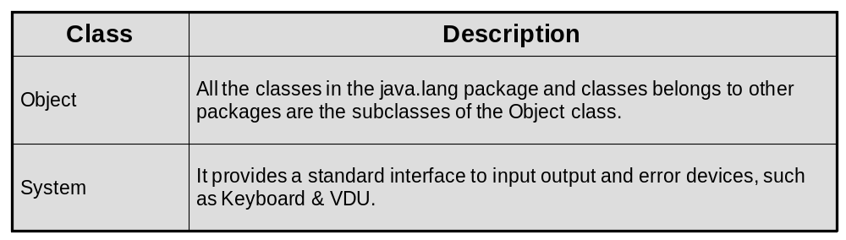
Overview of java.util package (continued)
The java.lang package provides various classes and interfaces that are fundamental to Java programming.
The java.lang package contains various classes that represent primitive data types, such as int, char, long, and double.
Classes provided by the java.lang package:
Notes:
Ankur Bag
java.lang package is the default package and not needed to be imported when using any of the classes and interfaces from the java.lang package. Like, when using System class, you don’t import java.lang package, by default it is imported.

Slide 37
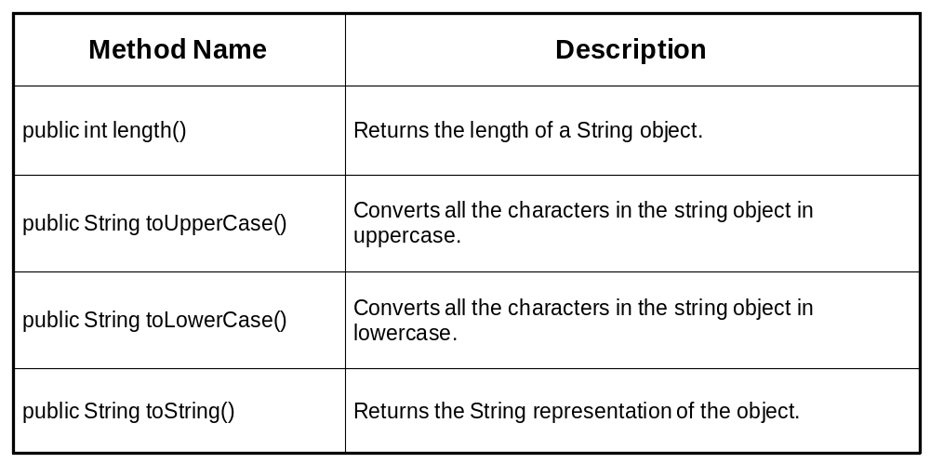
String class
Notes:
Ankur Bag

Slide 38
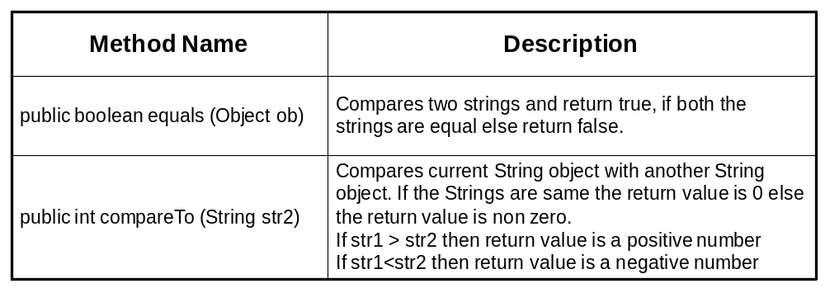
String class (continued)

Slide 39
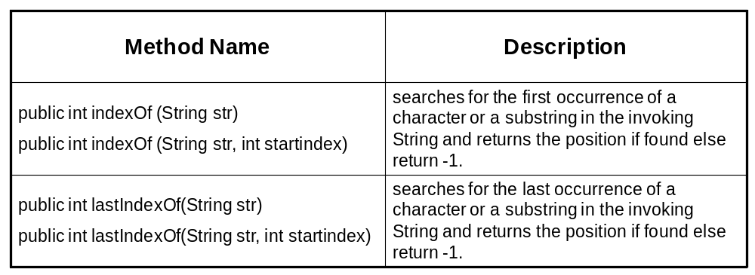
String class (continued)

Slide 40
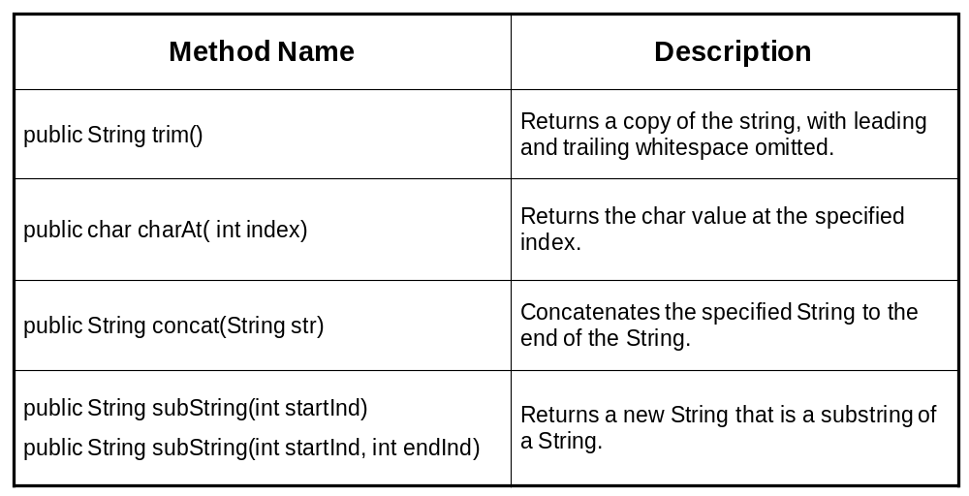
String class (continued)

Slide 41
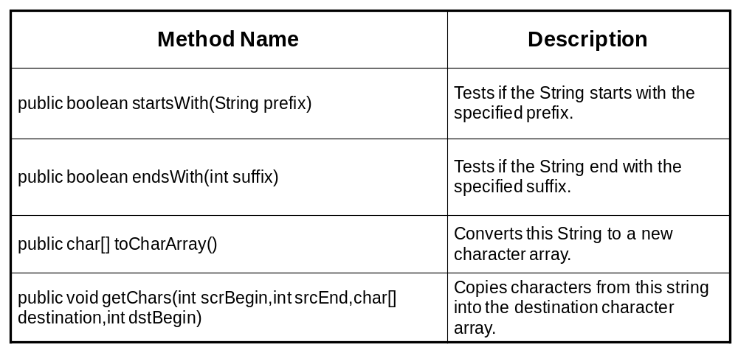
String class (continued)

Slide 42
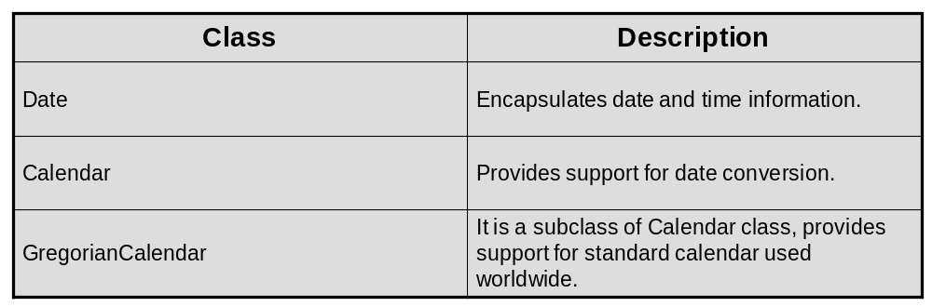
Overview of java.util package (continued)
The java.util package provides various utility classes and interfaces that support date and calendar operations, String manipulations and Collections manipulations. Classes provided by the java.util package

Slide 43
Date class
Date: Date class represent date and time. There are several constructors for Date objects.
Constructors :
Date() : produces the current date and time.
Date(int year, int month, ind dayofmonth)
Date(int year, int month, ind dayofmonth,int hours, int mins)
Date(int year, int month, ind dayofmonth,int hours, int mins,int secs)
Date(long milliseconds) : no of milliseconds from January 1, 1970
midnight
Date(String strdate) : Converts the string representation of date
into a Date object.
Methods
boolean after(Date pdate) - returns true if the current date is after pdate.
boolean before(Date pdate) - returns true if the current date is before pdate.
boolena eqauls(Date pdate) - returns true if the current date same as pdate.
int getDay()
int getMonth()
int getYear()
void setDay(int dayno)
void setMonth(int monthno)
void setYear(int year)

Slide 44
Date class (continued)
Example : Usage of Date class. SourceFile : datetest.java
import java.io.*;
import java.util.*;
public class datetest{
public static void main(String args[])
{
Date today = new Date();
System.out.println("Today\'s date is "+today.toString());
System.out.println("Current time is "+today.getTime());
Date aday = new Date(1998,10,9);
Date bday = new Date(1998,11,10);
Date cday = new Date(1998,9,23);
Date tday = new Date(1998,9,23,12,20);
System.out.println("A day is "+aday.toString());
System.out.println("B day is "+bday.toString());
System.out.println("C day is "+cday.toString());
System.out.println("T day with time is "+tday.toString());
if (aday.before(bday))
System.out.println(" a is before b");
if (cday.after(bday))
System.out.println(" c is after b");
System.out.println("Time of aday is "+aday.getTime());
System.out.println("Time of tday is "+tday.getTime());
Date today1 = new Date();
if (today1.equals(today))
System.out.println(" today is same as today1");
}

Slide 45
Calendar class
import java.util.Calendar;
class CalendarDemo
{
public static void main(String args[])
{
String months[]= {"Jan", "Feb", "Mar", "Apr", "May", "Jun", "Jul", "Aug", "Sep", "Oct", "Nov", "Dec"};
Calendar cal = Calendar.getInstance();
System.out.println("The Date is: ");
System.out.print(months[cal.get(Calendar.MONTH)]);
System.out.print(" " + cal.get(Calendar.DATE) + " ");
System.out.println(cal.get(Calendar.YEAR));
// Setting Time
cal.set(Calendar.HOUR, 10);
cal.set(Calendar.MINUTE, 27);
cal.set(Calendar.SECOND, 0);
System.out.print("Time is: ");
System.out.print(cal.get(Calendar.HOUR) + ":");
System.out.print(cal.get(Calendar.MINUTE) + ":");
System.out.print(cal.get(Calendar.SECOND));
}
}

Slide 46
Calendar class (continued)
import java.util.*;
public class GregorianCalendarDemo
{
public static void main(String args[])
{
Calendar calendar = new GregorianCalendar();
System.out.println(calendar.get(Calendar.YEAR)); System.out.println(calendar.get(Calendar.MONTH+1)); System.out.println(calendar.get(Calendar.DAY_OF_MONTH));
}
}

Slide 47
StringBuffer Class
Class StringBuffer
  Used for creating and manipulating dynamic string data
    i.e., modifiable Strings
  Can store characters based on capacity
    Capacity expands dynamically to handle additional characters
  CANNOT use operators + and += for string concatenation
  Fewer utility methods (e.g. no substring, trim, ....)

Slide 48
StringBuffer Class (continued)
Three StringBuffer constructors
  public StringBuffer();
    empty content, initial capacity of 16 characters
  public StringBuffer(int length);
    empty content, initial capacity of length characters
  public StringBuffer(String str);
    contain the characters of str, capacity is the number of characters in str plus 16
  Use capacity() method to get the capacity.
  If the internal buffer overflows, the capacity is automatically made larger.

Slide 49
StringBuffer Methods (continued)
Method length
  Return StringBuffer length (the actual number of characters stored).
Method capacity
  Return StringBuffer capacity (the number of characters can be stored without expansion)
Method setLength
  Increase or decrease StringBuffer length. If the new length is less than the current length of the string buffer, the string buffer is truncated.
Method ensureCapacity
  Set StringBuffer capacity
  The new capacity is the larger of the minimumCapacity argument or twice the old capacity, plus 2.

Slide 50
Manipulating StringBuffer characters
Method charAt
  Return StringBuffer character at specified index
Method setCharAt
  Set StringBuffer character at specified index
Method reverse
  Reverse StringBuffer contents

Slide 51
StringBuffer Methods (continued)
Method append
  Allow data-type values to be added to StringBuffer
  Should NOT use + and += for StringBuffer
  Overloaded methods to append primitive data type values, String, char array and the String representation of any Objects.
Method insert
  Similar to append and can specify where to insert
Methods delete and deleteCharAt
  Allow characters to be removed from StringBuffer
  delete : delete a range of characters, from start to end-1
  deleteCharAt : delete a character at a specified location

Slide 52
StringBuffer class
public class StringBufferDemo {
public static void main(String[] args) {
StringBuffer sb =new StringBuffer("Hello");
System.out.println("buffer= " +sb);
System.out.println("length= " +sb.length());
System.out.println("capacity= " +sb.capacity());
//appending and inserting into StringBuffer.
String s;
int a = 42;
StringBuffer sb1= new StringBuffer(40);
s= sb1.append("a=").append(a).append("!").toString();
System.out.println(s);
StringBuffer sb2 = new StringBuffer("I JAVA!");
sb2.insert(2, "LIKE");
System.out.println(sb2);
}
}

Slide 53
Converting object to string
Any Java reference type or primitive that appears where a String is expected will be converted into a string.
  System.out.println("1 + 2 = " + (1 + 2));
For an reference type (object)
  this is done by inserting code to call String toString() on the reference.
  All reference types inherit this method from java.lang.Object and override this method to produce a string that represents the data in a form suitable for printing.
To provide this service for Java's primitive types, the compiler must wrap the type in a so-called wrapper class, and call the wrapper class's toString method.
  String arg1 = new Integer(1 + 2).toString();

Slide 54
Converting object to string (continued)
For user defined classes they will inherit the standard Object.toString() which produces something like "ClassName@123456" (where the number is the hashcode representation of the object).
To have something meaningful the classes have to provide a method with the signature public String toString().
  public class Car()
  {
  ----
  ---
  String toString()
  {
  return brand + ” : ” + color + ” : ”+wheels+” : “+ speed;
  }
  }
Notes:
Ankur Bag

Slide 55
Converting string to numbers
Many data type wrapper classes provide the valueOf(String s) method which converts the given string into a numeric value.
The syntax is straightforward. It requires using the static Integer.valueOf(String s) and intValue() methods from the java.lang.Integer class.
To convert the String "22" into the int 22 you would write
  int i = Integer.valueOf("22").intValue();
Doubles, floats and longs are converted similarly. To convert a String like "22" into the long value 22 you would write
  long l = Long.valueOf("22").longValue();
To convert "22.5" into a float or a double you would write:
  double x = Double.valueOf("22.5").doubleValue(); float y = Float.valueOf("22.5").floatValue();
If the passed value is non-numeric like “Four," it will throw a NumberFormatException.

Slide 56
Example: Converting string to numbers
class Energy
{
public static void main (String args[])
{
double c = 2.998E8; // meters/second
double mass = Double.valueOf(args[0]).doubleValue();
double E = mass * c * c; System.out.println(E + " Joules");
}
}
Here's the output:
$ javac Energy.java $ java Energy 0.0456 4.09853e+15 Joules
Notes:
Ankur Bag

Slide 57
Regular expression
Regular expressions are a way to describe a set of strings based on common characteristics shared by each string in the set. They can be used to search, edit, or manipulate text and data.
The regular expression syntax supported by the java.util.regex API
Notes:
Ankur Bag
No value is assigned that’s why array arr store the default value of int i.e. 0.

Slide 58
Regular expression (continued)
The java.util.regex package primarily consists of three classes: Pattern, Matcher, and PatternSyntaxException.
A Pattern object is a compiled representation of a regular expression.
The Pattern class provides no public constructors.
  To create a pattern, you must first invoke one of its public static compile methods, which will then return a Pattern object.
  These methods accept a regular expression as the first argument; the first few lessons of this trail will teach you the required syntax.
A Matcher object is the engine that interprets the pattern and performs match operations against an input string.
  Like the Pattern class, Matcher defines no public constructors. You obtain a Matcher object by invoking the matcher method on a Pattern object.
A PatternSyntaxException object is an unchecked exception that indicates a syntax error in a regular expression pattern.
Notes:
Ankur Bag

Slide 59
Regular expression (continued)
import java.io.Console;
import java.util.regex.Pattern;
import java.util.regex.Matcher;
public class RegexTestHarness {
public static void main(String[] args){
Console console = System.console();
if (console == null) {
System.err.println("No console.");
System.exit(1);
}
Notes:
Ankur Bag

Slide 60
Regular expression (continued)
while (true) {
Pattern pattern =
Pattern.compile(console.readLine("%nEnter your regex: "));
Matcher matcher =
pattern.matcher(console.readLine("Enter input string to search: "));
boolean found = false;
while (matcher.find()) {
console.format("I found the text \"%s\" starting at " +
"index %d and ending at index %d.%n",
matcher.group(), matcher.start(), matcher.end());
found = true;
}
if(!found){
console.format("No match found.%n");
}
}
}
}
Compile the REGEX pattern
Seed the matcher with the string that you want to find matches
Get matcher from static method on Pattern class
Find parts of the string that match the REGEXP
Find the group ofchars that matched (as a String) and where those chars started and ended in the string to be matched

Slide 61
Regular expression (continued)
Character classes
  Enter your regex: [bcr]at
  Enter input string to search: bat
  I found the text "bat" starting at index 0 and ending at index 3.
Negation and Ranges
  Enter your regex: [^bcr]at
  Enter input string to search: cat
  No match found.
  Enter your regex: [a-c]
  Enter input string to search: a
  I found the text "a" starting at index 0 and ending at index 1.

Slide 62
Regular expression: Predefined character classes
Any character (may or may not match the terminators
\d A digit: [0-9]
\D A non-digit: [^0-9]
\s A whitespace character: [ \t\n\x0B\f\r]
\S A non-whitespace character: [^\s]
\w A word character: [a-zA-Z_0-9]
\W A non-word character: [^\w]

Slide 63
Regular expression: Matcher methods
A matcher is created from a pattern by invoking the pattern's matcher method. Once created, a matcher can be used to perform three different kinds of match operations:
  The matches method attempts to match the entire input sequence against the pattern.
  The looking at method attempts to match the input sequence, starting at the beginning, against the pattern.
  The find method scans the input sequence looking for the next subsequence that matches the pattern

Slide 64

Questions
Notes:
Ankur Bag
Urge the class to ask questions

Slide 65

Day 2 Summary
At the end of Day 2, we see that you are now able to:
Define inheritance and polymorphism
Identify the classes in Java

