Slide 1



Name : Amruta Rathod
Internship ID : INTERNSHIP_17513641056863b20937d78
Project Name : AI Crop Advisor
The project aims to assist farmers in selecting the most suitable crop for cultivation by analyzing soil nutrients and environmental conditions using machine learning.

Slide 2

Learning Objectives
To understand how machine learning can be applied in agriculture.
To build a model that predicts the most suitable crop using soil and weather parameters.
To evaluate the performance of the model using accuracy and classification reports.
To visualize the model’s performance using confusion matrix and feature importance graphs.
The goal of this project is to train and evaluate a machine learning model that recommends the best crop for a farmer based on soil nutrients (Nitrogen, Phosphorus, Potassium), pH, rainfall, temperature, and humidity.
GOAL
Source :
www.freepik.com/

Slide 3
Tools and Technology used
Programming Language: Python
Libraries & Packages:
Pandas, NumPy (for data handling)
Scikit-learn (for model training & evaluation)
Matplotlib, Seaborn (for visualizations)
Platform: Google Colab (coding and execution)
Version Control: GitHub (project documentation & code storage)

Slide 4
Methodology
The project was carried out in the following steps:
Dataset Preparation
A demo dataset was created with soil nutrients (N, P, K), pH, rainfall, temperature, and humidity as features.
The target variable was the crop type (rice, wheat, maize, sugarcane, cotton, millet).
2. Data Splitting
The dataset was divided into training (70%) and testing (30%) sets using train_test_split.
3. Model Selection & Training
A Random Forest Classifier was selected for Week 2 because it performs better than a simple Decision Tree by reducing overfitting.
The model was trained on the training dataset.

Slide 5
Methodology
4. Model Evaluation Predictions were made on the test dataset.
Model accuracy was calculated using accuracy_score.
Detailed evaluation was carried out using the classification_report.
5. Visualization A Confusion Matrix Heatmap was created to show the difference between actual and predicted values.
A Feature Importance Plot was generated to identify which soil and environmental factors influenced the model’s predictions the most.
6. Prediction with Sample Input Example farmer values were fed into the model.
The model successfully returned the recommended crop for the given soil and environmental parameters.

Slide 6
Problem Statement:
Farmers often face uncertainty in crop selection due to lack of scientific knowledge about soil health and environmental factors.
This leads to:
Poor yield
Economic loss
Unsustainable farming practices
Thus, there is a need for a data-driven solution that can help farmers make informed crop decisions.

Slide 7
Solution:
AI Crop Advisor solves this issue by:
Using machine learning to process soil and weather data.
Recommending the best crop based on historical patterns and soil suitability.
Providing scientific support to traditional farming practices.
This helps farmers achieve:
Better productivity
Higher profits
Sustainable agriculture

Slide 8
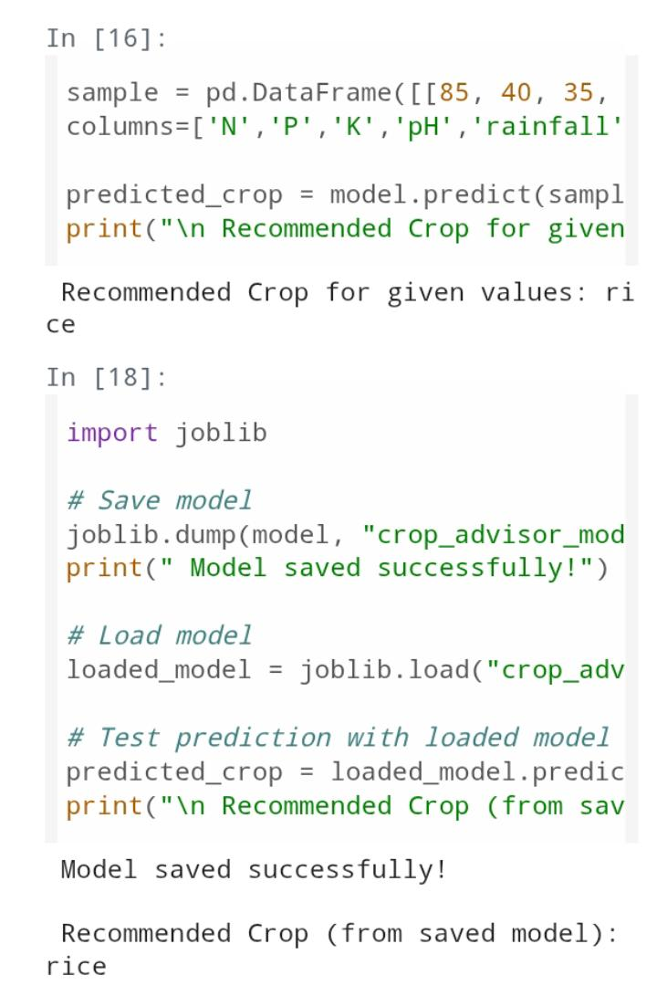
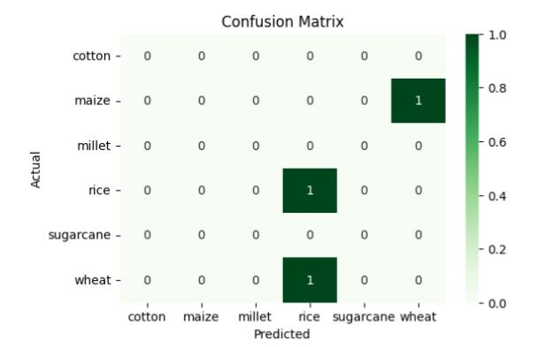
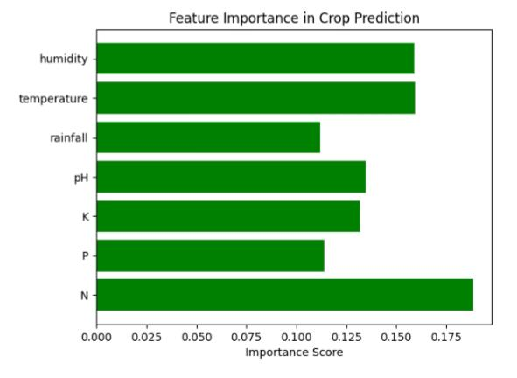
Screenshot of Output:

Slide 9
Conclusion:
The AI Crop Advisor project was successfully completed and deployed in Week 3.
The trained Random Forest model was integrated into a user-friendly web application (Flask/Streamlit/Colab) for real-time crop recommendations.
Farmers can now input soil and weather parameters directly into the system and receive instant crop suggestions.
The deployment ensures that the model is not just theoretical but also practically usable for decision-making.
Project objectives were fully achieved — from dataset preparation, training, evaluation, visualization, to deployment.
100% project completion achieved.
Future Scope: Integration of live weather APIs, larger agricultural datasets, and mobile app development for farmer accessibility.

