Slide 1

AI COLLEGE ASSISTANT
Internship Project Presentation
12-Week Industrial Training – iGAP Technologies Pvt. Ltd.
Department of Computer Engineering
Government Residence Women Polytechnic, Tasgaon
Academic Year 2026–27

Slide 2
INTRODUCTION
• Students study from lengthy college notes, textbooks and PDF documents.
• Finding specific information manually is time-consuming.
• Traditional PDF readers mainly provide keyword search.
• AI College Assistant provides document-based answers and study-support features in one platform.

Slide 3
PROBLEM STATEMENT
• Finding answers from lengthy study material is difficult and time-consuming.
• Students often need different tools for different study activities.
• Traditional search does not provide contextual answers.
• There is a need for an intelligent system that understands uploaded study material.

Slide 4
OBJECTIVES
• Upload and process college PDF documents.
• Answer questions using the uploaded study material.
• Generate concise study summaries.
• Generate practice MCQs.
• Generate important examination questions.
• Store and manage chat history.

Slide 5
TECHNOLOGIES USED
• Python – Programming language
• Streamlit – Web interface
• PyMuPDF – PDF text extraction
• LangChain – RAG and document processing
• HuggingFace Sentence Transformers – semantic embeddings
• FAISS – vector database and similarity search
• Google Gemini – AI response generation
• SQLite – chat history storage

Slide 6
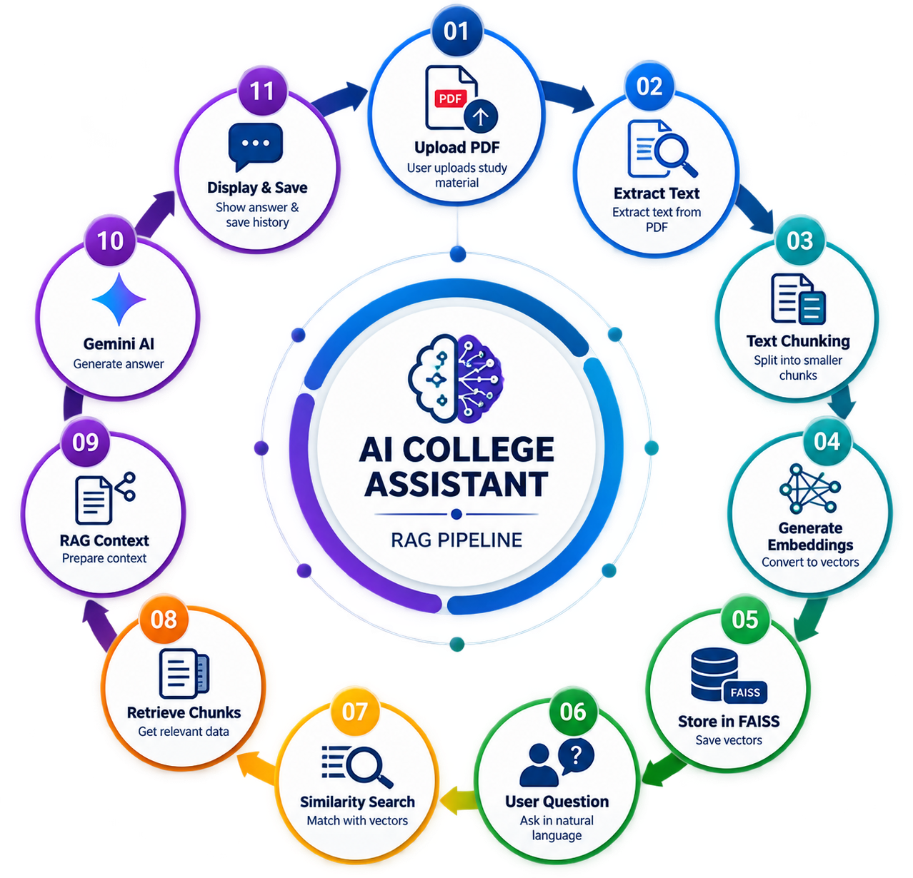
SYSTEM WORKFLOW

Slide 7
HOW RAG WORKS
• 1. PDF content is divided into smaller chunks.
• 2. Each chunk is converted into a numerical embedding.
• 3. Embeddings are stored in FAISS.
• 4. The user's question is matched with relevant document vectors.
• 5. Relevant chunks are retrieved as context.
• 6. Gemini generates an answer using the retrieved information.

Slide 8
Student Profile-Saves profile once logged in
AI Chat – Ask questions in natural language
Study Summary – Generate concise revision notes
Main Features
MCQ Generator – Create practice questions
Generate exam-oriented questions.
Chat History – Store, view and clear previous conversations
Study Planning- Makes study planning properly

Slide 9
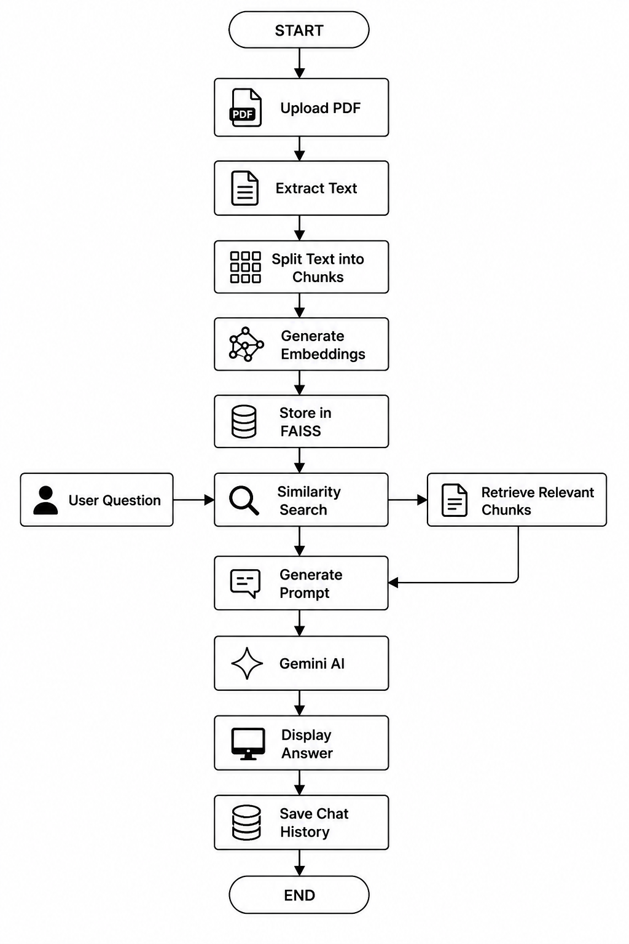
IMPLEMENTATION

Slide 10
TESTING & RESULTS
Test Case | Result
PDF Upload | ✅ PASS
Text Extraction | ✅ PASS
Empty PDF Handling | ✅ PASS
Chunking & FAISS Creation | ✅ PASS
AI Chat | ✅ PASS
Study Summary | ✅ PASS
MCQ Generation | ✅ PASS
Important Questions | ✅ PASS
Chat History & Clear History | ✅ PASS

Slide 11
CHALLENGES
Challenge | How we addressed it
🔗 Multiple AI/NLP libraries | Integrated modules with clear responsibilities
🔎 Semantic retrieval | Used embeddings + FAISS similarity search
📄 Chunk size selection | Tuned chunk size and overlap for retrieval
🤖 RAG + Gemini integration | Connected retrieved context with Gemini
⚠️ API errors & quota | Added error handling and dependency awareness
📚 Large / varied PDFs | Added PDF extraction and empty-file handling
☁️ Streamlit deployment | Configured dependencies and deployment setup

Slide 12
• OCR support for scanned PDFs.
• Multiple PDF support
• Multilingual and voice-based question answering.
• Interactive MCQ tests and study-progress dashboard
Future Scope
• Advanced embedding and hybrid search.
• Page-level citations in AI answers.
• User authentication and personalized profiles.

Slide 13
CONCLUSION
• AI College Assistant makes studying from lengthy PDFs easier.
• It combines PDF processing, embeddings, FAISS, RAG and Generative AI.
• It provides AI Chat, Summary, MCQs, Important Questions and Chat History.
• The project demonstrates a practical use of AI for education.
• It can be expanded into a personalized AI learning platform.

Slide 14
THANK YOU

