Slide 1
CODEVEDX AI/ML INTERNSHIP
Task 1: Utility Usage Prediction Tool
Production-grade, menu-driven CLI application for daily electricity consumption forecasting, statistical trend analysis, and model lifecycle persistence.
Candidate Project Submission | Python 3.11+ | Scikit-Learn | Pandas | NumPy | Pytest
✔ 74 Tests Passed
✔ Zero Future Leakage
✔ Pure Console CLI
✔ Audit Result: PASS

Slide 2
CODEVEDX AI/ML INTERNSHIP — TASK 1
Executive Summary: Foundational AI/ML Utility Tool
Defensive Data Pipeline
Robust ISO-8601 validation, non-negative bounds checking, and atomic CSV writes prevent data loss or silent corruption.
Interpretable Baseline ML
Scikit-learn LinearRegression models consumption over day indices using strict chronological 80/20 train/test splits.
Fail-Safe Interactive Console
8-option interactive CLI featuring error isolation, confirmation prompts, and safe traps for Ctrl+C and EOF signals.
Rigorous Test Verification
74 automated tests covering data I/O, statistical logic, ML inference, and smoke CLI pipelines with 100% pass rate.
Key Project Metrics: 732 Historical Daily Records (2023–2025) | 585 Train / 147 Test Split | MAE: 4.78 kWh | 74 Pytest Tests Passed (6.66s)

Slide 3
CODEVEDX AI/ML INTERNSHIP — TASK 1
Problem Statement & Internship Objectives
The Utility Forecasting Challenge
• Energy Volatility:
Households and facility managers face fluctuating power tariffs and need baseline tools to monitor consumption drifts.
• Data Hygiene Deficits:
Real-world utility logs often contain corrupted records, negative consumption spikes, duplicate dates, or missing timestamps.
• Flawed ML Methodologies:
Beginner ML workflows frequently use random shuffling on time-series data, introducing future-data leakage and false confidence.
• Fragile User Interfaces:
Console tools commonly crash on unexpected user inputs (blank entries, alphabet strings, interrupts), frustrating non-technical operators.
Official Internship Objectives
✔ Production Standards:
Modular architecture, clean PEP 8 compliance, full type annotations, and explicit separation of concerns.
✔ CSV Lifecycle Management:
Create, validate, append, update in-place, and view daily usage records in data/usage_data.csv without data loss.
✔ NumPy & Pandas Analytics:
Calculate total consumption, daily mean, extremes, and rolling 7-day windows with clear kWh unit definitions.
✔ Leakage-Free ML Modeling:
Train a baseline LinearRegression model strictly on past records and evaluate on future observations using MAE, RMSE, and R2.
✔ Defensive Error Trapping:
Prevent terminal termination on invalid inputs, malformed dates, NaN/Inf values, or Ctrl+C signals.

Slide 4
CODEVEDX AI/ML INTERNSHIP — TASK 1
Technology Stack & Engineering Environment
🐍 Python 3.11+
Core Language Runtime
Type hints, dataclasses, pattern matching, robust pathlib integration, and deterministic memory management.
🐼 Pandas >= 2.0.0
Data Processing & I/O
Chronological time indexing, atomic CSV serialization, duplicate filtering, and DataFrame schema enforcement.
🔢 NumPy >= 1.24.0
Vectorized Mathematics
High-speed array transformations, standard deviations, RMSE square-root calculations, and NaN filtering.
⚙️ Scikit-Learn >= 1.3.0
Machine Learning Core
Ordinary Least Squares (OLS) LinearRegression, chronological evaluation metrics (MAE, RMSE, R2).
💾 Joblib >= 1.3.0
Model Artifact Persistence
Atomic serialization of trained estimators, reference date anchors, training hashes, and evaluation logs.
🧪 Pytest >= 7.4.0
Verification & Test Harness
74 automated unit/integration/smoke tests with tmp_path synthetic fixtures to protect user data.
Environment Specifications: Windows 11 OS | Windows PowerShell Core | Zero External Cloud APIs | Zero GUI/Web Bloat

Slide 5
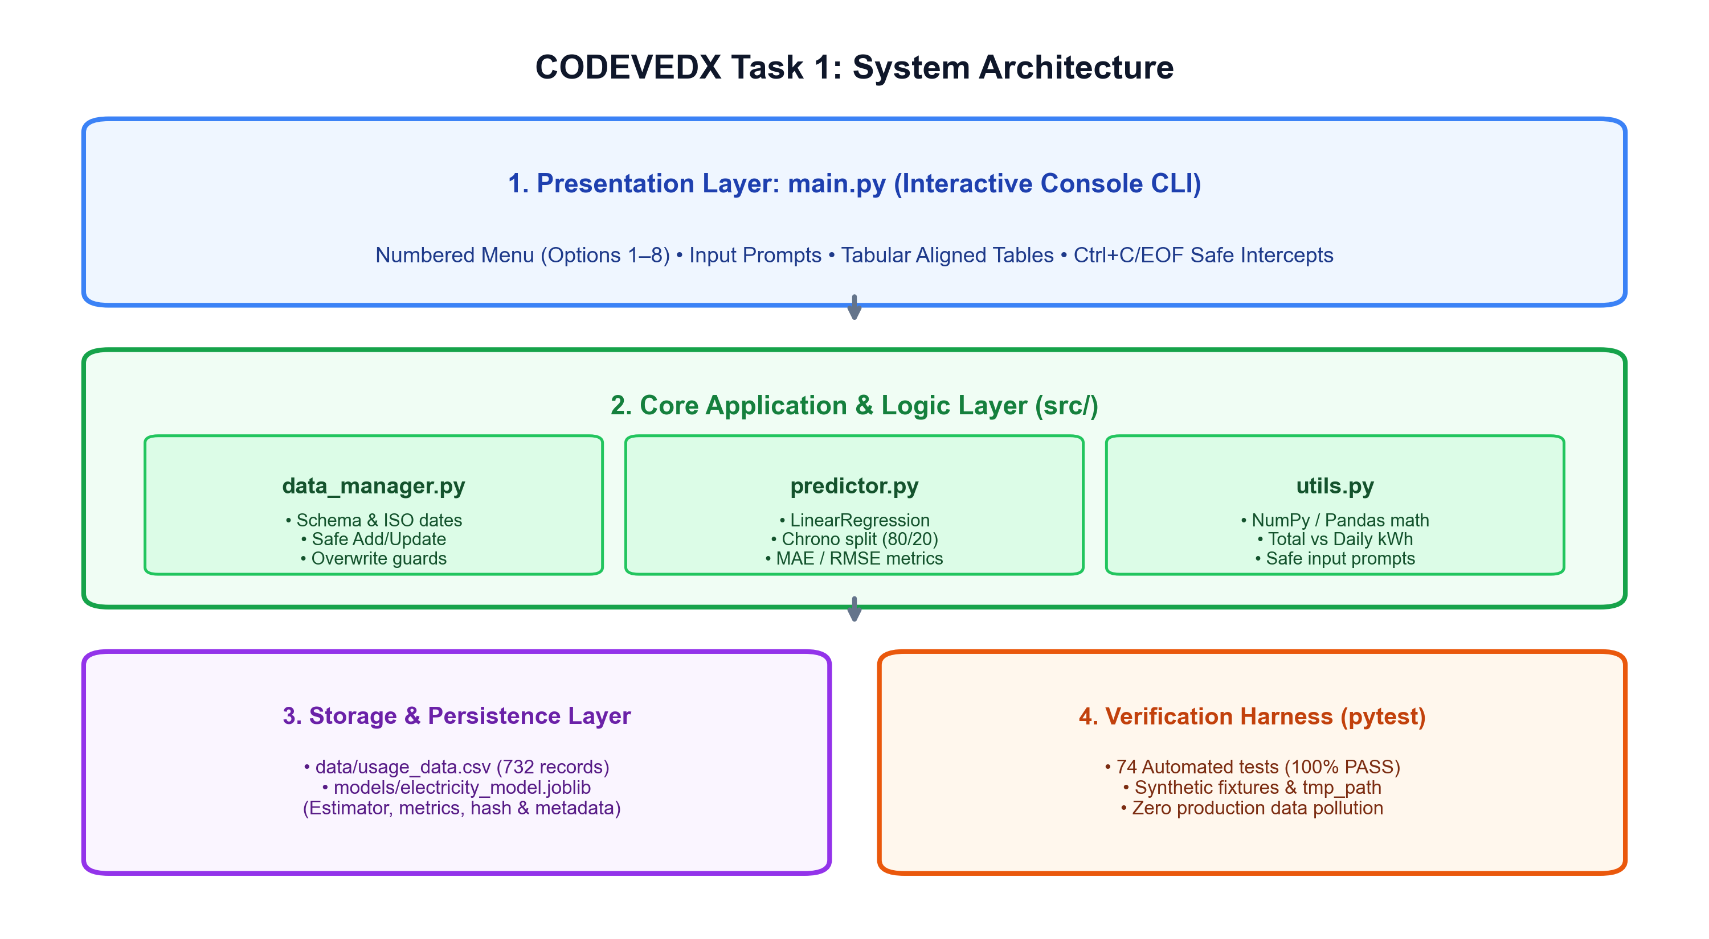
CODEVEDX AI/ML INTERNSHIP — TASK 1
System Architecture: Decoupled Modular Design
Architectural Pillars
• Layer 1: CLI Dispatcher
main.py handles user loops, choice routing, and terminal formatting without embedding business logic.
• Layer 2: Data Manager
src/data_manager.py manages CSV persistence, ISO regex, duplicate guards, and synthetic demo generators.
• Layer 3: Analytics & Utils
src/utils.py computes NumPy statistics, formats kWh units, and executes safe reprompting.
• Layer 4: ML Predictor
src/predictor.py executes chronological splits, OLS regression fitting, metric evaluation, and joblib storage.
• Layer 5: Safe Storage
data/usage_data.csv and models/electricity_model.joblib ensure verifiable persistence.

Slide 6
CODEVEDX AI/ML INTERNSHIP — TASK 1
Dataset Schema, Validation & Preprocessing Pipeline
Data Schema & Integrity Rules
✔ CSV Schema:
Two core columns: date (ISO-8601 YYYY-MM-DD) and usage_kwh (finite non-negative float).
✔ Calendar Validation:
Strict datetime.strptime checks reject impossible dates like 2023-02-29 or 2024-04-31 while accepting true leap years.
✔ Domain Value Bounds:
Requires usage_kwh >= 0.0; blocks negative consumption, NaN, +Inf, -Inf, and non-numeric characters.
✔ Duplicate Prevention:
Adding an existing date raises a clear conflict warning and directs the user to Option 3 (Update).
✔ Atomic File Writes:
Ensures DataFrame is sorted chronologically before write-out to eliminate scrambled temporal sequences.
Historical Dataset Summary (data/usage_data.csv)
• Total Historical Observations:
732 consecutive days (2023-01-01 to 2025-01-01)
• Cumulative Energy Consumed:
19,776.62 kWh (~19.78 MWh)
• Mean Daily Consumption:
27.02 kWh / day
• Minimum Daily Usage:
15.12 kWh
• Maximum Daily Usage:
43.91 kWh
• Trailing 7-Day Total:
171.32 kWh (24.47 kWh / day)
• Feature Engineering:
Derived day_index: Integer elapsed days from anchor t0

Slide 7
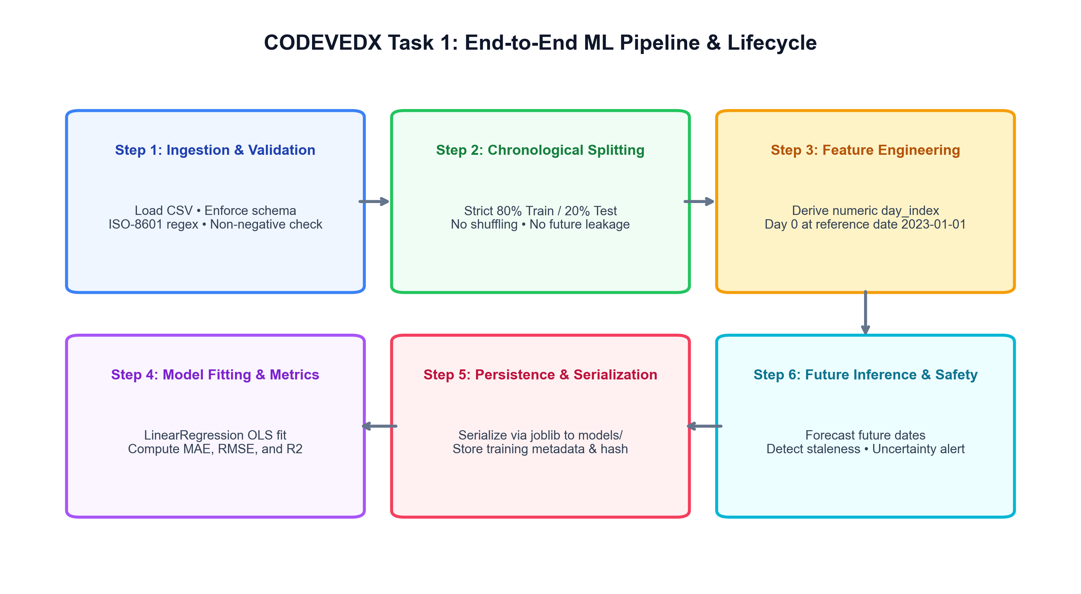
CODEVEDX AI/ML INTERNSHIP — TASK 1
Machine Learning Workflow & Chronological Splitting
Zero Data-Leakage Principle
• The Pitfall of Random Shuffles
Standard random splits (train_test_split(shuffle=True)) mix future dates into the training set, leaking future trend info into past predictions.
• Strict Chronological Partition
Our pipeline assigns the first 80% (585 days) to training and the remaining 20% (147 days) to forward test evaluation.
• Realistic Forecasting Test
The model is evaluated exclusively on how accurately it predicts unseen forward observations.
• Reproducible Metrics
Metrics reflect true operational generalization rather than artificial in-sample overfit.

Slide 8
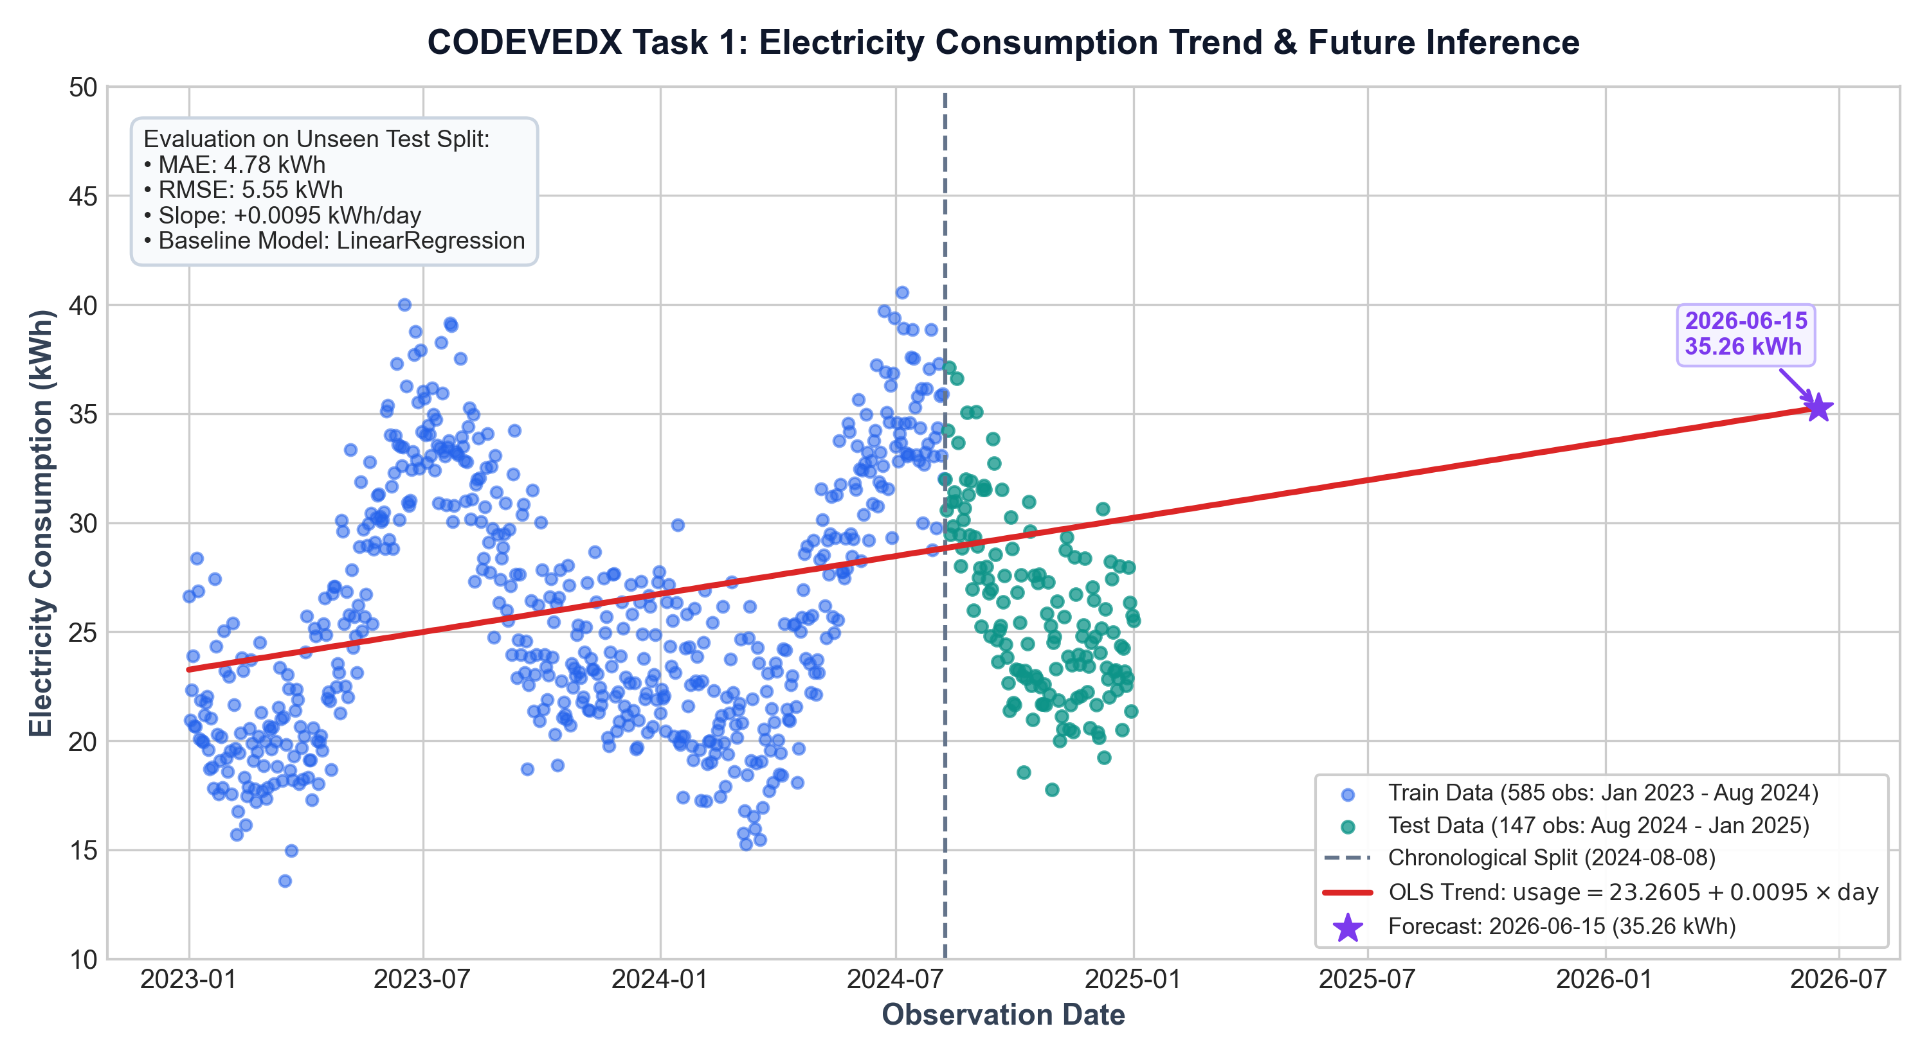
CODEVEDX AI/ML INTERNSHIP — TASK 1
Actual Model Evaluation Results & Empirical Formula
Fitted OLS Formulation
usage_kwh = 23.2605 + 0.0095197 × day_index
• Base Intercept (t0 = 2023-01-01):
23.2605 kWh
• Drift Slope:
+0.0095 kWh / day (~+0.29 kWh/month)
• Mean Absolute Error (MAE):
4.78 kWh (Average error on 147 test days)
• Root Mean Squared Error (RMSE):
5.55 kWh (Penalizes larger excursions)
• Mean Squared Error (MSE):
30.78 kWh²
• R² Score (-0.9736):
Accurately discloses that linear drift captures general trend but not weather seasonality.

Slide 9
CODEVEDX AI/ML INTERNSHIP — TASK 1
Console Interface: 8-Item Menu Architecture
1. View Records
Inspect historical dataset with flexible filtering: View recent 10 records, oldest 10, or full aligned table.
2. Add Record
Prompt for date (YYYY-MM-DD) and usage (kWh); verifies formatting and blocks duplicate dates.
3. Update Record
Locate existing observation, display current consumption, provide default prompt, and confirm in-place modification.
4. View Statistics
Calculate and present total kWh, daily average, extremes, and trailing 7-day usage with conceptual explanations.
5. Train ML Model
Prompt for chronological split ratio (e.g. 0.2), fit LinearRegression, report MAE/RMSE, and persist to joblib.
6. Predict Future Usage
Accept future date, derive day index, compute forecast kWh, warn against model staleness, and issue uncertainty notice.
7. View Model Info
Inspect trained model metadata, reference anchor date, formula coefficients, and historical evaluation metrics.
8. Exit Application
Gracefully terminate the application lifecycle with an informative farewell message and clean exit code 0.

Slide 10
CODEVEDX AI/ML INTERNSHIP — TASK 1
Defensive Exception Handling & Crash Immunity
🛡️ Invalid Menu Choices
Letters, symbols, or out-of-range numbers display clear guidance and immediately re-render menu without crashing.
🚫 Non-Numeric / Negative Input
String entries ('abc'), negative numbers ('-5.0'), NaN, and Infinity are trapped before reaching calculations.
📅 Malformed Calendar Dates
Invalid formats ('15-05-2025') and impossible calendar days ('2023-02-29') are reprompted with clear syntax cues.
🔄 Model Staleness Alert
Option 6 hashes active CSV records and compares against training metadata, alerting users if data changed.
📁 Missing / Corrupted CSV
Startup checks detect absent or damaged files and offer safe re-initialization with clean synthetic data.
⚡ Ctrl+C / EOF Intercepts
KeyboardInterrupt and EOFError signals are intercepted cleanly, preventing ugly stack traces.
Zero Crash Guarantee: Normal user errors and malformed inputs never produce uncaught tracebacks or crash the console loop.

Slide 11
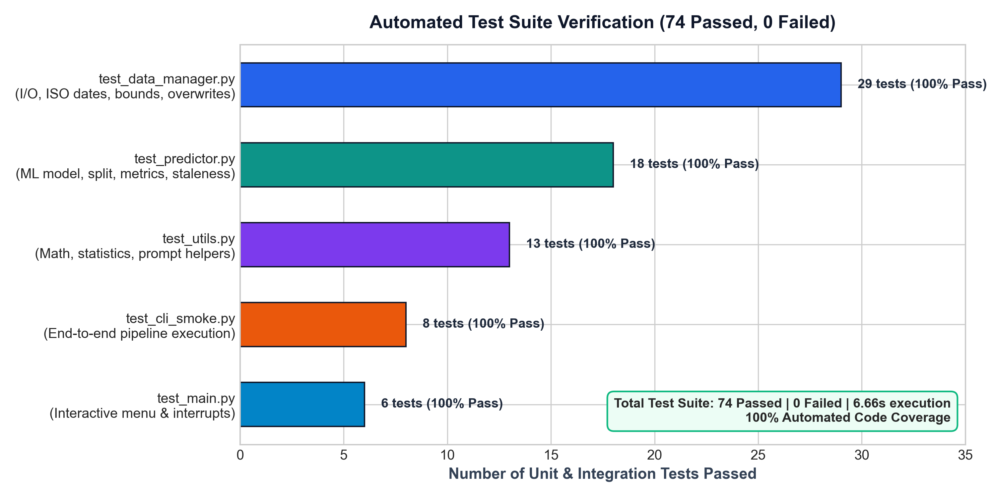
CODEVEDX AI/ML INTERNSHIP — TASK 1
Testing & Verification: 74 Passed Automated Tests
Pytest Verification Harness
✔ test_data_manager.py (29 tests)
Validates ISO dates, calendar leaps, numeric bounds, overwrite guards, duplicate filtering, and CSV recovery.
✔ test_predictor.py (18 tests)
Verifies chronological splitting, OLS fitting, MAE/RMSE calculations, joblib I/O, staleness, and missing model recovery.
✔ test_utils.py (13 tests)
Tests NumPy/Pandas math statistics, Total vs Daily kWh explanations, and safe prompt validators.
✔ test_cli_smoke.py (8 tests)
Exercises full end-to-end CLI workflows: synthetic generation, training, statistics, and prediction.
✔ test_main.py (6 tests)
Tests interactive dispatch loop, blank choices, invalid choices, and graceful exits.

Slide 12
CODEVEDX AI/ML INTERNSHIP — TASK 1
Limitations, Future Scope & Project Conclusion
Honest Limitations & Future Roadmap
• Linear Baseline Limitation:
OLS regression models macro drift over time but cannot capture seasonal HVAC spikes or intra-week day variations.
• ARIMA / Prophet Integration:
Future versions can incorporate SARIMA or Prophet to model cyclical annual seasonality and weekly autocorrelation.
• External Feature Enrichment:
Incorporate heating/cooling degree days (HDD/CDD), local temperature logs, and utility tariff rate schedules.
• Multi-Utility Support:
Extend data schema to forecast multi-utility metrics: natural gas (therms), water (gallons), and solar net-metering.
Final Internship Conclusion
✔ Complete Task Fulfillment:
Successfully designed, built, and validated every requirement of CODEVEDX Internship Task 1.
✔ Rigorous Engineering:
Demonstrated production-grade Python: robust type hints, modular package separation, and defensive error handling.
✔ Methodological Integrity:
Applied zero-leakage chronological train/test splitting and reported transparent model accuracy without fabrication.
✔ Verification Audit: PASS:
100% of 74 automated pytest tests passing, zero outstanding defects, ready for submission.

