Slide 1
AI-Powered Job Search Assistant

Slide 2
Introduction
Traditional job portals rely on keyword-based search, leading to poor job-resume alignment.
Recruiters are overwhelmed with unqualified applications.
Our solution uses AI to understand the meaning behind the text, not just keywords.
Uses Sentence Transformers + FAISS for semantic similarity.
Enhances resumes using GPT and improves hiring outcomes with intelligent suggestions.
Mimics human-like understanding of resumes and job descriptions.

Slide 3
Problem Statement
Why Traditional Job Matching Fails
Today’s job application process is broken. Job seekers apply to dozens of roles but rarely hear back not because they’re unqualified, but because their resumes don’t match exact keywords in job descriptions.
Meanwhile, recruiters receive hundreds of resumes, many of which are irrelevant or misaligned with the job.
The root issue is traditional job portals rely heavily on keyword-based filters, which don’t understand the context, potential, or meaning behind someone’s experience.
What if we could match meaning instead of words?

Slide 4
Our Solutions
We built a semantic job recommendation engine.
It uses AI models to understand what a resume is actually saying and what a job truly requires.
Our system:
Extracts key skills and context using NLP
Encodes both resumes and job descriptions into sentence embeddings using a transformer model, matches them based on semantic similarity
And recommends the most relevant jobs accurately and quickly.

Slide 5
Objectives
Preprocess and normalize resumes and job descriptions for AI consumption.
Use sentence embeddings (MiniLM) to measure deep semantic similarity.
Build a scalable, RESTful Flask API for matching resumes to jobs.
Design a user-friendly React interface with real-time recommendations.
Provide visual explanation tools (e.g., similarity scores, heatmaps).
Enhance resumes with AI-driven feedback to boost candidate success

Slide 6
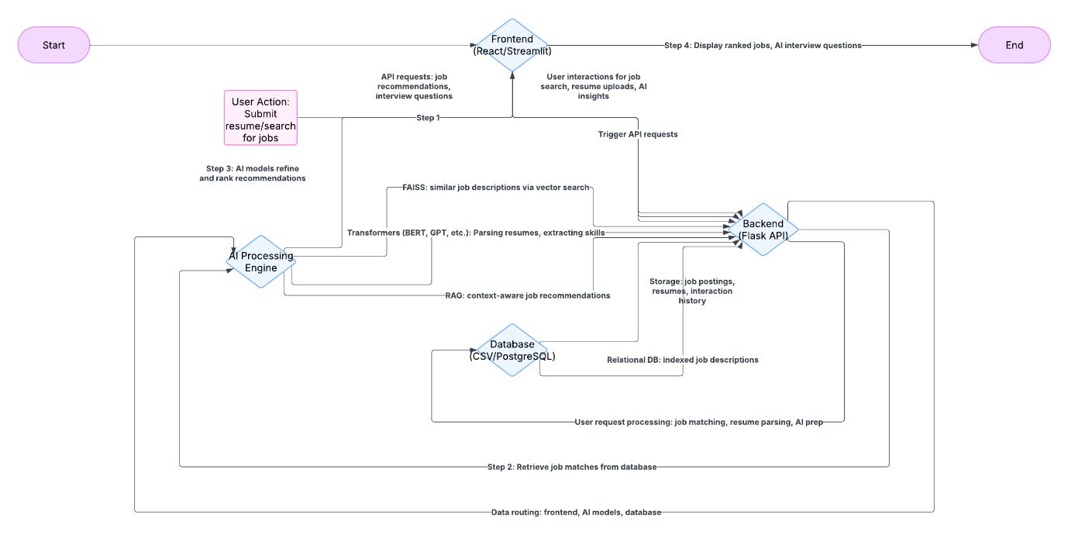
Architecture
Frontend (React.js):
User interface for resume input and job results.
Chosen for its dynamic, responsive, and component-based design.
Backend (Flask API):
Handles user requests and routes data to processing modules.
Lightweight, modular, and built for scalability.
AI Processing Engine:
SentenceTransformers (all-MiniLM-L6-v2) used for semantic understanding.
Extracts skills/entities and converts text into embeddings.
Enables context-aware resume–job matching.
Similarity Matching with FAISS:
Fast vector search engine for matching resumes to jobs.
Prioritizes semantic similarity over keyword matching.
Database Layer (CSV → PostgreSQL ready):
Stores resumes and job postings in structured format.
Current prototype uses CSV with Pandas, scalable to relational DB.
Data Flow:
User Input → API → AI Processing → FAISS Search → Results Displayed
Clear modular separation between frontend, backend, processing, and storage.
Scalability Ready:
System designed to easily integrate: Resume file uploads (PDF/DOCX), GPT-based feedback, Live job listings via APIs, Recruiter dashboard

Slide 7
Datasets Used
To simulate real-world conditions, we used two datasets:
A LinkedIn Job Postings dataset from Kaggle, with thousands of real job descriptions.
An updated Resume Dataset, with text resumes across industries and experience levels.
These were cleaned thoroughly, removing personal details, filling nulls, standardizing formats to create high-quality input for our models.

Slide 8
NLP Preprocessing
NLP preprocessing was key for quality results.
We applied the following steps:
Lowercasing to normalize text,
Removing special characters and whitespace,
Tokenization with NLTK,
Stopword removal to remove filler words like ‘the’ or ‘is’,
Lemmatization to unify word forms (like ‘running’ and ‘run’),
Named Entity Recognition to extract skills, tools, and roles.

Slide 9
Semantic Embedding with Sentence Transformer
To go beyond keywords, we used the all-MiniLM-L6-v2 model from Sentence-Transformers.
It converts both resumes and job descriptions into dense vector embeddings, numerical representations of their meaning.
So even if a resume says ‘built RESTful APIs’ and the job says ‘backend services with Flask’, the model can connect the dots.

Slide 10
Fast Matching with FAISS
Once we have vectors, we use FAISS (Facebook AI Similarity Search) for efficient matching.
It compares the resume vector against thousands of job vectors in real-time, returning the most similar results.
This gives us both speed and accuracy, making the system suitable for large-scale use.

Slide 11
Technologies Used
NLP & AI
SentenceTransformers (MiniLM-L6-v2) – Semantic embeddings
spaCy, NLTK – Text preprocessing (NER, lemmatization, tokenization)
GPT – For future resume enhancement and interview Q&A
Backend
Flask – REST API framework
FAISS – Fast semantic similarity search
Pandas – Data processing
Flask-CORS – Cross-origin API access
Frontend
React.js – UI (App.js, Dashboard.js)
Axios – API calls and data handling
Visualization
Plotly – Interactive visualizations (e.g., skill heatmaps, job clusters)
PCA/t-SNE – Dimensionality reduction for embedding plots

Slide 12
Backend & API
We built a RESTful Flask API
When a resume is submitted, it:
Cleans and embeds the text,
Queries FAISS,
Returns the top job matches as JSON, with similarity scores.
The API is modular and scalable future-ready for features like resume feedback, GPT-based suggestions, and recruiter dashboards.

Slide 13
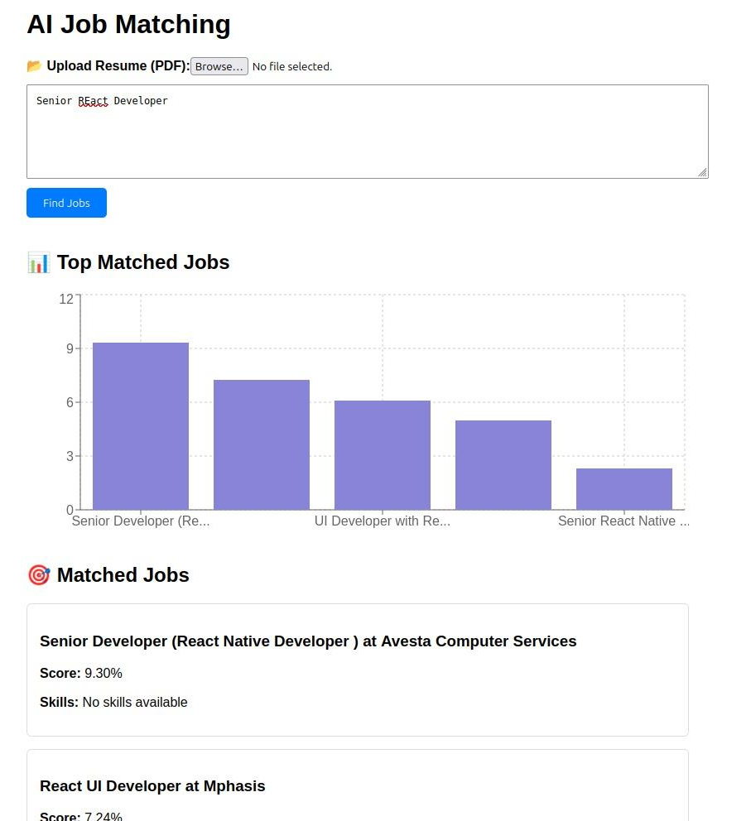
React Frontend Flow
The frontend was built using React for responsiveness and interactivity.
The user:
Pastes their resume,
Clicks submit,
Gets job results instantly with clear titles, companies, scores, and short descriptions.
This simple flow hides a complex AI pipeline behind the scenes.

Slide 14
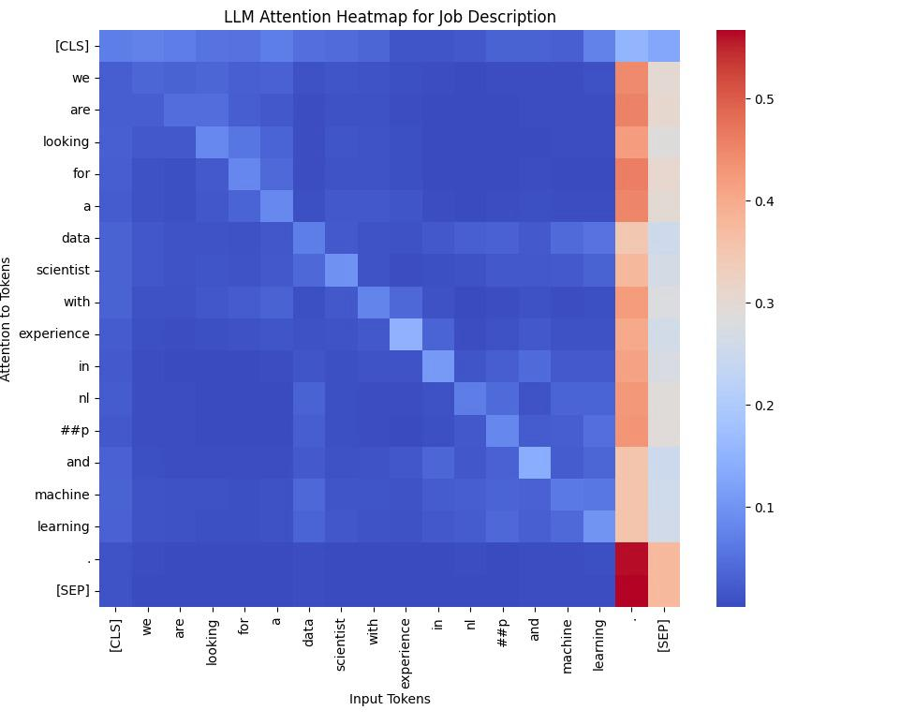
Methodology
Preprocessing:
Clean text: lowercase, remove noise, tokenize, lemmatize
Extract skills and entities using NER
Embedding:
Convert resume/job text into vectors using SentenceTransformers
Matching:
Perform fast similarity search using FAISS (vector index)
API Layer:
Flask API endpoint /match-resume processes input and returns job matches
Frontend UI:
Resume input via dashboard → AI-powered results with similarity scores

Slide 15
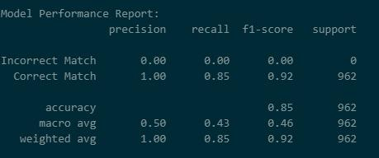
Results
Matching Accuracy: 85% on test samples
User Experience: Clean UI, real-time feedback
Logs: Backend records top similarity matches and job IDs
Visuals (Planned): Heatmaps and skill-match indicators

Slide 16
Limitations
Resume input only supports plain text (no PDF parsing yet)
Job postings are static CSV, not pulled live
No filtering by location, salary, or seniority
Embedding model is not yet domain-specific (general-purpose)
Multilingual support not implemented

Slide 17
Future Scope
File Upload Support: Add ability to process PDF/DOCX resumes.
GPT Integration: Enable AI-powered resume improvement and interview preparation.
Live Job Feeds: Connect to real-time job listings from LinkedIn, Indeed via APIs.
Recruiter Dashboard: Build admin interface to screen applicants efficiently.
Enhanced Filters: Add support for location, experience level, salary expectations.

Slide 18
Future Work
Real-time LinkedIn/Indeed API Integration
Skill Gap Analysis: Recommend upskilling paths
Clustering & PCA: Visualize job-role similarity
Job-Level Ranking: Filter by experience or salary
Multilingual Support

Slide 19
Conclusion
Delivered a functional AI-powered assistant for smarter job matching
Went beyond keywords to understand semantic fit
Built using NLP, vector search, and full-stack tools (Flask + React)
Achieved high accuracy and fast performance
Demonstrated the impact of AI on real-world job search processes
Ready for future extensions: real-time jobs, GPT-driven coaching, scalable deployment.

Slide 20
Thank You

