Slide 2
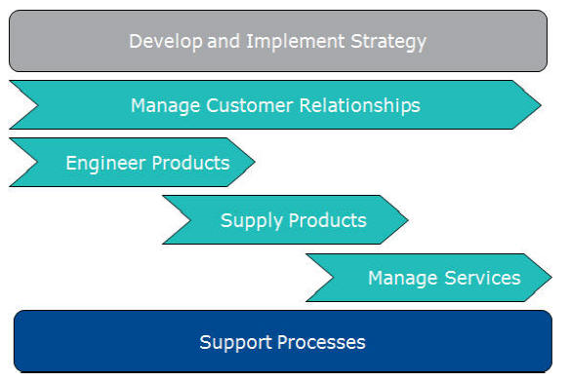

Slide 3
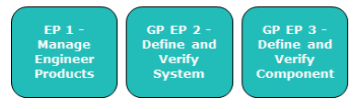

Slide 4
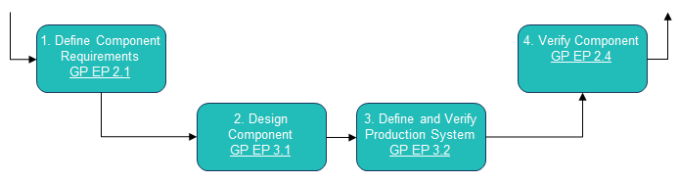
Define and Verify Component

Slide 5
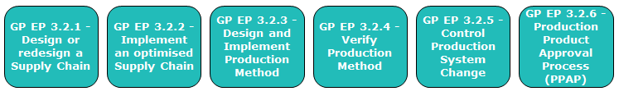
Define and Verify Production System

Slide 6
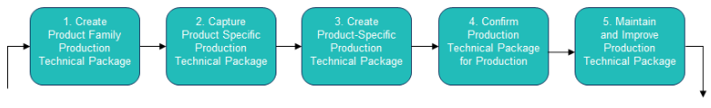
Design and Implement Production Method

Slide 7
PFMEA
Process Control Plan
Design and Implement Production Method
Step 3
Characteristics Matrix
Quality Standards and Specifications
Stage Drawings/Models
Tooling & Fixturing

Slide 8


MES
Inspection Plan
Data capture form
MSA Minitab GR&R
Future BiQ Flow
Statistical Process Control
Engineering MBD
Stage MBD / BCT
CAPP
PFD
DCM
PFMEA
CP
3DTI
DFMEAs
Process specific PFD
CAPP Reference
Global Reference PFMEAs
Reference Part
Quality History O,D ratings
SAP- Concessions History
Product Family Template (reference) – Capability Intranet
(Manual)

Slide 9
Input
Work Flow
Method & Tools
Design Drawing
Launch TcE and Nx, Generate TCG
Manual
TcE, NX
Characteristics Matrix – Current state
Design Drawing
In drafting mode import a dwg sheet and align with origin
Manual
NX
MPOS numbering using BCT move bubble for proper positions
Manual
BCT
Process Time -
RFT -
Any correction in the BCT excel table before export into DCM template
Manual
BCT
Assign project id and save in ipxml and PDF
Manual
BCT
Extract into DCM template
Manual
BCT
Check section A and align correct each column for the DWG requirements for page 1
Manual
Excel
Repeat step 8 for the remaining pages
Manual
Excel
Future state
Stage Drawings/Process
Prepare for filling MOM (TI, CMD, IPS, standards and RQSC)
Manual
Excel
Flow diagram
Refer above documents and fill MOM and inspection methods for each features
Manual
Excel
Time Calculation
Peer review
Manual
Excel
Rework
Manual
Excel
Delivery and communicate to counterpart
Manual
Email

Slide 10
Work Flow
Method & Tools
Launch TcE and Nx, Generate TCG
Manual
TcE, NX
Characteristics Matrix – Future state
In drafting mode import a dwg sheet and align with origin
Manual
NX
MPOS numbering using BCT move bubble for proper positions
Automatic
BCT
Any correction in the BCT excel table before export into DCM template
Not necessary
Process Time -
RFT -
Manual
BCT
Assign project id and save in ipxml and PDF
Manual
BCT
Obsolete
Extract into DCM template
Manual
BCT
Not necessary
Check section A and align correct each column for the DWG requirements for page 1
Manual
Excel
Repeat step 8 for the remaining pages
Manual
Excel
Current state
Prepare for filling MOM (TI, CMD, IPS, standards and RQSC)
Need to automate through BCT, CAPP
Manual
Excel
Flow diagram
Refer above documents and fill MOM and inspection methods for each features
Manual
BCT
Peer review
Manual
BCT
Rework
Manual
BCT
Delivery and communicate to counterpart
Manual
TcE

Slide 11
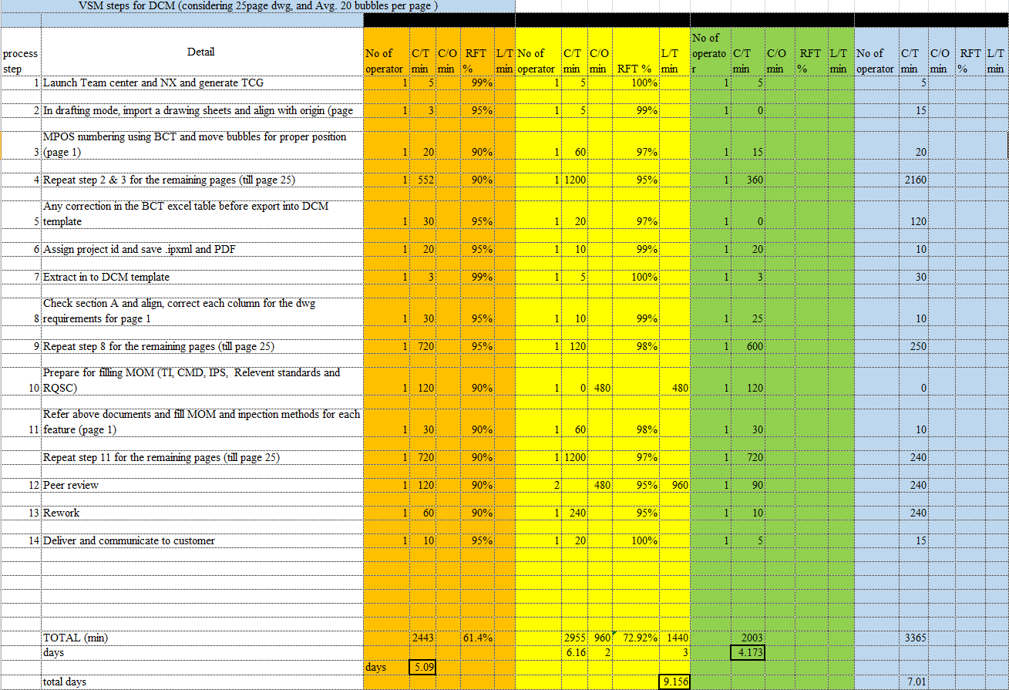
Current State Design - DCM

