Slide 1
AILP – Allianz Initial Learning Program
Amrutha Mohan (T10313)
IT DATA Team (SAS)
13th September, 2018

Slide 2
CONTENTS
1. ABOUT ALLIANZ | 6. IT DATA TEAM
2. KEY LEARNINGS | 7. SAS TECHNOLOGY
3. PROJECT – WEB DEVELOPMENT | 8. CLAIMS
4. APPLICATIONS & TOOLS | 9. PARTICIPATIONS
5. PROJECT SCREENSHOTS

Slide 3
01
Allianz

Slide 4
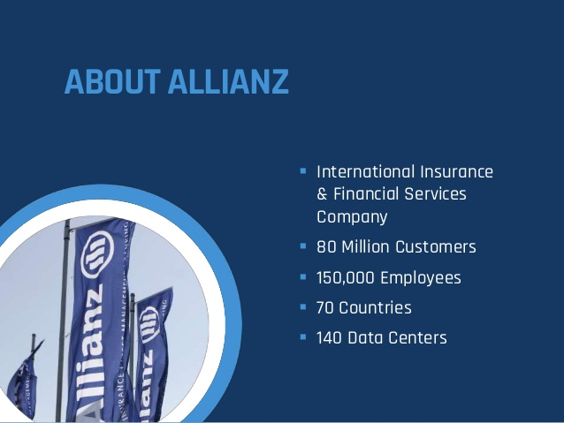

Slide 5
02
Key Learnings

Slide 6
Learnings
Technologies
Core Java
JSP, JSTL
Servlet
HTML, CSS
Java Script
Database Basics
Oracle DB
SQL
PL/SQL
Basics of Insurance
Sessions
Corporate Induction
Team Induction
Agile
ACDM

Slide 7
03
Project – Web Development

Slide 9
04
Applications & Tools

Slide 10


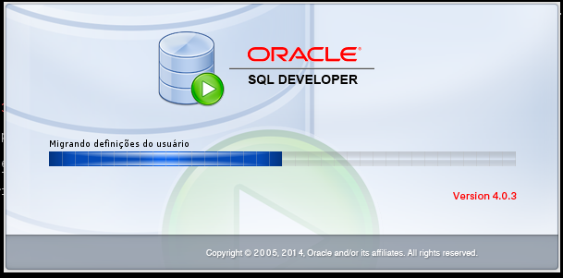
Applications
Server : Apache Tomcat 9
IDE : Eclipse Neon
DB IDE : Oracle SQL Developer 4.0.3

Slide 11







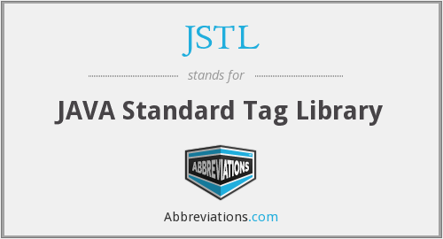
Tools

Slide 12
05
Project Screenshots

Slide 13
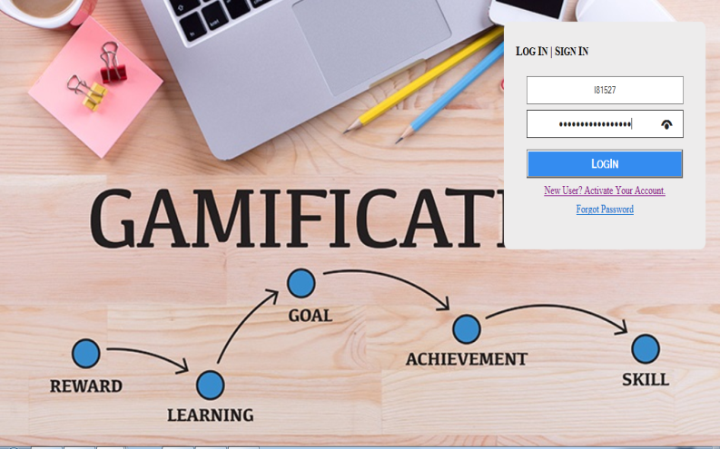
Index Pages
H

Slide 14
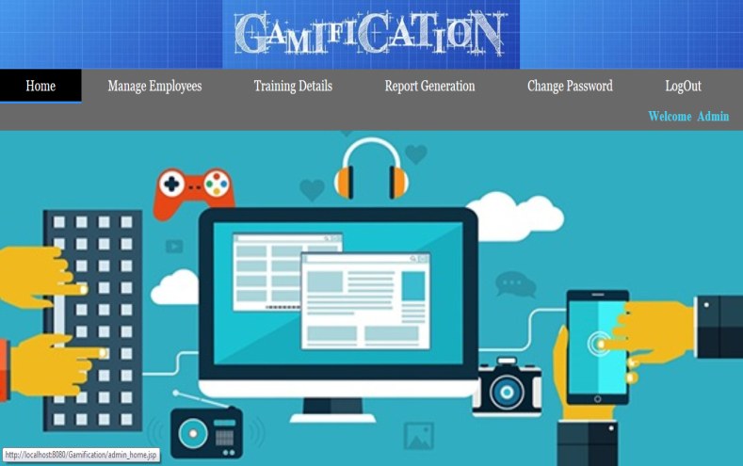
Admin Home Page

Slide 15
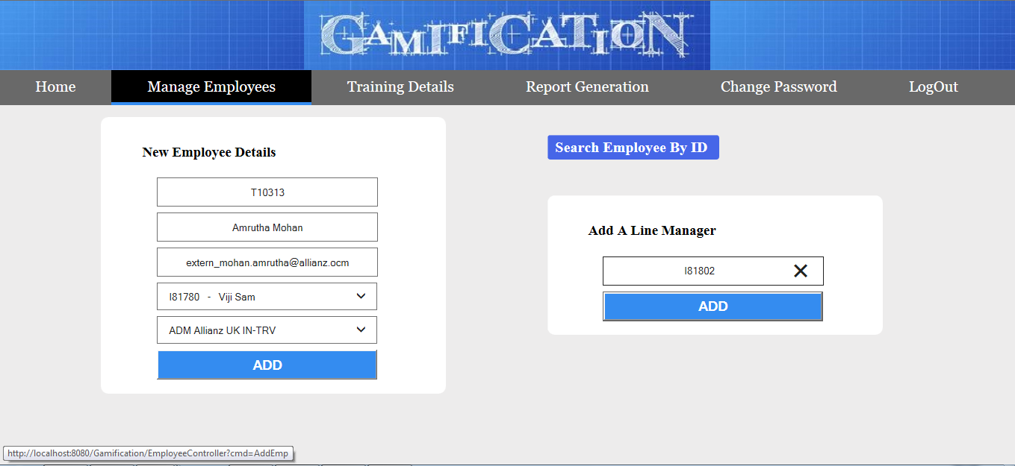
Add an Employee & Line Manager

Slide 16
Search, Edit & Delete Employee

Slide 17
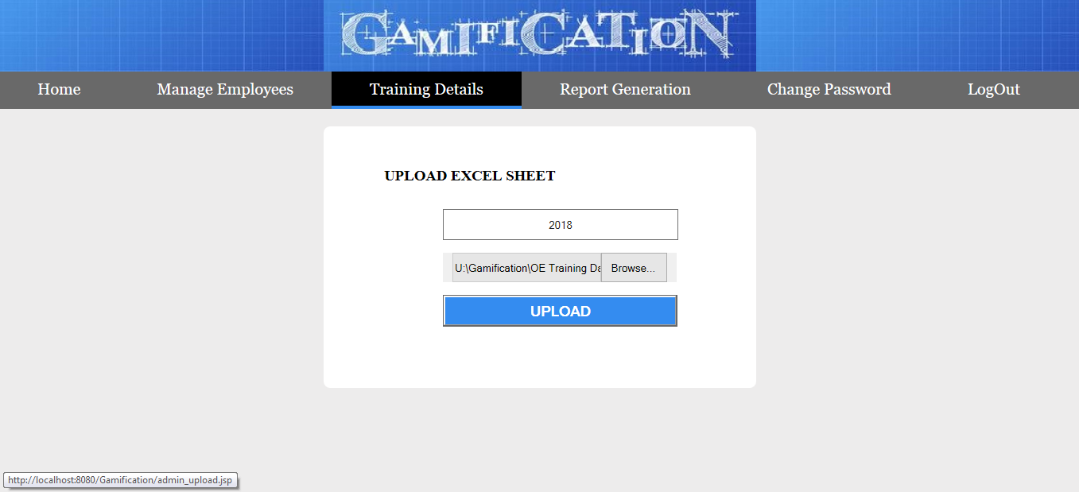
Upload Excel Sheet

Slide 18
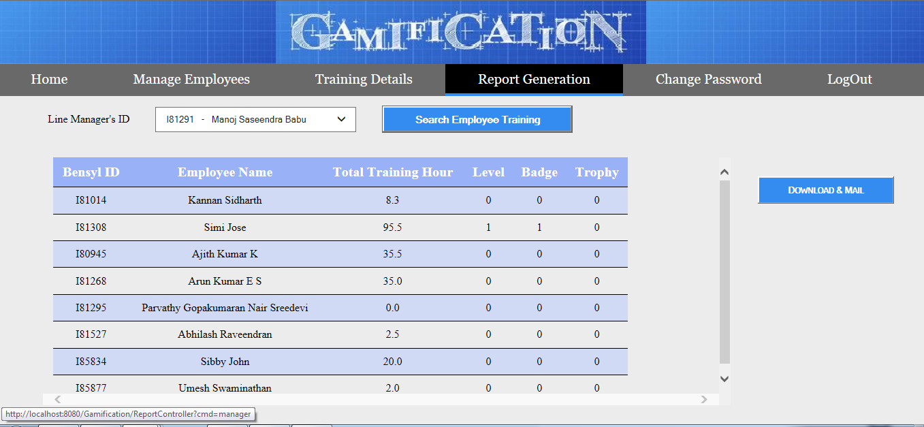
Report Generation

Slide 19
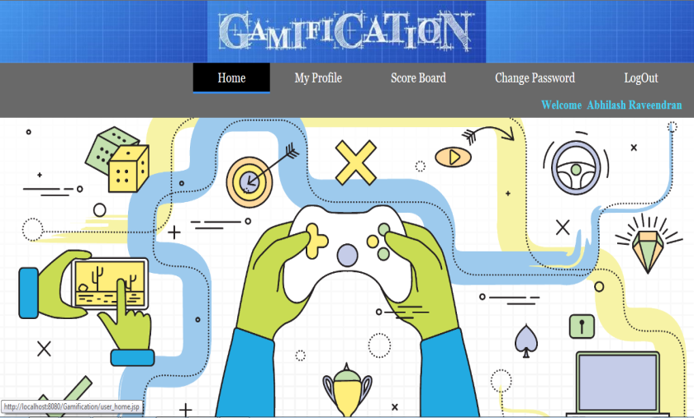
Employee Home Page

Slide 20
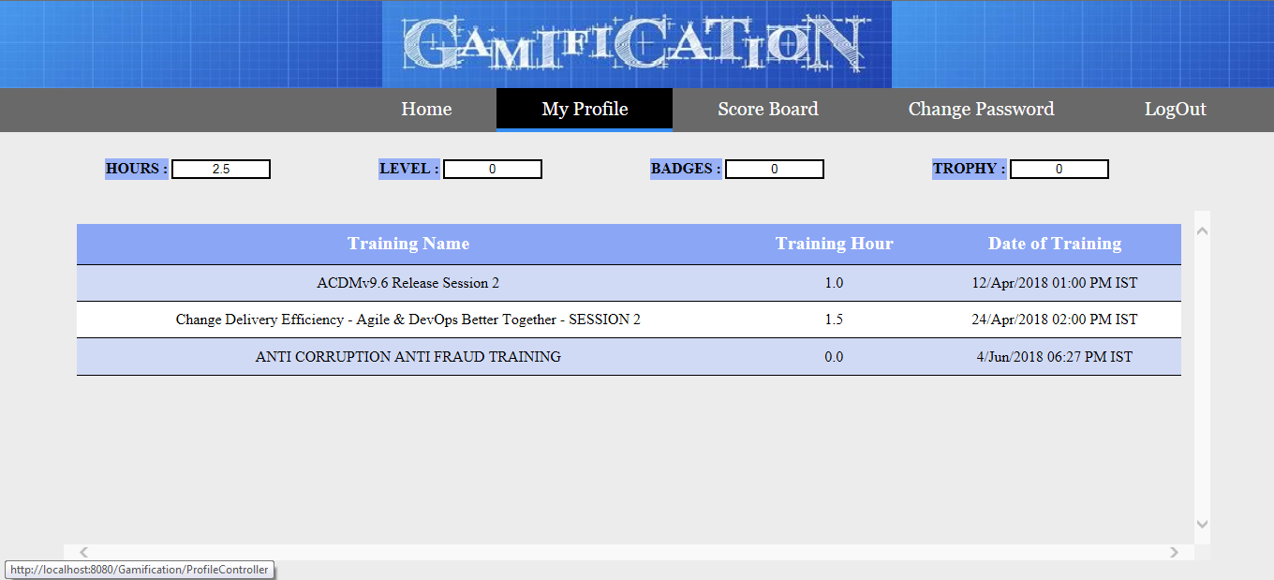
Employee Profile

Slide 21
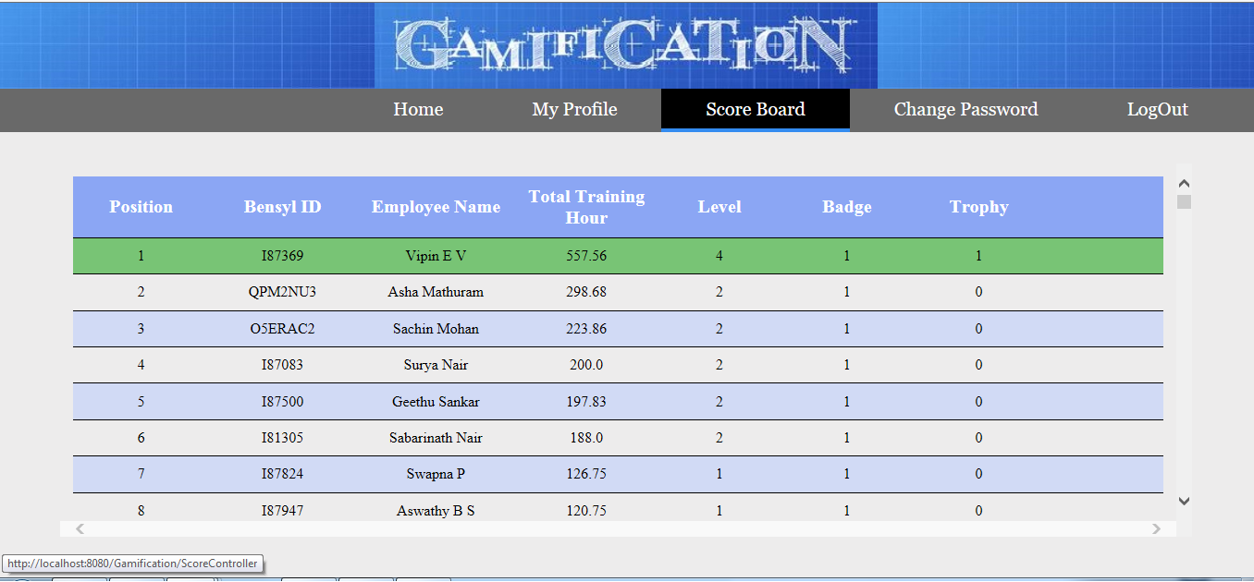
Employee Scoreboard

Slide 22
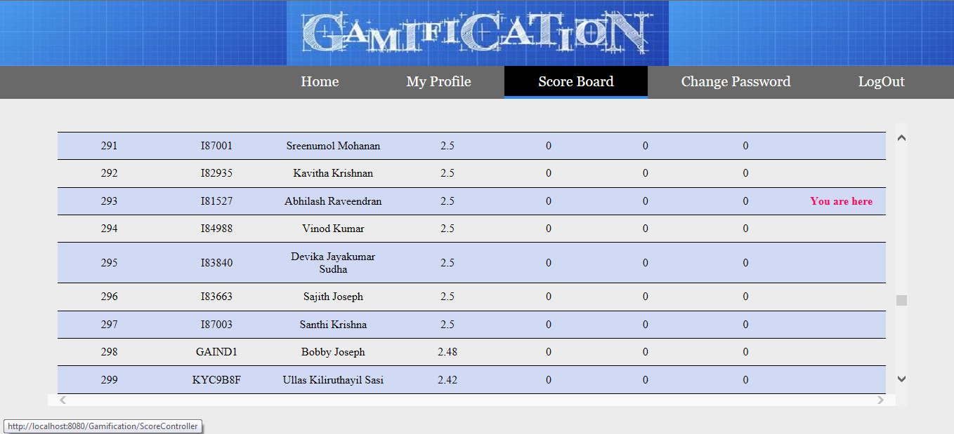
Position Relative to Others

Slide 23
06
IT Data Team

Slide 24
Corporate MIS Team
EBI IT Team
IT Data Team

Slide 25
Data Warehousing and Data reporting.
Track all organizational data and keep histories.
Produces reports on operations for every level of management.
Data Analysis and Decision Making.
Ultimate Goal : Increase the Value and Profit of business.

Slide 26
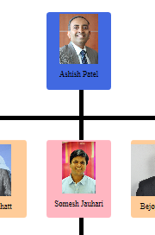
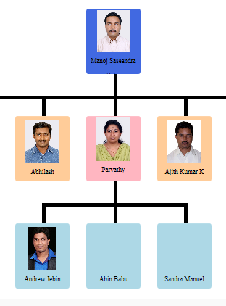


Organizational Chart

Slide 27
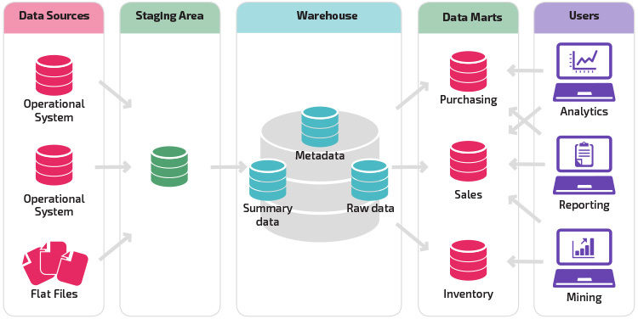
Data Warehouse
Architecture

Slide 28
ETL Process

Slide 30
07
SAS Technology

Slide 32
08
Claims

Slide 34
09
Participations

Slide 36


