Slide 1
AILP – Allianz Initial Learning Program
Amrutha Mohan (T10313)
IT DATA Team (SAS)
13th September, 2018

Slide 2
CONTENTS
1. ABOUT ALLIANZ | 6. IT DATA TEAM
2. KEY LEARNINGS | 7. SAS TECHNOLOGY
3. PROJECT – WEB DEVELOPMENT | 8. CLAIMS
4. APPLICATIONS & TOOLS | 9. PARTICIPATIONS
5. PROJECT SCREENSHOTS

Slide 3
01
Allianz

Slide 4
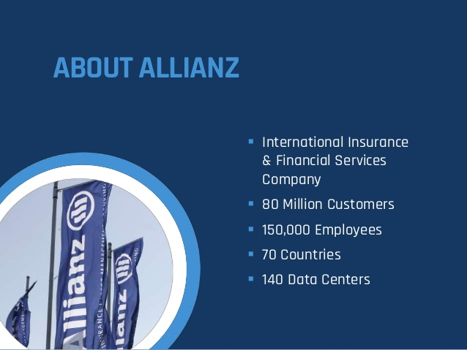

Slide 5
02
Key Learnings

Slide 6
Learnings
Technologies
Core Java
JSP, JSTL
Servlet
HTML, CSS
Java Script, Ajax
Database Basics
Oracle DB
SQL
PL/SQL
Basics of Insurance
Sessions
Corporate Induction
Team Induction
Agile
ACDM

Slide 7
03
Project – Web Development

Slide 8
Gamification
Employee :
Admin :
Login
Login
Upload Training Details
Manage Employees
Generate Reports
Change Password
View Profile
View Scoreboard
Change Password
Add Line Manager
Search/Edit/ Delete an Employee
Add an Employee
Logout
Activate an Employee Account
Logout

Slide 9
04
Applications & Tools

Slide 10
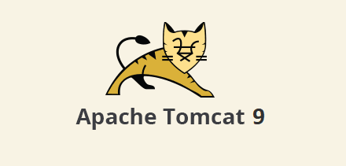

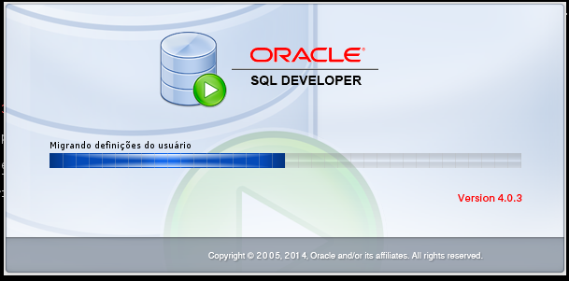
Applications
Server : Apache Tomcat 9
IDE : Eclipse Neon
DB IDE : Oracle SQL Developer 4.0.3

Slide 11




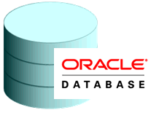
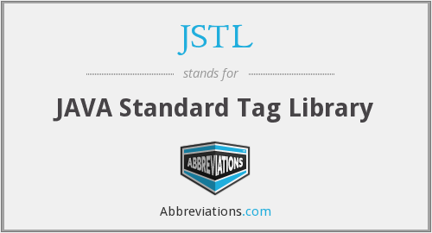


Tools

Slide 12
05
Project Screenshots

Slide 13
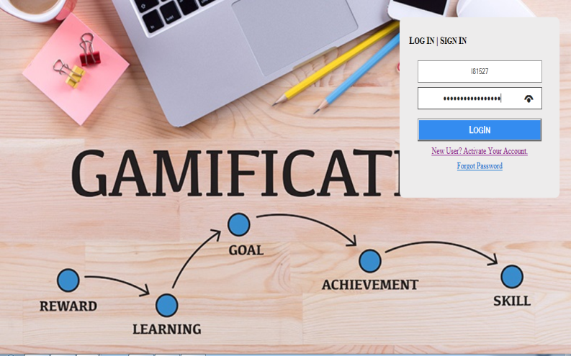
Index Pages
H

Slide 14
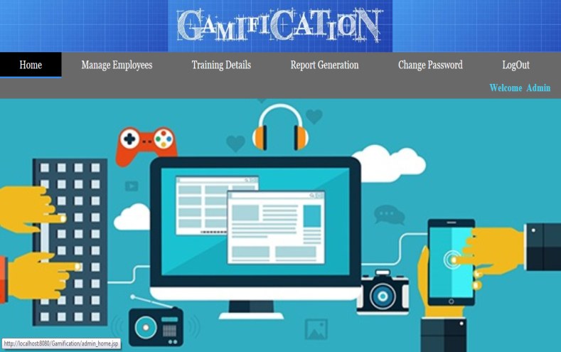
Admin : Home Page

Slide 15
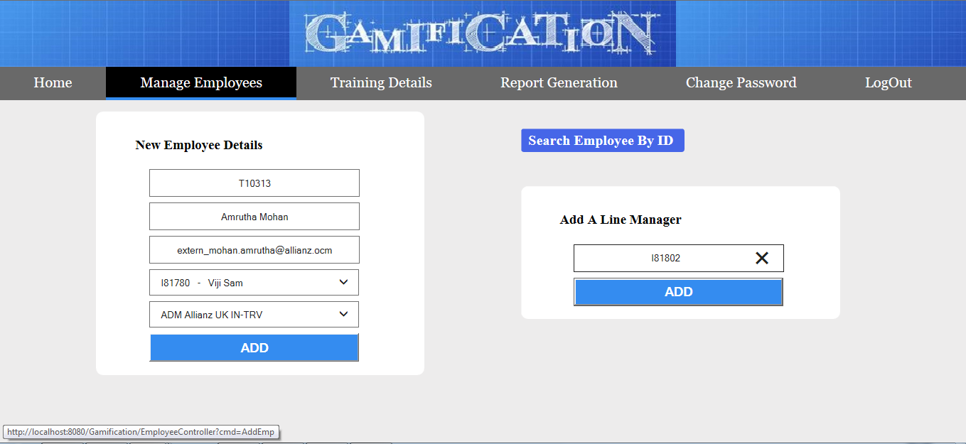
Add an Employee & Line Manager

Slide 16
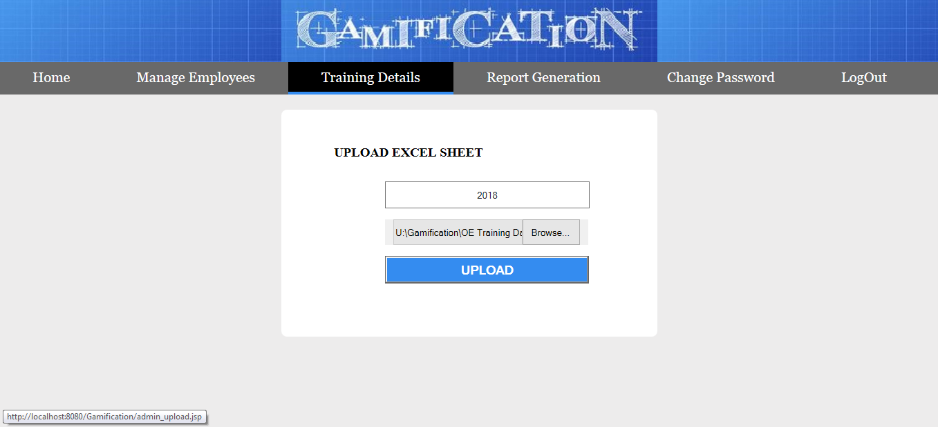
Upload Excel Sheet

Slide 17
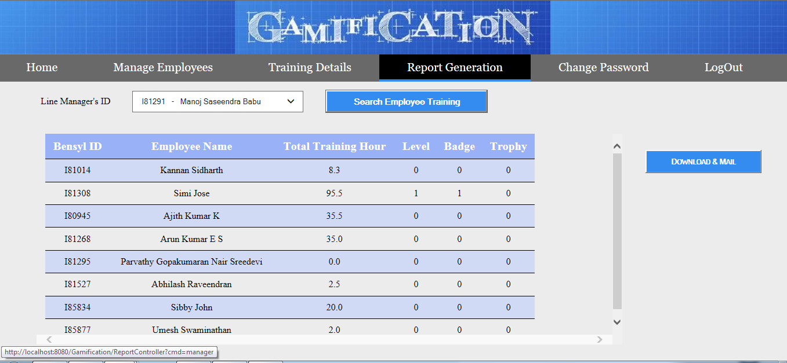
Report Generation

Slide 18
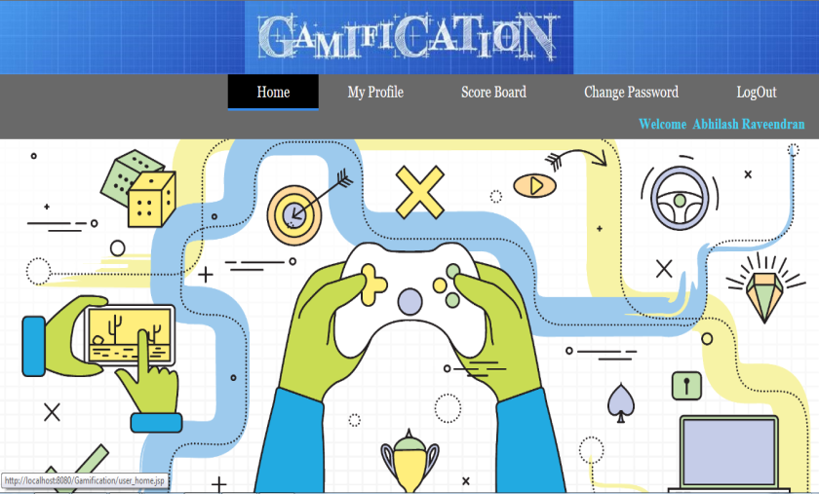
Employee Home Page

Slide 19
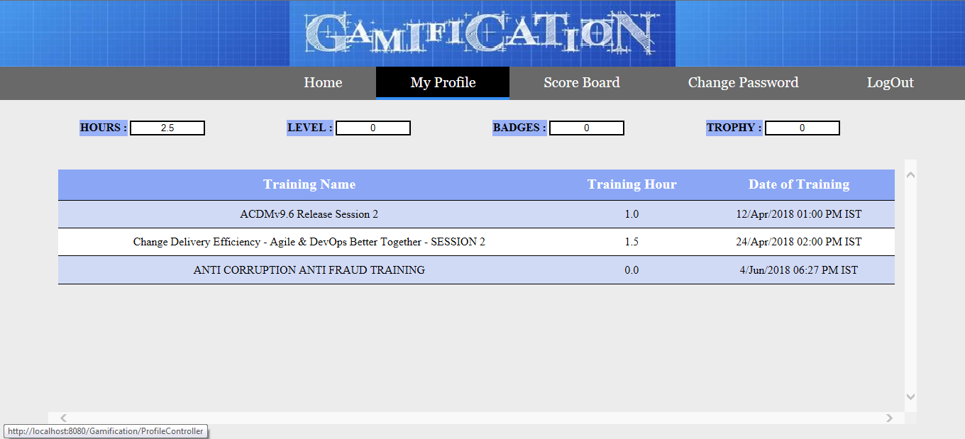
Employee Profile

Slide 20
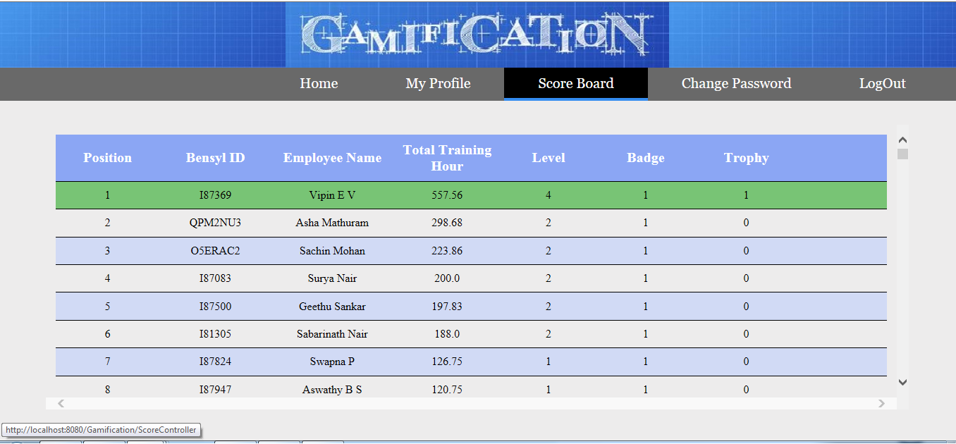
Employee Scoreboard

Slide 21
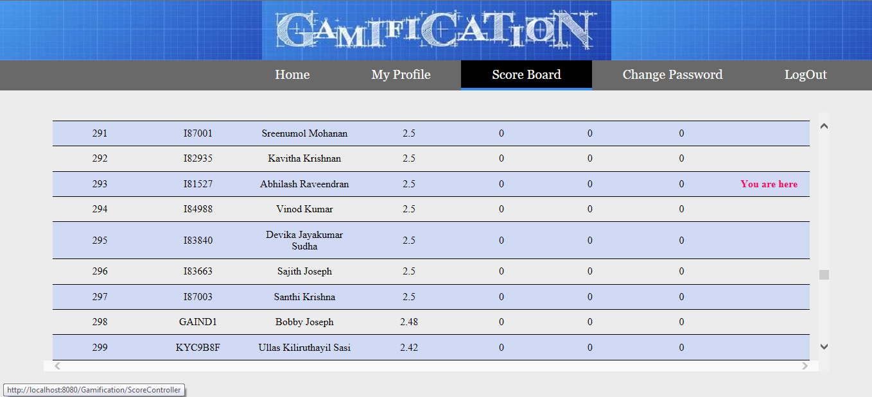
Position Relative to Others

Slide 22
06
IT Data Team

Slide 23
Team
Corporate MIS Team
EBI IT Team
IT Data Team

Slide 24
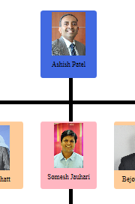
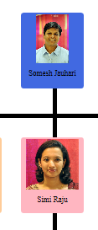
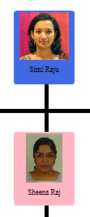
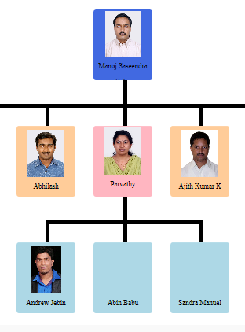
Organizational Chart

Slide 25
Why such a Team?
Track all organizational data and keep histories.
Produces reports on operations for every level of management.
Data Warehousing and Data Reporting.
Data Analysis and Decision Making.
Ultimate Goal : Increase the Value and Profit of business.

Slide 26
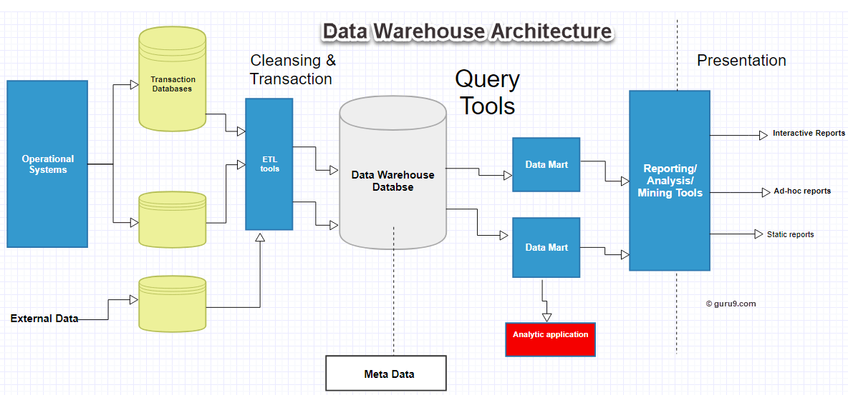
Data Warehouse

Slide 27
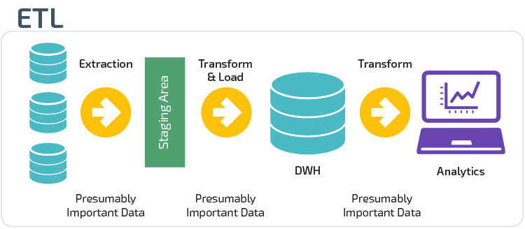

Slide 28
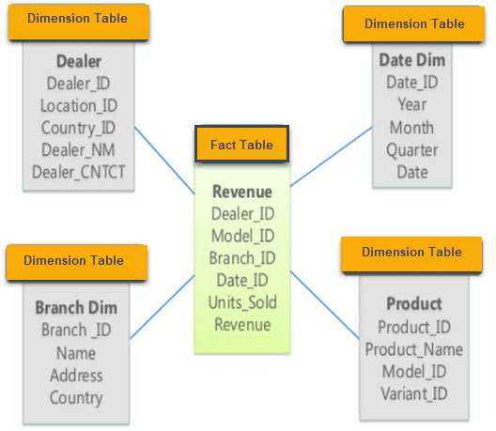
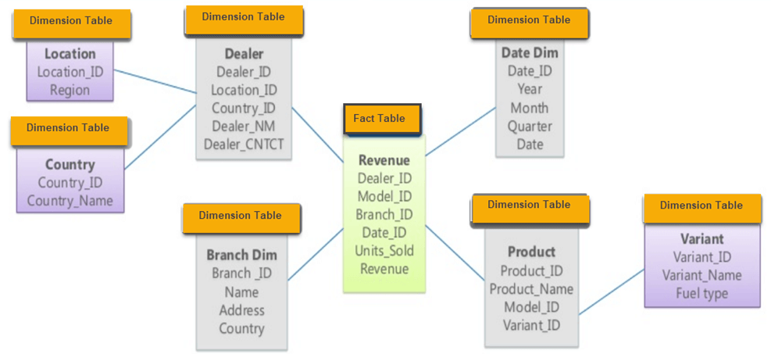
Multidimensional Schema
Star Schema
Snowflake Schema

Slide 29
Data Flow
DHOLAP Reports
Platform
Model
Summaries
Web Reports
Extracts
Excels
Data Warehouse

Slide 30
07
SAS Technology

Slide 31
SAS
Company and Software.
Have rules and conventions like other programming languages
Only two datatypes : Character & Numeric
Formats and Informats. Format : How to write data. Informat: How to read data.
Eg : DATEw. Like date7. (16AUG95)
SAS Dataset : Variables and Observations.
DATA Step & PROC Step of a SAS program.

Slide 32
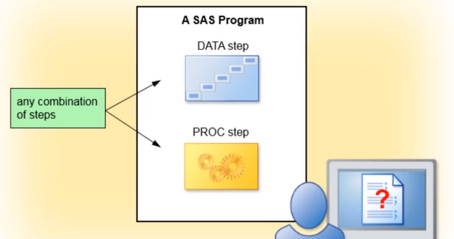
SAS Program Structure
Read and Modify data.
Create SAS Data Set.
Perform specific analysis or function.
Produce results or output.

Slide 33
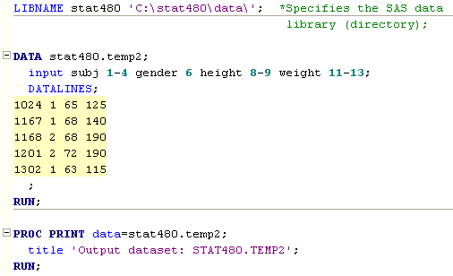
Sample SAS Program

Slide 34
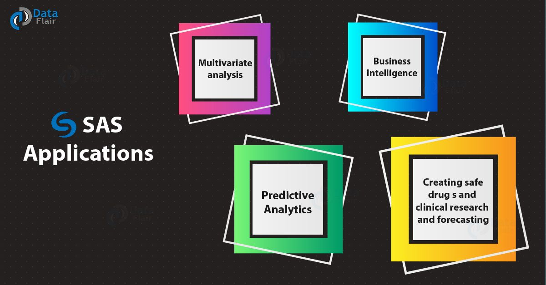
Applications of SAS

Slide 36


Slide 37
08
Claims

Slide 39
09
Participations

Slide 41


