Slide 1
AILP – Allianz Initial Learning Program
Amrutha Mohan (T10313)
IT DATA Team (SAS)
13th September, 2018

Slide 2
CONTENTS
1. ABOUT ALLIANZ | 6. IT DATA TEAM
2. KEY LEARNINGS | 7. SAS TECHNOLOGY
3. PROJECT – WEB DEVELOPMENT | 8. CLAIMS
4. APPLICATIONS & TOOLS | 9. PARTICIPATIONS
5. PROJECT SCREENSHOTS

Slide 3
01
Allianz

Slide 4
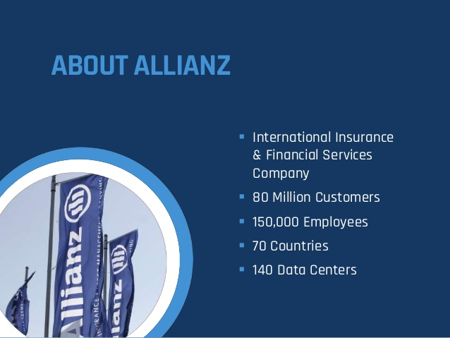

Slide 5
02
Key Learnings

Slide 6
Learnings
Technologies
Core Java
JSP, JSTL
Servlet
HTML, CSS
Java Script, Ajax
Database Basics
Oracle DB
SQL
PL/SQL
Basics of Insurance
Sessions
Corporate Induction
Team Induction
Agile
ACDM

Slide 7
03
Project – Web Development

Slide 8
Gamification
Employee :
Admin :
Login
Login
Upload Training Details
Manage Employees
Generate Reports
Change Password
View Profile
View Scoreboard
Change Password
Add Line Manager
Search/Edit/ Delete an Employee
Add an Employee
Logout
Activate an Employee Account
Logout

Slide 9
04
Applications & Tools

Slide 10
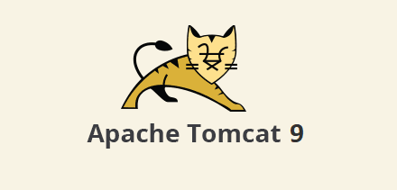

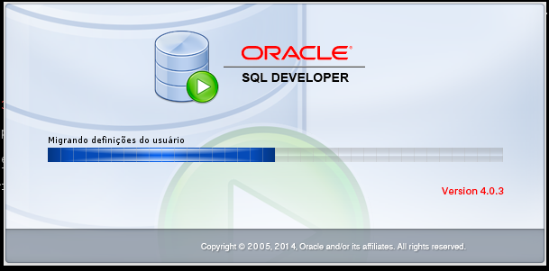
Applications
Server : Apache Tomcat 9
IDE : Eclipse Neon
DB IDE : Oracle SQL Developer 4.0.3

Slide 11

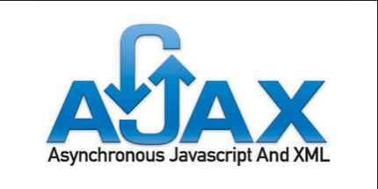


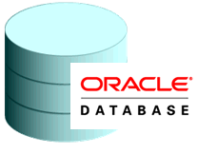
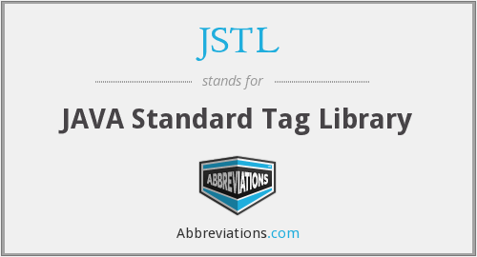


Tools

Slide 12
05
Project Screenshots

Slide 13
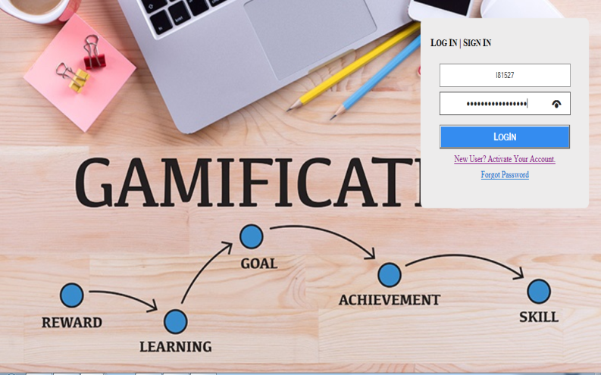
Index Pages
H

Slide 14
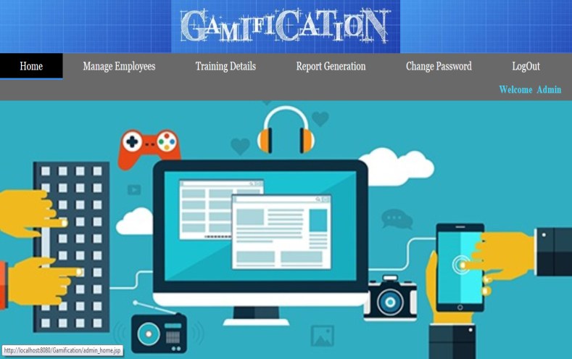
Admin : Home Page

Slide 15
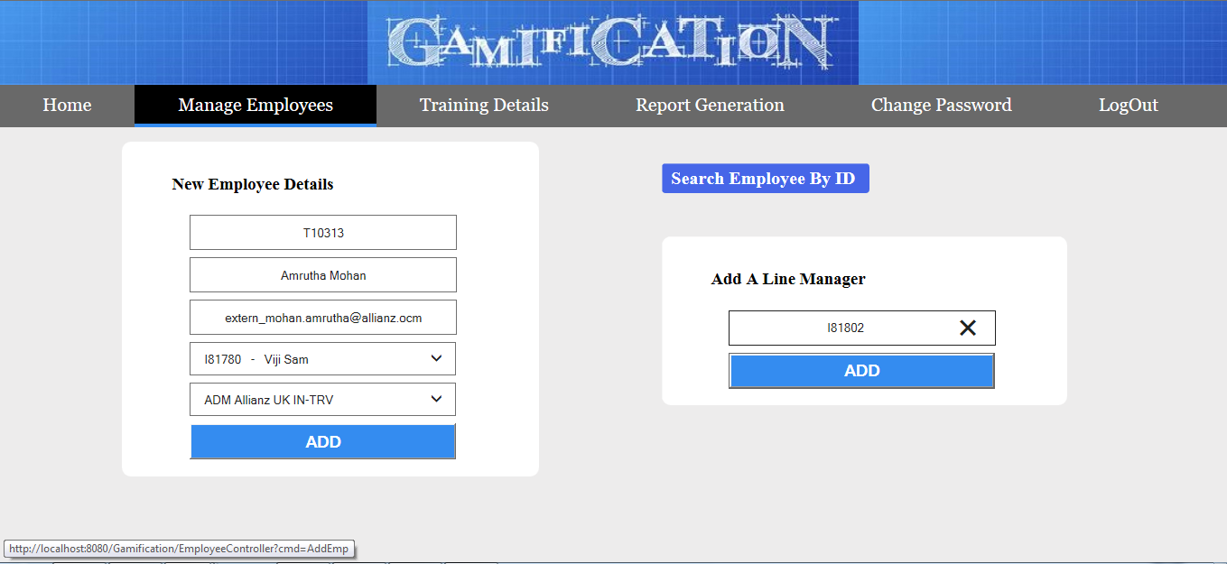
Add an Employee & Line Manager

Slide 16
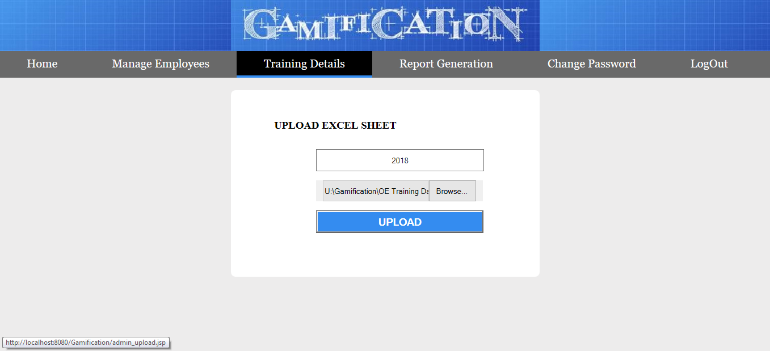
Upload Excel Sheet

Slide 17
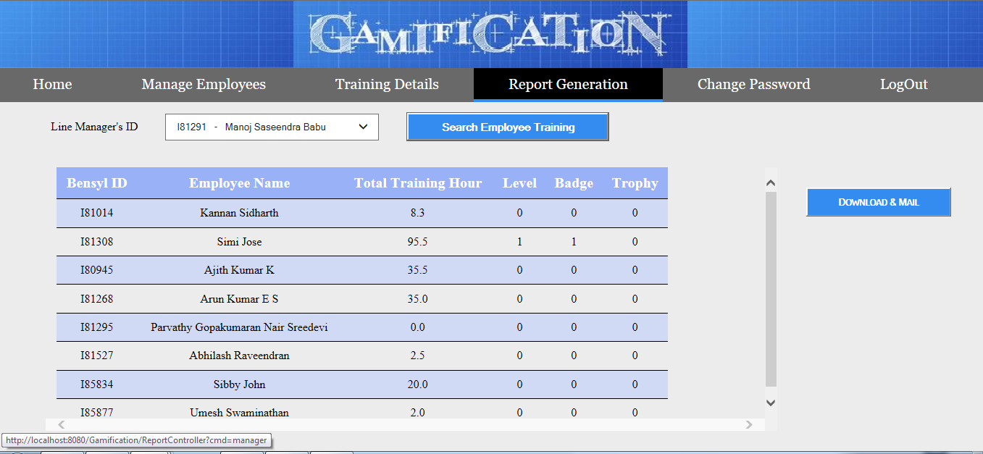
Report Generation

Slide 18
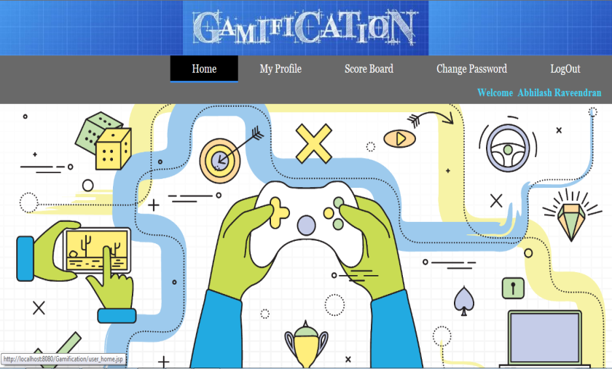
Employee Home Page

Slide 19
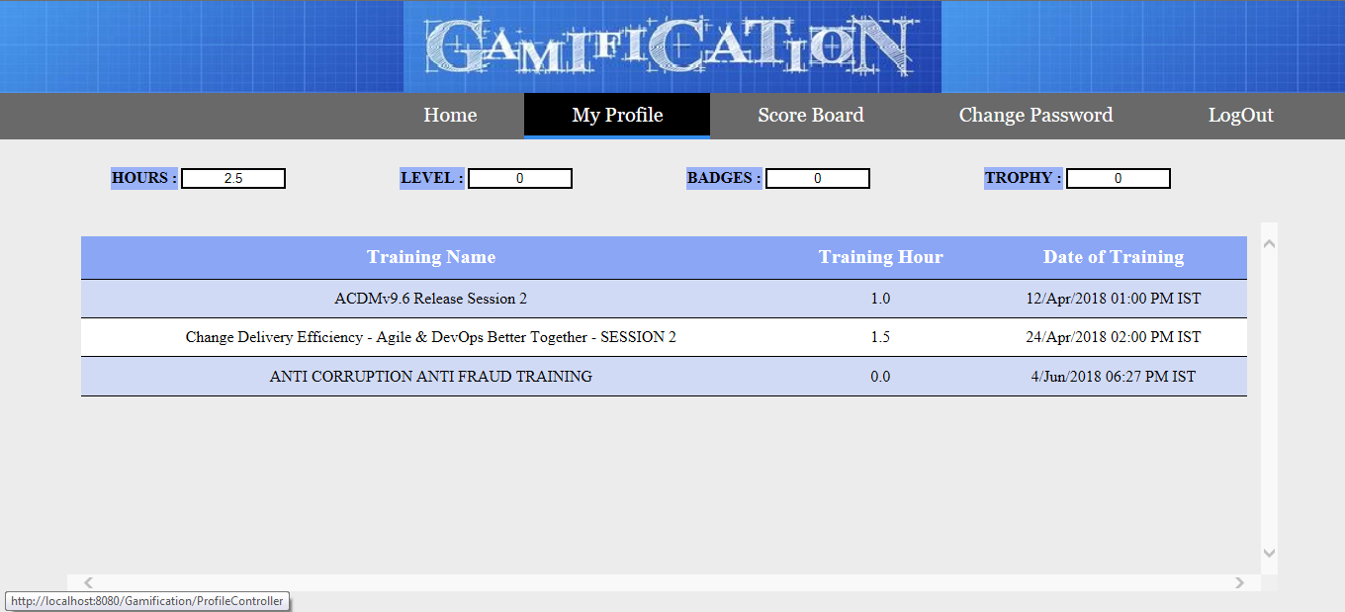
Employee Profile

Slide 20
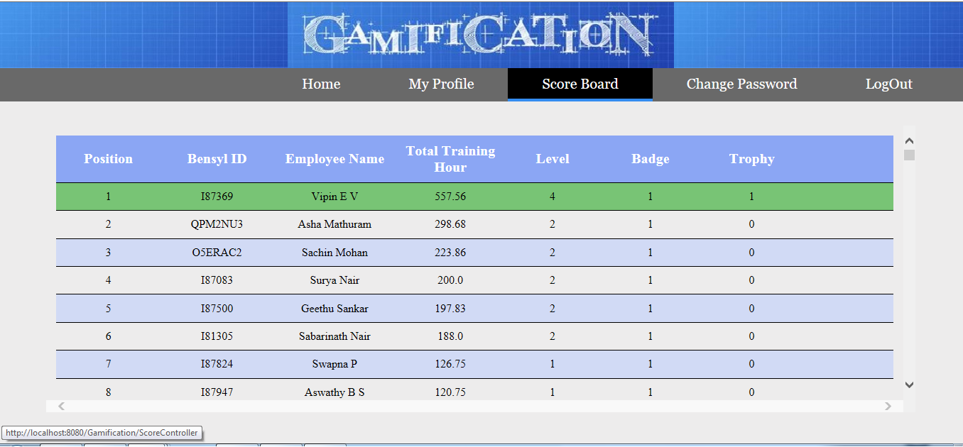
Employee Scoreboard

Slide 21
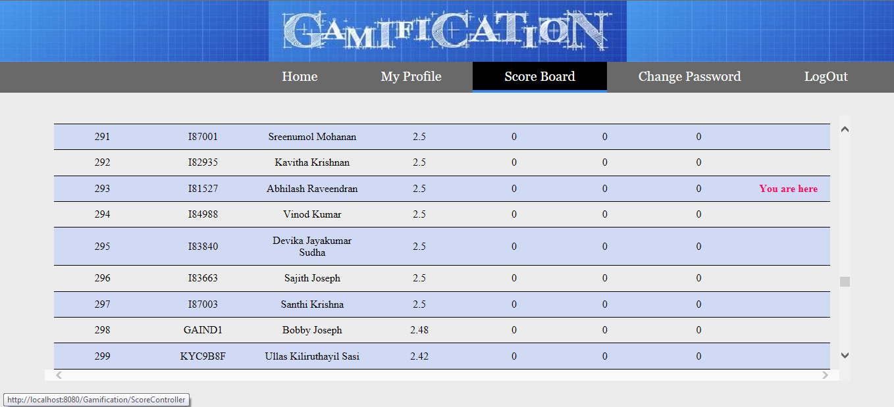
Position Relative to Others

Slide 22
06
IT Data Team

Slide 23
Team
Corporate MIS Team
EBI IT Team
IT Data Team

Slide 24
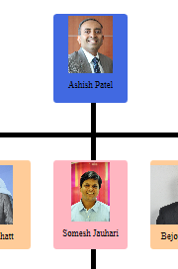
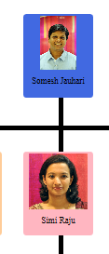
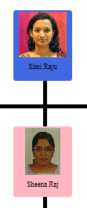
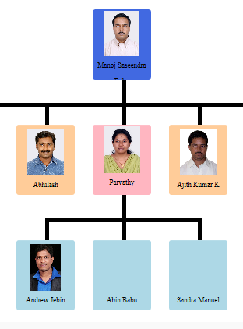
Organizational Chart

Slide 25
Focuses in the management of operation systems data which helps in efficient and effective decision making.

Slide 26
What we do
Track all organizational data and keep histories.
Produce reports on operations for every level of management.
Data Warehousing and Data Reporting.
Data Analysis and Decision Making.
Ultimate Goal : Increase the Value and Profit of business.

Slide 27
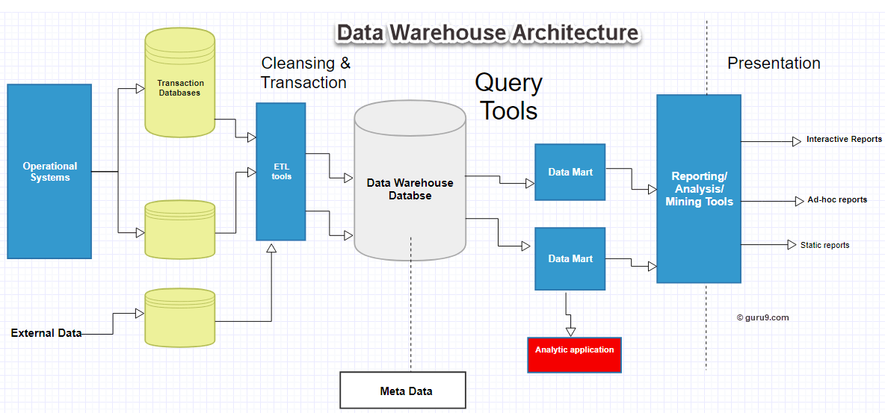
Data Warehouse

Slide 28
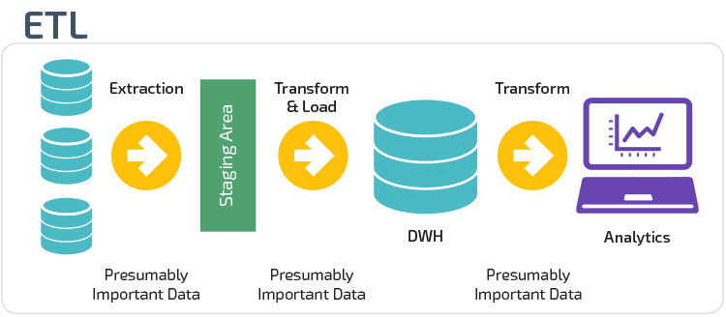

Slide 29
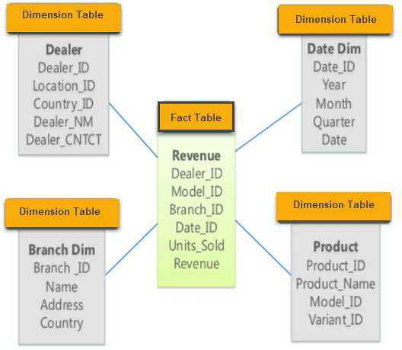
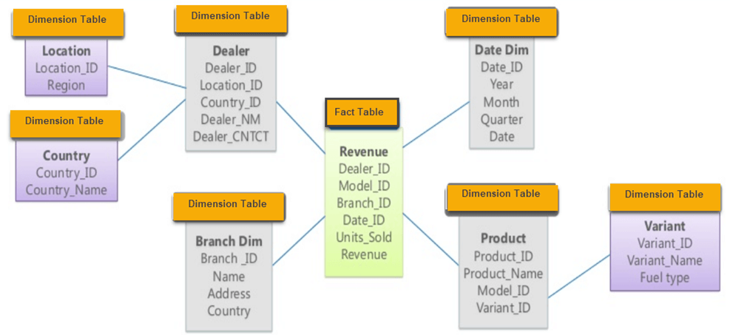
Multidimensional Schema
Star Schema
Snowflake Schema

Slide 30
Data Flow
DHOLAP Reports
Platform
Model
Summaries
Web Reports
Extracts
Excels
Data Warehouse

Slide 31
07
SAS Technology

Slide 32

Company (SAS Institute) and Software.
SAS suit has 200 components.
Base SAS
SAS/ACCESS
SAS Data Quality Server
SAS/STAT etc.
SAS is a 4GL.
ETL Tool & BI.

Slide 33
SAS Programming
Rules and Conventions.
Only two datatypes : Character & Numeric
Formats and Informats. Format : How to write data. Informat : How to read data.
Eg : DATEw. Like date7. (16AUG95)
SAS Dataset : Variables and Observations.
DATA Step & PROC Step of a SAS program.

Slide 34
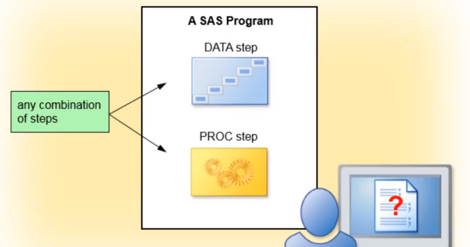
SAS Program Structure
Read and Modify data.
Create SAS Data Set.
Perform specific analysis or function.
Produce results or output.

Slide 35
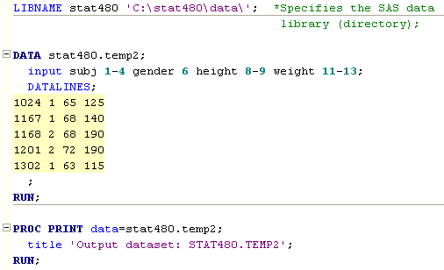
Sample SAS Program

Slide 36
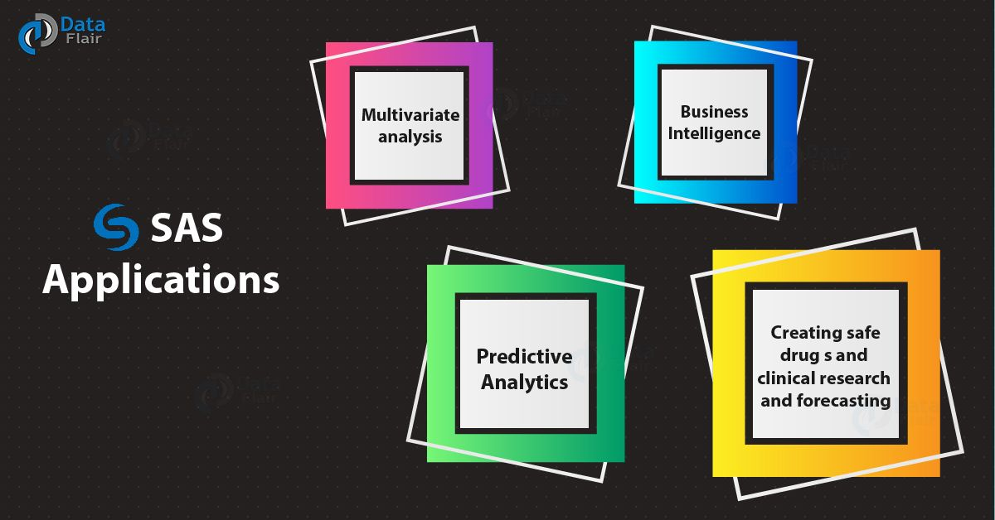
Applications of SAS

Slide 38
WHO ARE WE?
MANAGEMENT INFORMATION SYSTEM
MIS Team focuses on the management of operational
systems data which helps in efficient and effective
strategic decision making.
MIS plays a pivotal role in the organization and creates an
impact on the organization’s functions, performance and
productivity.
It goes without saying that all managerial functions are
performed through decision-making. For taking rational
decision, timely and reliable information is essential and
is procured through a logical and well-structured method
of information collecting, processing and disseminating to
decision makers. Such a method in the field of management
is widely known as MIS.

Slide 39
WHAT MAKES MIS TEAM SO SPECIAL?
Can be compared to the role of heart in the body;
information as the blood and MIS the heart.
MIS ensures that an appropriate data is collected from
the various sources, processed and send further to all the
needy destinations. The system is expected to fulfil the
information needs of an individual, a group of individuals,
the management functionaries: the managers and top
management. Thus MIS helps in strategic planning,
management control, operational control and transaction
processing.

Slide 40
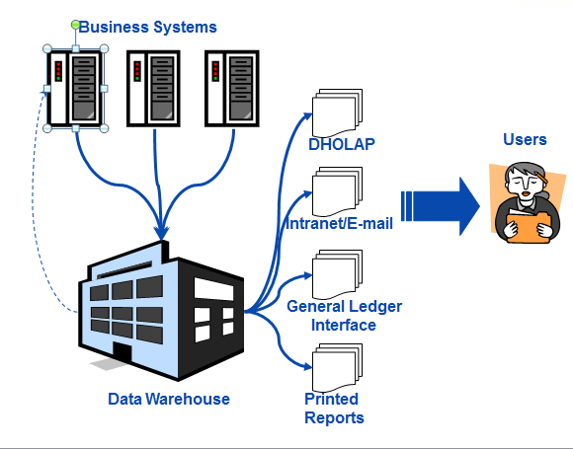

Slide 41
CUSTOMER GROUP?
Actuarial and Planning - Provides the GLM data for
statistical analysis
Accounts Team - Supports Accounts team in the
generation of reconciliation reports between different
systems and sends inputs to SAP
Commercial Lines Business Users - Provides reports
on different date basis (E.g. Financial date basis, Effective
date basis, Underwriting date basis and Triangle reports)
Retail Business – A number of reports for Retail Direct,
Retail Broker and Retail Corporate Partners (Schemes)
[E.g. Triangles, Portfolio based reports, Profitability reports]
Claims Business - Generates Dashboards, Web reports
and Claims Specialist reports
Senior Managers - Financial Results Pack and Daily claims
alert reports

Slide 42
Technology
Primary Technology: SAS Base: Macros/Base
SAS BI: SAS OLAP Cube Studio/ SAS Web Report Studio/ SAS Information
Delivery Portal/ SAS Data Integration Studio/SAS Enterprise
Guide/SAS Information Map Studio/SAS Management Console
Supportive Technologies: Mainframes, UNIX, Windows and Oracle

Slide 43
08
Claims

Slide 45
09
Participations

Slide 47


