Slide 1
AILP – Allianz Initial Learning Program
Amrutha Mohan (T10313)
IT DATA Team (SAS)
13th September, 2018

Slide 2
CONTENTS
1. ABOUT ALLIANZ | 6. IT DATA TEAM
2. KEY LEARNINGS | 7. SAS TECHNOLOGY
3. PROJECT – WEB DEVELOPMENT | 8. CLAIMS
4. APPLICATIONS & TOOLS | 9. PARTICIPATIONS
5. PROJECT SCREENSHOTS

Slide 3
01
Allianz

Slide 4
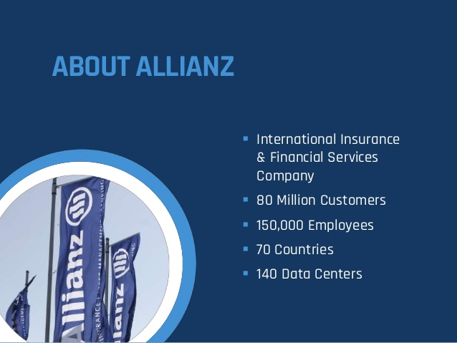

Slide 5
02
Key Learnings

Slide 6
Learnings
Technologies
Core Java
JSP, JSTL
Servlet
HTML, CSS
Java Script
Database Basics
Oracle DB
SQL
PL/SQL
Basics of Insurance
Sessions
Corporate Induction
Team Induction
Agile
ACDM

Slide 7
03
Project – Web Development

Slide 9
04
Applications & Tools

Slide 10
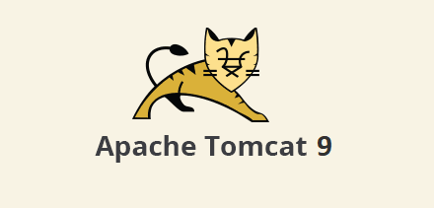

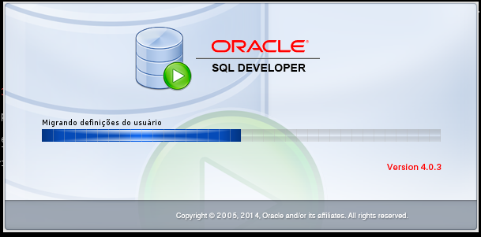
Applications
Server : Apache Tomcat 9
IDE : Eclipse Neon
DB IDE : Oracle SQL Developer 4.0.3

Slide 11

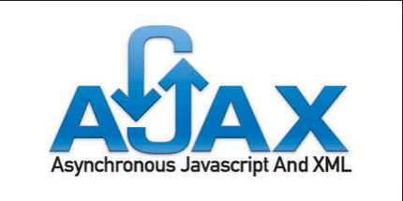


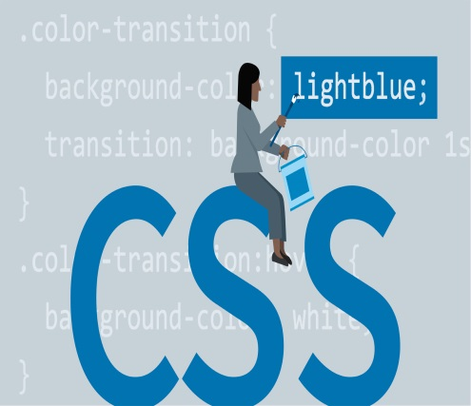
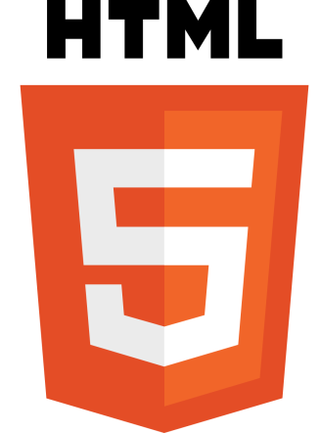
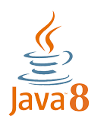
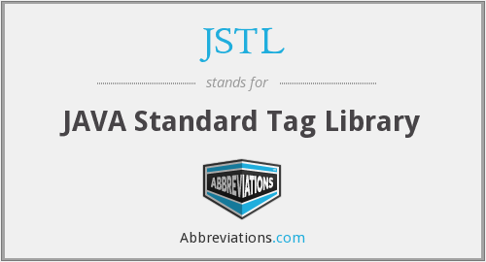
Tools

Slide 12
05
Project Screenshots

Slide 13
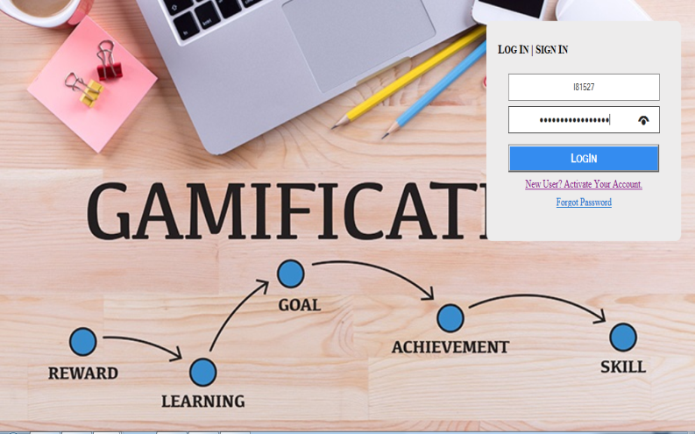
Index Pages
H

Slide 14
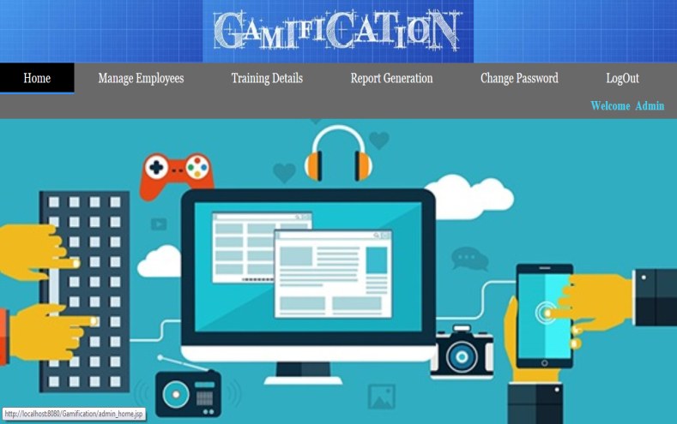
Admin Home Page

Slide 15
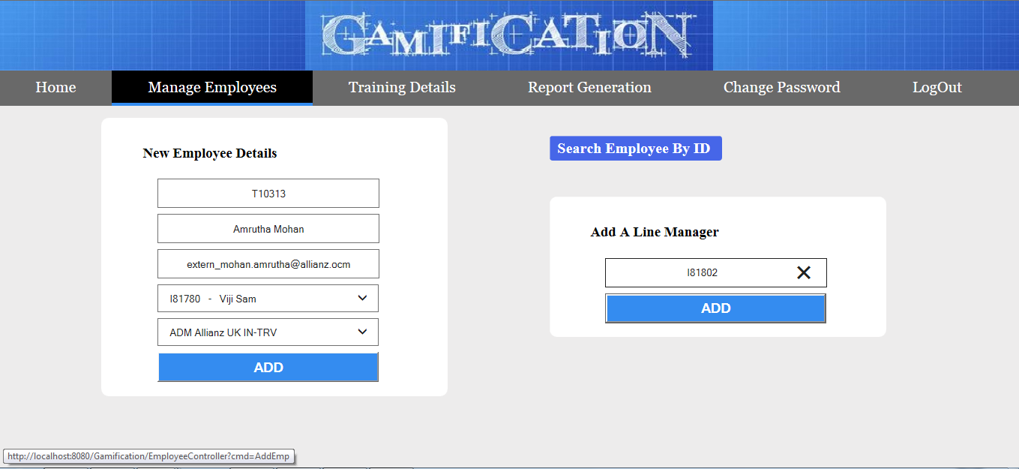
Add an Employee & Line Manager

Slide 16
Search, Edit & Delete Employee

Slide 17
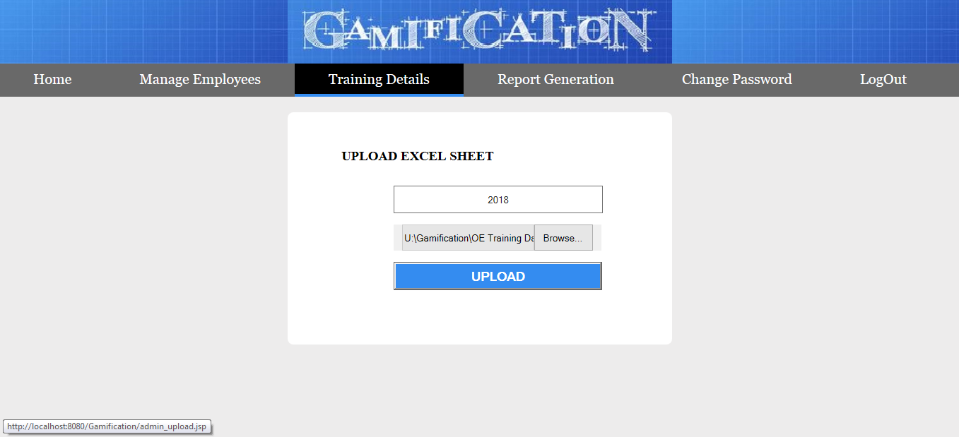
Upload Excel Sheet

Slide 18
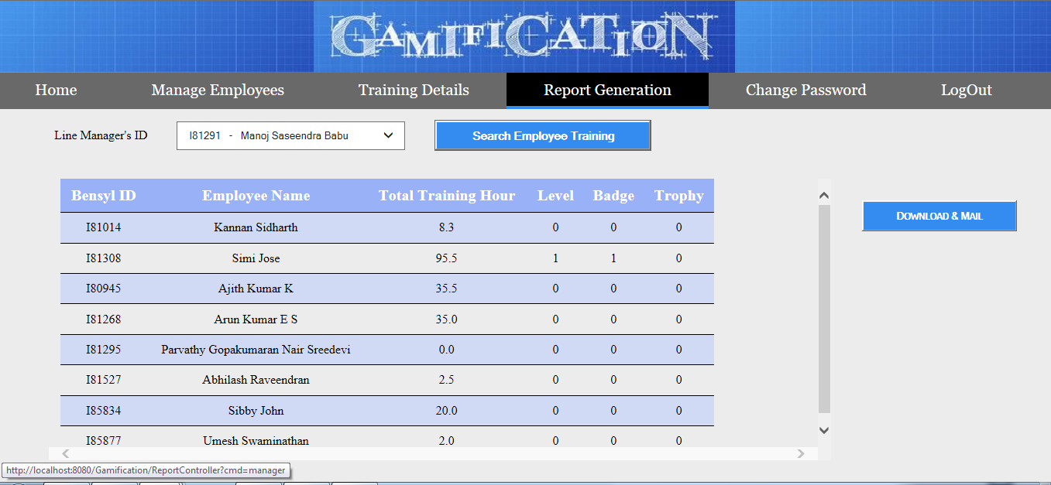
Report Generation

Slide 19
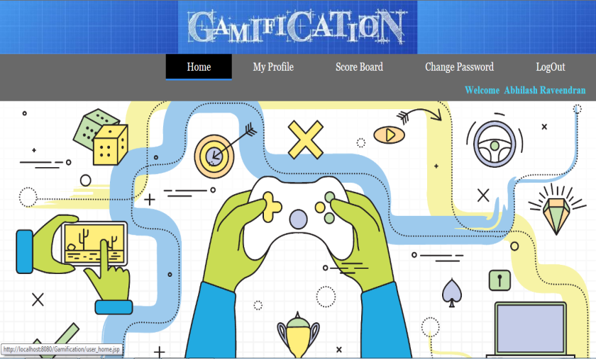
Employee Home Page

Slide 20
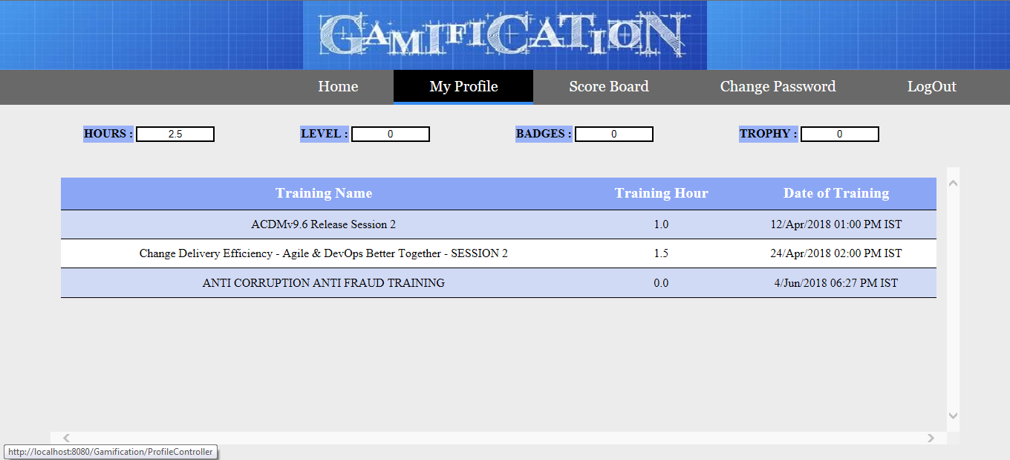
Employee Profile

Slide 21
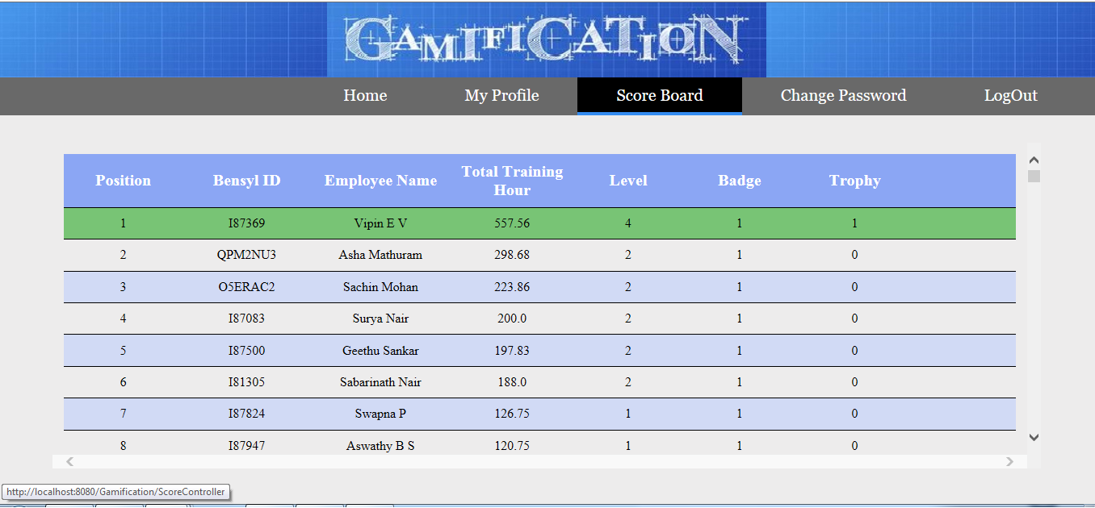
Employee Scoreboard

Slide 22
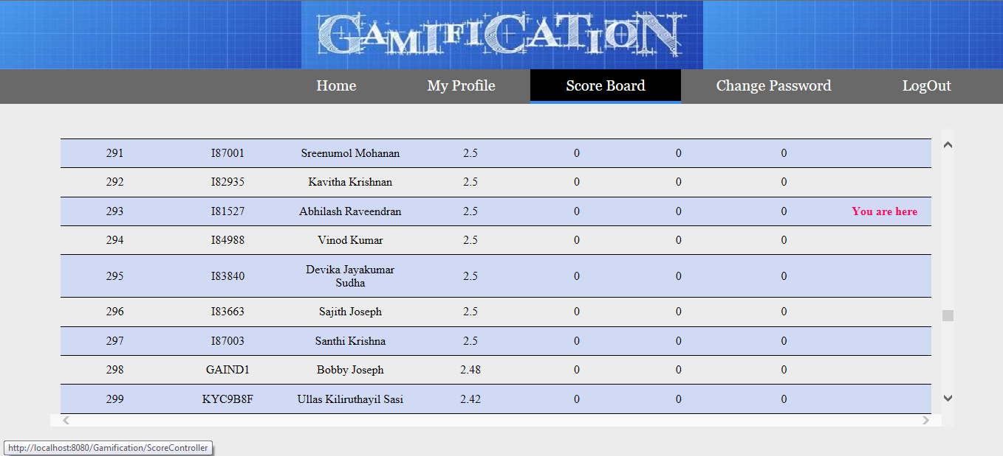
Position Relative to Others

Slide 23
06
IT Data Team

Slide 24
Corporate MIS Team
EBI IT Team
IT Data Team

Slide 25
Data Warehousing and Data reporting.
Track all organizational data and keep histories.
Data Analysis and Decision Making.
Produces reports on operations for every level of management.
Ultimate Goal : Increase the Value and Profit of business.

Slide 26
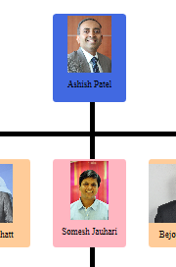
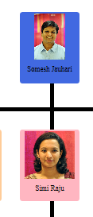
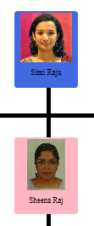
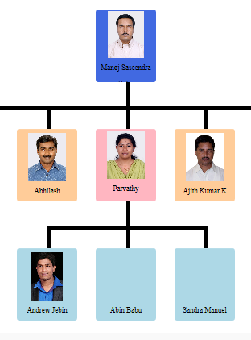
Organizational Chart

Slide 27
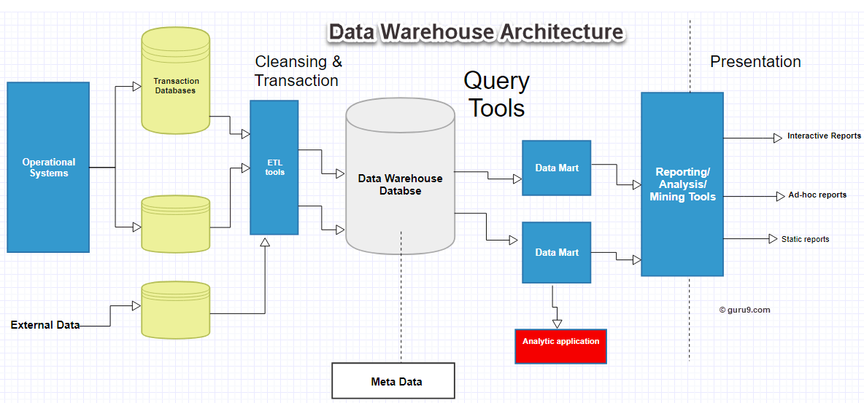
Data Warehouse

Slide 28
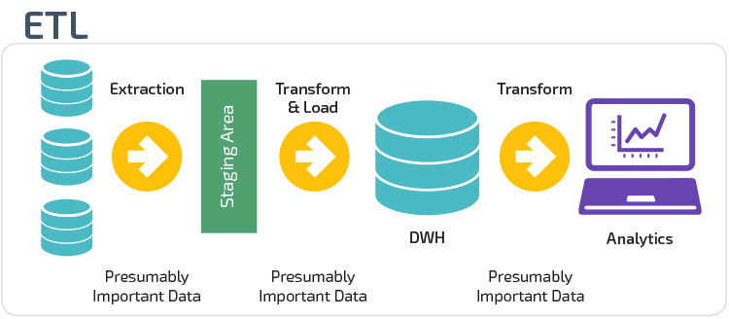

Slide 29
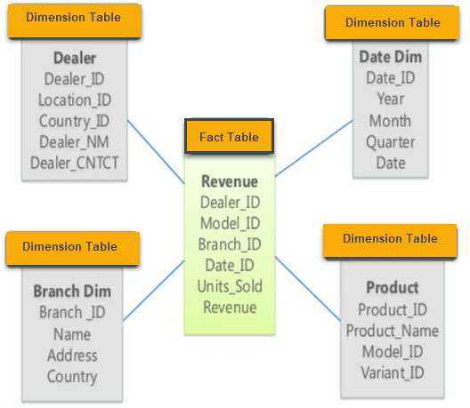
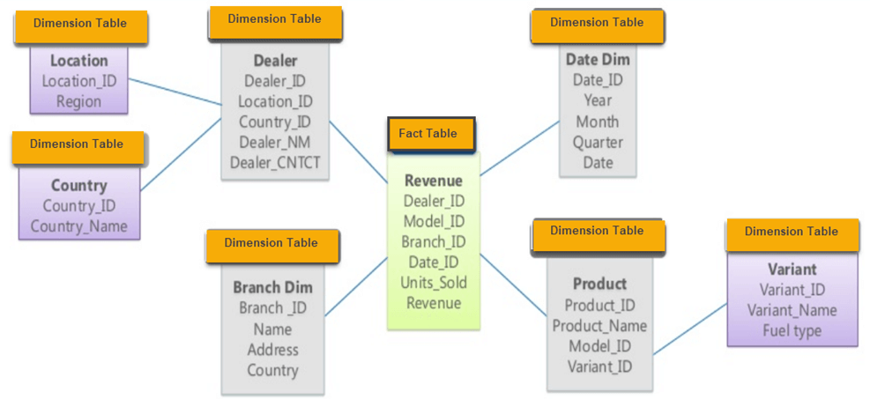
Multidimensional Schema
Star Schema
Snowflake Schema

Slide 30
07
SAS Technology

Slide 31
SAS
Company and Software.
Have rules and conventions like other programming languages
Only two datatypes : Character & Numeric
Formats and Informats. Format : How to write data. Informat: How to read data.
SAS Dataset : Variables and Observations.
DATA Step & PROC Step of a SAS program.

Slide 32
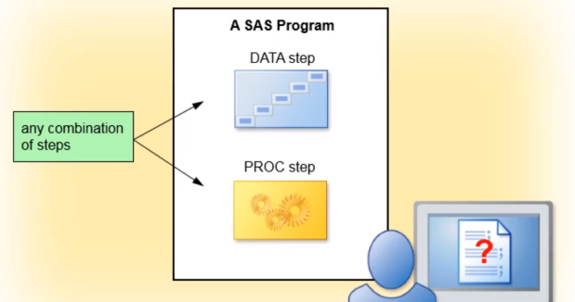
SAS Program Structure
DATA Step :
Read and Modify data.
Create SAS Data Set.
PROC Step :
Perform specific analysis or function.
Produce results or output.

Slide 33
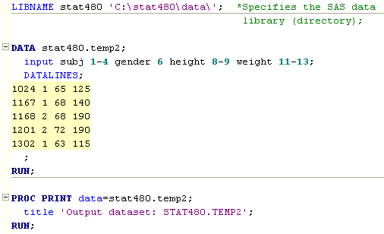
Sample SAS Program

Slide 34
a. Multivariate Analysis
For instance, consider a person wishes to buy stock in bulk. So he or she would weigh various factors like price and quantity or price and quality etc. The multivariate analysis does the same thing. It detects and analyses various statistical variables of an outcome at the same time. A technique is used in this analysis. It uses various studies which depict the effect of variable factors on one single result. It includes analysis of factor analysis, bivariate analysis, and multiple regressions.
Let’s Discuss SAS One Way ANOVA – SAS PROC ANOVA
b. Business Intelligence
It refers to strategies and technologies used by any enterprise for data analysis of business information. It provides insights regarding predictive, current and historical views of business working. The analysis of data helps the senior board with scope for decision making. These technologies include reporting, data mining, process mining, complex event processing, benchmarking etc.
c. Predictive Analytics
As the name suggests it uses already available data to predict the future. It uses various statistical techniques to draw inferences. For instance, in a company, the trend in sales of product A has been constant over years. So, it suggests non-changing demand of the product. But for product B with changing demand every month. It analyses all the factors causing the variation, hidden inferences in text, customer thought process etc. Here predictive model exploits patterns found in historical data to identify risk.
Read a new Topic – SAS Repeated Measure Analysis
d. Creating Safe Drugs & Clinical Research and Forecasting
Diagnosis and prognosis are a very critical element of medicine. They should always be very precise and accurate. SAS has played a revolutionary role in the field of medicine. It is used in clinical decision making support system. This is used to monitor whether patients are at risk. They are even used to find small opportunities for improvement in the condition of a patient.
SAS is a 4GL language. The main SAS application is to minimize programming efforts and reduce the time and money required to develop software.
So, this was all about SAS Applications. Hope you like our explanation.

Slide 35
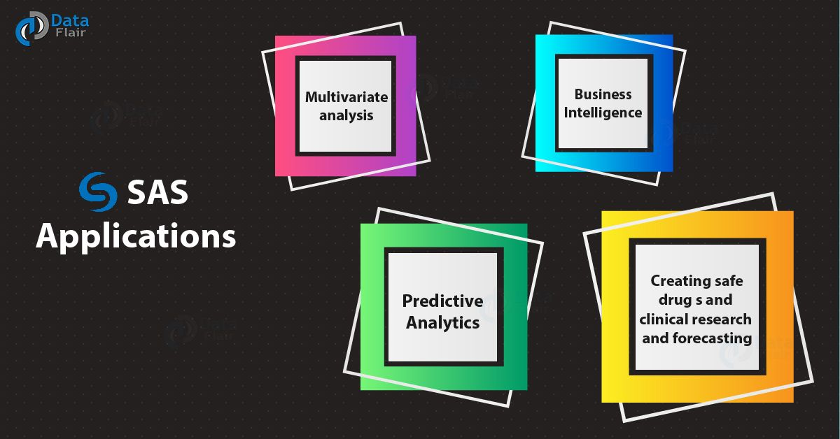

Slide 36
https://data-flair.training/blogs/sas-tutorial/

Slide 38
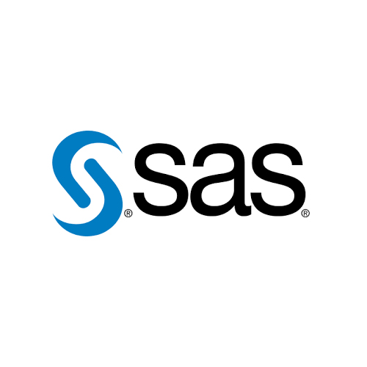

Slide 39
08
Claims

Slide 41
09
Participations

Slide 43


