Slide 1
Alzheimer’s Disease Classification Using Deep Learning, Integrating with Explainable AI, and LLM
Team:
MANAM AMRUTHA VARSHINI(22BCE7782)
KODURI RENU SRI PRIYA(22BCE9362)
ARIBANDI PRIYATAM(22BCE7145)
KOTA VIJAY RAMA ROYAL(22BCE8713)

Slide 2
Contents:
1. Introduction
2. Motivation
3. Literature Survey
4.Gaps Identified
Problem Statement
5.Objectives
6.Proposed Solution
7.Result
8.Conclusion

Slide 3
Introduction
Alzheimer’s disease is a progressive neurodegenerative disorder that causes memory loss and cognitive decline, with MRI scans revealing key structural brain changes.
Manual MRI Interpretation is time consuming , expertise-dependent and prone to human error , making early detection and large scale screening difficult.
This project develops an AI-based Alzheimer’s Disease Classification using Convolutional Neural Networks (CNNs) to automatically classify stages into Non-Demented, Very Mild Demented, Mild Demented, and Moderate Demented.
This integrates Explainable AI (XAI), and LLM-based explanations to deliver high accuracy, interpretability, and trustworthy insights for AI-assisted diagnosis and research.

Slide 4
Motivation
Rising Prevalence of Alzheimer’s Disease
Limitations of Manual MRI Analysis
Need for Automation and Precision
Advancements in AI and Explainability
Contribution to Medical Innovation

Slide 5
Literature Survey
S.NO | TITLE | AIM | ADVANTAGES | DISADVANTAGES
1. | Classification of Alzheimer’s Disease Using Deep Convolutional Neural Networks (CNNs) —Suk, H.-I., Lee, S.-W., Shen, D. (2017) | To develop a CNN-based model for classifying MRI brain scans into different stages of Alzheimer’s disease. | High classification accuracy; automatic feature extraction; minimal preprocessing. | Requires large labeled datasets; risk of overfitting with small data.
2. | Alzheimer’s Disease Detection Using Transfer Learning with VGG16 —Islam, J., Zhang, Y. (2018) | To apply pre-trained VGG16 for MRI-based Alzheimer’s stage detection. | Faster convergence; leverages pretrained features; robust feature representation. | High computational demand; domain adaptation challenges.
3. | Explainable Deep Learning for Medical Image Diagnosis Using Grad-CAM—Selvaraju, R. R., Cogswell, M., Das, A. (2017) | To visualize CNN attention regions using Grad-CAM for interpretability in medical imaging. | Enhances transparency; aids clinical trust and understanding. | Provides coarse localization; lacks detailed region precision.

Slide 6
4. | Integrating Language Models with Medical Imaging for Explainable Diagnosis — Singh, A., et al. (2021) | To combine deep learning and LLMs for natural language explanations of model predictions. | Improves interpretability; helps non-technical users understand AI decisions. | May produce uncertain or generic explanations; needs API dependency.
5. | Multimodal Alzheimer’s Disease Prediction Using MRI and Cognitive Data — Liu, M., Cheng, D., Yan, W. (2018) | To combine MRI imaging with cognitive test data for improved Alzheimer’s detection accuracy. | Captures broader indicators; enhances prediction reliability. | Complex data fusion; requires multimodal dataset availability.
6. | Automated Alzheimer’s Stage Detection using EfficientNet Architecture — Jain & Singh, 2021 | To enhance classification accuracy and model efficiency using lightweight CNNs like EfficientNet-B0. | High accuracy with fewer parameters; suitable for real-time deployment. | Limited explainability; model performance may vary across datasets.
7. | XAI-Based Deep Learning Framework for Alzheimer’s Stage Classification —Sharma et al., 2023 | To integrate Explainable AI with CNN models for stage-wise Alzheimer’s classification from MRI. | Combines interpretability with performance; user-trust enhancement in diagnosis. | Complex integration; may increase inference time.

Slide 7
Gaps Identified:
Limited Differentiation Between Early and Mild Stages
Dependence on Large, Expert-Annotated MRI Datasets
Insufficient Explainability in Deep Learning Models
Lack of Standardization Across Datasets and Evaluation Protocols
Limited Real-Time and User-Friendly Diagnostic Tools
Minimal Integration of Multimodal and Text-Based Insights

Slide 8
Problem Statement:
To design and develop a deep learning–based system capable of accurately classifying different stages of Alzheimer’s disease from MRI brain scans using Convolutional Neural Networks (CNNs), enhanced with Explainable AI (XAI) for interpretability and natural language explanations for clinical support.

Slide 9
Objectives:
1. Implement Robust MRI Data Preprocessing and Augmentation
Apply image preprocessing techniques such as skull stripping, normalization, and resizing to ensure data consistency.
Use augmentation methods like rotation, flipping, and contrast enhancement to improve model robustness and reduce overfitting.
Develop a Deep Learning Model for Alzheimer’s Stage Classification
Design and train CNN architectures to classify MRI brain scans into various Alzheimer’s stages (Non-Demented, Very Mild, Mild, Moderate).
Optimize model performance using hyperparameter tuning and validation strategies.
Integrate Explainable AI (XAI) for Model Transparency
Incorporate Grad-CAM or similar techniques to visualize key brain regions influencing predictions.
Enhance trust and interpretability for medical professionals through clear visual explanations.

Slide 10
Enable Natural Language Output Generation
Implement LLM-based summarization to translate model predictions into simple, clinically relevant language for easier interpretation.
Deploy as a Web-Based Diagnostic Platform
Build an interactive Flask web application allowing users to upload MRI scans and receive stage classification along with XAI and textual explanations.

Slide 11
Proposed Solution:
System Workflow:
1.Data Collection & Preparation:
  Gather MRI brain scan images categorized into four classes — NonDemented, VeryMildDemented, MildDemented, and ModerateDemented.
  Convert images from BGR to RGB, resize to 96×96 pixels, normalize to [0,1], and prepare for model input.
2.Data Augmentation:
  Apply transformations such as rotation, flipping, zooming, brightness, and contrast adjustments to enhance dataset diversity.
  Use augmentation to reduce overfitting and improve model robustness across varied scan conditions.
3.Model Development:
  Implement and compare two architectures — a custom CNN and VGG16-based transfer learning model for multi-class classification.
  Train with early stopping, batch normalization, and dropout to optimize accuracy and prevent overfitting.

Slide 12
Proposed Solution:
4.Model Evaluation:
  Evaluate both models using metrics such as accuracy, precision, recall, F1-score, and confusion matrix.
  Compare model performance on unseen test data and analyze visualization and explanation consistency.
5. Explainable AI Integration:
  Employ Grad-CAM, multi-class Grad-CAM, and saliency maps to visualize brain regions influencing predictions.
  Generate 2×2 class-specific heatmap grids for interpretability and trust in model decisions.
6. Natural Language Explanation:
  Integrate LLM-based explanation generation (using GPT-4o-mini or fallback T5) for contextual, human-understandable reports.
  Provide interpretations covering prediction meaning, confidence, affected brain regions, and clinical significance.

Slide 13
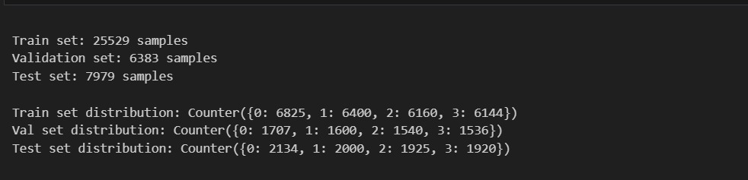
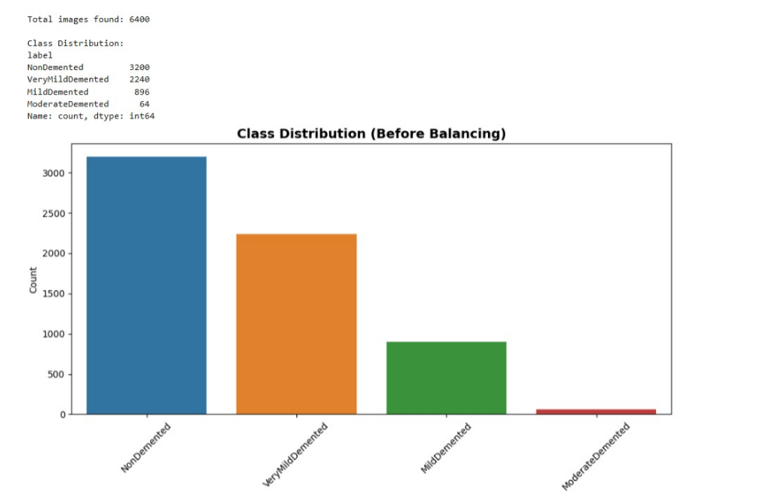
Objective-1:
The dataset was systematically split into training, validation, and testing sets to ensure balanced learning and reliable evaluation. Each MRI image was resized, normalized, and augmented using techniques such as rotation, brightness, hue adjustment, and flipping to increase data diversity and reduce overfitting.
Since the original dataset was relatively small (≈6,400 images) and class-imbalanced, extensive augmentation was applied to balance all categories. After augmentation, each class contained 9,600 images, resulting in a total of 38,400 images, enabling robust and generalized model training.

Slide 14
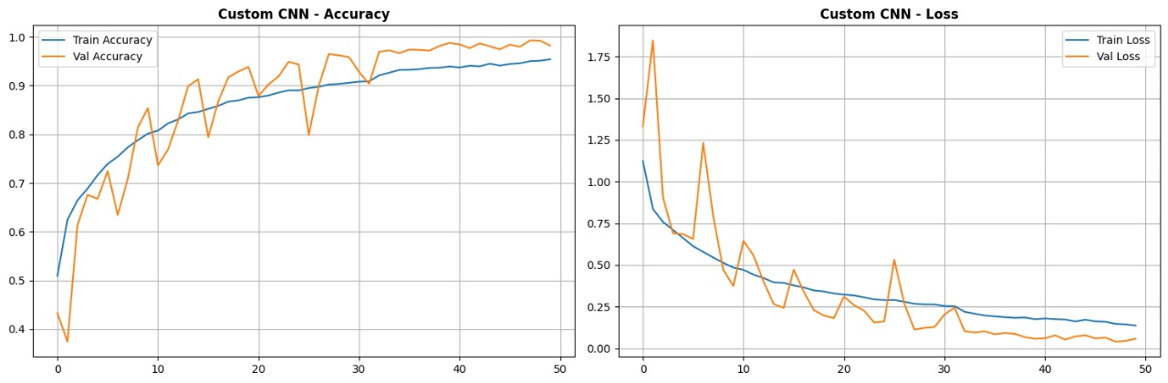
Objective-2:
Custom CNN Model: Achieved strong baseline performance with stable training, high accuracy, and excellent generalization across all Alzheimer’s stages. The model demonstrated superior test performance with minimal overfitting and effectively captured fine-grained MRI features.

Slide 15
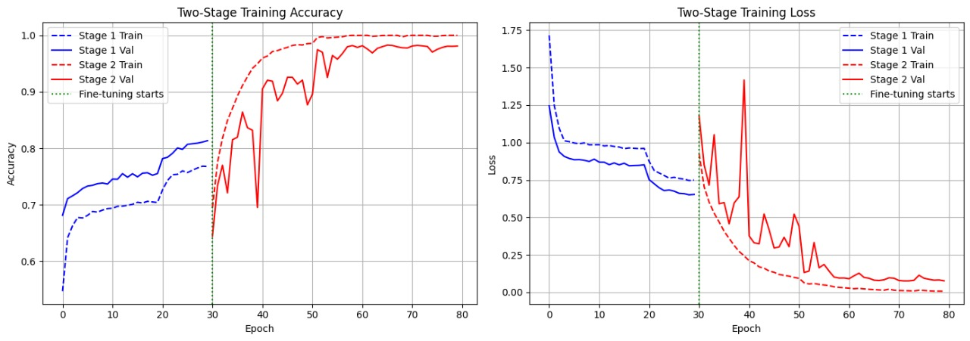
VGG16 Model: Delivered competitive results through transfer learning, leveraging pre-trained ImageNet weights for efficient feature extraction. While accuracy and validation performance were slightly lower than the Custom CNN, it exhibited robust learning and faster convergence during initial training stages.

Slide 16
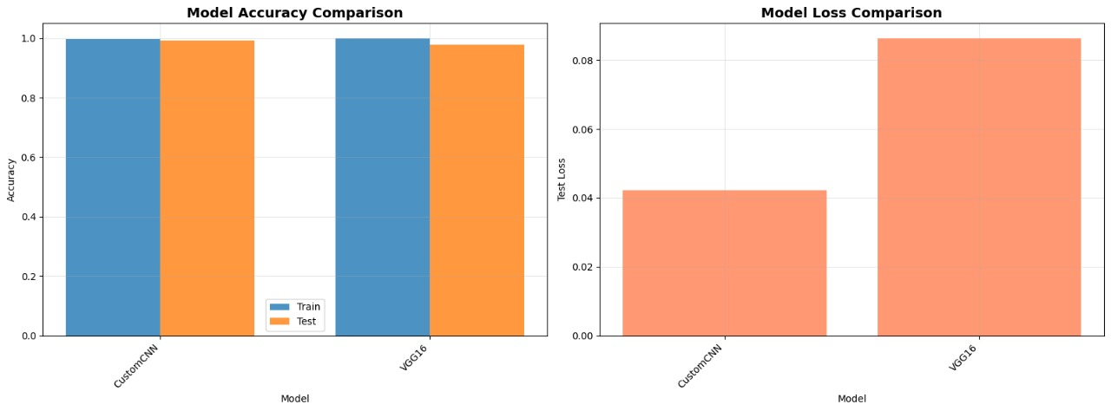
Compared Analysis:

Slide 17
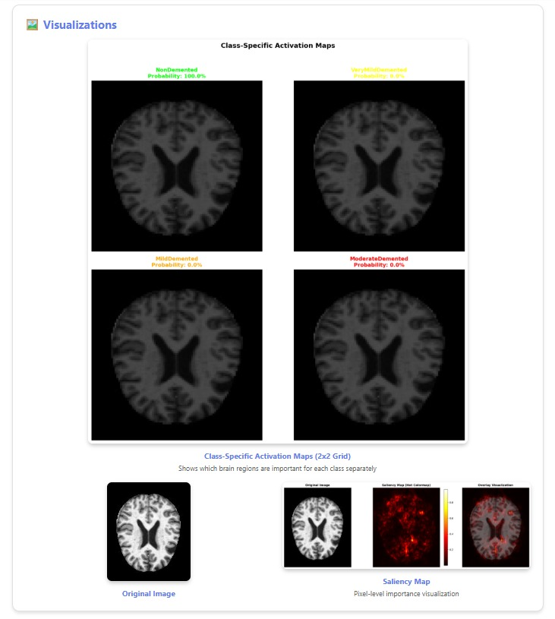
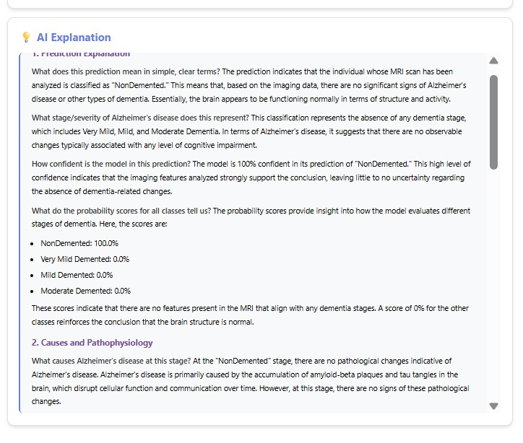
Objective-3:
Integrated Explainable AI (XAI) techniques to interpret model predictions, ensuring transparency and trust in Alzheimer’s stage classification. Grad-CAM and saliency maps were employed to highlight critical brain regions influencing decisions. Additionally, a Natural Language Explanation Module was developed to generate clear, human-understandable summaries of model outputs, bridging the gap between complex AI reasoning and clinical interpretability.

Slide 18


Results:
Two deep learning architectures — Custom CNN and VGG16 (transfer learning) — were implemented and evaluated on the prepared Alzheimer’s MRI dataset.
The dataset comprised four classes: NonDemented, VeryMildDemented, MildDemented, and ModerateDemented, representing progressive stages of Alzheimer’s disease in real-world clinical conditions.
The following are the evaluation metrics and performance comparisons for both models:
Custom_CNN:
VGG16:

Slide 19
Key Observations
  The Custom CNN slightly outperformed VGG16, achieving higher test accuracy and lower loss due to its optimized architecture and task-specific design.
  Both models demonstrated strong classification performance, successfully distinguishing subtle structural variations across Alzheimer’s stages.
  Data augmentation significantly improved model generalization and mitigated overfitting, particularly for underrepresented classes like ModerateDemented.
  The VGG16 model, though slightly lower in accuracy, provided stable convergence and faster training through transfer learning with pre-trained ImageNet features.
Performance Visualization
  Accuracy and loss curves displayed smooth and stable convergence during training, indicating balanced learning with minimal overfitting.
  Confusion matrices revealed high true-positive rates across all four classes, with near-perfect classification for ModerateDemented cases.
  Comparison plots illustrated that the Custom CNN achieved higher precision and recall across all stages, validating its superior feature extraction and decision consistency.

Slide 20
Conclusion:
This project developed an AI-based system using deep learning and explainable AI to automatically classify Alzheimer’s disease stages from MRI brain scans. By implementing both Custom CNN and VGG16 transfer learning models, the system achieved high accuracy, reliability, and interpretability in differentiating between NonDemented, VeryMildDemented, MildDemented, and ModerateDemented stages.
The Custom CNN demonstrated superior performance with better generalization and lower test loss, while VGG16 provided stable convergence and transfer learning advantages.
Integrated Grad-CAM visualizations and natural language explanations enhanced transparency, enabling clinicians to understand model decisions.
Overall, the system reduces diagnostic effort, improves consistency in analysis, and establishes a foundation for AI-assisted, explainable, and scalable Alzheimer’s disease screening in healthcare and research.

