Slide 1

Integrated Project on Project Title
Team Members (GB 7)
Shivant Pandey (Y, 1811981296)
Narayan Singla (Y, 1811981197)
Ashish Kumar (Y, 1811981075)
Gurucharan Maparu (Y, 1811981135)
Riya Panhotra (W, 1811981262)

Slide 2
Technologies Used
Frontend Technologies
BACKEND TECHNOLOGIES
HTML
CSS
JAVASCRIPT
BOOTSTRAP
REACT JS
SPRINGBOOT
PostgreSQL (Database)

Slide 3
Insights about IP Project
Time taken to complete the Project – 18 days
Editors used for Frontend and Backend : IntelliJ Idea, Visual Studio Code
Github Repo Link –
1. https://github.com/spandey1296/MusicHost-Frontend
2. https://github.com/spandey1296/TrailHost
Deployment on Heroku and AWS.

Slide 4

Key Features
User Sign up/ Login
User Authentication with jwt token
Upload media files
Access Uploaded files
Navigation Bar
Search bar to navigate

Slide 5
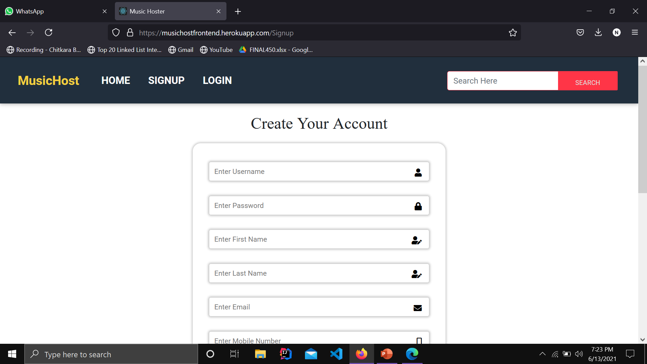
Signup

Slide 6
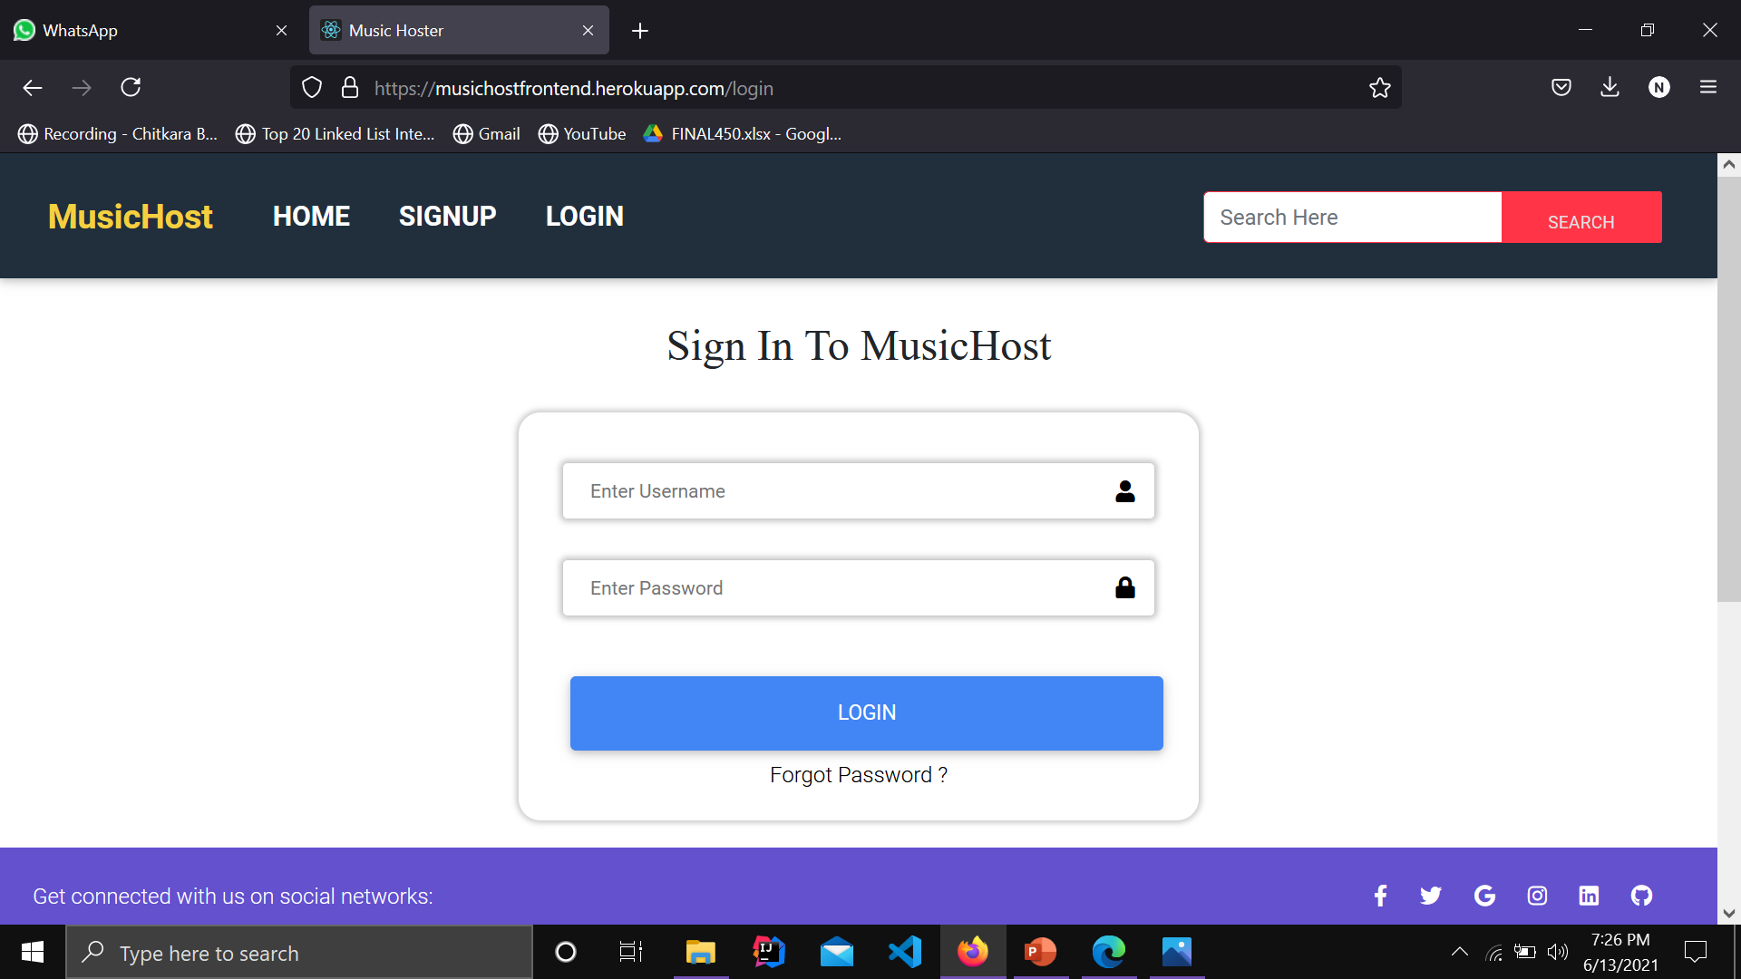
Login

Slide 7
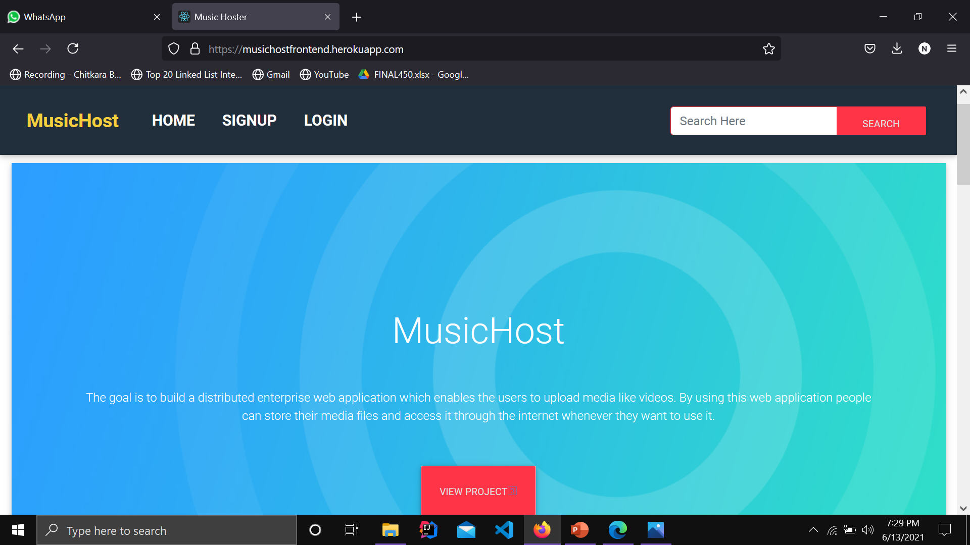
Home

Slide 8
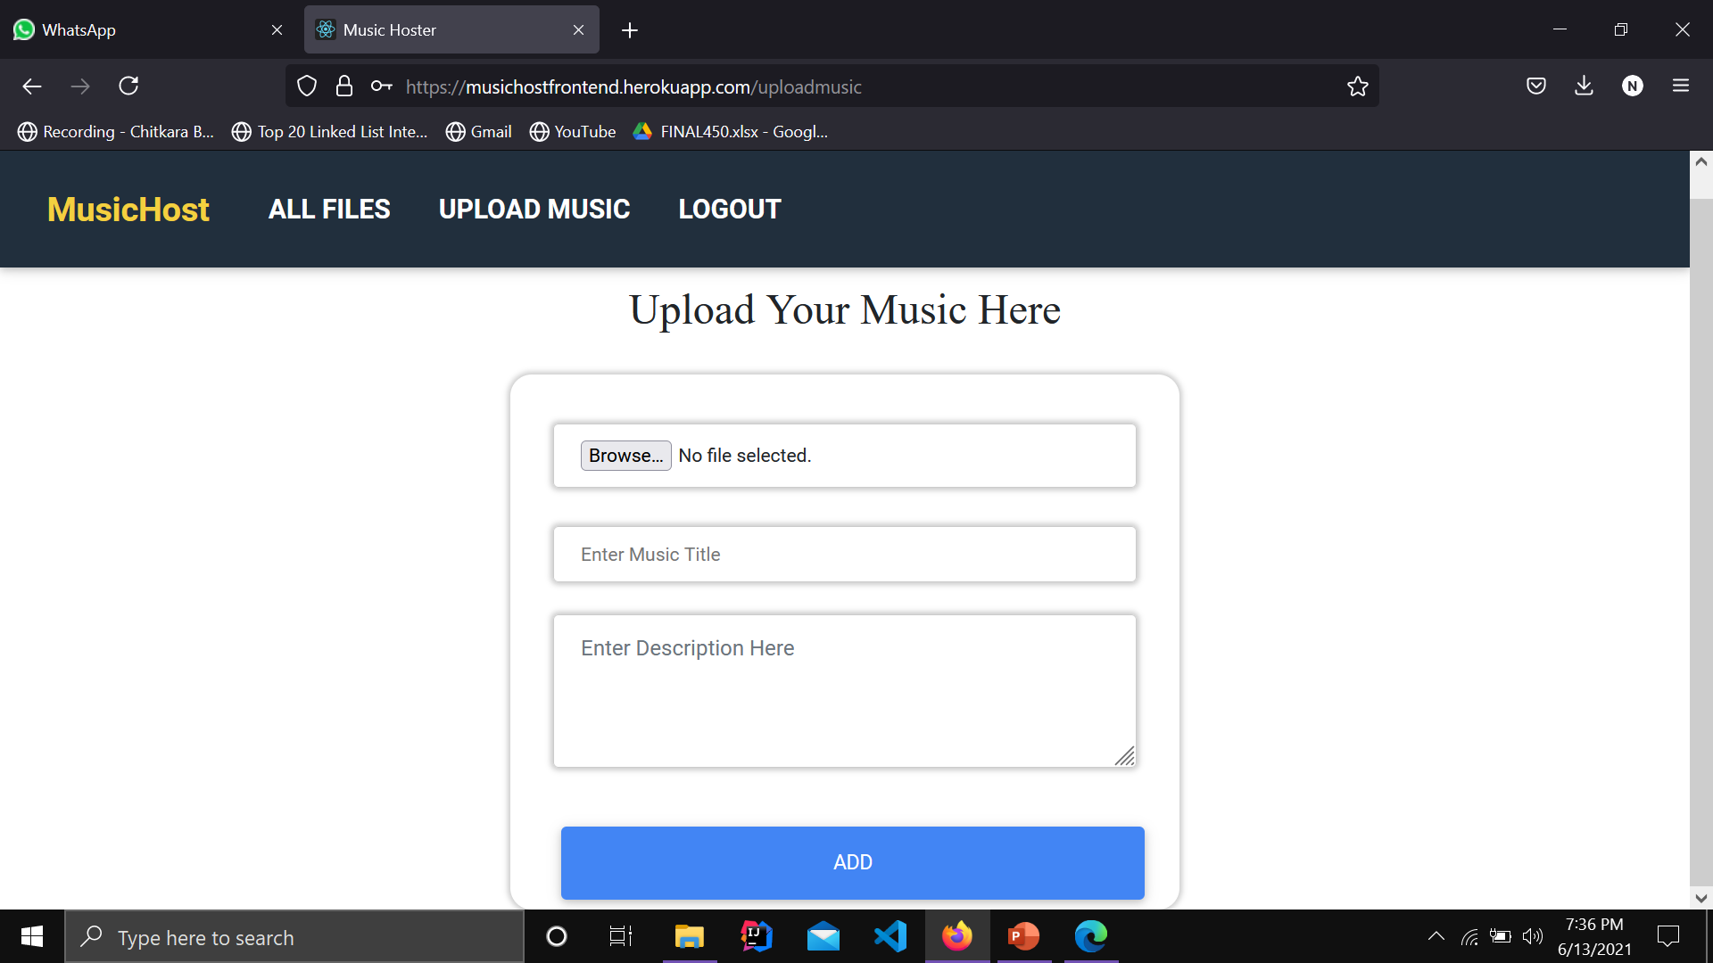
Upload Music

Slide 9
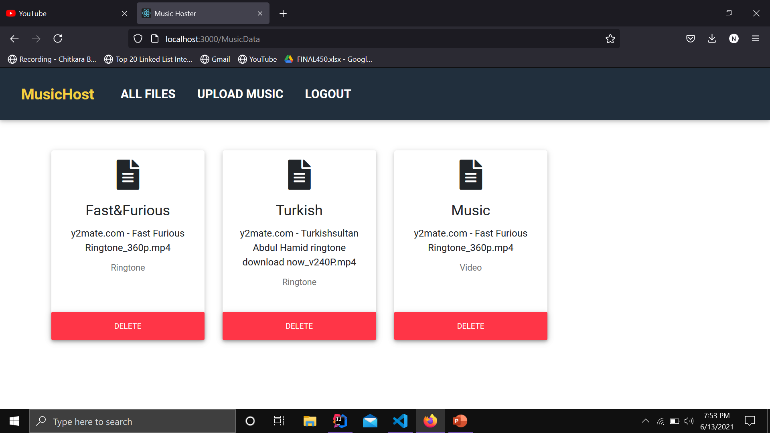
All Files

