Slide 1

What is the perfect size of a dataset?

Slide 2
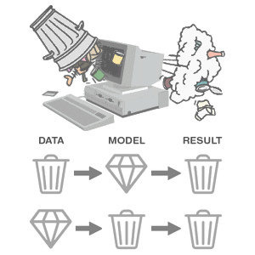
GARBAGE IN, GARBAGE OUT
Failed industrial projects because of the faulty dataset
Tay, Microsoft's Chatbot (2016)
Use – To learn from and engage with users’ conversations
Issue - Started posting offensive and inappropriate messages
Reason – bot learned from the biased and toxic interactions with users
Google Photos' Racist Labeling (2015)
Use – Label images
Issue – Labeled a photo of two black people as “gorillas”
Reason – Algorithm’s insensitivity and lack of diversity in training data
Amazon's AI Recruiting Tool (2018)
Use – to review resumes and identify the most qualified candidates
Issue – Biased against female applicants
Reason – predominantly male-oriented training data

Slide 3
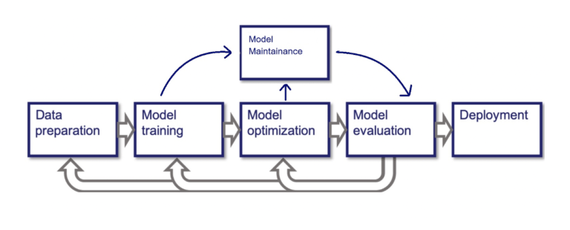
MACHINE LEARNING PIPELINE

Slide 4

What can be the right size of data for machine learning?

Slide 5

Then, what could be the possible ways to find the right sample data size?

Slide 6
A practical approach using code
A statistical approach using the formula
Rule of thumb
Cross-validation method
Learning curve
Optimal stopping theory
Power analysis
Mead’s correction method

Slide 7
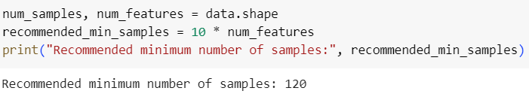
Rule of thumb
No. of features * 10

Slide 8
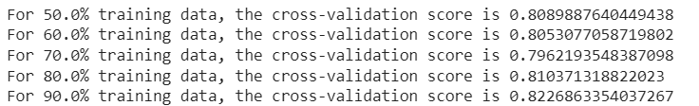
Cross-validation
How does this work?
The data set is split into multiple folds, and a model is trained and evaluated on different subsets of the data
What is it doing?
By comparing the mean cross-validation accuracies for different dataset sizes, it’s evaluating how model performance changes as the dataset size increases.

Slide 9
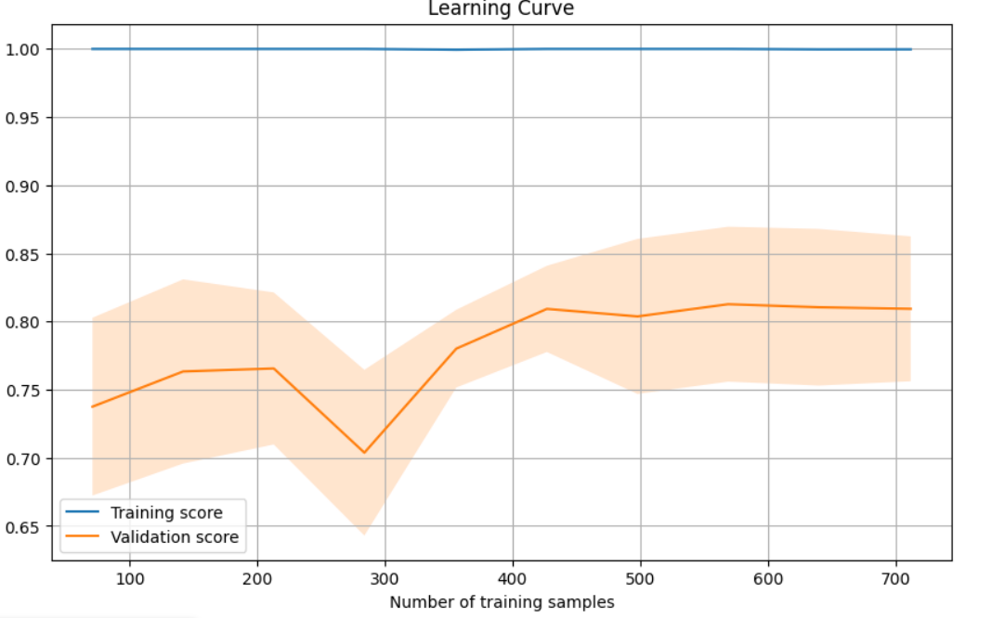
Learning Curve

Slide 10
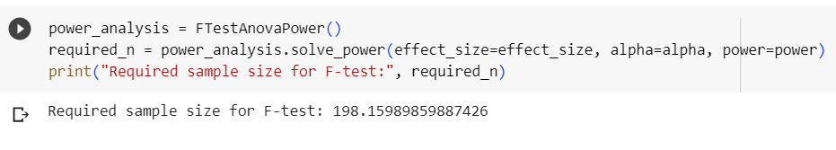
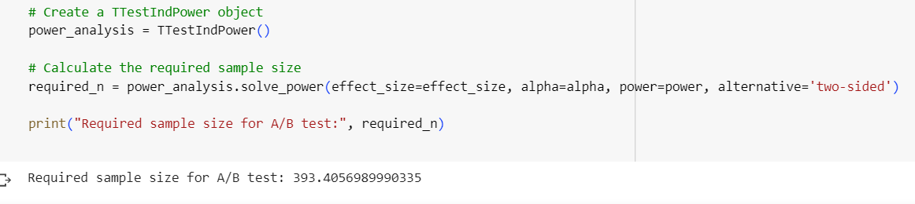
Power Analysis
What is power analysis?
How do we calculate it?
Our results:
For F-test
For A/B testing

Slide 11
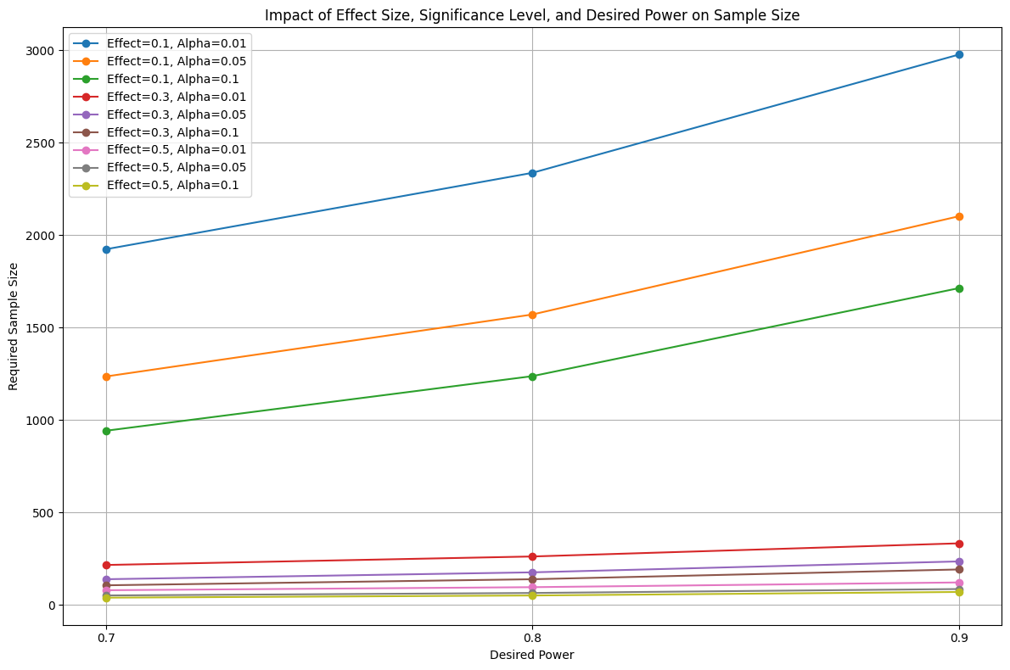
How do we decide on the values of parameters?

Slide 12
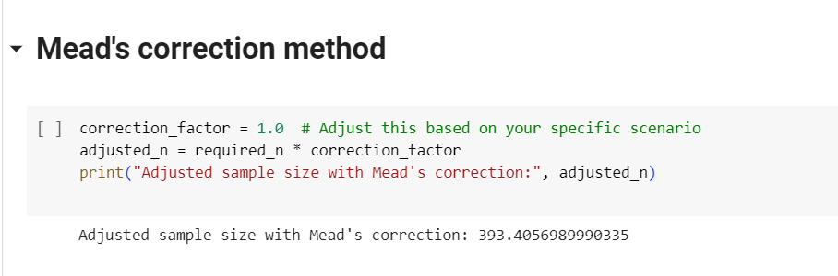
Mead’s correction

Slide 13
Conclusion
Practical Approach (through experimentation):
Advantages: This approach provides direct insights into how a model performs on a real-world dataset. It allows you to see the actual impact of dataset size on model performance.
Use Case: This approach is useful when you have access to a dataset and want to assess model performance realistically. It helps you understand the challenges and limitations of working with a small dataset.
Statistical Approach (Using Power Analysis or other methods):
Advantages: Power analysis helps you estimate the required sample size to achieve a certain level of statistical power for hypothesis testing. It helps in planning studies and experiments by ensuring you have enough data to detect meaningful effects.
Use Case: This approach is beneficial when you're planning a study or experiment and want to ensure that your sample size is sufficient to detect the effect size you're interested in.

