Slide 1

Resolve IT: Smart Grievance and Feedback Management System
Project by A. Amrutha

Slide 2
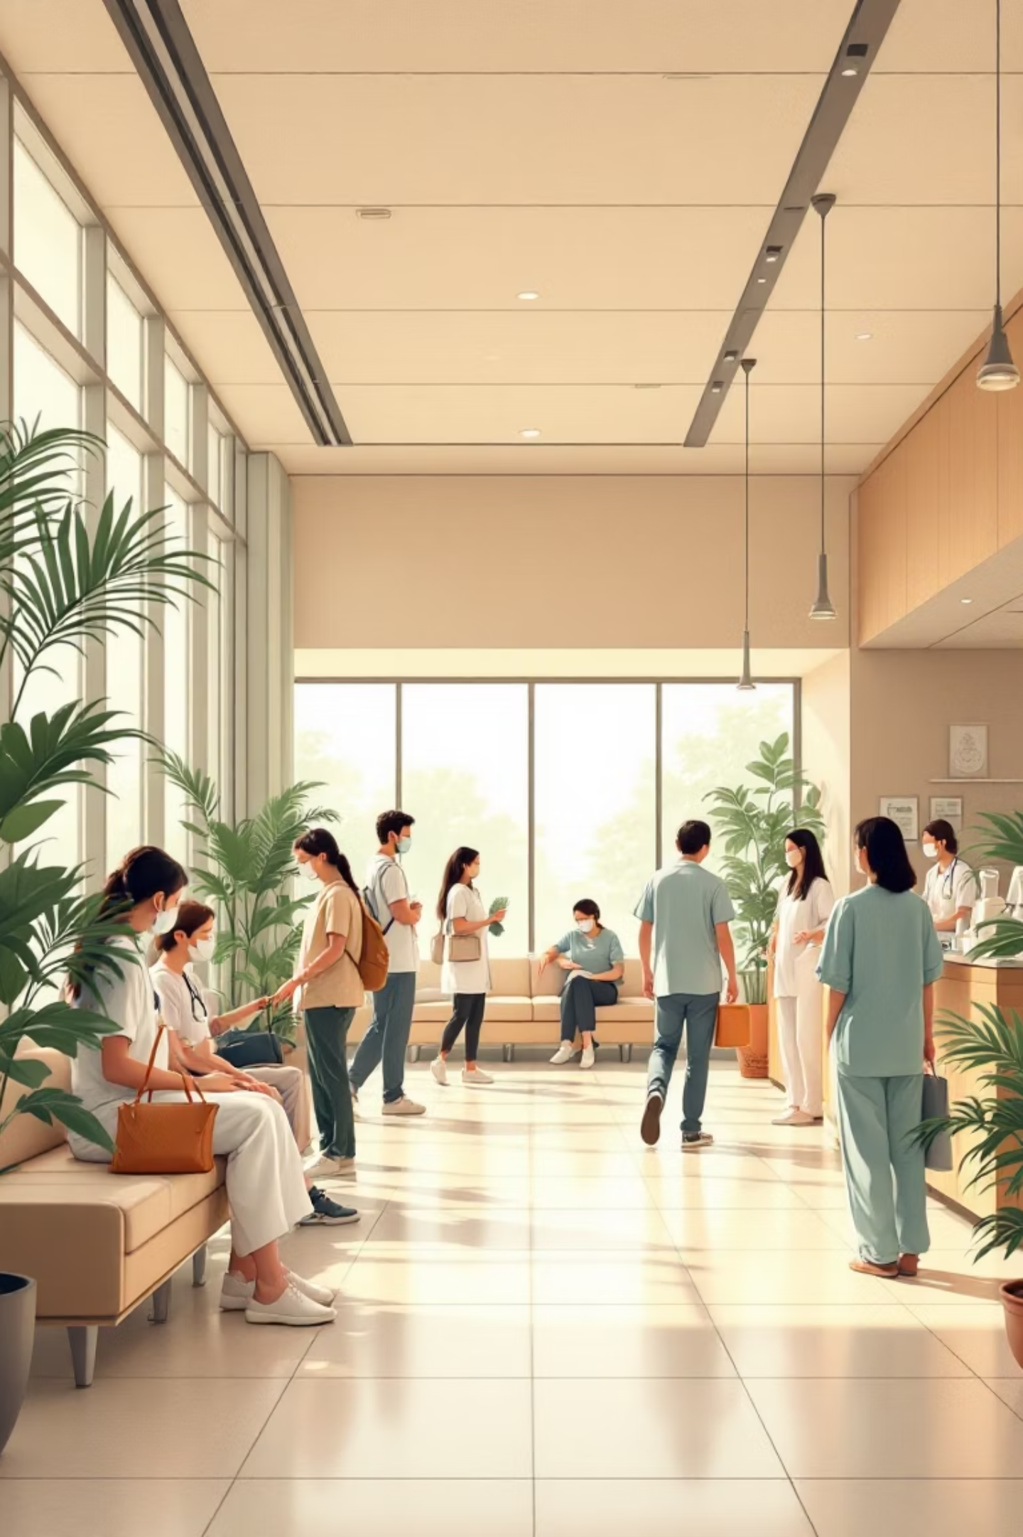




Project Overview: Resolve IT
Resolve IT is an innovative, smart grievance management system specifically engineered for healthcare environments. It centralizes all feedback and complaint records, providing hospital administrators with a streamlined, efficient approach to patient satisfaction and operational excellence.
User Dashboard
Log in and access a personal dashboard to manage all your interactions and submitted items.
Submit Grievances
Easily submit complaints related to various hospital services with clear categorization options.
Provide Feedback
Offer constructive feedback on experiences to continuously help improve service quality and patient care.
Track Status
View real-time status statistics including pending, in-progress, and resolved issues for complete transparency.

Slide 3

Transforming Healthcare: Benefits for Hospitals
The Resolve IT system empowers hospitals to significantly enhance operational efficiency and elevate patient care through seamless digital transformation.
Efficient Digital Records
Maintain all records digitally, drastically reducing paperwork, minimizing manual errors, and ensuring data integrity.
Reduced Response Delays
Streamline processes to ensure quicker resolution times for complaints and feedback, improving overall responsiveness.
Improved Patient Satisfaction
Address patient concerns promptly and effectively, leading to a consistently better patient experience and higher trust.
Enhanced Accountability
Foster greater responsibility and transparency among staff and departments, ensuring every issue is tracked and managed.

Slide 4

Proposed Solution: Key Features of Resolve IT
Our solution offers a comprehensive web platform meticulously designed to manage patient grievances and feedback with unparalleled effectiveness and ease.
Centralized Web Platform
Secure Login System
Real-time Status Visibility
A unified hub for submitting and managing all patient grievances and feedback, accessible from anywhere.
Authenticated user access ensures data privacy and provides personalized dashboards for every user.
Monitor the live progress of all submitted complaints, ensuring transparency for both patients and administrators.
Categorized Grievances
Dedicated Feedback Module
Modern UI with React
Efficiently categorize complaints based on specific hospital departments, facilitating targeted and rapid resolution.
A specialized tool for collecting and analyzing feedback, driving continuous service quality improvement initiatives.
Developed with React for a smooth, intuitive, and highly responsive user experience across all devices.
Scalable Architecture
Designed for future expansion, allowing seamless integration of backend services, an administrative panel, and advanced database functionalities.

Slide 5






System Workflow: From Submission to Resolution
The Resolve IT system ensures a clear, efficient, and transparent process for handling every grievance and feedback submission, from the initial entry to the final resolution.
User Logs In
Accesses Dashboard
Secure access to the system through a personalized login portal.
A personalized overview of all interactions, submissions, and their current statuses.
Submits Grievance/Feedback
Admin Reviews
Easy and intuitive submission of concerns or valuable feedback.
Dedicated hospital staff promptly addresses and triages the submitted issue.
Updates Status
User Notified
Administrators provide continuous progress updates, maintaining transparency.
The resolution is clearly communicated to the user, closing the feedback loop effectively.

Slide 6


Tech Stack: Powering Resolve IT
Resolve IT is built using a robust and modern technology stack to ensure optimal performance, scalability, and a seamless user experience for all stakeholders in the healthcare system.
Frontend: HTML, CSS, React
Backend: Java Spring Boot
Database: MySQL
Tools: GitHub, VS Code, Postman

Slide 7





UI/UX Design Principles: User-Centric Approach
Our design philosophy is deeply rooted in creating an intuitive, efficient, and user-friendly interface that caters to the needs of all users within the hospital environment.
Clean & Modern Interface
Aesthetically pleasing design with intuitive layouts for effortless navigation and a pleasant user experience.
Simple Navigation
Clear, well-defined module tabs ensure effortless browsing and quick access to desired sections.
Consistent Styling
Uniform colors and consistent styling across the platform enhance readability and maintain brand identity.
Easy Forms
Simplified grievance and feedback submission processes minimize user effort and maximize completion rates.
Quick Status Overview
The intuitive dashboard is designed for immediate and transparent checks of complaint statuses.

Slide 8
Feature Document: Current Development Status
We are proud to announce that all core UI/UX features for Resolve IT have been successfully completed, providing a robust and user-friendly foundation for the system.
S.No | Module / Feature | Description | Status
1 | Home Page | Displays system overview with options for login and registration. | Completed
2 | User Authentication | Secure login and registration for patients and admins. | Completed
3 | Patient Dashboard | Allows patients to view grievances, track status, and navigate features. | Completed
4 | Admin Dashboard | Enables admins to view and manage all grievances. | Completed
5 | Grievance Submission Form | Allows patients to submit grievances with details and attachments. | Completed
6 | Grievance Status Tracking | Shows status as Pending, In Progress, and Resolved. | Completed
7 | Feedback Submission | Allows patients to submit feedback on hospital services. | Completed
8 | User Profile Module | Displays user profile details. | Completed
9 | Dark & Light Theme Mode | Provides theme switching for better user experience. | Completed

Slide 9
S.No | Module / Feature | Description | Status
1 | Grievance Status Update (Admin) | Admin can update grievance progress (Pending → In Progress → Resolved). | Completed
2 | Grievance Analytics | Displays grievance data using charts for analysis. | Completed
3 | Admin Feedback Viewing | Admin can view all feedback submitted by users. | Completed
4 | File Upload Support | Allows uploading files with grievances. | Completed
5 | File download/View Support | Admin can view or download attached files. | Completed
6 | Secure REST API Integration | Ensures safe communication between frontend and backend. | Completed
7 | Database Management (MySQL) | Stores user, grievance, and feedback data securely. | Completed
8 | Role-Based Access Control | Controls access for Admin and Patient roles. | Completed

Slide 10
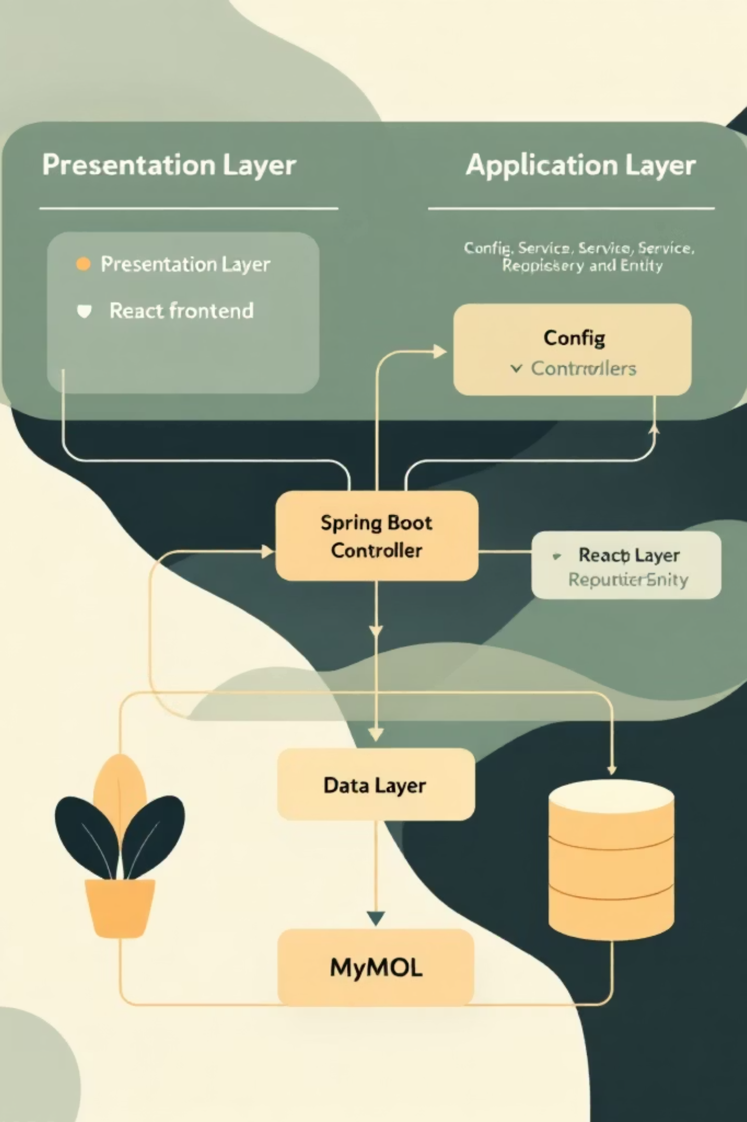
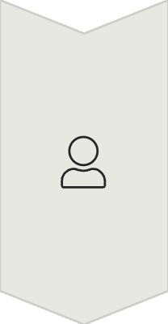


System Architecture: Resolve IT
Resolve IT's architecture is built on a modular, layered approach, ensuring robust performance, scalability, and maintainability across all system components.
Presentation Layer (Frontend)
React.js based user interface
Login, grievance submission and dashboards
Communicates with backend using REST APIs
Application Layer (Backend – Spring Boot)
Config Layer: CORS & JWT Security configuration
Controller Layer: Auth, Grievance & Feedback APIs
Service Layer: Business logic handling
Repository Layer: Database operations (JPA)
Entity Layer: Maps Java objects to DB tables
Data Layer (Database)
MySQL database
Stores users, grievances, feedback and status data

Slide 11
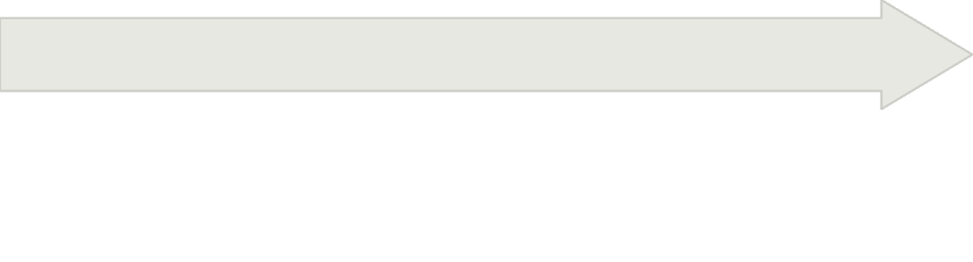

Sprint Planning & Development
A structured approach to developing Resolve IT, ensuring efficient progress and timely delivery of all key features across five focused sprints.
Core Features
Frontend Development
Grievance & Feedback Form Creation
Foundation & Setup
Initial Frontend Development
Backend Integration for Forms
Project Setup & Environment Configuration
User Authentication Module
Data Flow & Storage Implementation
Database Schema Design
Dashboard UI Implementation
Core API Architecture Definition
Launch & Deployment
Quality Assurance
Final User Acceptance Testing (UAT)
Comprehensive System Testing (Unit, Integration)
Documentation & User Guides
Bug Identification & Resolution
Production Deployment & Launch
Preparation for Deployment Environment

Slide 12
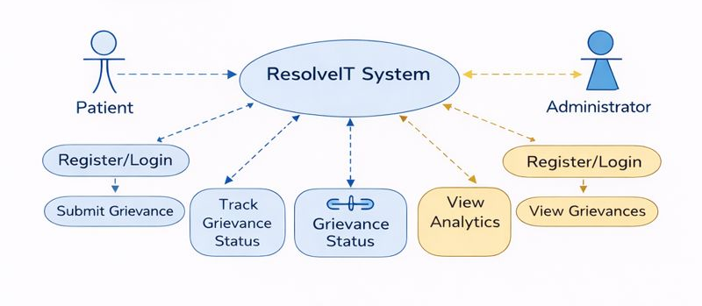
USECASE DIAGRAM
The Use Case Diagram outlines the interactions between various actors (Submit Complaint/Feedback, Admin, Department Head) and the ResolveIT System. It details key use cases such as managing complaints, assigning resolutions, and accessing databases for viewing and updating statuses.

Slide 13
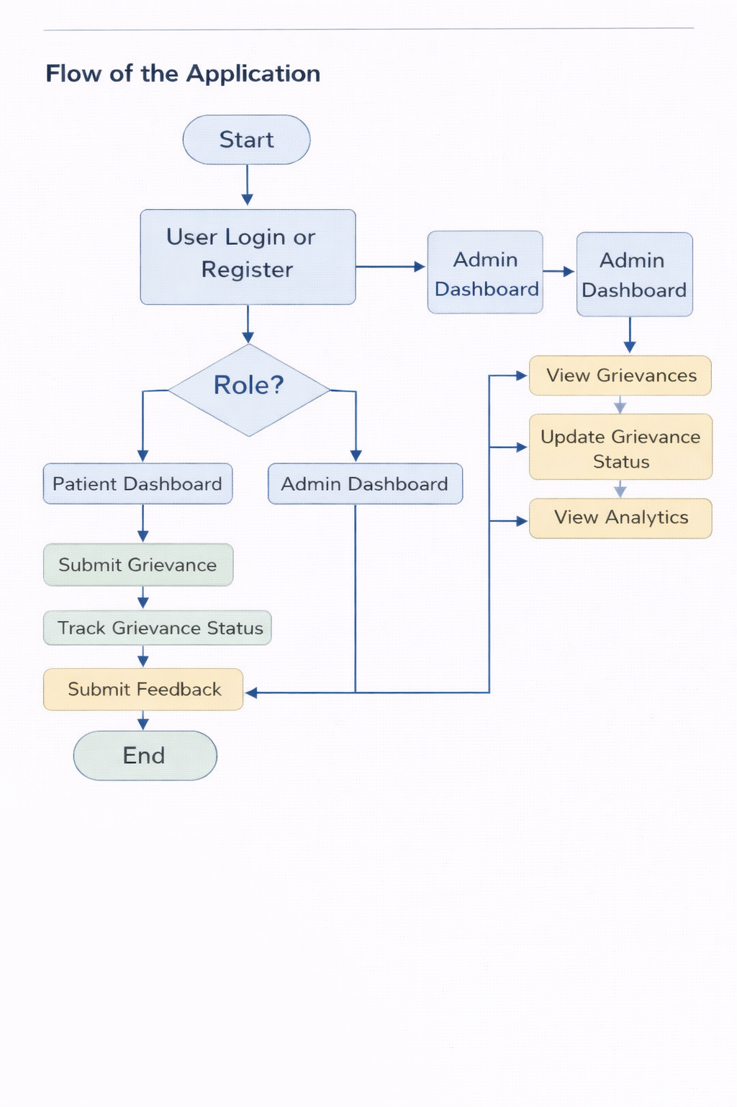
WORKFLOW DIAGRAM
ResolveIT Workflow Diagram
This diagram illustrates the comprehensive workflow of the ResolveIT system, from user submission to complaint resolution and subsequent analytics. It highlights the categorization, priority assignment, and feedback loops essential for continuous improvement.

Slide 14
Advantages of Resolve IT
Resolve IT offers numerous benefits, transforming grievance management into a strategic asset for healthcare providers.
Faster Grievance Registration
Improved Transparency
Streamlined process for quick complaint submission.
Clear visibility into issue resolution status.
Enhanced Communication
Efficient Complaint Tracking
Better interaction between patients and staff.
Hospital management can monitor issues effectively.
Reduced Paperwork & Errors
Increased Patient Satisfaction
Digital system minimizes manual tasks.
Leads to higher quality service and trust.
Secure Data Management
Continuous Improvement
Ensures privacy and integrity of patient information.
Digital records support data-driven decisions.

Slide 15

Thank You

