Slide 1


LOW-CODE APPLICATION DEVELOPMENT
USING ZOHO CREATOR
Apartment Maintenance Management System
Team Member : Amruthavalli M
Register No. : 240701037
MENTOR : S. Kaviya
Assistant Professor, Dept. of CSE

Slide 2
ABSTRACT
Apartment communities must coordinate resident information, maintenance requests, staff and payment records. When these are handled through disconnected records or informal communication, it is hard to find request details or tell pending work from completed work.
This project, built on Zoho Creator, provides forms, reports, task pages and a dashboard. Together they give one central interface for capturing and viewing apartment maintenance information, from request submission to task completion.
Automation, integrations and role-based access are proposed as future enhancements.
4
Data-entry forms
5
Reports
3
Pages: tasks and dashboard
Keywords: Zoho Creator; Apartment Maintenance; Resident Records; Maintenance Requests; Low-Code Application

Slide 3
OBJECTIVES
1
Create forms for resident, maintenance request, maintenance staff and maintenance payment records
2
Provide reports to view resident, request, staff and payment information
3
Provide separate views for pending tasks and completed tasks
4
Present a dashboard for quick access to maintenance information
5
Evaluate the application through test cases and identify future automation opportunities

Slide 4
INTRODUCTION
Background
Problem Statement
Apartment maintenance involves resident details, repair requests, staff coordination, work status and payment records
A central application makes these records easier to enter, search and review
Built on Zoho Creator, a low-code platform, using visual forms and reports
No single, structured place to record residents and maintenance activity
Resident and maintenance details need consistent data-entry forms
Pending and completed work should be easy to tell apart
Staff and payment records should be available as structured reports

Slide 5
LITERATURE SURVEY
Existing manual process
Resident reports issue
Request is recorded
Staff reviews / performs work
Status is updated
Payment record kept
Limitations
S.No. | Source | Relevance
1 | Zoho Creator Help Documentation [1] | Forms, reports, configuration
2 | Deluge Script Reference [2] | Scripting and automation
3 | Zoho Creator Resources [3] | Learning material, examples
Information spread across separate records and channels
No dedicated pending list for outstanding work
Staff and payment details hard to link to a request
Manual reporting is slow and can create duplicate or incomplete records
Low-code gives visual forms, built-in reports and a hosted platform, with Deluge available for custom logic.

Slide 6
ARCHITECTURE
User / Administrator
Zoho Creator UI
Forms and Reports
Stored Application Records
Forms (4)
Reports (5)
Pages (3)
Resident Form
Maintenance Request Form
Maintenance Staff Form
Maintenance Payment Form
All Residents
All Maintenance Requests
Pending Maintenance Requests
All Maintenance Staffs
Maintenance Payment report
Pending Tasks
Completed Tasks
Maintenance Dashboard
No external API or separate database integration is used in the current scope.

Slide 7
PROPOSED SYSTEM
One Zoho Creator application centralises resident details, maintenance requests, staff details and payment records.
Reports give searchable views of stored records
Pending and Completed task pages show work status
The dashboard gives a quick overview
Users: administrator, resident, maintenance staff and management reviewer
Residents
Requests
Resident Form, All Residents
Request Form, All and Pending reports
Staff
Payments
Staff Form, All Maintenance Staffs
Payment Form, Payment report
Task views and dashboard
Pending Tasks, Completed Tasks and Maintenance Dashboard

Slide 8
REQUIREMENT ANALYSIS
ID | Functional requirement | Priority
FR-01 | Capture resident information | High
FR-02 | Display resident records in a report | High
FR-03 | Capture maintenance request details | High
FR-04 | Report of all maintenance requests | High
FR-05 | View of pending requests or tasks | High
FR-06 | View of completed tasks | Medium
FR-07 | Capture and list maintenance staff | Medium
FR-08 | Capture and display payment records | Medium
FR-09 | Maintenance dashboard | Medium
Non-functional
Usability: clear labels, consistent navigation
Data integrity: mandatory fields, valid types
Security: authorised users only
Availability: when Creator and network are up
Maintainability: organised naming
Software
Zoho Creator platform
Chrome or Edge, internet connection

Slide 9
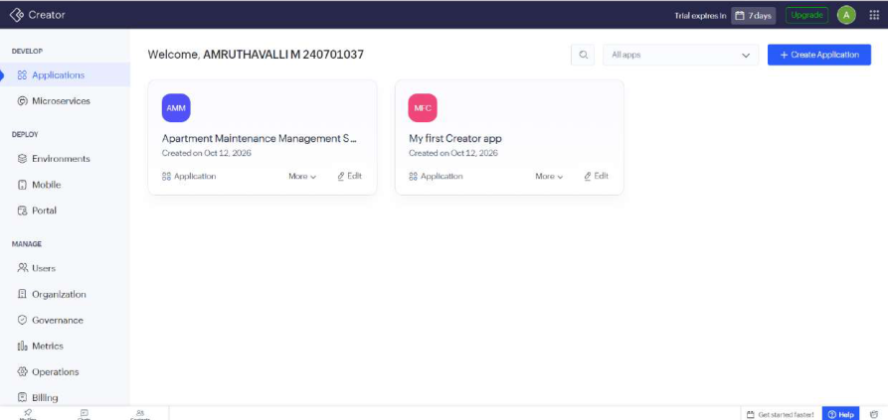
IMPLEMENTATION DETAILS
Apartment Maintenance Management System, built on Zoho Creator
Left navigation menu groups forms, reports, task pages and the dashboard
Configured visually with forms, reports and pages
Deluge scripting, integrations and pro-code extensions are outside the current scope
Application home and navigation
4
Forms
5
Reports
3
Pages

Slide 10
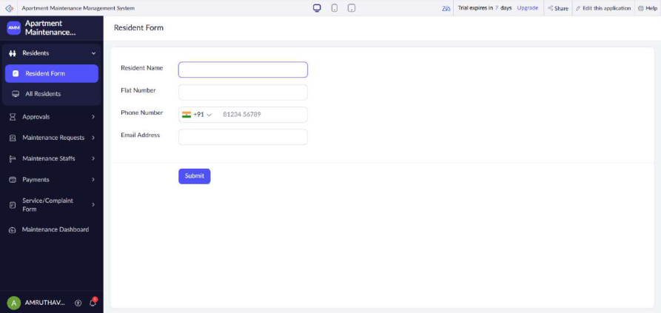
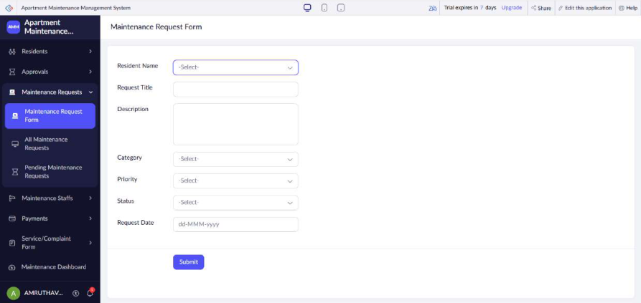
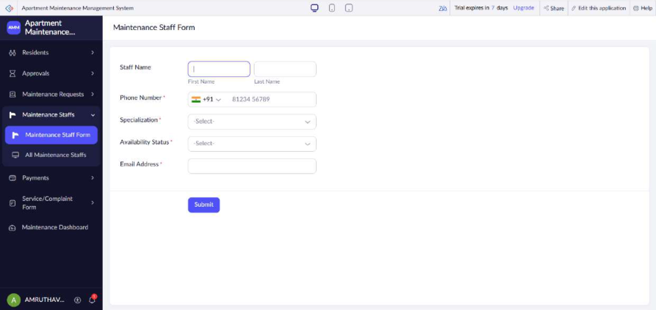
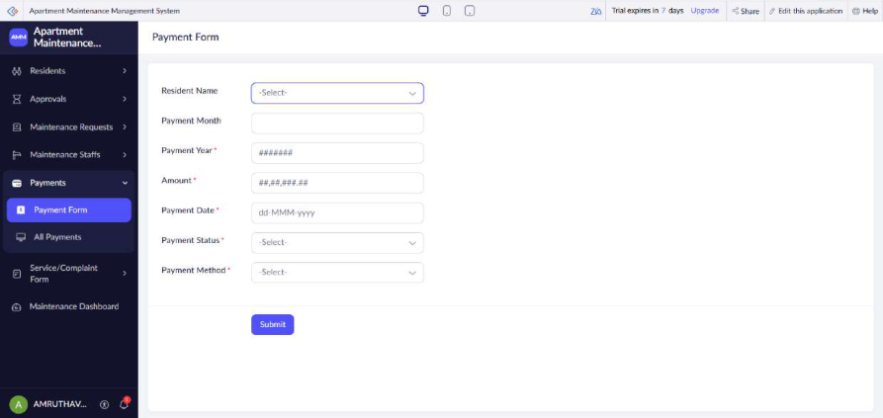
IMPLEMENTATION: FORMS
Data captured
Resident: name, flat number, phone, email
Request: title, description, category, priority, status, date
Staff: name, phone, specialization, availability
Payment: month, year, amount, date, status, method
Resident Form
Maintenance Request Form
Maintenance Staff Form
Maintenance Payment Form

Slide 11
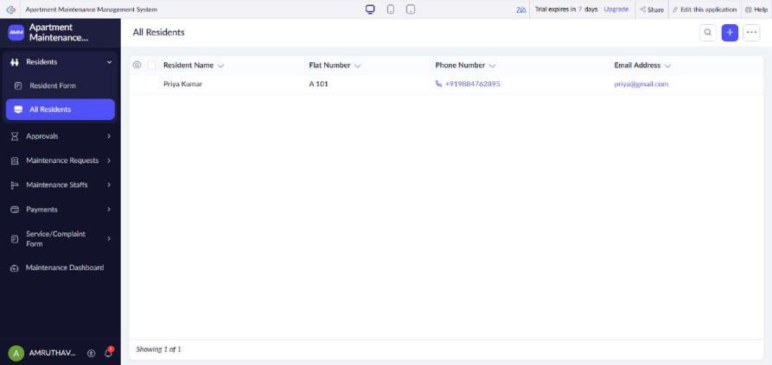
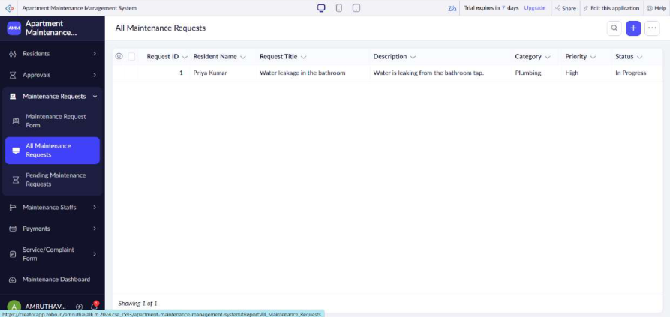
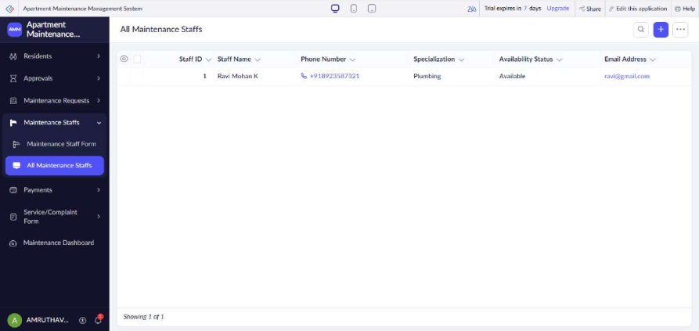
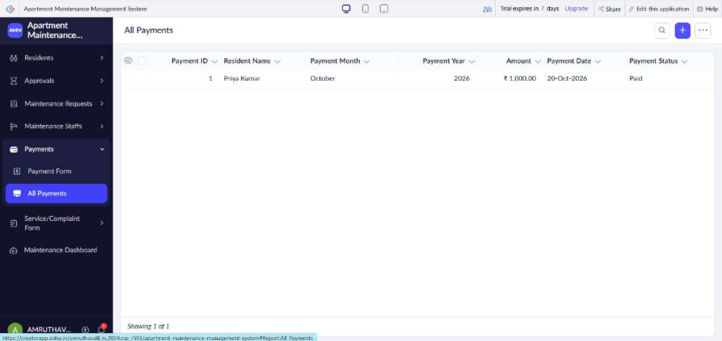
IMPLEMENTATION: REPORTS
What they show
Saved records listed in table form
Requests show category, priority and status, e.g. a Plumbing request marked High and In Progress
Search and add controls on each report
Pending Maintenance Requests view filters outstanding work
All Residents
All Maintenance Requests
All Maintenance Staffs
Maintenance Payment report

Slide 12
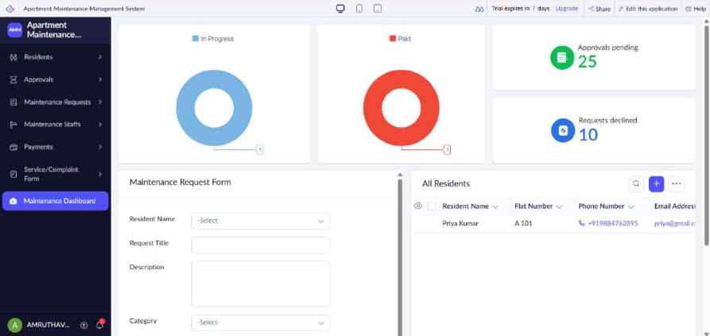
IMPLEMENTATION: DASHBOARD
Status charts for In Progress requests and Paid payments
Summary cards: Approvals pending 25, Requests declined 10
Request form and resident list embedded on the same page
Metric definitions to be verified in the page configuration
Maintenance Dashboard
2
Status charts
2
Summary cards
2
Embedded views

Slide 13
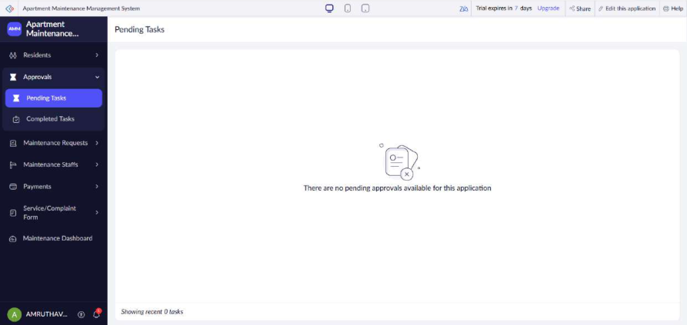
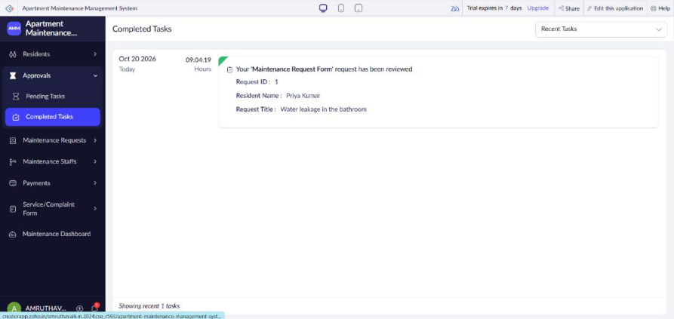
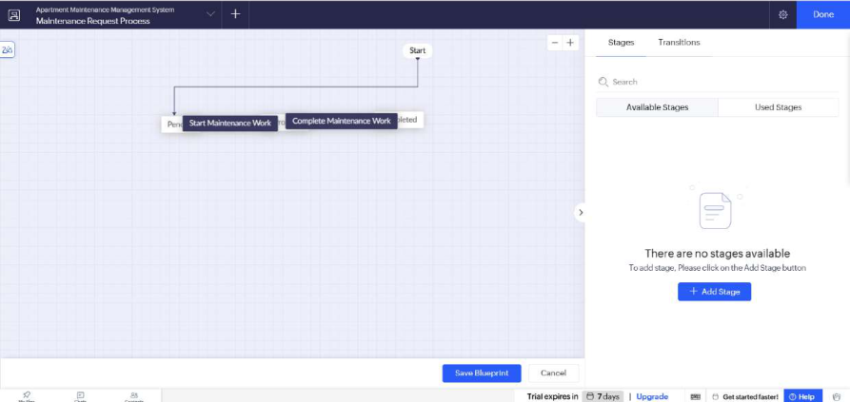
IMPLEMENTATION: TASKS AND WORKFLOW
Pending Tasks
Completed Tasks
Workflow stages
Lists approvals awaiting action; shows a clear message when none are pending
Shows reviewed requests, e.g. request ID 1, water leakage in the bathroom
Process-stage builder opened for the Maintenance Request form; no stages configured yet

Slide 14
TESTING
Area | Test cases | Expected result | Status
Forms: open and save | TC-01, 02, 05, 09 to 12 | Forms open and records are saved | To test
Validation | TC-03, TC-06 | Missing required data is blocked, if configured | To test
Reports | TC-04, 07, 08 | Saved records appear; pending view filters correctly | To test
Task views and dashboard | TC-13 to 15 | Pages load and match saved records | To test
Access control | TC-16 | Unauthorised role is restricted, if configured | To test
16 test cases defined (TC-01 to TC-16). Next: run them on the live application, log any defects, and collect feedback from at least two users.

Slide 15
LIVE DEMO WALKTHROUGH
1
Home and navigation
2
Register a resident
3
Submit a request
Open the application and show the left menu
Resident Form, submit, then confirm in All Residents
Maintenance Request Form, then check All and Pending requests
4
Staff and payments
5
Task views
6
Dashboard
Add staff and payment records, open their reports
Show the Pending Tasks and Completed Tasks pages
Show charts, summary cards and embedded views

Slide 16
RESULTS
Objective | Evidence in the application | Assessment
Capture resident data | Resident Form and All Residents report | Interface shown
Capture maintenance requests | Request Form and request reports | Interface shown
Maintain staff and payment records | Staff and Payment forms and reports | Interface shown
Separate pending and completed work | Pending Tasks and Completed Tasks pages | Pages shown; status logic to verify
Provide dashboard overview | Maintenance Dashboard | Dashboard shown
Some reports are empty in the captured state. This may reflect an empty dataset or an active filter, so validation and status handling are confirmed through testing.

Slide 17
FUTURE ENHANCEMENT
1
2
3
Assign maintenance staff to requests
Status transitions: submitted, in progress, completed
Email or in-app notifications for new and overdue requests
4
5
6
Link payments to residents and requests
Role-specific permissions and record-level access
Richer dashboard metrics and mobile / portal access

Slide 18
CONCLUSION
The Apartment Maintenance Management System organises resident, request, staff and payment information in Zoho Creator, with reports, task pages and a dashboard as a foundation for centralised maintenance record management.
Shown in the application
To verify before submission
4 data-entry forms
5 reports
Pending and Completed task pages
Maintenance dashboard
Data validation
Automated status changes and notifications
Integrations and role-based access
Test and user-acceptance results

Slide 19
REFERENCES
Zoho Corporation, "Zoho Creator Help Documentation."
https://www.zoho.com/creator/help/ (accessed 20 October 2026)
1
Zoho Corporation, "Deluge Script Reference."
https://www.zoho.com/deluge/ (accessed 20 October 2026)
2
Zoho Corporation, "Zoho Creator Resources."
https://www.zoho.com/creator/resources/ (accessed 20 October 2026)
3

Slide 20
THANK YOU

