Slide 1


Bank of Baroda Hackathon - 2022
Technology Partner
Your Team Name : OnlyNERDS
Your team bio : Team of technical enthusiasts determined to build a solution to solve real-world problems
Date : 19-9-22

Slide 2
Problem Statement?
Why did you decide to solve this Problem statement?
Bank handles large volumes of cheques in the clearing process. They are subjected to huge processing and transaction environments with a vulnerability of fraud occurrences. The main reason behind approaching this problem statement is to:
Increase technical efficiency of the solve the given problem.
Reduce human/manual efforts and processing time.
Build a smooth transaction process.
Establish a smooth customer experience by supporting multilingual options.
Increase security by ideal fraud detection process.
For proper authentication and verification of the signatures.

Slide 3
User Segment & Pain Points
Which user /advertiser segment would be early adopter of your product & why?
Banks - Banking is the main user segment that is an early adopter of the product, as it solves customer problems and enhances their experience. Banks are hubs of a huge number of customers. They are in the need of the hour to deploy their architecture towards trending technology, and reduce manual efforts as much as possible. Cheque processing using our prototype is very essential for building an efficient transaction structure in the banks.
Many sub-domains in banks can also make use of this prototype. Some of the potential use cases inside the bank segment include –
Fund Verification systems, Credit card and Debit card identification, Effective fraud detection, Cheque payment systems, and transaction processing architecture.
It is inclusive of all the user segments and their types such as active users, prospective users, former users and lapsed users.

Slide 4
Pre-Requisite
What are the alternatives/competitive products for the problem you are solving?
There are many alternatives/competitive products for the problem. Apart from the traditional cheque processing systems, there are many other products in the market that are of high competition.
MicroAquire – MicroAquire provides cheque scanning and processing in banks, but not very efficient in providing smooth processing services. It does not provide an efficient cheque detection and tracking system.
Joist – Joist is another product used for cheque scanning processes. But, it is not very competent enough to be utilized in the market. Our solution prototype solves the lagging points of all the existing prototypes.

Slide 5
Azure tools or resources
Azure tools or resources which are likely to be used by you for the prototype, if your idea gets selected
—> Azure SQL Database
—> Azure Functions
—> Azure API Management
—> AI Builder
—> Azure Active Directory(Azure AD)
—> Azure DevOps
—> Azure Cognitive Services

Slide 6
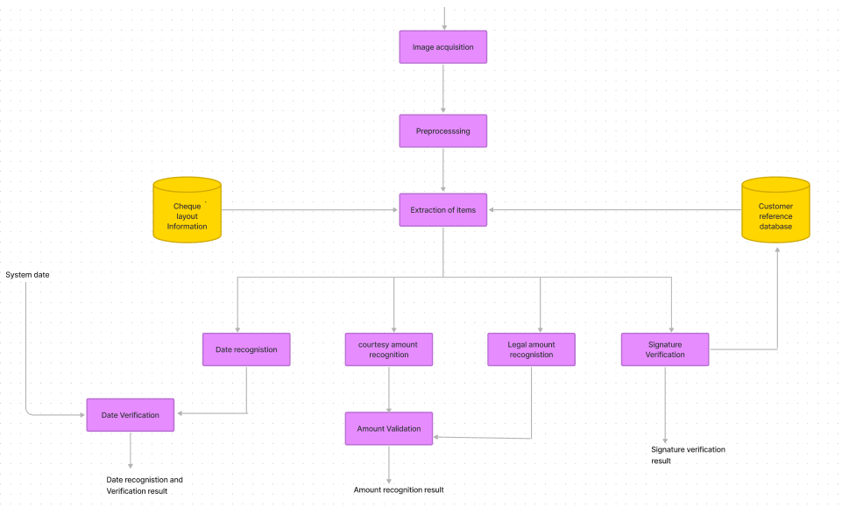
Any Supporting Functional Documents
Our prototype of the Cheque clearing system is replicated using the following methodology:
The main purpose behind using the AI methodology in cheque clearance and processing is to reduce the processing time and to make the process less prone to errors and possible frauds due to collision.

Slide 7
Key Differentiators & Adoption Plan
How is your solution better than alternatives and how do you plan to build adoption?
Our solution prototype stands apart from the rest of the other existing prototypes because of the following reasons:
Thorough extraction of all the handwritten information on the cheque and easy processing system.
Extraction of the signatures present in the cheques, for proper detection.
Correct validation of the information against the business rules deemed by the organization.
Extraction and verification of the signature present in the cheque with that of in the organization’s database.
Attraction of the clients/companies who strive for a passion for product innovation. Our
Solution is built on covering all the use cases and all the user agent segments.

Slide 8
GitHub Repository Link & supporting diagrams, screenshots, if any
GitHub link - https://github.com/Amruthaaaaa/OnlyNERDS

Slide 9
Thank You
Amrutha KH
Keerthan Gowda S
Satish V
G Preritha

