Slide 1

MARKETING ANALYTICS BUSINESS CASE
Sports Retail Performance Analysis
Conversion, Social Engagement & Customer Sentiment — powered by SQL, Python & Power BI
Prepared for ShopEasy Sports | Data Analytics Portfolio Project

Slide 2

Introduction to the Business Problem
ShopEasy Sports, an online sports & fitness equipment retailer, is facing reduced customer engagement and conversion rates despite launching several new marketing campaigns. They need a detailed analysis to identify where their marketing strategy is breaking down.
Why It Matters
9.57%
Overall conversion rate — with room to improve
THE CHALLENGE
Customer interactions with site content and campaigns have declined
9M
Total content views across all products
Fewer site visitors are converting into paying customers
Marketing spend is up, but ROI isn't meeting expectations
3.69 / 5
Customer feedback hasn't been systematically analyzed for insight
Average customer review rating

Slide 3

The Request
A message from the Marketing Manager at ShopEasy Sports
Subject: Request for Data Analysis to Improve Marketing Strategy
Hi Data Analyst,
We've been facing some challenges with our marketing campaigns lately. Despite increased investment, we've observed a decline in customer engagement and conversion rates — our marketing spend is up, but the return on investment isn't meeting expectations.
We have data from customer reviews, social media engagement, and campaign performance metrics. We need a comprehensive analysis to understand what's working, where customers are dropping off, and how we can turn this around.
Looking forward to your insights.
Best regards,
Jane Doe, Marketing Manager — ShopEasy Sports

Slide 4




Key Performance Indicators (KPIs)
The four metrics used to evaluate marketing performance throughout this analysis
Conversion Rate
Customer Engagement Rate
Percentage of website visitors who make a purchase
Level of interaction with marketing content — clicks, likes, views
Average Order Value (AOV)
Customer Feedback Score
Average amount spent by a customer per transaction
Average star rating from customer reviews

Slide 5


Project Goals
Three goals shaped the entire analysis, from data cleaning to dashboard design
Increase Conversion Rates
01
Identify where visitors drop off in the funnel and recommend ways to optimize conversion.
Enhance Customer Engagement
02
Determine which content types (blog, social, video) drive the highest engagement.
Improve Customer Feedback Scores
03
Surface recurring themes in reviews — positive and negative — to guide improvements.

Slide 6



Data Sources & Tools
DATA TABLES
TOOLS
dim_customers + dim_geography — customer profile & location
SQL Server
dim_products — catalog, price, category
Data cleaning, joins & transformation
fact_customer_journey — funnel events (view, click, purchase)
Python (pandas, NLTK, GenAI)
fact_engagement_data — views, clicks, likes by content type
VADER sentiment scoring on reviews + Gemma 4 via OpenRouter
fact_customer_reviews — ratings & free-text reviews
Power BI
Interactive 5-page dashboard & DAX measures

Slide 7





Methodology — Data Cleaning (SQL)
Raw source tables had real-world quality issues — each resolved with a dedicated T-SQL query
01
02
03
04
05
Join customer + geography
Categorize products by price
Clean review text
Standardize engagement data
De-duplicate customer journey
Enriched customer profiles with Country/City via LEFT JOIN
CASE statement buckets products into Low / Medium / High tiers
Removed inconsistent double-spacing from free-text reviews
Fixed labels, split combined Views-Clicks field, filtered Newsletter rows
ROW_NUMBER() + PARTITION BY removed duplicates; AVG() OVER imputed missing durations

Slide 8


Methodology — Sentiment Analysis (Python)
Customer reviews were scored and categorized using NLTK's VADER, combined with star ratings
Pull Reviews
Score Sentiment
Categorize
Load Back
SQLAlchemy + pyodbc pull cleaned reviews from SQL Server into pandas
NLTK VADER computes a compound SentimentScore from -1 (negative) to 1 (positive)
Score + star Rating combine into a SentimentCategory: Positive, Negative, Mixed Positive, Mixed Negative, Neutral
Enriched data exported to CSV and written to a new SQL table for Power BI
Result: 1,363 customer reviews scored, categorized, and ready for trend analysis in Power BI

Slide 9
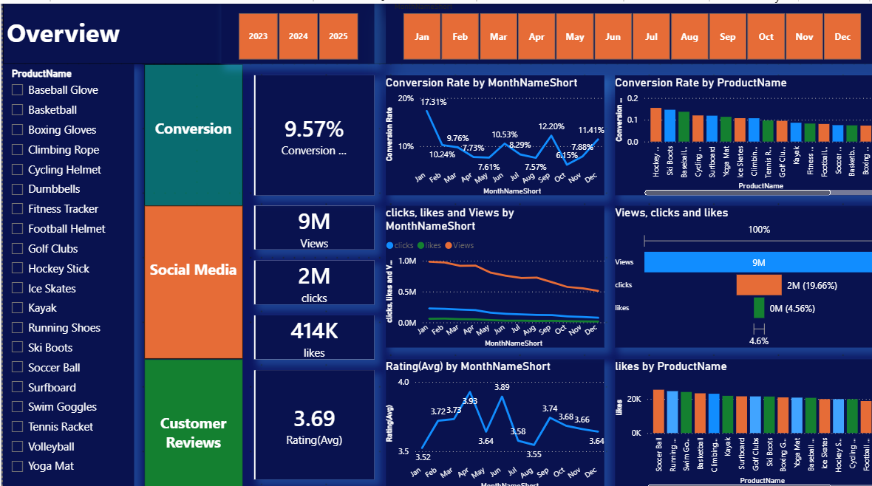
Power BI Dashboard — Overview
A single page summarizing conversion, social media, and customer review performance
9.57%
Conversion Rate
9M
Views
2M
Clicks
414K
Likes
3.69
Avg. Rating

Slide 10
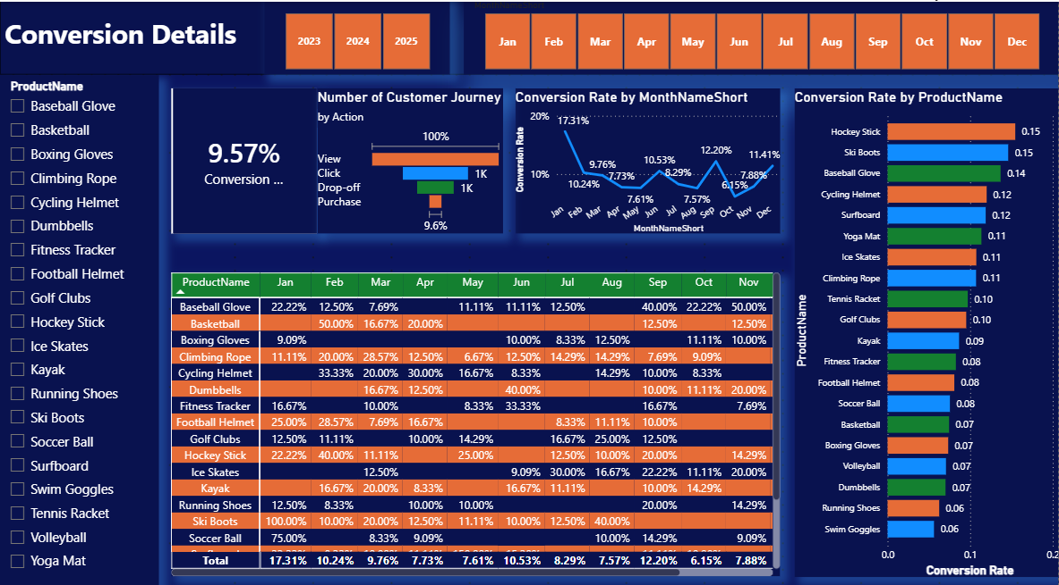
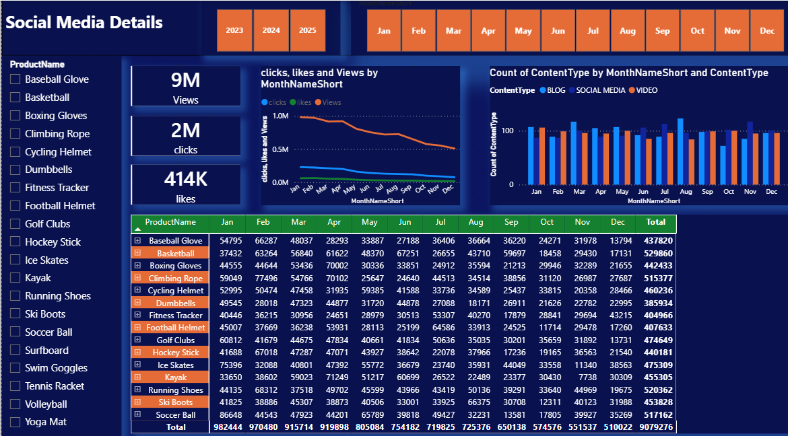
Dashboard — Conversion & Social Media Details
Conversion funnel: View → Click → Drop-off → Purchase, by product and month
Engagement trends and content-type performance (Blog, Social Media, Video)

Slide 11
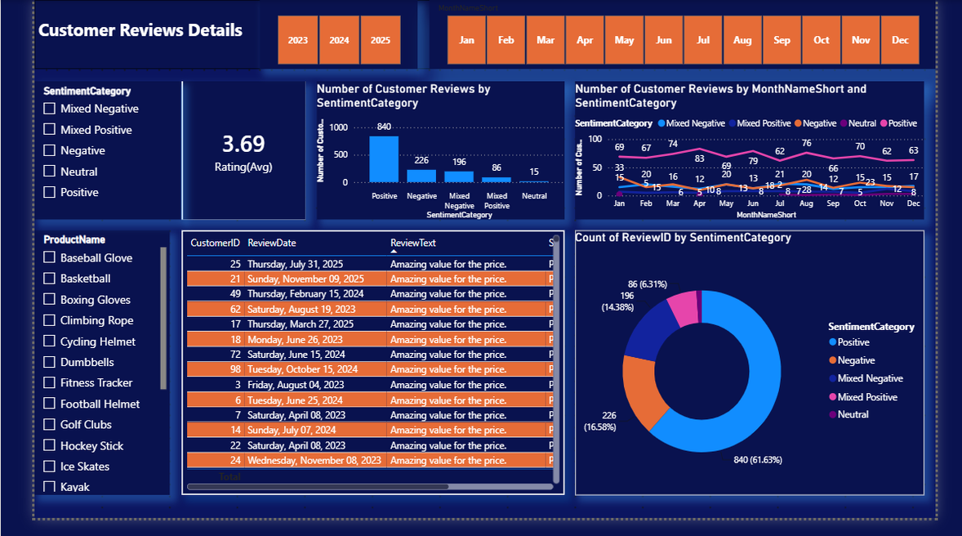
Dashboard — Customer Reviews Details
Sentiment distribution with donut chart, monthly trends, and review detail table by sentiment category
61.63%
Positive
16.58%
Negative
14.38%
Mixed Negative
6.31%
Mixed Positive
1.10%
Neutral

Slide 12
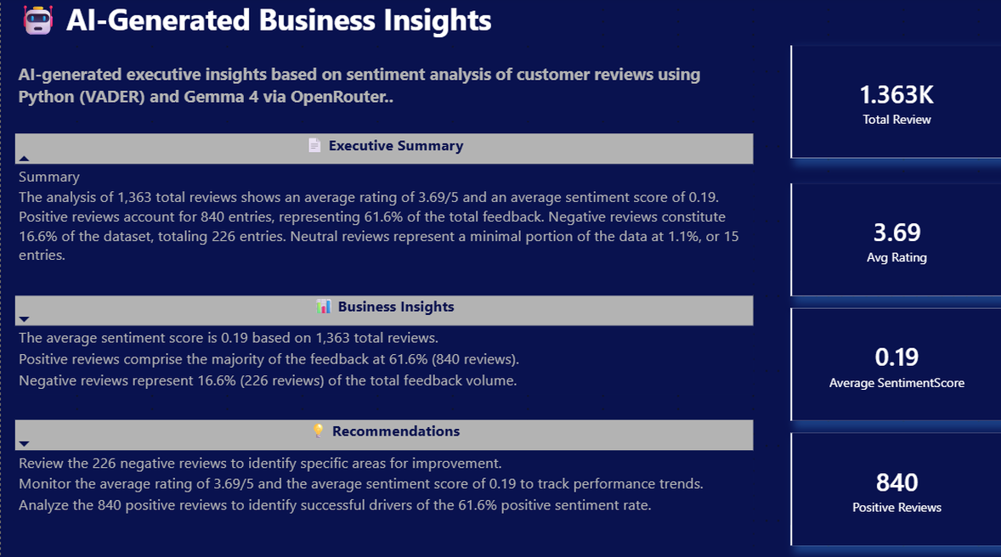
Dashboard — AI-Generated Business Insights (NEW)
AI-generated insights based on Python VADER sentiment analysis and Gemma 4 via OpenRouter
1.363K
Total Reviews
3.69
Avg Rating
0.19
Average SentimentScore
840
Positive Reviews
61.6%
Total Review

Slide 13
AI-Generated Business Insights — Detail
Executive Summary | Business Insights | Recommendations — powered by Gemma 4 via OpenRouter
EXECUTIVE SUMMARY: Analysis of 1,363 reviews shows avg rating 3.69/5 and avg sentiment score 0.19. Positive reviews account for 840 entries (61.6%). Negative reviews constitute 16.6% (226 entries). Neutral reviews are 1.1% (15 entries).
BUSINESS INSIGHT 1: Average sentiment score is 0.19 based on 1,363 total reviews.
BUSINESS INSIGHT 2: Positive reviews comprise the majority at 61.6% (840 reviews). Negative reviews represent 16.6% (226 reviews).
RECOMMENDATIONS: Review 226 negative reviews for improvement areas. Monitor 3.69 avg rating and 0.19 sentiment score. Analyze 840 positive reviews to identify success drivers.

Slide 14
Key Insights
Seasonal conversion swings
Clear product winners
Conversion rate peaks in September (~12.2%) and dips mid-year — campaign timing matters.
Hockey Stick and Ski Boots convert best (~15%); Soccer Ball and Swim Goggles convert lowest (~6%).
Engagement is softening
Sentiment is mostly positive
Views trend downward across the year even as clicks/likes stay flat — an early content-fatigue signal.
~62% of reviews are Positive, but a meaningful Mixed Negative share warrants per-product monitoring.

Slide 15
Recommendations
Actionable next steps for the ShopEasy Sports marketing team
Double down on campaign timing around high-converting months like September; investigate what drove the mid-year dip.
Shift content investment toward formats and products proven to drive engagement (e.g. video for top-converting products).
Set up alerts on Mixed Negative sentiment by product to catch quality or service issues before they spread.
Refresh declining-engagement content categories to counter the downward view trend identified in Social Media Details.

Slide 16

Thank You
Full project — SQL scripts, Python sentiment pipeline, and the Power BI dashboard — available on GitHub
github.com/Amruthaashokan5

