Slide 1
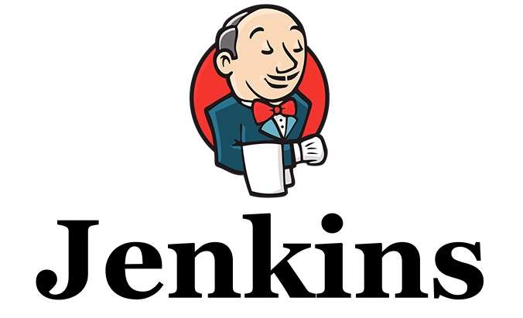

Slide 2
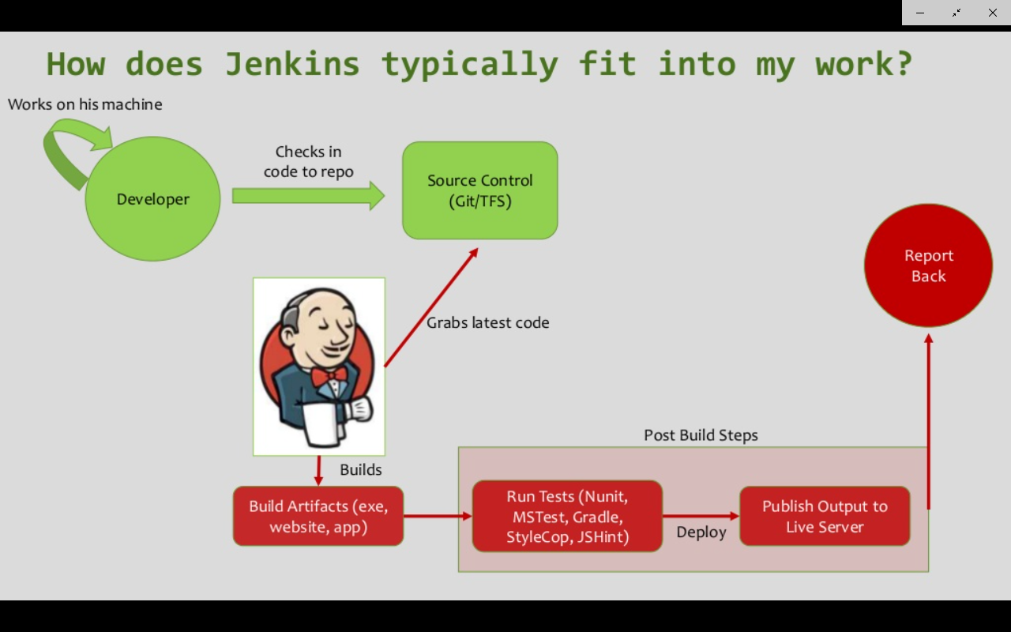
What is Jenkins
Jenkins is a powerful application that allows continuous integration and continuous delivery of projects, regardless of the platform you are working on.
Why Jenkins?
Jenkins is a software that allows continuous integration. Jenkins will be installed on a server where the central build will take place. The following flowchart demonstrates a very simple workflow of how Jenkins works.

Slide 3
What is Jenkins cont…
What is Continuous Integration?
Continuous Integration is a development practice that requires developers to integrate code into a shared repository(GITHUB / BITBUCKET) at regular intervals. This concept was meant to remove the problem of finding later occurrence of issues in the build lifecycle. Continuous integration requires the developers to have frequent builds. The common practice is that whenever a code commit occurs, a build should be triggered.

Slide 4
Getting started with Jenkins
System Requirements
JDK | JDK 1.5 or above
Memory | 2 GB RAM (recommended)
Disk Space | No minimum requirement. Note that since all builds will be stored on the Jenkins machines, it has to be ensured that sufficient disk space is available for build storage.
Operating System Version | Jenkins can be installed on Windows, Ubuntu/Debian, Red Hat/Fedora/CentOS, Mac OS X, openSUSE, FReeBSD, OpenBSD, Gentoo.
Java Container | The WAR file can be run in any container that supports Servlet 2.4/JSP 2.0 or later.(An example is Tomcat 5).
Download Jenkins
The official website for Jenkins is https://jenkins.io If you click the given link, you can get the home page of the Jenkins official website as shown below. Click on Download Jenkins war file - https://jenkins.io/

Slide 5
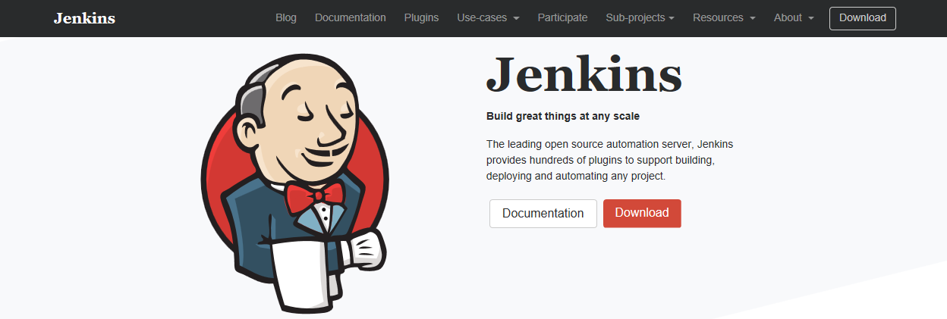

Slide 6
Starting Jenkins
Open the command prompt. From the command prompt, browse to the directory where the jenkins.war file is present. Run the following command
D:\>Java -jar Jenkins.war
After the command is run, various tasks will run, one of which is the extraction of the war file which is done by an embedded webserver called winstone.
D:\>Java -jar Jenkins.war
Running from: D:\jenkins.war Webroot: $user.home/ .jenkins
Once the processing is complete without major errors, the following line will come in the output of the command prompt.
INFO: Jenkins is fully up and running

Slide 7
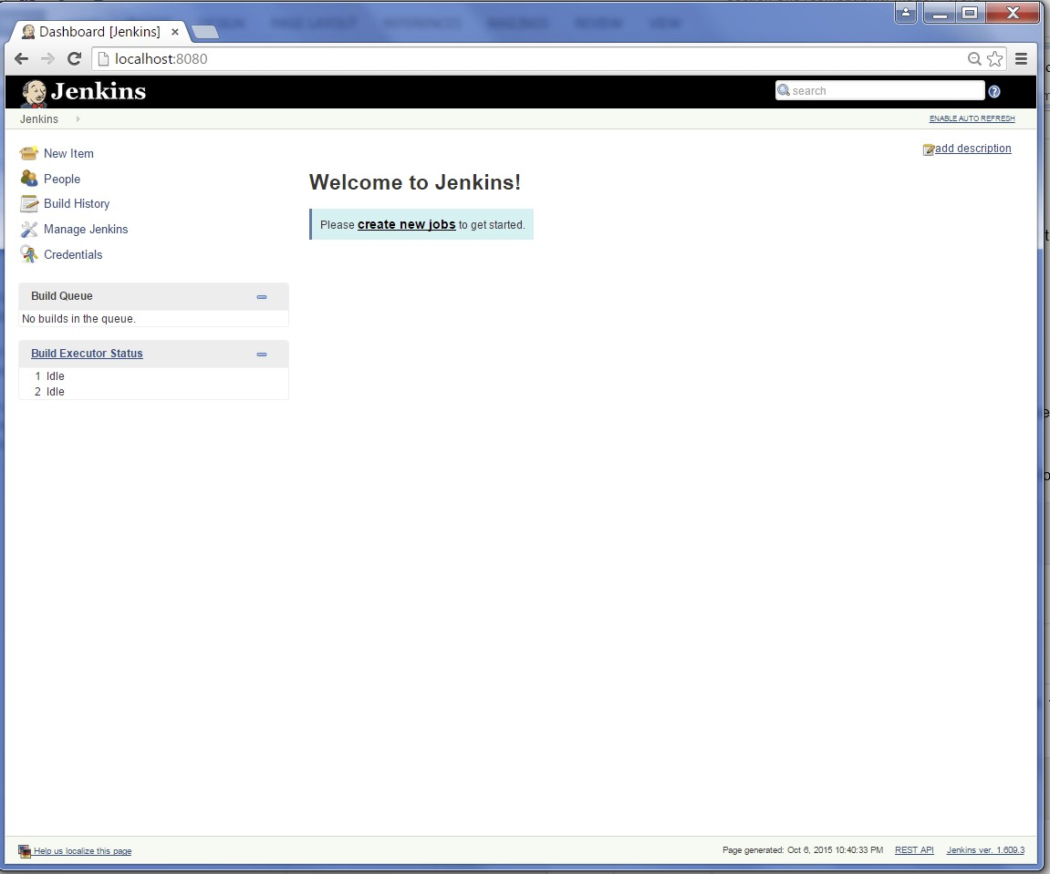
Jenkins Dashboard
Once Jenkins is up and running, one can access Jenkins from the link - http://localhost:8080 This link will bring up the Jenkins dashboard.

Slide 8
Jenkins On Tomcat
Step 1 : Download Tomcat
Step 2 : Unzip and place tomcat folder at any location
Step 3 : Copy/Place the jenkins.war file inside tomcat/webapps folder
Step 4 : Goto commandpromt (cmd) - windows | terminal – mac / Linux
- goto tomcat/bin directory
- make all files executable : chmod +x *.sh
In case of windows this command will not work. This step might not be needed if you are on windows. Else you can right click on the file/folder goto security tab and change the permissions.
TOMCAT - How to install and run on Windows | Change Port | Run app
Step 5 : Start Tomcat got to TOMCAT folder and under tomcat/bin : ./startup.sh
(to shutdown tomcat : ./shutdown.sh)
Step 6 : verify if tomcat started : browser - http://localhost:8080
Step 7 : After adding JENKINS.WAR file to WEBAPP folder under TOMCAT verify if jenkins is running on tomcat : http://localhost:8080/jenkins
*** To start jenkins (standalone) on a diff port***
java -jar jenkins.war - - httpPort=9090

Slide 9
Home Directory (.jenkins)
What and Why is Home Directory?
Home Directory is the .jenkins folder that is created when you deploy jenkins.
This is the folder that contains all the configurations , user managements, plugins, jobs, logs etc details of the jenkins instance.
We can change the location of the HOME DIRECTORY if there is a
Project requirements
To move jenkins home dir to a location that has enough disk space
Step 1 : Check your current home directory
Step 2 : Create a new folder (which will be new home dir)
Step 3 : Copy all data from old dir to new dir
Step 4 : change env variable - JENKINS_HOME and set to new dir Windows - change env variable
- goto terminaal
export JENKINS_HOME=/Users/location/of /The/Jenkins/JenkinsHome/
Step 5 : restart Jenkins

Slide 10

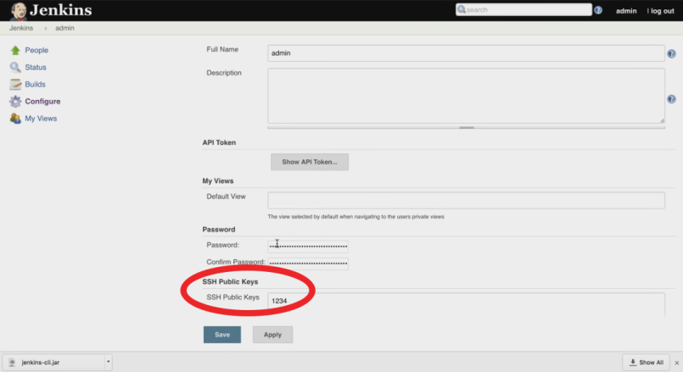
Jenkins as CLI
Step 1 : start Jenkins
Step 2 : goto Manage Jenkins - Configure Global Security - enable security
Step 3 : goto - http://localhost:8080/cli/
Step 4 : download jerkins-cli jar. Place at any location.
Step 5 : test the jenkins command line is working
CMD or Terminal got to the jerkins-cli jar folder and here
:java -jar jenkins-cli.jar -s http://localhost:8080/ help
If asked for passphrase then
Goto admin or login configure and under
SSH PUBLIC KEY section is the passphrase.
Note : Also for Authorization section make
Sure you have selected the correct option.

Slide 11
How to create Users + Manage + Assign Roles
How to create New Users
How to configure users
How to create new roles
How to assign users to roles
How to Control user access on projects
Step 1 : Create new users
Step 2 : Configure users
Step 3 : Create and manage user roles Role-based Authorization Strategy
Plugin - download - restart jenkins
Step 4 : Manage Jenkins - Configure Global Security - Authorisation - Role Based Strategy
Step 5 : Create Roles and Assign roles to users
Step 6 : Validate authorization and authentication are working properly
Notes:
Under – MANAGE AND ASSIGN role
Global Role as
Employee and give overall (READ access) and (View access)
Create Projects Roles
Devloper project – Dev.*
Tester project – Test.*
Now got to
ASSIGN ROLE
Under Gobal Roles
You will see the ADDED GLOBAL ROLE (i.e EMPLOYEE)
Here you add the users giving them the global role.
Under Project Based
You will see the ADDED PROJECT ROLE (i.e DEVELOPER and TESTER)
ADD the user to that role accordingly.

Slide 12
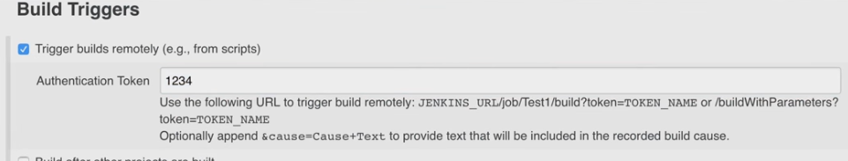
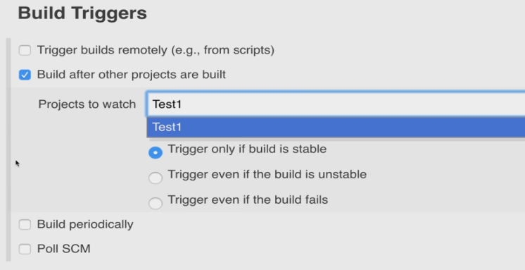
Getting started with JOBS
1. How to create a basic JOB in Jenkins
2. Basic job configurations
2. How to run the Job remotely
4. How to chain Job Execution
Step 1 : Jenkins - New Item - add details
Step 2 : How to trigger the job remotely-
Goto – Buid Triggers under this select
-> TIGGER BUILDS REMOTELY
Generate Token under that it and use the above in any browser from any where.
Step 3 : How to chain job executions
Goto : Goto – Buid Triggers under this select
-> Build After other projects are built.

Slide 13
Jenkins integration with GIT (SCM)
1. Create a java program and run it through command line
2. Create a Jenkins job to run the java program
3. Add this program/project to Git
4. Jenkins - add git plugin
5. Configure Jenkins job to trigger the execution when a change is pushed to GitHub
__________________________________________________________
Step 1 : Create a java program
Step 2 : Compile from command line
javac “name of .java class” java “name of class without extension .java”
Then $> java “just the name of the .class file”
Note: Make sure you are in the same directory as the file is.
Step 3 : Create a Jenkins job to run this program
Step 4 : Add the project to Git and GitHub
Note : Use Repo: https://github.com/Muubash/cucumberbasic.git to build using MAVEN
$> mvn
$> mvn clean
$> mvn compile
Notes:
Java Programme.
####################
public class Hello{
public static void main(String[] args){
for (int i=1; i<=10; i++){
System.out.println("Hello World..."+i);
}
}
}
###############################
Use the below commands in the cmd.exe at the folder (git clone https://github.com/Muubash/cucumberbasic.git)
$> mvn
$> mvn clean
$> mvn compile
Now create the same project/job in Jenkins

Slide 14
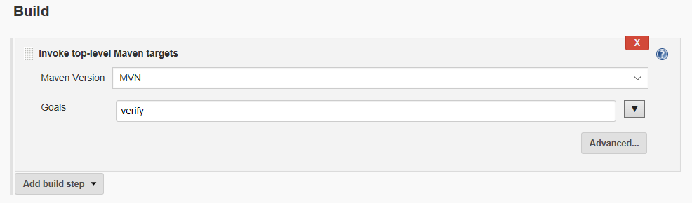
Jenkins integration with GIT (SCM) and Maven tool
1. Create a Maven project and run it through command line.
2. Create a Jenkins job to build the same USING MAVEN as plugin.
3. Configure Jenkins job to trigger the execution when a change is pushed to GitHub
Use the below commands in the cmd.exe at the folder (git clone https://github.com/Muubash/cucumberbasic.git)
$> mvn
$> mvn clean
$> mvn compile
Now create the same project/job in Jenkins use <Invoke top-level Maven targets> options under Build options
Also use the repo https://github.com/Muubash/SeleniumWithCucucumber.git for doing the same and generate the report using cucumber report plugin.
Notes:
Also use the repo https://github.com/Muubash/SeleniumWithCucucumber.git for doing the same and generate the report using cucumber report plugin.

Slide 15
Jenkins integration with Pipeline
What is Pipeline?
How to create the Pipeline Syntax.
Use of Snippet Generator.
Show Staging.
Parallel process.
Multiple NODES or SLAVE/AGENT topology.
_____________________________________________________________________
Jenkins Pipeline is a suite of plugins which supports implementing and integrating continuous delivery pipelines into Jenkins.
Step 1: Add the Pipeline plugin.
Step 2: Create a New Item/ job select Pipeline type
Follow the procedure to generate the snippet using the Snippet Generator.
Check link below.
https://jenkins.io/doc/book/pipeline/getting-started/#defining-a-pipeline-in-the-web-ui
https://jenkins.io/solutions/pipeline/

Slide 16
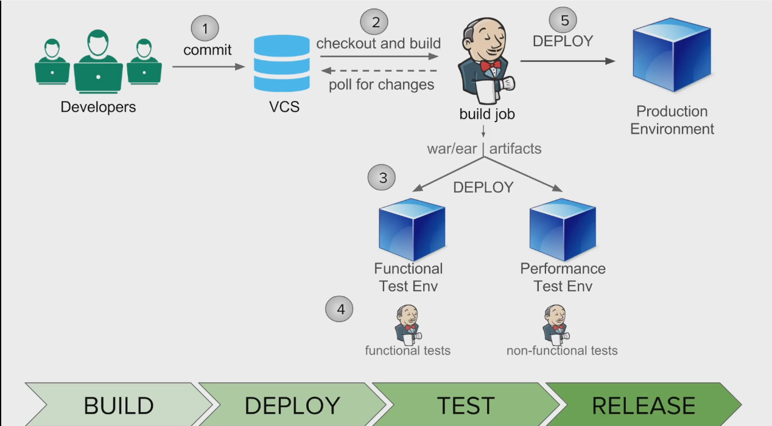
Notes:
Deploy Plugin Demo using sample war file from
https://tomcat.apache.org/tomcat-7.0-doc/appdev/sample/
Deploy the above in a Tomcat 7.X container from Jenkins

Slide 17
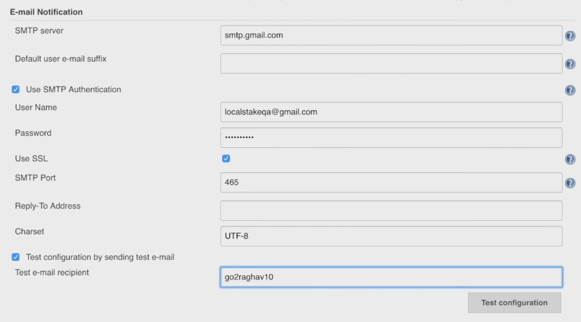
How to set Email Notfication in Jenkins
One can set Notification at each stage of the Job to notify if the Job was build,
Successfull, Unsuccessful or Unstable.
Goto System configuration under Manage Jenkins.
Goto Email Notifcation.Set the SMTP Server Details and Test the Configuration.
Got to any job created and under Post Build select the Email Notification.
https://www.arclab.com/en/kb/email/list-of-smtp-and-imap-servers-mailserver-list.html

Slide 18
Blue Ocean Plugin and View.
What is Blue Ocean?
Blue Ocean rethinks the user experience of Jenkins. Designed from the ground up for Jenkins Pipeline, but still compatible with Freestyle jobs, Blue Ocean reduces clutter and increases clarity for every member of the team.
Sophisticated visualizations of continuous delivery (CD) Pipelines, allowing for fast and intuitive comprehension of pipeline’s status.
Pipeline editor makes creation of Pipelines approachable by guiding the user through an intuitive and visual process to create a Pipeline.
Personalization to suit the role-based needs of each member of the team.
Pinpoint precision when intervention is needed and/or issues arise. Blue Ocean shows where in the pipeline attention is needed, facilitating exception handling and increasing productivity.
Native integration for branch and pull requests enables maximum developer productivity when collaborating on code with others in GitHub and Bitbucket.
To start using Blue Ocean, see Getting Started with Blue Ocean.

