Slide 1
USA HOUSING
AMRUTHA KAKKOTH

Slide 2
PROBLEM STATEMENT
The factors that could influence residential home prices across the US over next 10 years and how

Slide 3
INFLUENTIAL FACTORS
Many factors can affect the housing price like population density, income, revenue, interest rates, topography etc.
Here we have visualization for the below factors:
Income
Population
No. Of stories
No. Of bedrooms
House age

Slide 4
INCOME
Income for those in rural maybe lesser compared to those in urban,hence their demand for the house too will vary
Urban people look forward for expensive homes too

Slide 5
POPULATION
When densely populated, more demand for residential houses and hence its a contributing factor.
Population increases with respect to amenities available from within the area such as super markets, malls, schools, etc.

Slide 6
NUMBER OF BEDROOMS
With respect to the number of people in the family , it contributes to the search for ready to occupy houses with more bedrooms and if for construction of new house, add more bedrooms.
The price of a house tends to increase with the number of bathrooms available.

Slide 7
STORIES
Even though people tend to pay more for houses with more floors. They are also other factors that would also affect the price.
The price of a house tends to increase with the number of bathrooms available.

Slide 8
AGE AND STATE OF THE HOUSE
Houses that were built recently are usually costlier than older houses and people tend to pay more for houses that were just recently renovated.
Houses with beautiful views and waterfronts tend to be costlier.

Slide 9
Other factors like interest rates, unemployment, even neighborhood are also affecting nowadays.

Slide 10
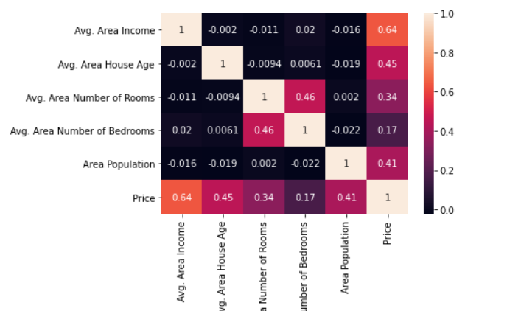
HEATMAP SHOWING CORRELATION BETWEEN FEATURES

Slide 11
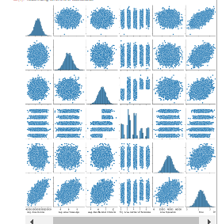
PAIRPLOT

Slide 12
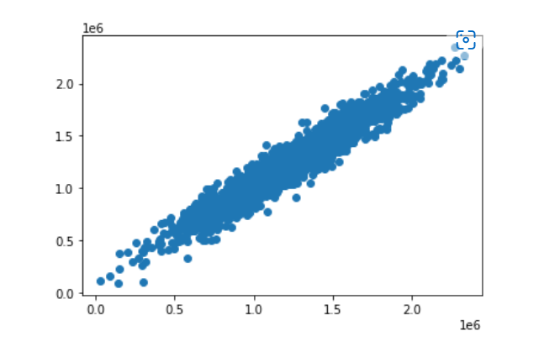
SCATTER PLOT FOR PREDICTION
PLOT FOR PRICE ON X AXIS

Slide 13
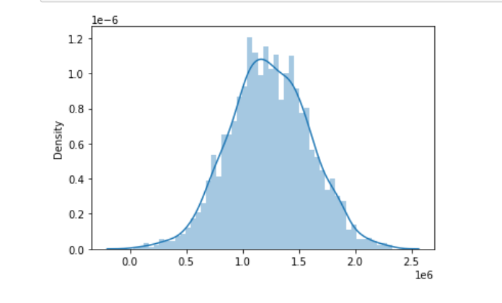
DISTANCEPLOT FOR PREDICTION
PLOT FOR POPULATION DENSITY

Slide 14
THANK YOU

