Slide 1
Student Result/Grade Management System

Slide 2
Introduction
Welcome to our innovative MERN stack project, the Student Result/Grade Management System! This comprehensive solution harnesses the power of MongoDB, Express.js, React.js, and Node.js to revolutionize the way academic data is handled. Our system offers a user-friendly interface for effortless management of student profiles, grades, and results. With features such as secure user authentication, dynamic grade entry and calculation, and automated result generation, we aim to provide educators and administrators with a robust platform to streamline the complexities of academic record-keeping. Join us on this journey as we redefine efficiency and precision in student result management through the seamless integration of cutting-edge technologies.

Slide 3
Project Description
Our Student Result/Grade Management System is a dynamic and comprehensive solution designed to simplify the complexities of managing student academic records. Built on the MERN stack, this project seamlessly integrates MongoDB, Express.js, React.js, and Node.js to create a robust and user-friendly platform.
Key Features:
Student Profile Management: Create, update, and delete student profiles, including personal details and academic information.
Result Generation: Automated result generation, offering a quick overview of students' academic performance.
Report Generation: Comprehensive reporting capabilities, including individual student reports and class-wise performance summaries.

Slide 4
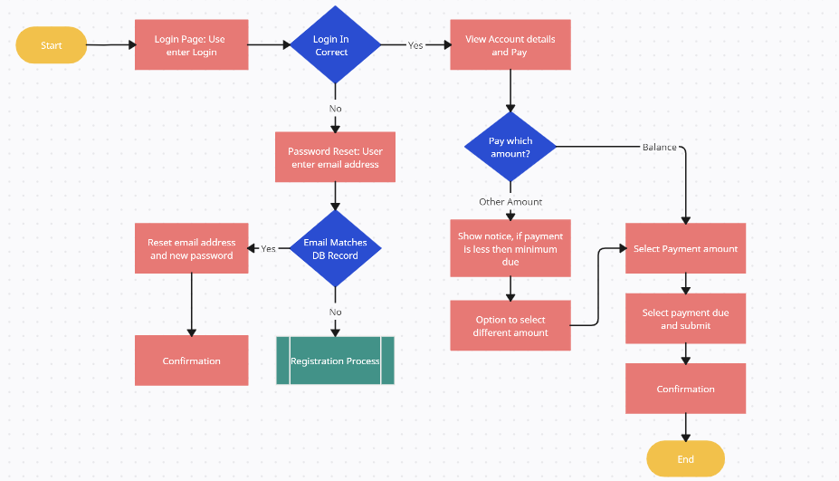
Customer Journey Map

Slide 5
Recommendations By Users:
Updating any information through emails.
Take more care about Fee Payments Section.
Clean and User-Friendly Interface.
Reducing the server issues.
Academic calendar should be available.
Make it simple to enrol for courses.

Slide 6
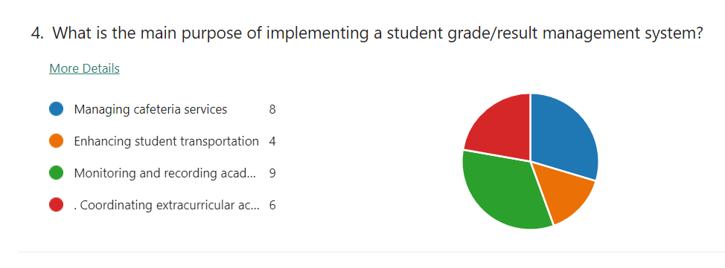
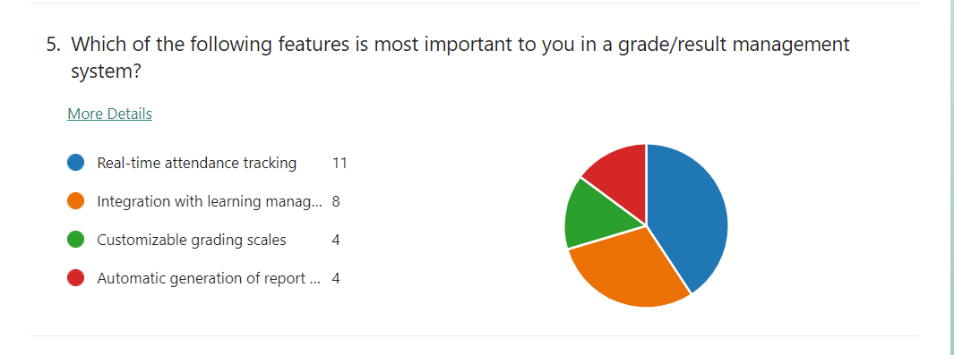
Field Review

Slide 7
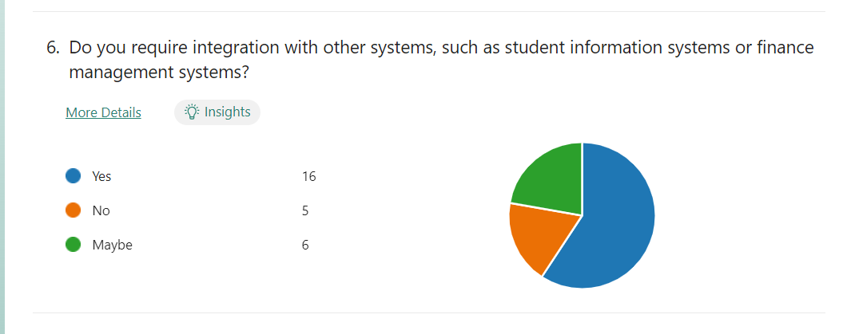
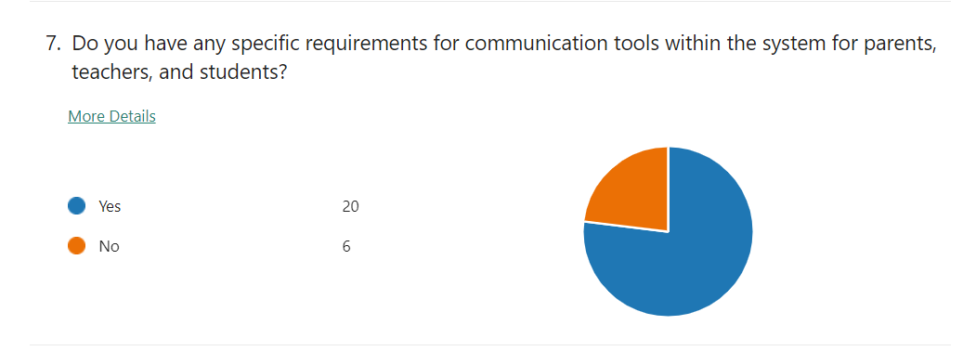
Field Review

Slide 8
Conclusion
We interviewed a total of 25 students to understand the issues they are facing with student course management systems (SCMSs).
The following are the key findings of our interviews:
Course registration
Server down issues
Fee payment issues
Timetable clashes

Slide 9
THANK YOU
TEAM MEMBERS:
G.AMRUTHA SIRI(2200031206)
B.DEVI AKSHAYA (2200031208)
A.SAVYA SAI SRI (2200031205)

