Slide 1
IPL 2025 PLAYERS AND TEAM PERFORMANCE ANALYSIS
Data Analytics Report
AMRUTHA V
AF04972561
November 2025

Slide 2
Business Requirements
Through This Power BI Analysis, we will:
Understand player performance trends and team dynamics across IPL 2025
Analyze batting and bowling statistics to identify top performers
Identify teams with high and low performance metrics
Support data-driven team selection and strategy decisions

Slide 3
Problem Statements :
Total Runs Analysis: Understand the overall batting performance across all players and teams.
Strike Rate Analysis: Evaluate batting efficiency and aggressive play patterns.
Match Volume Analysis: Examine total matches played to gain insight into player consistency.
Boundary Analysis: Analyze 4s and 6s distribution to understand scoring patterns
Team Performance Analysis: Evaluate team-wise runs contribution and player distribution

Slide 4
Analysis Done For
SUM OF 4s AND 6s BY PLAYERS NAME(TABLE):
Detailed view of boundary hitting agility for each player matrix is designed.
COUNT OF AVG,SUM OF Hs, SUM OF SR AND BF BY PLAYER NAME (CLUSTERED BAR CHART):
Multi-metric comparision showing batting average, highest score, strike rate and balls faced
SUM OF RUNS AND INN BY MATCHES(LINE CHART):
Visuzlise match-wise run accumulation and innings trands over tournament progression.
SUM OF RUNS BY TEAMS(PIE CHART):
Represent the contribution of different teams to total runs scored.
OVERALL PERFORMANCE USING CARDS:
Display key matrics at a glance.
SLICERS FOR PLAYER NAME AND TEAM:
Enable filtering for specific player or team analysis.

Slide 5
Overall Performance using Cards
Total Runs
25K
Sum of Runs
Strike Rate
18.89K
Sum of SR
Total Matches
1,442
Sum of Matches

Slide 6
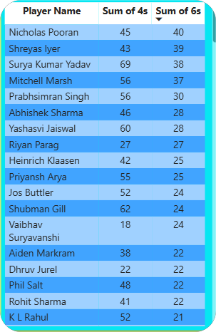
Key Insights - Top Performers
Highest run scorers identified with consistency metrics across multiple matches
Players with best strike rates showcasing aggressive batting styles
Boundary kings analyzed through most 4s and 6s distribution
Player performance comparison across all teams

Slide 7
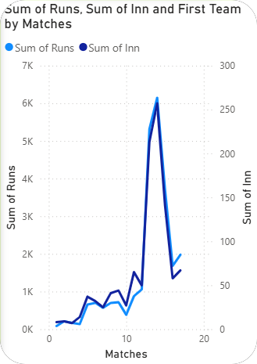
Key Insights - Team Analysis
Team-wise run contribution and distribution patterns identified
Player depth analysis across all eight franchises
Performance patterns tracked across tournament progression
Match trends showing run accumulation throughout the season

Slide 8
Conclusion & Key Findings
Comprehensive view of IPL 2025 player and team performance metrics
Data-driven insights enable strategic decision-making for team management
Clear identification of strengths and areas for improvement
Interactive dashboard allows filtering by player and team for detailed analysis

Slide 9
Thank You!
Questions?

