Slide 1
NORTHSTAR INTELLIGENCE PLATFORM
Attribution Lab
Visual logic & calculations
Which attribution model fits the portfolio, what changes if you switch —
and the arithmetic behind every score the page reports.
Selected model: Last Touch · recommended: First Touch · 6 models compared

Slide 2
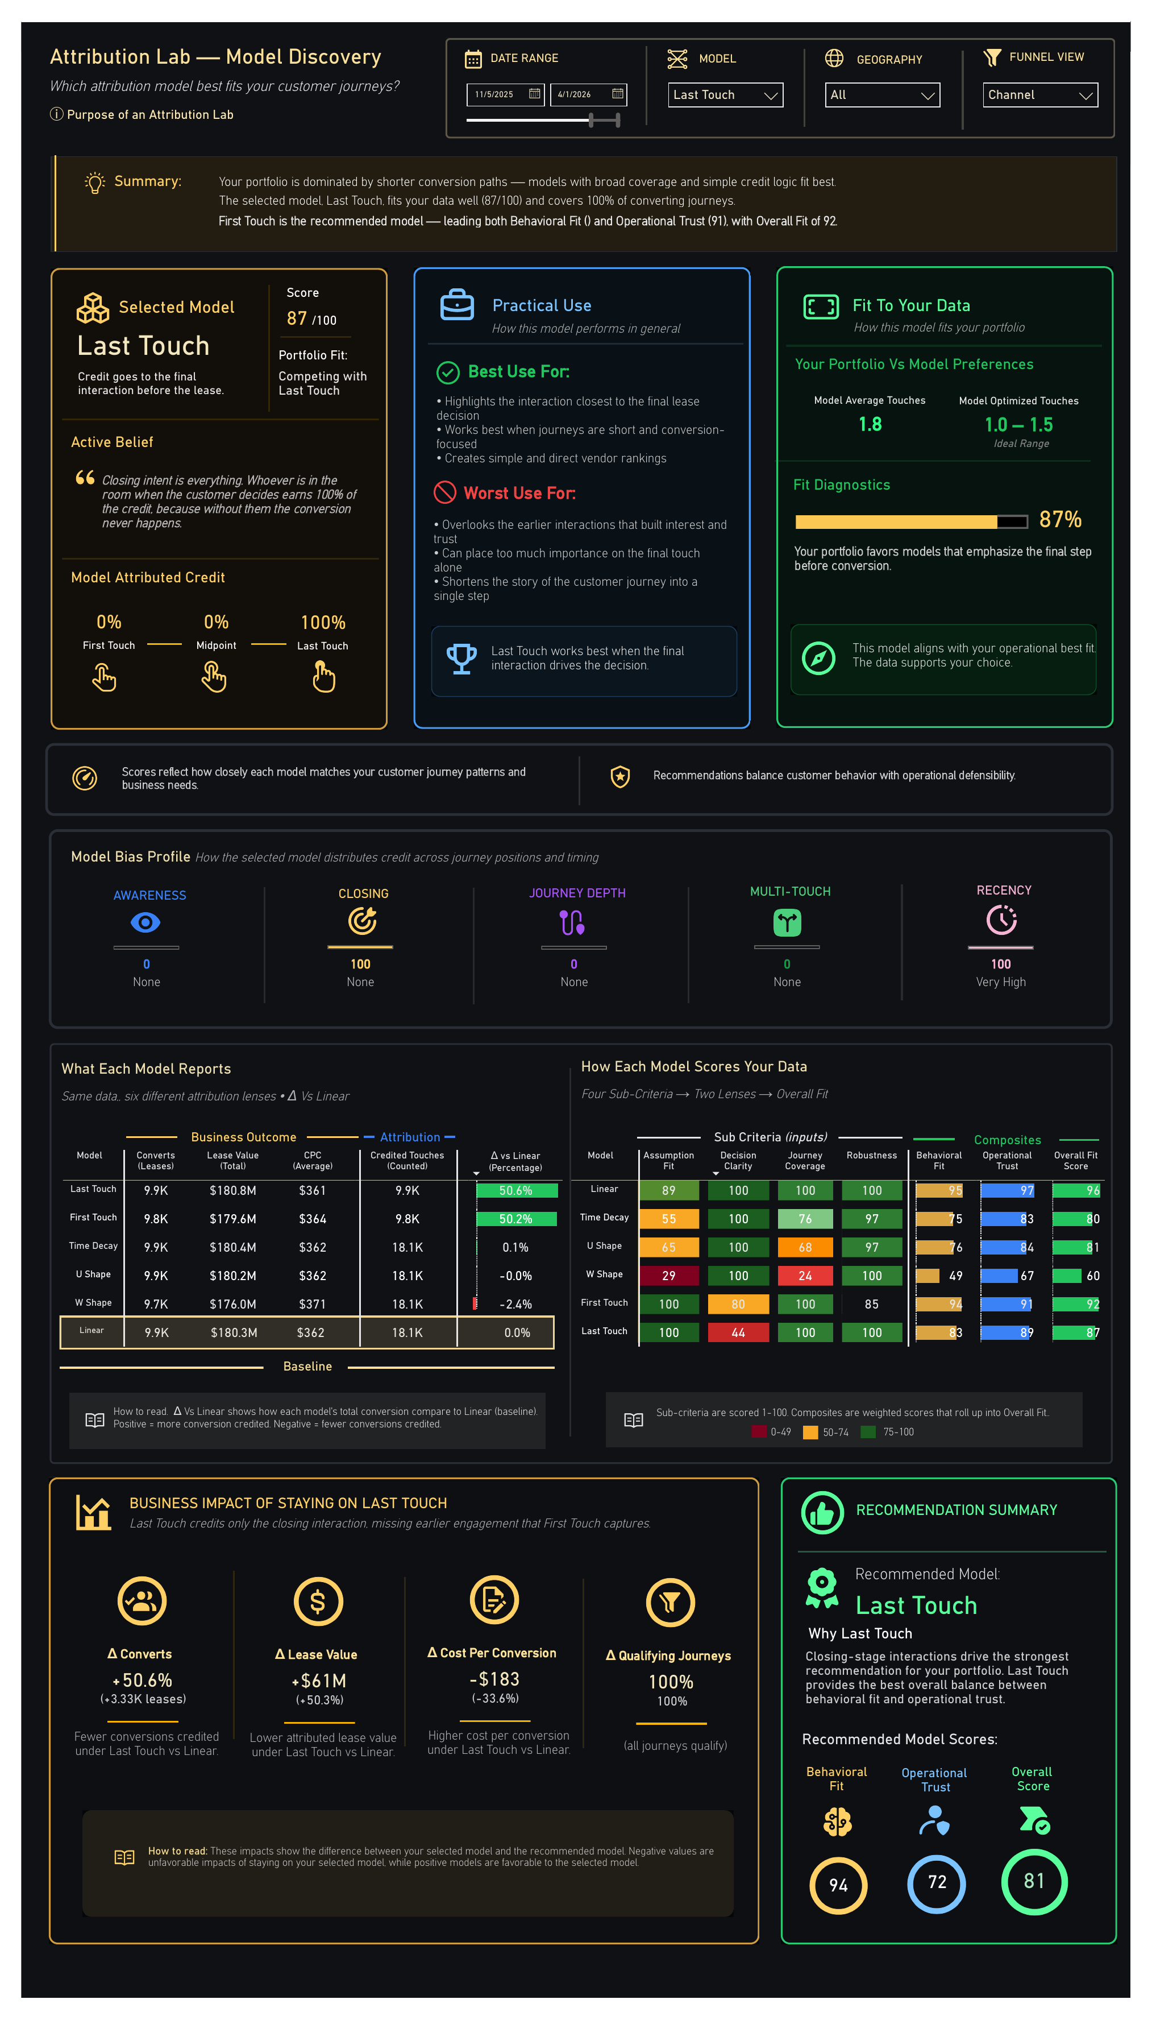
The page — Model Discovery
Nine elements, all answering one question: does the model you chose actually fit your journeys?

Slide 3
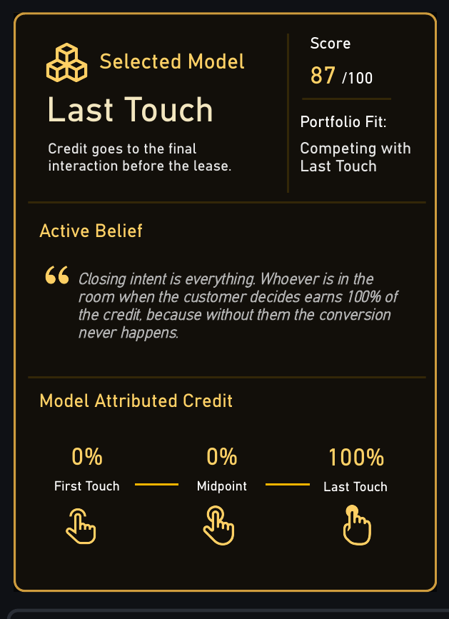
1 · Selected Model
A credit rule, the belief it encodes, and the fit score that tests it
CREDIT DISTRIBUTION — LAST TOUCH
First Touch 0%
Midpoint 0%
Last Touch 100%
Every converting journey assigns its full
credit to the final interaction before signature.
Six models, six credit rules — the same journeys, divided differently.
What it does
Reading the score
States the rule in plain language, then names the belief that rule commits you to.
Last Touch asserts that closing intent is everything: whoever is present at the decision earns all of the credit.
87 of 100 is the model's Overall Fit against this portfolio, not a quality rating of the model itself.
A model can be defensible in general and still be the wrong lens for the journeys you actually have.

Slide 4
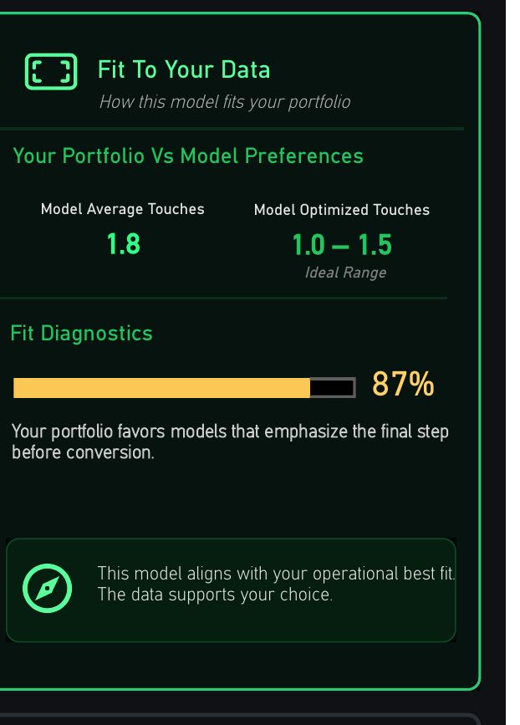
2 · Fit To Your Data
The portfolio's journey shape, measured against what the model assumes
ASSUMPTION FIT — THE PENALTY LADDER
avg touches ≤ 2 penalty 0
≤ 4 penalty 5 + (t-2) × 7.5
≤ 7 penalty 20 + (t-4) × 5
≤ 12 penalty 35 + (t-7) × 5
>12 penalty 60
score = MAX(0, 100 - penalty)
At 1.8 average touches Last Touch draws no penalty — Assumption Fit 100.
Each model has an enemy
Why 1.8 matters
The ladder differs by model. Last Touch is punished by long journeys with real pre-close work.
First Touch is punished by long elapsed time, and again if journeys are so short that first and last are the same touch.
The portfolio averages 1.8 touches per converting journey against an ideal range of 1.0 to 1.5.
Short paths are why single-touch models score well here. On a portfolio with six-touch journeys the same models would collapse.

Slide 5
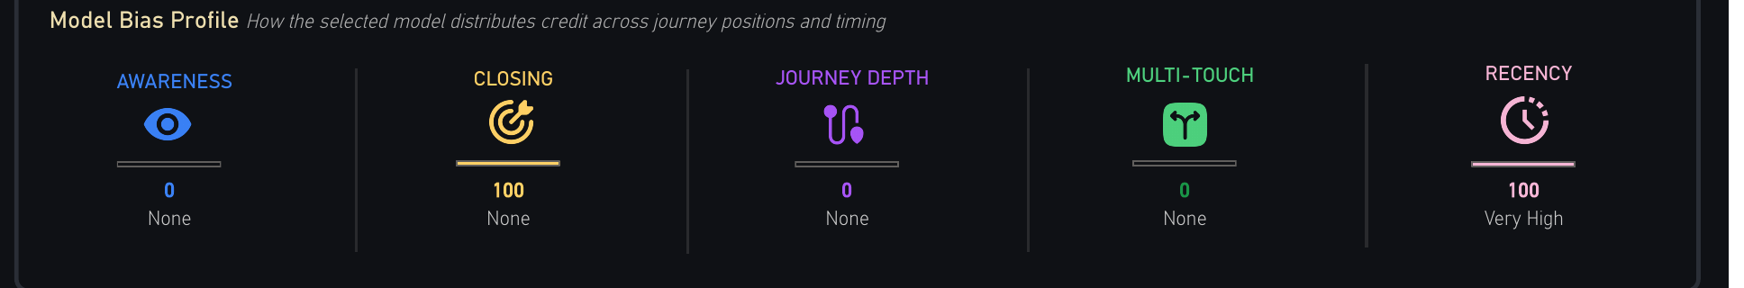
3 · Model Bias Profile
Five fixed dimensions declaring what the chosen rule systematically over-weights
BIAS — CLOSING, BY MODEL
Why declare bias at all
First Touch 0
W Shape 30
Linear 33
U Shape 40
Time Decay 50
Last Touch 100
Five dimensions scored this way: Awareness,
Closing, Journey Depth, Multi-Touch, Recency.
Every attribution model is biased. The dishonest ones simply do not say so.
Last Touch reads Closing 100 and Recency 100, Awareness 0, Journey Depth 0, Multi-Touch 0. That profile is not a defect to be corrected; it is the model doing exactly what it was chosen to do.
Stating it up front means a vendor ranking can be challenged on the rule rather than on the arithmetic.
Fixed constants — properties of the model, not of the data.

Slide 6
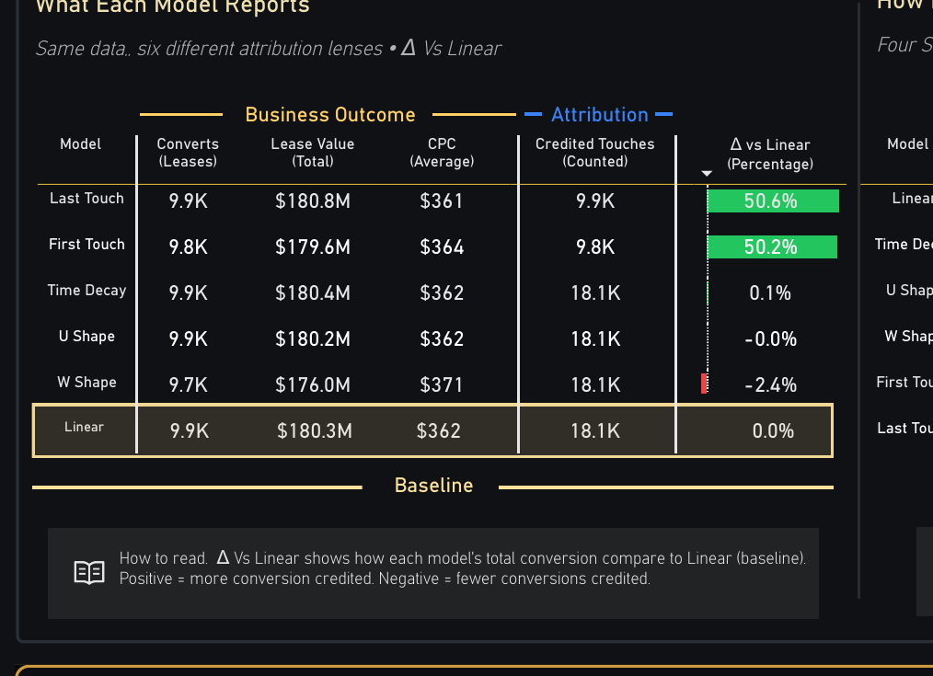
4 · What Each Model Reports
The same journeys under six lenses, every difference measured against Linear
CREDITED TOUCHES — THE SPLIT
Linear 18.1K
Time Decay 18.1K
U Shape 18.1K
W Shape 18.1K
First Touch 9.8K
Last Touch 9.9K
Single-touch models credit one touch per journey; multi-touch models credit them all.
The number that is not moving
Lease value lands between $176.0M and $180.8M across all six models — a spread under 3%.
Attribution does not change how many leases were signed or what they were worth. It changes only who gets credited for them.
The choice is therefore a budget-allocation decision, not a measurement one.

Slide 7
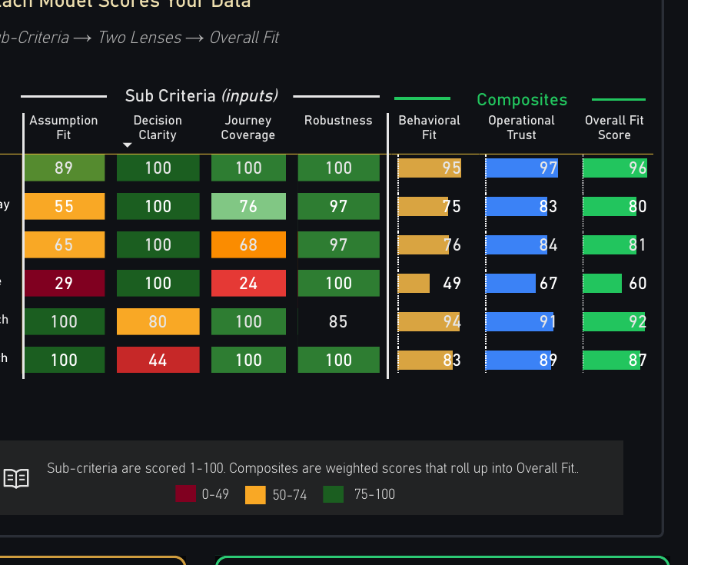
5 · How Each Model Scores Your Data
Four sub-criteria, two composite lenses, one Overall Fit — all of it fixed arithmetic
THE TWO LENSES
Behavioral Fit = 0.40 × Assumption Fit
+ 0.30 × Journey Coverage
+ 0.30 × Decision Clarity
Operational Trust = 0.25 × Assumption Fit
+ 0.20 × Journey Coverage
+ 0.20 × Decision Clarity
+ 0.35 × Robustness
Robustness enters Trust only — stability is an operational question, not a behavioural one.
WORKED ON FIRST TOUCH
A 100 C 100 D 80 R 85
BF = 0.40(100) + 0.30(100) + 0.30(80) = 94.00
OT = 0.25(100) + 0.20(100) + 0.20(80)
+ 0.35(85) = 90.75
Overall = 0.40(94.00) + 0.60(90.75) = 92.05
Trust outweighs Fit 60/40 — a defensible answer beats a flattering one.

Slide 8
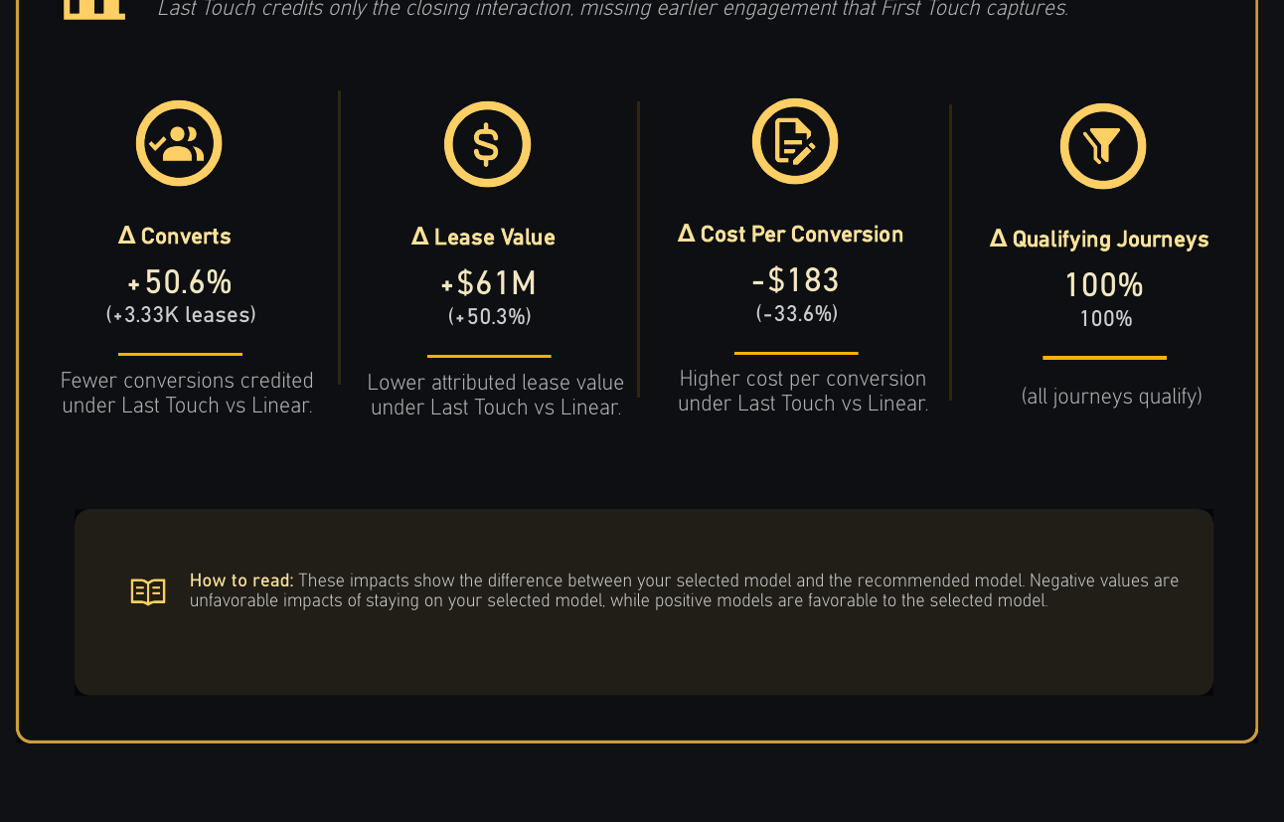
6 · Business Impact
What staying on the selected model costs, stated in leases and dollars
THE FOUR DELTAS
Δ Converts +50.6%
Δ Lease Value +$61M
Δ Cost / Conv -$183
Δ Qualifying 100%
Selected model measured against the recommended one.
Why state it in money
A fit score of 87 against 92 is an abstraction. A $61M difference in attributed lease value is not.
The section exists to convert a methodological preference into a number a budget owner can argue with.

Slide 9
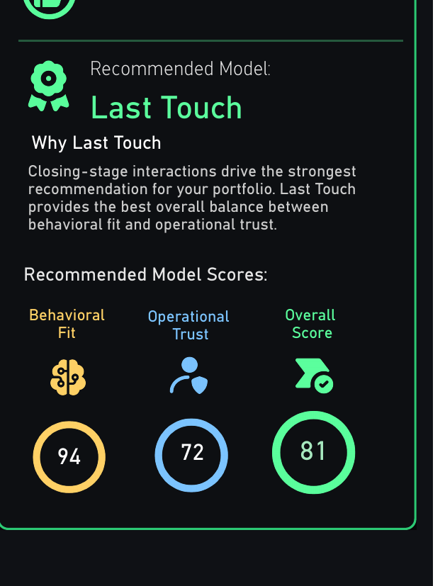
7 · Recommendation Summary
One model named, by the highest Overall Fit — with no tie-breaking discretion
THE SELECTION
Linear 96 First Touch 92
Time Decay 80 Last Touch 87
U Shape 81 W Shape 60
recommended = TOPN(1, all six Overall Fit scores, DESC)
The highest score wins. No weighting by preference, no manual override.
Where the page stops
It names a model, reports the gap, and prices the difference. It does not switch anything.
Attribution is a commercial agreement about how vendors get paid as much as it is a measurement choice, so the page hands the operator a defensible position rather than a decision already taken.

Slide 10
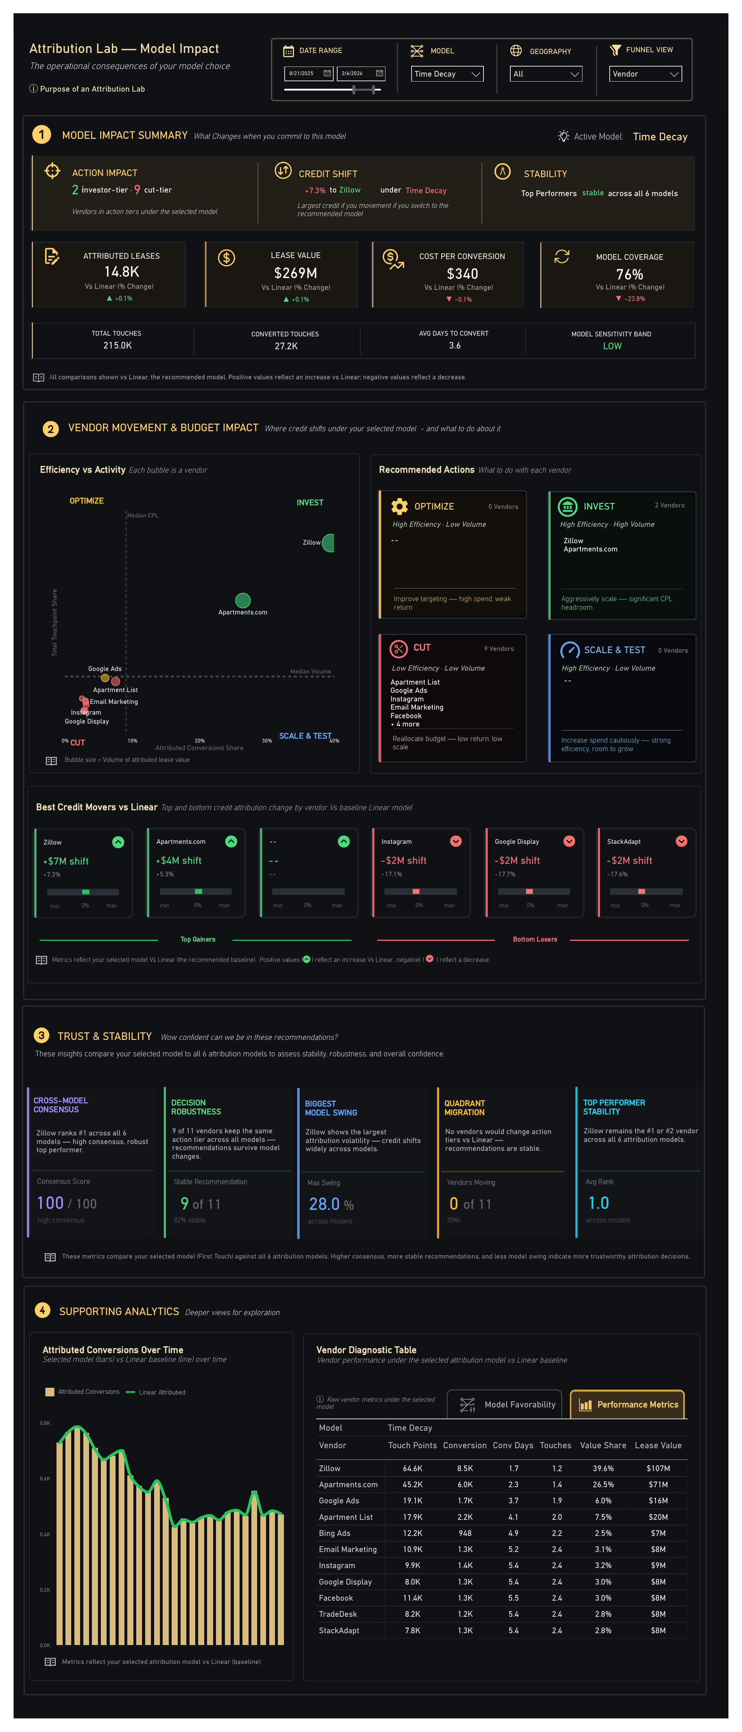
The page — Model Impact
Four sections answering the second question: if you commit to this model, what actually changes?

Slide 11
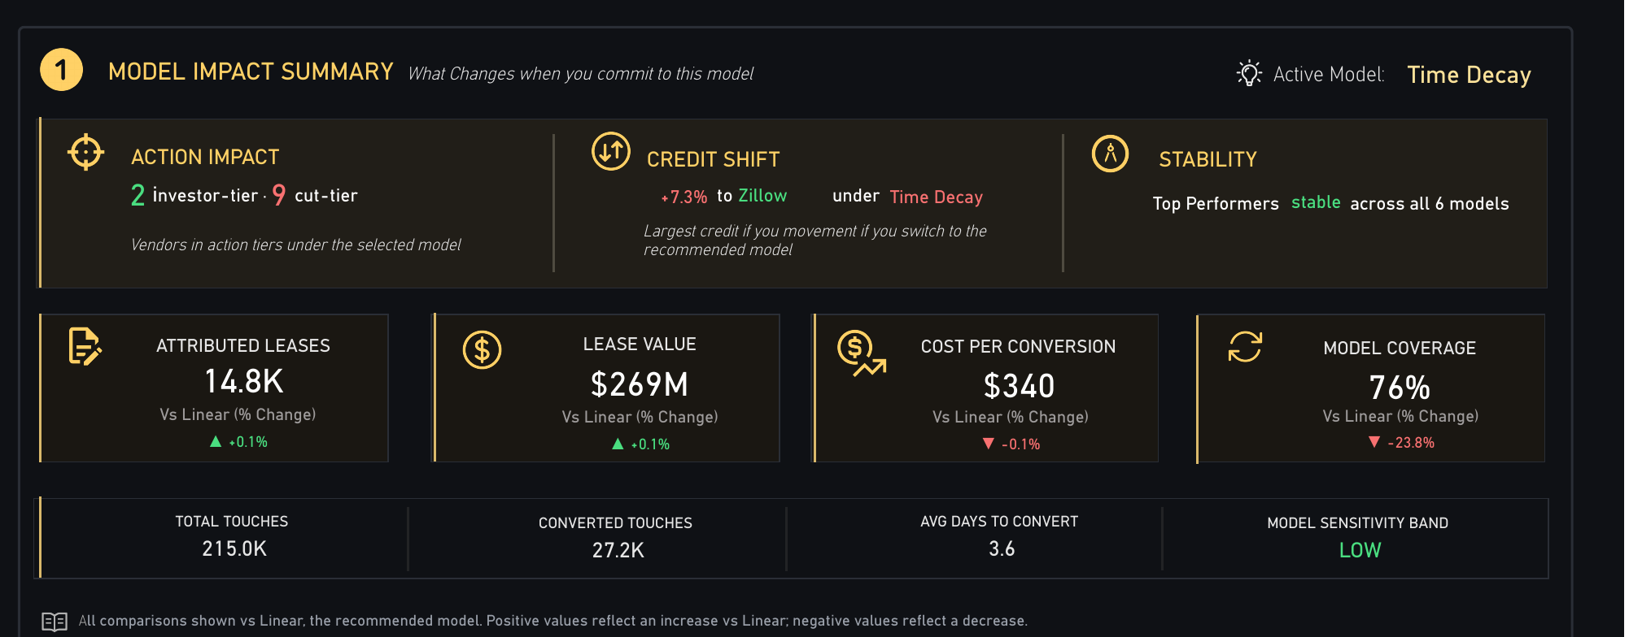
8 · Model Impact Summary
The operational consequences of the choice, every figure indexed to Linear
WHAT MOVES, AND WHAT DOES NOT
One number is doing all the work
Attributed Leases 14.8K ▲ +0.1%
Lease Value $269M ▲ +0.1%
Cost per Conversion $340 ▼ -0.1%
Model Coverage 76% ▼ -23.8%
Three of the four headline figures move by a tenth of a percent. Coverage falls 23.8%.
That asymmetry is the finding. Switching models barely alters the totals, but it changes which journeys are eligible to be counted — and therefore which vendors can be paid.
A summary that averaged these four into one health score would have hidden precisely the thing worth knowing.
Coverage counts the share of converting journeys the model can credit at all.

Slide 12
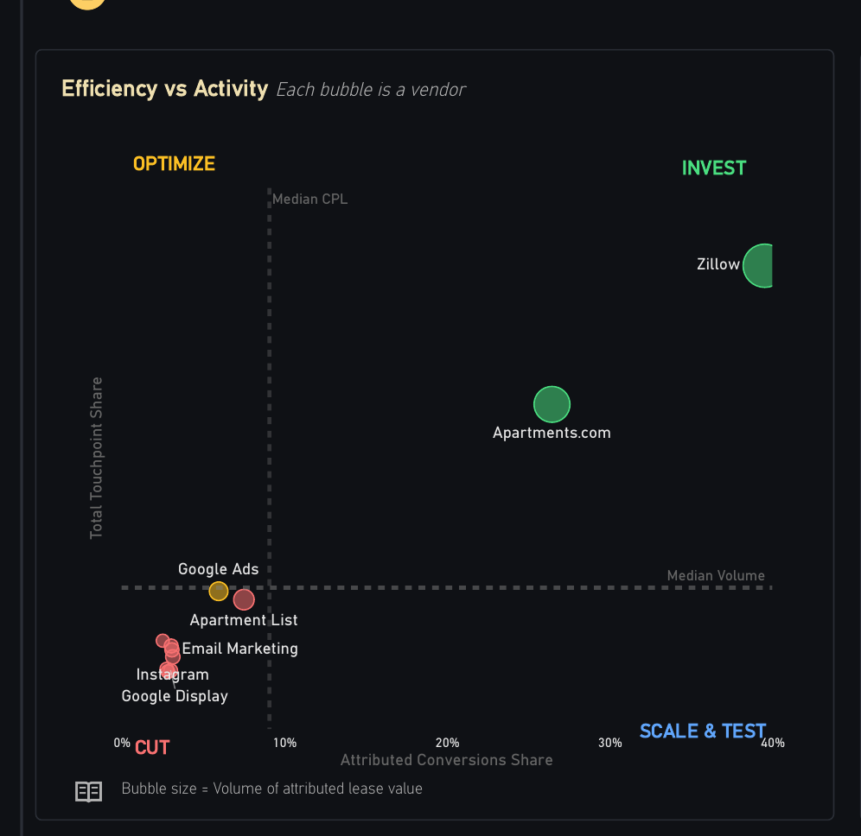
9 · Vendor Movement
Two shares plotted against a fair-share line, yielding one posture per vendor
QUADRANT ASSIGNMENT
conv > fair and touch > fair → INVEST
conv ≤ fair and touch > fair → OPTIMIZE
conv ≤ fair and touch ≤ fair → CUT
conv > fair and touch ≤ fair → SCALE & TEST
conv = share of attributed conversions
touch = share of contributed touchpoints
Two comparisons against one line — no thresholds to tune, no discretion.
Why share, not volume
A vendor is judged on whether it converts more than its share of the touches it consumes, so a large vendor cannot buy its way into a good quadrant by spending more.
Zillow and Apartments.com clear the line on both axes. Nine vendors clear neither.

Slide 13
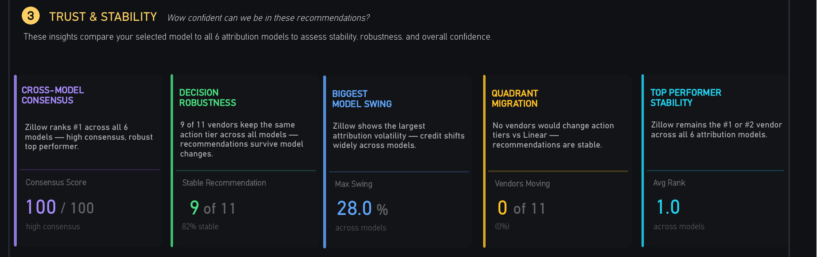
10 · Trust & Stability
Five tests asking whether the recommendation survives changing the model
THE FIVE TESTS
Testing the conclusion, not the data
Consensus wins / 6 models × 100 = 100
Robustness vendors holding tier = 9 of 11
Max Swing widest credit shift = 28.0%
Migration vendors changing tier = 0 of 11
Avg Rank top vendor, all models = 1.0
Every other section reports what the selected model says. This one asks whether that answer would survive a different choice.
Nine of eleven vendors hold their action tier across all six models, and no vendor migrates quadrant against Linear. The budget recommendation is therefore not an artefact of the model chosen.
Where consensus is low, the honest response is to act on the vendors all six models agree on and leave the rest alone.
Each test runs the same question across all six models, not just the selected one.

Slide 14
What the page decides for you
Six behaviours, each governed by fixed and auditable rules
01
02
03
Declares its own bias
Tests the model against your journeys
Separates fit from trust
Five fixed dimensions state what the chosen rule over-weights, before any vendor is ranked
A penalty ladder on average touches and elapsed days — a different enemy for every model
Behavioural plausibility and operational defensibility scored apart, then weighted 40/60
04
05
06
Names one model and prices the gap
Checks its own stability
Stops short of switching
Highest Overall Fit wins outright, and the difference is restated in leases and dollars
Five tests re-run the recommendation across all six models, not just the selected one
It hands over a defensible position; the commercial decision stays with the operator
The models disagree by design. The page measures the disagreement rather than resolving it quietly.

Slide 15
NORTHSTAR INTELLIGENCE PLATFORM
The model is a choice.
The page prices it.
Attribution Lab · Visual logic & calculations

