Slide 1
NORTHSTAR INTELLIGENCE PLATFORM
ETL Operations
Visual logic & calculations
Five tabs answering questions about the platform itself rather than the portfolio —
what each one shows, the query behind it, and the decision it is built to support.
Served by the Azure Function App at /api/dashboard · captured 01 August 2026

Slide 2
The shell
One route, five renderers, and a failure mode that keeps the navigation alive
ROUTING
Why one route, not five
/api/dashboard?tab=overview did it run?
=runs what is the record?
=reconciliation what disagreed?
=attribution what has no trail?
=activity what happened, in order?
unrecognised tab → list of valid tabs, not an error
A ?tab= parameter selects the renderer, so navigation state lives in the URL. Any tab can be linked to, bookmarked, or sent to someone mid-investigation.
The alert banner is rendered by the shell rather than by any tab, so a problem found on one screen stays visible on all of them. At capture time it reads: 10 open high-severity actions, and 2 days missing from bronze in the last 7.
Each renderer returns a body and a title; a shared shell adds navigation and styling.
THE OTHER ROUTES
Failure behaviour
read five tab renderers + health as JSON
write resolve one action, or all matching the filter
export CSV of runs, reconciliation, attribution, activity
If a renderer throws, the router catches it and returns a styled panel naming the tab and the exception, navigation intact.
One broken tab never takes down the dashboard — and never presents as an empty one.
Server-rendered HTML, no client framework.

Slide 3
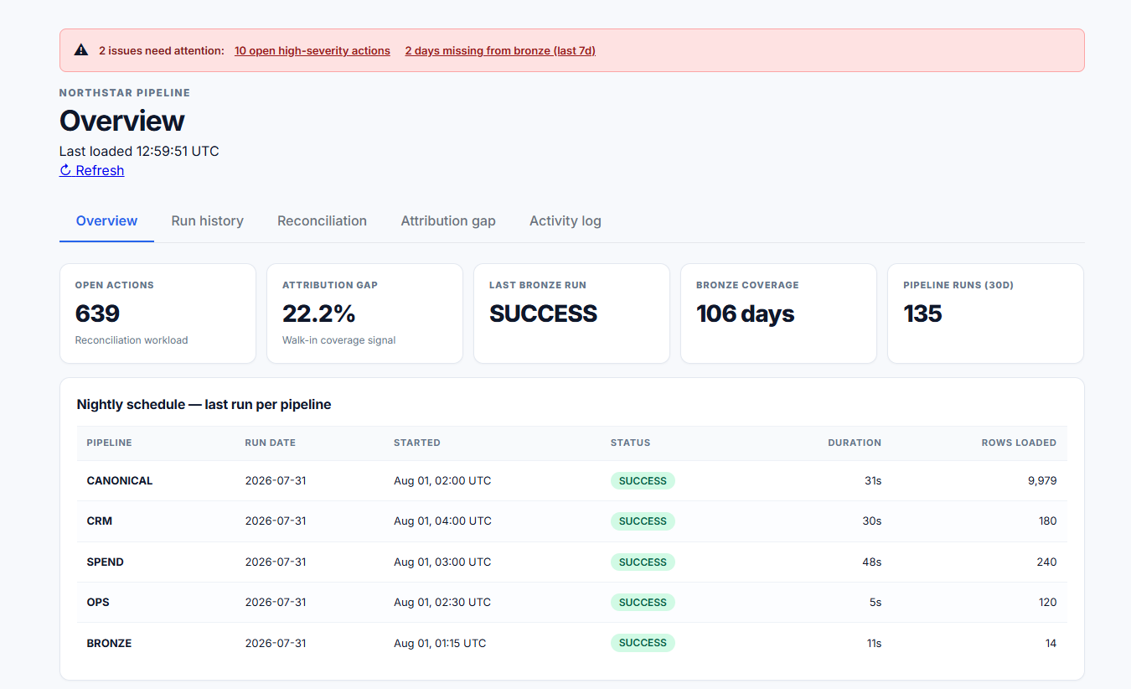
1 · Overview — did it run?
Freshness and backlog in the same strip, then the latest run of every pipeline
LAST RUN PER PIPELINE
SELECT PipelineKey,
MAX(RunId) AS LatestRunId
FROM pipeline.pipeline_runs
GROUP BY PipelineKey
Not a TOP 6 — that would return six runs of the same busy pipeline.
Why it matters
Grouping by pipeline means every pipeline occupies a row whether it ran last night or last week.
A stale date in that table is how an absence becomes visible. A query that returned only recent runs would render a silent failure as nothing at all.

Slide 4
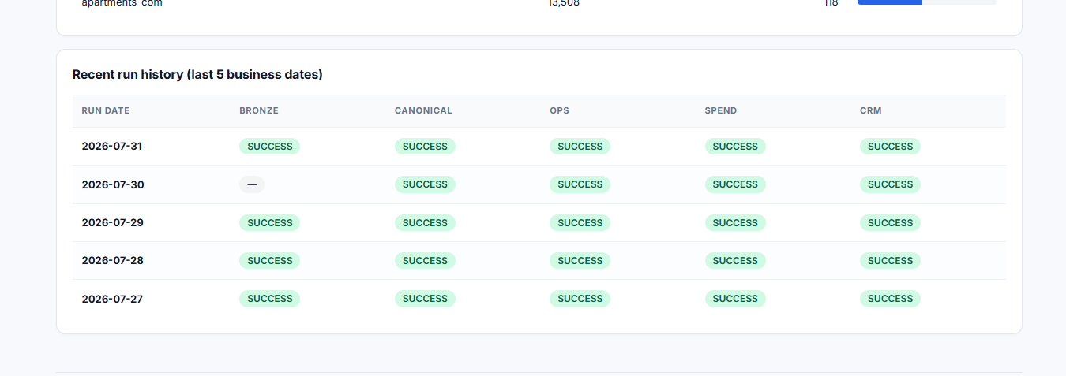
1 · Overview — the panels beneath
A log-scale trend, an action distribution, and a cross-tab that reads two ways
WHY THE TREND IS LOG SCALE
Action distribution
CANONICAL 9,979 ────────────
SPEND 240 ──
CRM 180 ──
OPS 120 ─
BRONZE 14 ·
linear axis → four of five pipelines flatline
Every reconciliation action grouped by type, with the high-severity count split out beside the total.
SPEND_DIVERGENCE_UNRESOLVED carries 56,640 actions and zero high severity — volume without urgency. MISSING_FOLDER carries 6 actions, all six high. Both facts are legible in the same row, which a single total would have hidden.
A gap in the line means a night with no successful run.
The cross-tab reads two ways
Five business dates as rows, pipelines as columns. Reading down a column shows whether one pipeline is unreliable; reading across a row shows whether one night failed broadly.
The em dash against BRONZE on 2026-07-30 is the case that matters: the other four pipelines succeeded that night, so bronze produced its files and failed only to record the fact.

Slide 5
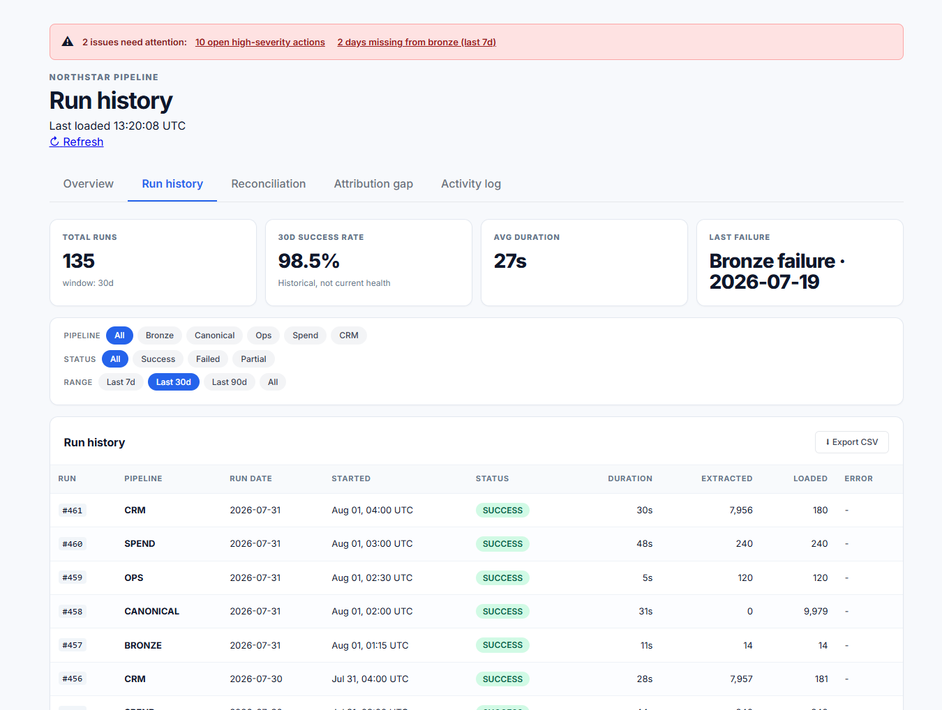
2 · Run history
The execution ledger — status, duration, and what was actually written
STATUS VOCABULARY
SUCCESS completed, rows written
FAILED crashed or threw
RUNNING started, no end recorded
ROW_COUNT_MISMATCH wrote, did not reconcile
135 runs · 98.5% over 30d · 27s average
A mismatch is deliberately not a failure — it is a different problem from a crash.
Why rows loaded sits beside status
A run can finish SUCCESS and have written nothing. Putting the row count next to the status makes an empty success visible immediately.
That was a real defect this platform carried, before the publisher was changed to fail on a zero-row write.

Slide 6
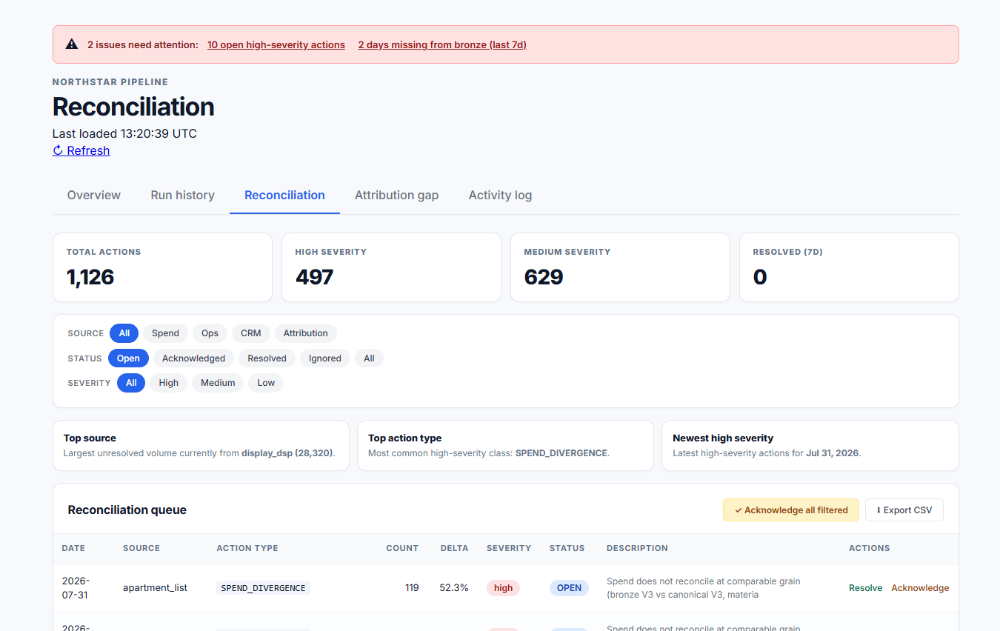
3 · Reconciliation
The only tab that is a workflow rather than a report
THREE COMPOSING FILTERS
source spend · ops · crm · attribution
status open · ack · resolved · ignored
severity high · medium · low
1,126 actions → 639 open · 497 high · 629 medium
Chips rather than dropdowns, so the current filter state is always on screen.
Bulk applies to the filter, not the page
Acknowledging all filtered acts on every matching row, not the 25 currently visible. Working a queue of 639 one page at a time is not workable.
The narrowing is the safeguard: a reader must first reduce the set to one source and one severity, and that act of narrowing is what prevents clearing too much.

Slide 7
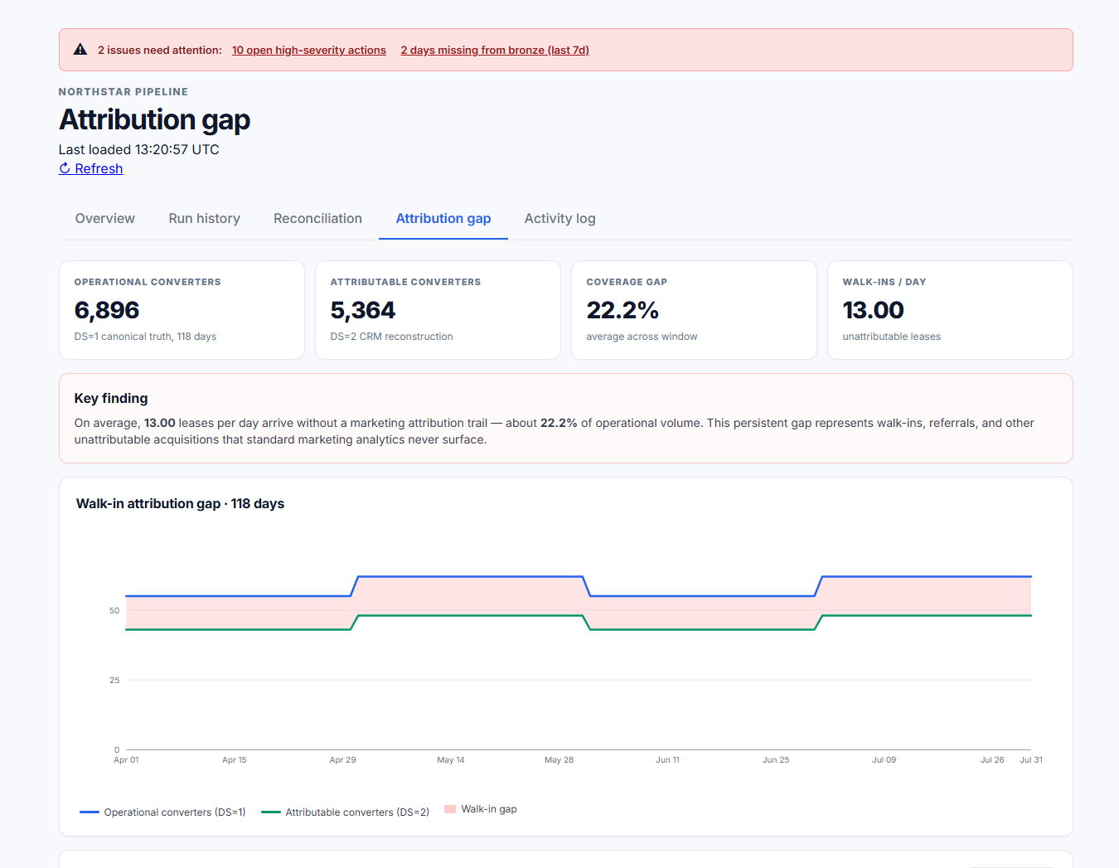
4 · Attribution gap
Two sources of the same truth, differenced — and the difference is the finding
THE SUBTRACTION
operational (DS=1) 6,896 canonical truth
attributable (DS=2) 5,364 CRM rebuild
──────
walk-in gap 1,532 22.2%
≈ 13.00 leases per day with no marketing trail
Leases that happened, carrying no attributable acquisition path.
Why this is possible here
The platform holds a canonical record of what happened beside the CRM's reconstruction of it, so the two can be differenced.
A real operator has only the CRM view and therefore cannot see what it is missing. Holding both makes the invisible measurable — and a wide gap is walk-ins and referrals behaving normally, not a data quality failure.

Slide 8
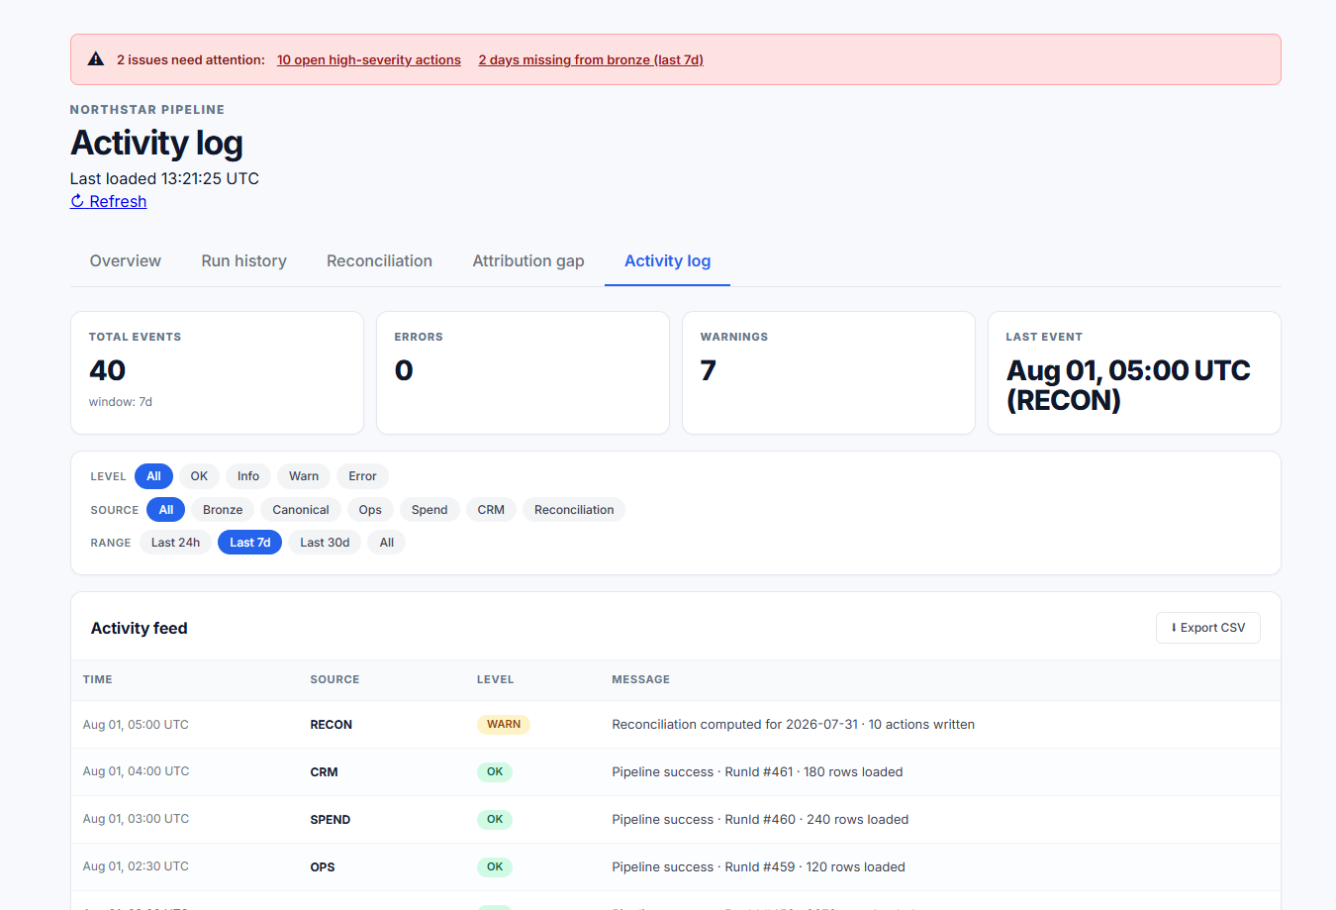
5 · Activity log
Every pipeline's events unioned into one chronological feed
ONE CTE, FOUR CONSUMERS
unioned events → total count 40
→ error count 0
→ warning count 7
→ the feed itself
same filter clause applied to each
The KPI strip and the table can therefore never disagree about what is shown.
Why unify rather than link
Diagnosis is chronological. When a night goes wrong the useful question is what happened, in order — and that answer spans pipelines.
Separate per-pipeline logs force the reader to interleave timestamps by hand, which is exactly the work the feed exists to remove.

Slide 9
What the dashboard is for
Six behaviours, each built so that nothing missing looks like nothing wrong
01
02
03
Freshness before detail
Absence occupies a row
Success is verified
The first thing on screen is when the platform last ran, not what the data says
Grouping by pipeline means a silent failure renders as a stale date, never as blank space
Row counts sit beside status, so a run that wrote nothing cannot look healthy
04
05
06
Disagreement is queued
Work is filterable and bulk-resolvable
The unmeasurable is measured
Source conflicts become actions with a type, a severity and an owner, not averaged-away noise
The queue stays usable at 639 open actions, with the filter itself as the safeguard
Canonical truth beside the CRM reconstruction turns the walk-in gap into a number
The Power BI reports answer questions about the portfolio. This answers questions about the platform that produces them.

Slide 10
NORTHSTAR INTELLIGENCE PLATFORM
A report on stale data
is worse than one that fails.
ETL Operations Dashboard · Visual logic & calculations

