Slide 1
MARKETING RESEARCH PROJECT
Reaching Every Shelf:
Danone Egypt's Distribution and Availability Challenge
Applying Malhotra's Marketing Research Process (Chapters 1 to 5)
Ahmed Sabri • Tariq Salama • Ahmad Awad • Mahmoud Ibrahim
EMBA Program | 2026 • Course project: full research cycle, consumer survey N = 35

Slide 2
SCOPE & PURPOSE
A Full-Cycle Learning Exercise
This is a course project. Our objective was to correctly walk the ENTIRE marketing research process, from problem definition to final recommendation, applying every chapter in sequence, not to publish market-grade data.
What we set out to do
What we are transparent about
Define, design, collect, analyze, and report, every stage in order
Use both qualitative (interviews) and quantitative (survey) methods
State four hypotheses and test them against the data we gathered
Reach a defensible management recommendation at the end
Convenience sample, N = 35, urban-skewed: indicative, not representative
The five retailer interviews are simulated composites built from secondary sources, used to illustrate the qualitative method, not offered as field evidence
The value here is the process, executed correctly from start to end
Danone Egypt Distribution | Marketing Research
2

Slide 3
ROADMAP
What This Project Covers
1
The Problem
2
Problem Definition
Danone's reach gap vs Juhayna
Decision problem, research problem, hypotheses
3
Research Design
4
Qualitative Research
Exploratory + descriptive, secondary data
Depth interviews with shop owners
5
The Survey & Results
6
Recommendations
Live consumer survey, N = 35, findings
Answering the management question
Danone Egypt Distribution | Marketing Research
3

Slide 4
THE PROBLEM
Juhayna Reaches More Shops Than Danone
In Egypt's dairy market the battle is won at the small grocery store. Juhayna's owned cold-chain network puts it on roughly a third more shelves than Danone (company-reported figures, July 2026).
~136,000
~100,000
~26%
outlets reached by Juhayna
points of sale reached by Danone
fewer outlets for Danone (~36,000 shops)
Why it matters
Small traditional grocers are about 97% of retail food outlets and carry about 74% of retail food sales (USDA, 2019). When Danone is not on the shelf, shoppers simply buy whatever brand is there.
Danone Egypt Distribution | Marketing Research
4

Slide 5
CHAPTER 1
The Marketing Research Process We Followed
1
2
3
4
5
6
Define
the problem
Develop
an approach
Design
the research
Collect
the data
Analyze
the data
Report
findings
How this maps to our report: Steps 1-2 are Chapter 2, Step 3 is Chapter 3, Step 4 is Chapters 4 and 5 (interviews + survey), Steps 5-6 are the analysis and this report.
Danone Egypt Distribution | Marketing Research
5

Slide 6
CHAPTER 1
The Company and the Market
Danone Egypt
The Egyptian Dairy Market
Competes in dairy: yogurt, Activia, and Danette desserts
Strategy built on premium, branded, value-added products
Activia grew in 2024 on a gut-health and immunity message
Competes through brand strength, not mass reach
Dairy and eggs worth about USD 2.59 billion in 2025, growing fast
Crowded: Juhayna, Domty, Almarai/Beyti, Lactalis, Danone
Local champions are vertically integrated and low cost
Traditional small shops dominate distribution and sales
Danone Egypt Distribution | Marketing Research
6

Slide 7
CHAPTER 2
Defining the Problem
Management Decision Problem
Marketing Research Problem
What should management DO?
What INFORMATION do we need?
“Should Danone Egypt expand its distribution reach to compete with Juhayna's coverage in the Egyptian dairy market?”
Determine how limited availability affects consumers' yogurt choices and Danone's lost sales, and identify the distribution barriers from the retailer's side.
Danone Egypt Distribution | Marketing Research
7

Slide 8
CHAPTER 2
Research Questions and Hypotheses
We test four hypotheses with the survey data:
Availability significantly influences which yogurt brand consumers choose.
H1
Danone's perceived availability is significantly lower than Juhayna's.
H2
Many consumers have switched away from Danone because it was not available.
H3
The availability gap is wider in rural areas than in major cities.
H4
Danone Egypt Distribution | Marketing Research
8

Slide 9
CHAPTER 2
The Conceptual Model Behind the Hypotheses
Five variables feed one consumer outcome. Each hypothesis tests one arrow of this model.
Reach / Availability
Consumer
purchase
decision
the independent variable under study
Buys Danone
Price
preference converts to a sale
other purchase driver we measure
Brand preference
other purchase driver we measure
Store type
we split the results by it (H2, H3)
Switches brand
the dependent variable
the lost sale we measure in H3
Area type
we split the results by it (H4)
The model in one line: Reach/Availability + Price + Brand preference + Store type + Area type → Purchase vs Brand-switch
Danone Egypt Distribution | Marketing Research
9

Slide 10
CHAPTER 3
Research Design: Two of the Three Types, by Choice
USED
USED
NOT USED
Exploratory
Descriptive
Causal
Understand the issue
Quantify the relationships (cross-sectional)
Prove that X causes Y (experiment)
Secondary data on the market and distribution networks
Depth interviews with small-shop owners
Sharpens the survey questions
A single structured consumer survey
Measures availability, choice, switching
Tests the four hypotheses
Would need a field experiment: vary availability, watch sales
Not feasible in a course timeline or without Danone's cooperation
So our verdicts are associations, stated as such, not proven causation
Danone Egypt Distribution | Marketing Research
10

Slide 11
CHAPTER 3
Secondary Data: The Distribution Gap
By the numbers
Juhayna: 38 distribution centers, 1,000 vehicles
Danone: 31 centers (7 direct, 24 indirect)
Danone reaches ~36,000 fewer outlets, a ~26% gap
Reach figures are self-reported company numbers (websites, July 2026)
Danone Egypt Distribution | Marketing Research
11

Slide 12
CHAPTER 3
The Small Shop Decides the Game
~97%
74%
113,724
$2.59B
of retail food outlets in Egypt (USDA 2019)
of retail food sales (USDA 2019)
traditional grocers nationwide (USDA 2019)
dairy & eggs market, 2025 (IMARC)
When the decisive channel is the neighbourhood shop, shelf presence is everything.
Danone Egypt Distribution | Marketing Research
12

Slide 13
CHAPTER 4 - FINDINGS
Why Juhayna Wins the Shelf
Five retailer depth interviews, from city centre to village (illustrative composites). Five themes recur.
Rep / van visits
Juhayna calls weekly to twice-weekly, to the door. Danone ranges from once a week in a big Cairo shop to never in the village.
Delivery
Juhayna delivers and stacks. Danone usually must be collected from a wholesaler, which lone and rural shops cannot do.
Risk terms
Juhayna: small minimums, light credit, takes back near-expiry stock. Danone: cash up front, larger minimum, spoilage is the grocer's loss.
The cooler
Juhayna and Almarai supply the branded fridge. Danone rarely does; in the village, cooler plus cold delivery is the whole game.
Demand pull
Customers ask by name for Activia and Danette and will wait. For plain yogurt they take whatever is on the shelf.
The gap widens monotonically: present on city main streets → "Danone stops at the big city" → simply absent in the village.
Danone Egypt Distribution | Marketing Research
13

Slide 14
CHAPTER 5
The Survey: Our Primary Data
Live electronic survey (Google Forms)
Each question earns its place
Self-administered, in Egyptian Arabic, about 4 minutes
Distributed via WhatsApp and social media
Convenience and snowball sampling; target was 100 to 150
Achieved N = 35 valid responses (pilot scale, indicative)
Online and urban skew noted; offset by the retailer interviews
H1 - importance of availability
H2 - availability grid: Danone vs Juhayna
H3 - preferred vs actually-bought gap
H4 - availability split by area type
Danone Egypt Distribution | Marketing Research
14

Slide 15
CHAPTER 5 - RESULTS
Who Answered, and What Drives Choice
The sample (N = 35)
Alexandria 24, Sharqia 6, Cairo 2, Dakahlia 2, Beheira 1
Major city 23, town 10, village 2
Only 7 (20%) buy from a small grocery, the key channel
Skews urban and modern-trade, so it understates the gap
H1: availability ranks LAST of six drivers (3.14). It is a silent gatekeeper, not a stated preference.
Danone Egypt Distribution | Marketing Research
15

Slide 16
CHAPTER 5 - RESULTS
The Gap Is Real, and It Costs Sales
H2 - Perceived availability (mean, 1-5)
H3 - Unrealised demand and switching
11 vs 5
prefer Danone vs actually buy it most → a gap of 6
32 of 35
bought a competing brand when Danone was missing
Premium line
lost sales concentrate in Activia and Danette, where buyers ask by name and will wait
Gap = 0.53 of a point (1-5 scale). Modest at the consumer level, and the urban sample understates it.
Danone Egypt Distribution | Marketing Research
16

Slide 17
CHAPTER 5 - RESULTS
By Area, and the Verdict on Each Hypothesis
H4 - Danone vs Juhayna availability by area
H1
Not supported as a stated driver
ranks 6th of 6 (3.14)
H2
Supported (modestly)
4.03 vs 4.56, gap 0.53
H3
Supported
prefer 11 / buy 5; 32 of 35 switched
H4
Directionally supported
city-town dip; clear in interviews
Major city: gap 0.50 n=23
Town: gap 0.70 n=10
Village: gap 0.00 n=2
Gap widens city-to-town; only 2 rural respondents, so the village cell leans on the interviews.
Danone Egypt Distribution | Marketing Research
17

Slide 18
CHAPTER 6
Recommendations
The binding constraint is route-to-market, not the product. Four moves, in priority order:
Fix the route-to-market
Lead with the premium line
Match Juhayna's three shelf-winning levers: scheduled rep visits, near-expiry returns or consignment, and smaller minimum orders. Not advertising.
Push Activia and Danette first, where brand-locked demand and the best retailer margin make an availability fix pay back fastest.
Towns before villages
Provide the cooler
Densify suburban and town coverage first for quick payback, then reach the rural last mile via micro-distributors and solar coolers.
Supply the branded fridge: a merchandising asset and the precondition for stocking chilled product where power is unreliable.
Danone Egypt Distribution | Marketing Research
18

Slide 19
REFLECTION
Limitations and What the Exercise Taught Us
We would rather name the limits of a course-scale study than overclaim. This is where a real project would go next.
Honest limitations
With more time, and what we learned
Sample: convenience, N = 35, Alexandria and urban-skewed; only 7 buy from small grocers, the key channel, so the gap is understated
Interviews: five simulated composites from secondary sources, not real fieldwork
Results are directional and indicative, not statistically representative
Scale to 100 to 150 respondents with genuine rural and small-grocer representation
Run real depth interviews with shop owners in each area type
The core learning: designing and executing the full research cycle correctly, from problem definition through to a defensible recommendation
Danone Egypt Distribution | Marketing Research
19

Slide 20


EXPLORE THE PROJECT
Everything Is Online: Scan or Click
The full project site (Arabic)
The live consumer survey
Interactive report: problem, method, live results, and all the files, readable on any phone.
The actual Google Form (Arabic) our 35 respondents filled. Still live: try it yourself.
https://amsamms.github.io/danone-distribution-research/
docs.google.com/forms/... (scan the code)
Danone Egypt Distribution | Marketing Research
20

Slide 21
Thank You
Questions and discussion
Ahmed Sabri • Tariq Salama • Ahmad Awad • Mahmoud Ibrahim

Slide 22
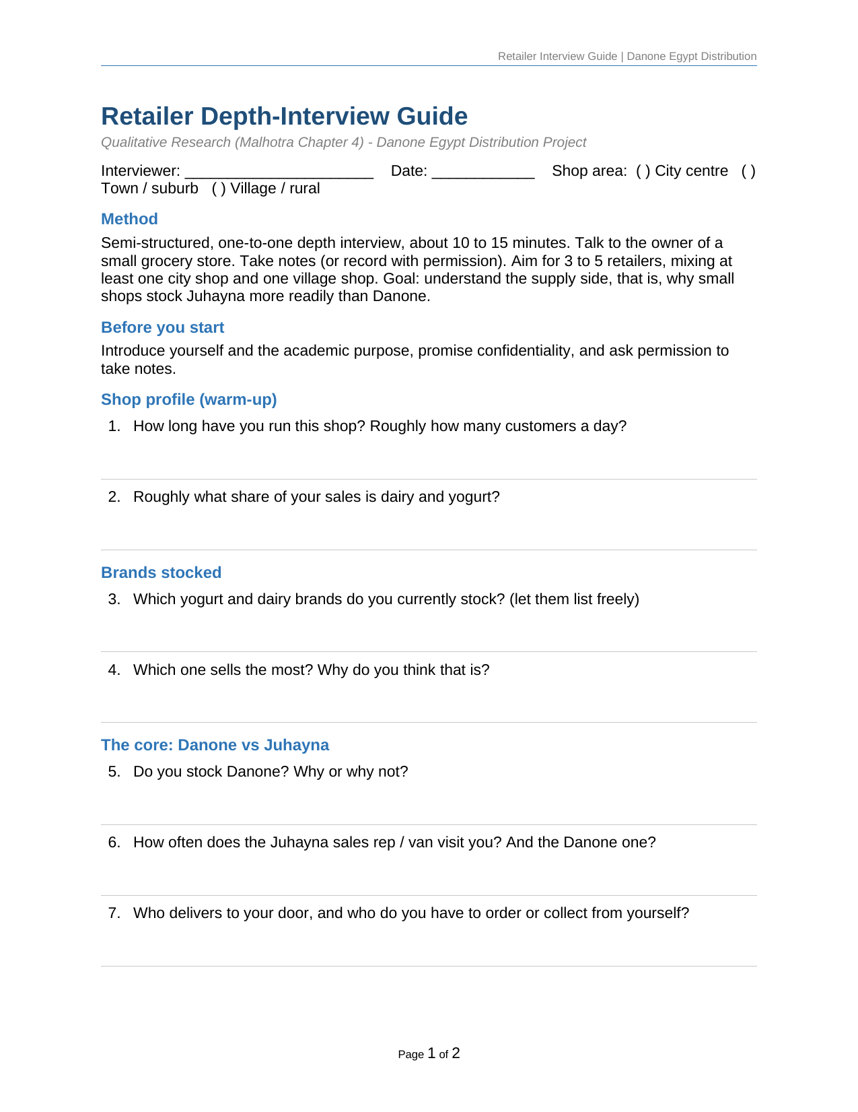
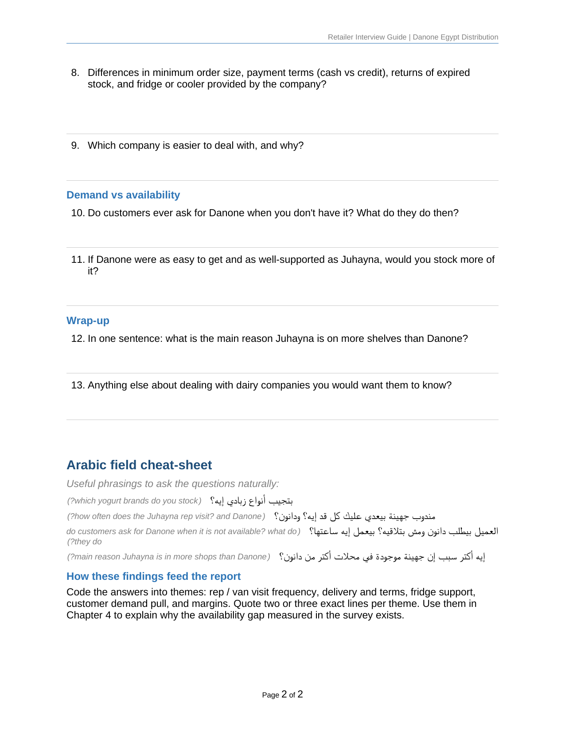
APPENDIX A - SHOWN ON REQUEST
The Retailer Depth-Interview Guide
Danone Egypt Distribution | Marketing Research
22

Slide 23
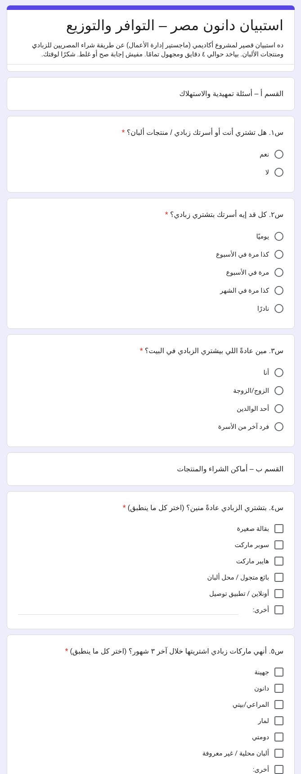
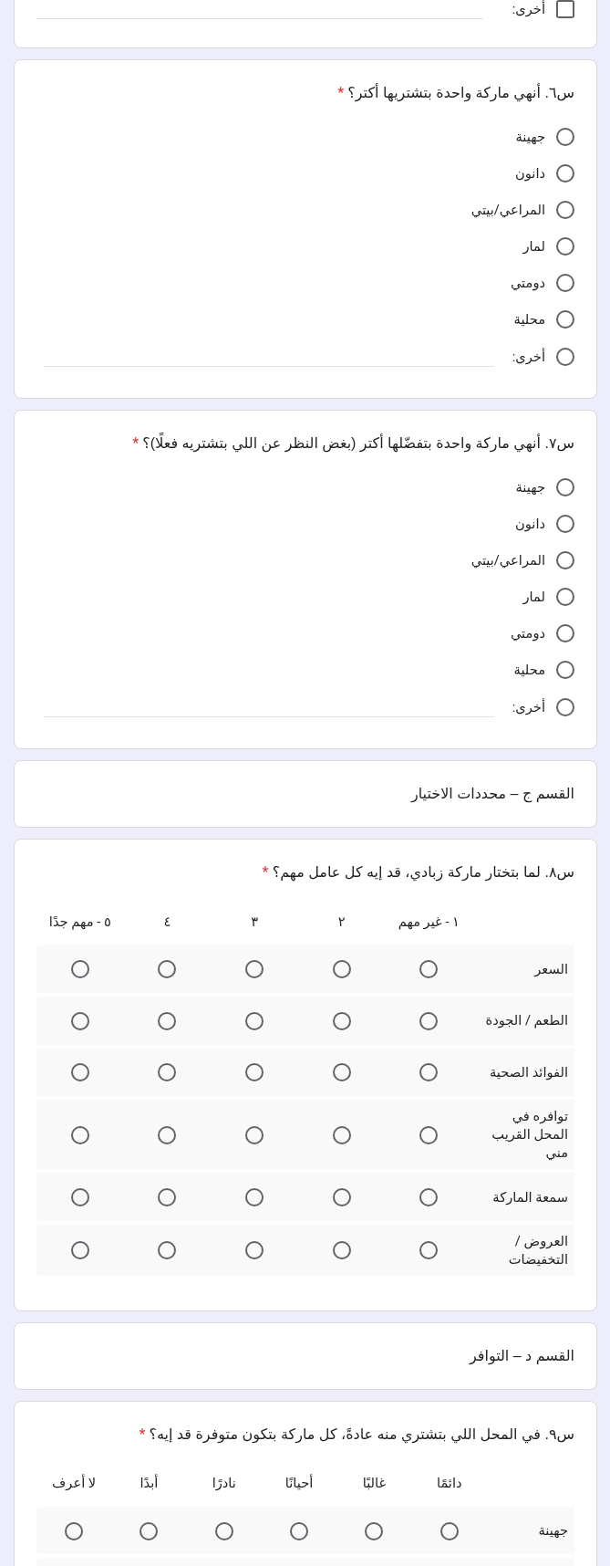
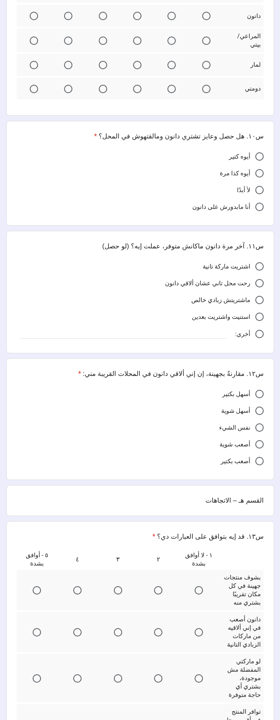
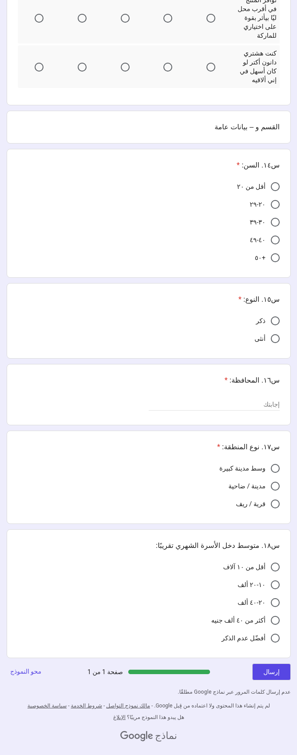
APPENDIX B - SHOWN ON REQUEST
The Consumer Survey As Respondents Saw It
Live Google Form, Egyptian Arabic, 22 items in 4 sections. Read left to right, top to bottom.

Slide 24
APPENDIX C - REFERENCES
Sources Behind Every Number
Same numbered sources as the written report. Every figure quoted in this deck traces to one of these and was re-verified against the live source on 6 July 2026.
1
Malhotra, N. K. Essentials of Marketing Research, 1st Edition, Pearson. The research process, problem definition, research design, secondary data, qualitative research, and surveys.
2
Juhayna Food Industries: Distribution (company website). 38 distribution centers, 1,000 vehicles, ~136,000 retail outlets served. Accessed 6 Jul 2026. juhayna.com/farm-to-fork/distribution
3
Danone Egypt: About Us and Impact (company website). 7 direct + 24 indirect distribution centers, ~100,000 points of sale, OMDA rural micro-distribution (~380 micro-distributors, ~50,000 retailers). Accessed 6 Jul 2026. danone.eg/about-us-new · danone.eg/impact
4
USDA Foreign Agricultural Service: Egypt Retail Foods Report (GAIN EG19009, 27 Jun 2019). Traditional grocers 113,724, ~74% of retail food sales; modern trade 3,913 outlets (~26% of sales); traditional share of outlets ~97% (derived from these counts). apps.fas.usda.gov (GAIN: Retail Foods, Cairo, Egypt)
5
Euromonitor International: Yoghurt and Sour Milk Products in Egypt. Best Cheese Co (Lactalis) maintains category leadership. Accessed 6 Jul 2026. euromonitor.com/yoghurt-and-sour-milk-products-in-egypt/report
6
Mordor Intelligence: Middle East and Africa Dairy Market. MEA dairy ~USD 42.83B (2025); Egypt dairy CAGR ~3.72% (2026-2031). Corroboration. Accessed 6 Jul 2026. mordorintelligence.com/industry-reports/middle-east-and-africa-dairy-market
7
IMARC Group: Egypt Dairy Products & Eggs Market. USD 2,586.1M (2025), projected USD 5,588.4M (2034), CAGR 8.49%. Accessed 6 Jul 2026. imarcgroup.com/egypt-dairy-products-eggs-market
Danone Egypt Distribution | Marketing Research
24

