Slide 1

GAN FOR SUPER RESOLUTION
PRESENTED BY:
K.AMSAVENI
59F7E165E44E4E69B8E4F40AB13D310C
CSE 3rd YEAR
GOVERNMENT COLLEGE OF ENGINEERING
venikannan2002@gmail.com

Slide 2
OUTLINE
Problem statement
Proposed system/solution
System development approch
Algorithm&deployment
Result
Conclusion
Reference

Slide 3
Problem statement
To recover or restore high resolution image from low resolution image. There are many forms of image enhancement which includes noise-reduction, up-scaling image and color adjustments. This post will discuss enhancing low resolution images by applying deep network with adversarial network (Generative Adversarial Networks) to produce high resolutions images.
Our main target is to reconstruct super resolution image or high resolution image by up-scaling low resolution image such that texture detail in the reconstructed SR images is not lost.

Slide 4
Proposed system/solution
GANs : GANs are class of AI algorithms used in Unsupervised Machine Learning. GANs are deep neural network architectures comprised of two networks (Generator and Discriminator) pitting one against the other (thus the “adversarial”). GANs is about creating, like drawing a portrait or composing a symphony. The main focus for GANs is to generate data from scratch.
GANs consist of a Generator and Discriminator. Think it like a game where Generator tries to produce some data from probability distribution and Discriminator acts like a judge. Discriminator decides whether input is coming from true training data set of fake generated data. Generator tries to optimize data so that it can match true training data. Or we can say discriminator is guiding generator to produce realistic data. They just work like encoder and decoder.

Slide 5
SRGAN : Super-resolution GAN applies a deep network in combination with an adversary network to produce higher resolution images.
Training procedure is shown in following steps:
We process the HR(High Resolution) images to get down-sampled LR(Low Resolution) images. Now we have both HR and LR images for training data set.
We pass LR images through Generator which up-samples and gives SR(Super Resolution) images.
We use a discriminator to distinguish the HR images and back-propagate the GAN loss to train the discriminator and the generator.

Slide 6
Picture1 Data processing and model training pipeline: Original image is processed with different camera parameters using ISET Camera Designer. These images are resized to 32x32x3 and served as the (LR) input to the generator. The target HR images are the original ones which are not processed. Total four models were trained:
Model_SR: SRGAN model that does super resolution only
Model_SR_Color: SRGAN model that does super resolution and color correction
Model_SR_Pixel: SRGAN model that does super resolution and restore spatial resolution due to reduction of system MTF
Model_SR_Deblur: SRGAN model that does super resolution and deblur

Slide 7
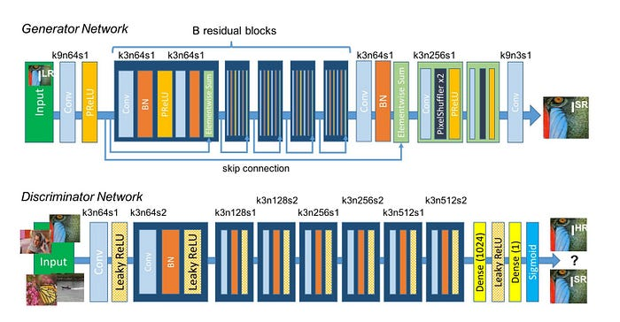
Generator and discriminator

Slide 8
System development approch
Software requirements:
Python:GAN implementations are commonly done in Python due to its extensive libraries for machine learning and deep learning.
Gan libraries:Tensorflow and its high-level API,Keras,PyTorch are used for building and training the GAN architecture.
Text Editor or IDE: You'll need a text editor or an Integrated Development Environment (IDE) like PyCharm, VSCode, or Jupyter Notebook for writing your Python code.
Hardware Acceleration: For training complex GAN models, especially for high-resolution image generation, you might need access to GPUs or TPUs to accelerate computation.

Slide 9
ALGORITHM &DEPLOYMENT
Data Collection
Gather a dataset of low-resolution images and their corresponding high-resolution counterparts.
Preprocessing
Preprocess the images (e.g., normalization, resizing) to prepare them for training.
Architecture Selection
Choose a GAN architecture suitable for super-resolution tasks, such as SRGAN (Super-Resolution Generative Adversarial Network) or ESRGAN (Enhanced Super-Resolution Generative Adversarial Network).
Generator and Discriminator Training
Train the GAN's generator and discriminator networks using the low-resolution images as input. The generator aims to produce high-resolution images that are realistic and similar to the ground truth high-resolution images, while the discriminator learns to differentiate between generated high-resolution images and real high-resolution images.

Slide 10
Adversarial Training
Alternately train the generator and discriminator networks in a adversarial manner. The generator tries to fool the discriminator into believing that its generated images are real, while the discriminator aims to correctly classify real and generated images.
Loss Functions
Define appropriate loss functions, such as adversarial loss, content loss (e.g., perceptual loss), and optionally, feature loss (e.g., VGG loss), to guide the training process and ensure the generated images are visually appealing.
Model Serialization
Serialize the trained model into a format suitable for deployment, such as TensorFlow's SavedModel format or PyTorch's .pth format.
Input Processing
Implement code to preprocess input images (e.g., resizing, normalization) before passing them through the model.

Slide 11
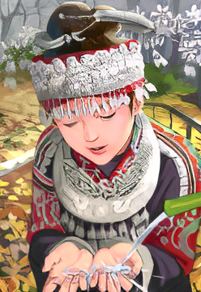

Result

Slide 12
Conclusion
Super resolution with GANs has demonstrated remarkable success in enhancing image quality from low-resolution inputs. Despite challenges such as training stability and mode collapse, GAN-based methods offer impressive results. The technology holds great promise for applications in fields like medical imaging, surveillance, and entertainment. Continued research is vital to address limitations and optimize performance for diverse datasets. Overall, GAN-based super resolution stands as a powerful tool with significant potential for real-world applications.

Slide 13
Reference
https://www.tensorflow.org/
https://keras.io/
https://medium.com/
https://github.com/

Slide 14
THANK YOU

