Slide 1
Proposed Project Person Identification using ensemble of Face matching, clustering and Super Resolution GANs
Team Members
Name | Roll no. | Branch and Year
Akshat Rajkumar Jain | 19095009 | Electronics, Part - II
Akshat Sood | 19095010 | Electronics, Part - II
Aman Kumar | 19095011 | Electronics, Part - II
Aman Mishra | 19095012 | Electronics, Part - II

Slide 2
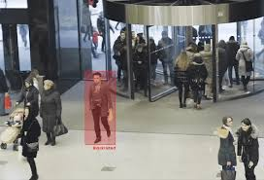
What is Person Identification
Person identification is the process of matching the image of a person either with its ID or with the already present members in the database.
For example – In the given image the bounded person should be checked with the already present member in the database, if the present is not matched with anyone then it will be considered as an outsider to that organization or place.

Slide 3
Why we want to adopt it here?
We can use this method for surveillance at places where less monitoring facilities are available:
1. Hostels – Cameras using in hostels are generally of lower quality hence it will be very difficult to track the person even if it can be seen in the camera.
2. Classrooms – Tracking of persons can be done using this approach in classes.
3. Other college monitoring places like labs, departments etc.

Slide 4
Our Approach
We can divide our approach in four different part :-
1. Object detection – In this part we will use YOLOv3 model to detect the persons in our images and segment all the persons from the images.
2. Conversion to higher Resolution and pass via Siamese network- In this part we will increase the resolution of the extracted persons from input image. For this purpose we will use Super Resolution GANs and pass this image to Siamese network for matching.
3. Clustering - In this part we will apply K-means clustering on the input subjects with the persons present in database.
4. Ensemble - We will ensemble the results obtained from Siamese network + k - means clustering

Slide 5
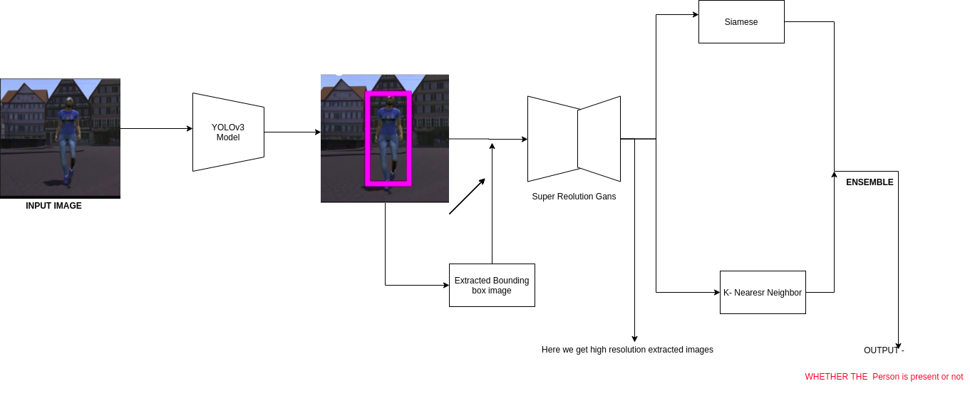
Visual representation of Approach

Slide 6


Thankyou

