Slide 1
Operating Systems – Scheduler Project
Alex Stack
Fall 2019

Slide 2
Intro
(Obviously) Scheduler implementing FCFS, SJF Preemptive, Priority, and RR.
Made own unique algorithm implementations based off queue.
Created Gantt class to output detailed Gantt charts
1. Create dispatcher object and spin own thread
2. Read processes from file, place into temporary holding array
3. Sort processes based on arrival time

Slide 3
Algorithm Implementations
FCFS – if no running processes, parse array and see if clk > arrival time for head of queue. Yes – pop and start. No – continue, incr clk
Prio – same as FCFS, but if new process arrives with greater prio than current, halt current (saving state) and push into waiting queue, start new process.
SJF Preemptive – very similar to Prio, replace prio with burst time
RR – most intricate implementation, requires extensive use of priority queue. Preemptive, when Prio > current process prio, halt, save state, replace, push old process into waiting queue. When time quant is reached, halt, save state, replace, push old process into waiting queue.

Slide 4
Common Difficulties
Ensuring that saving state saves proper information i.e. remaining time (needs to calculate upon halting).
Making processes spin off as new threads – very hard to properly implement properly in Java environment.
Several approaches: binding thread to object (my approach) and invoking start() within object. However, not guaranteed true multithreading, as there is no good way to truly halt process once started.
This dispatcher is a working demonstration on how a true dispatcher would operate, without the functionality of a real dispatcher and with empty processes (processes not doing real work).

Slide 5
Take-home Knowledge.
Implemented using my own algorithms, always try to develop algorithms yourself before resorting to Google.
Thought out implementations and sketched sudo-code using techniques learned in other classes, apply and adapt your knowledge gained from the University.
Used programming techniques that save resource utilization. Always keep efficiency in mind, as it separates novice programmers from professionals, don’t be lazy!
Many differing approaches to the problem, pick the simplest approach, no need for unnecessary complexity.

Slide 6
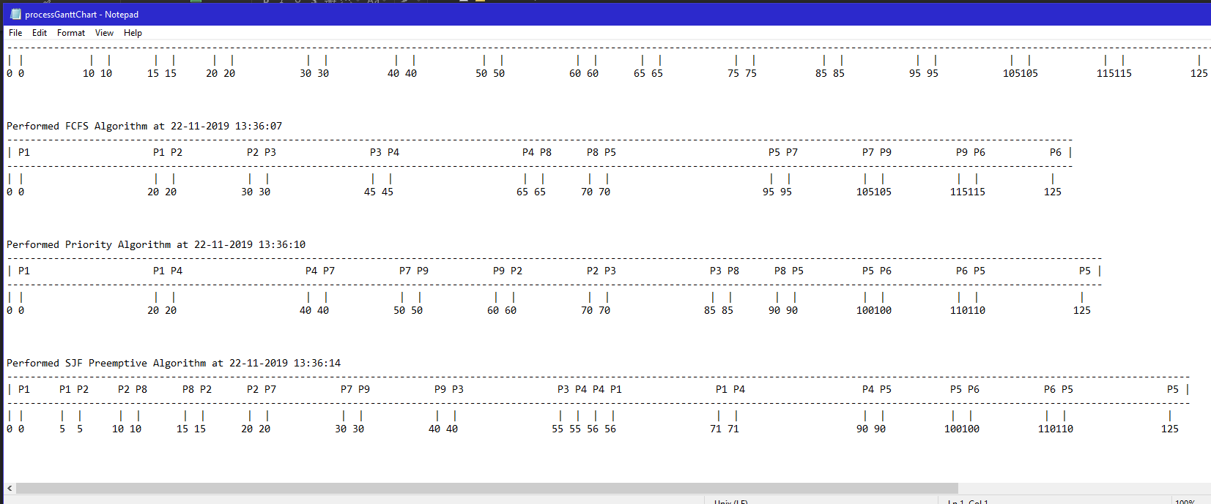
Example of my Gantt charts

