Slide 1
Reproducible code in R
R User Meet Amsterdam UMC
09 July 2026 | Merel Postema

Slide 2
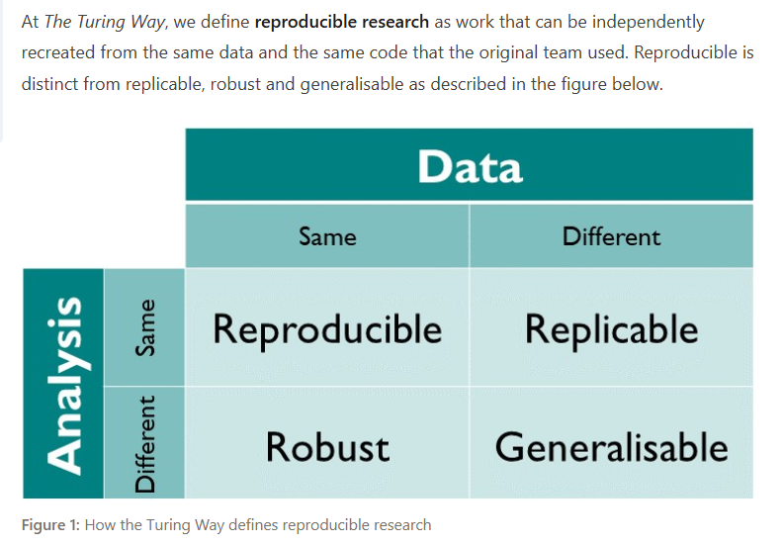
What is reproducibility
Guide for Reproducible Research - The Turing Way

Slide 3
Why reproducibility matters
Trustworthy results
Faster updates
Fewer mistakes
Better collaboration
Future-proof research
"Can you rerun the analysis from two years ago?" → script everything!
"Reviewer 2 asks for one additional subgroup." → quatro!
"A colleague leaves the department." → document!

Slide 4
Script everything
“R is a statistics software”
Well, partly… but it can be used for your entire computational workflow.
If you can scrip it, then script it.
Rstudio can also support other languages, like Python.
De Graaff 2021, reproducibility.pdf

Slide 5
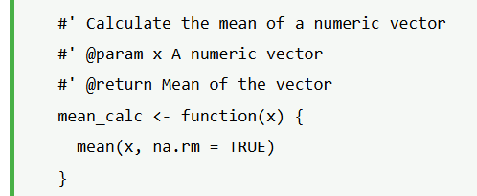
Document your workflow
Clear documentation is key to making your code understandable and reproducible.
Include a README.md file in your project. This file should explain the project’s purpose, the data used, and how to run the code. It helps other users understand your work quickly and set up the environment for running the code.
Use comments throughout your code to explain what each section does. When you create functions, document their purpose, inputs, and outputs.
You can use the roxygen2 package to document functions directly within the code:
https://www.statology.org/5-best-practices-for-writing-reproducible-code-in-r/

Slide 6
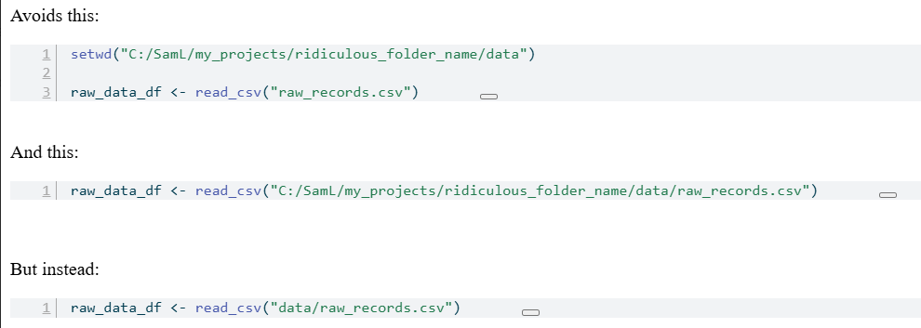
Relative paths
GitHub - langtonhugh/reprod_r: Material on reproducible workflows in R. · GitHub

Slide 7
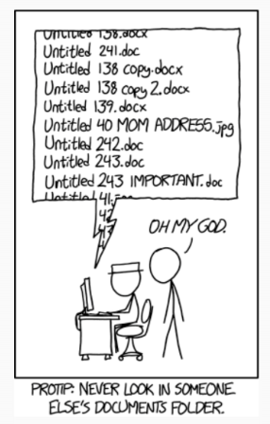
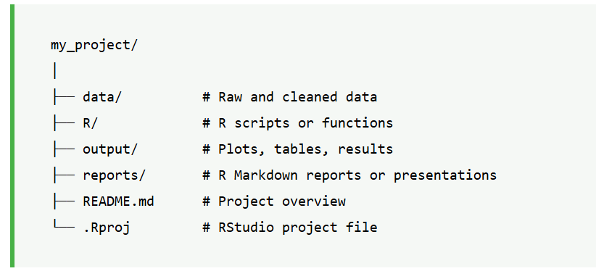
Example folder structure: organize your stuff!
R projects
Relative paths
https://www.statology.org/5-best-practices-for-writing-reproducible-code-in-r/

Slide 8
Make code readable
x<-a%>%filter(y==1)%>%group_by(z)%>%summarise(n=n())
patients <- data %>%
filter(sex == "Female") %>%
group_by(treatment) %>%
summarise(
n = n()
)
meaningful names
comments
whitespace
Avoid copy/paste the same code → write a function
consistent style (stylr, lintr)

Slide 9
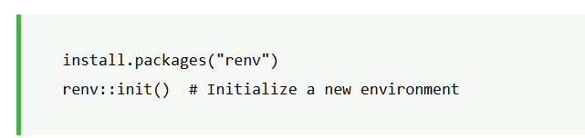
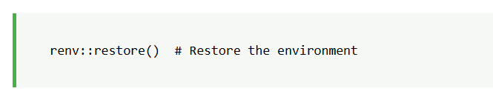
Consistent environment: renv
To setup renv, run:
This will create a renv.lock file that lists the exact versions of the packages being used. Anyone else working on the project can restore the same environment by running:
https://www.statology.org/5-best-practices-for-writing-reproducible-code-in-r/
Notes:
renv::snapshot()

Slide 10
Reproducible reports
Rmarkdown
Quatro (recommended)
Show a report where code, tables, figures and text are generated automatically. One click (render) produces HTML, PDF or Word.
No copy-pasting results into Word.
Makes you 200% more efficiënt
It also makes everything look better (Gallery – Quarto)

Slide 11
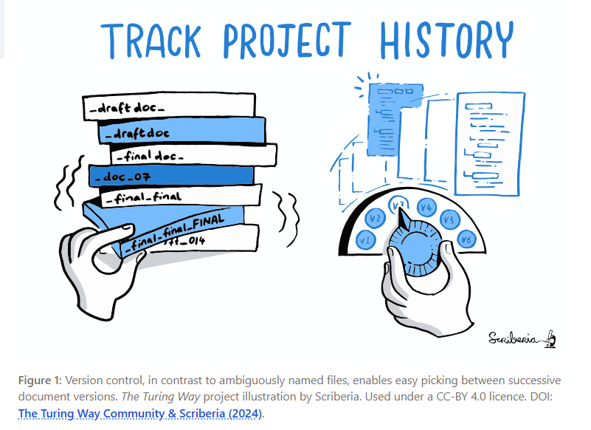
Version control
GitHub/GitLab
Amsterdam UMC GitHub:
https://github.com/AmsterdamUMC

Slide 12
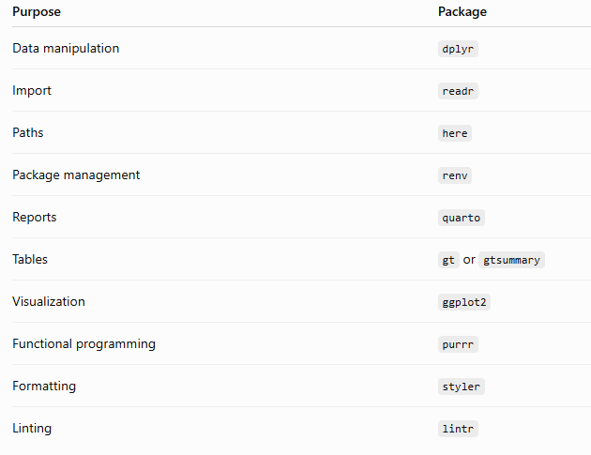
Usefull R packages

Slide 13
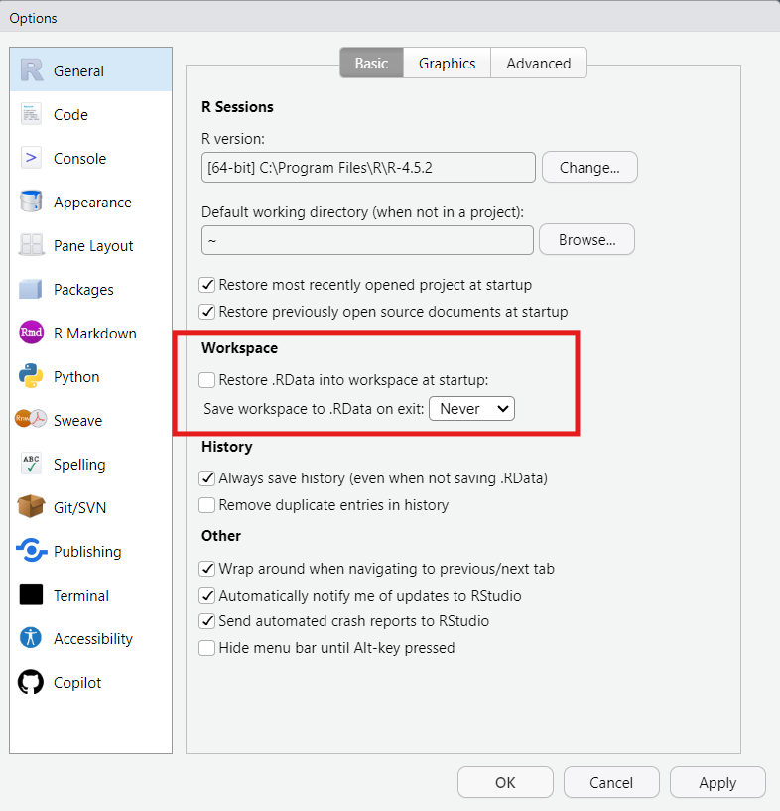
Options in R studio
Workspaces are pure evil.
Turn them off.
Tools > Global options:

Slide 14
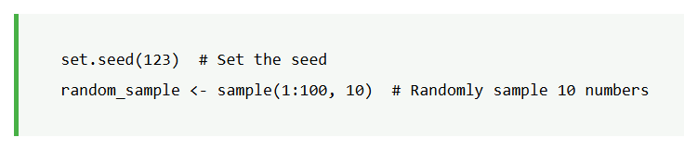
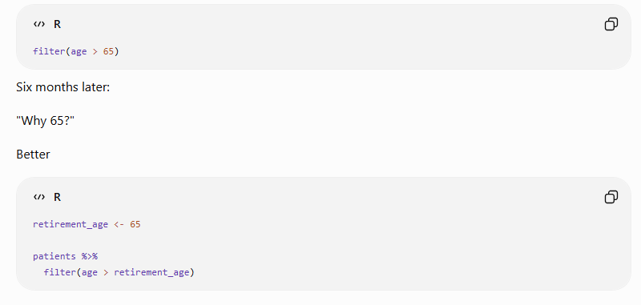
Common pitfalls
Manual editing (script everything!)
No comments (explain why, your future self will be gratefull)
Overwriting objects
Not setting a seed for randomness
Hardcoded numbers

Slide 15
Reproducibility cheatsheet
Amsterdam UMC Reproducibility Cheat Sheet.docx

Slide 16

CODECHECK
Get your code reviewed
Improved code
Learn from it!
Receive a CODECHECK certificate
Bonus points for journal submission!
Request an institutional CODECHECK via the RDM helpdesk, here: Service Catalog Item - Employee Center
RDM has received funding for a project looking into the issues encountered during a CODECHECK
CODECHECKs needed!

Slide 17
Learning goals
Understand what reproducible code means.
Organize an R project so others (and future you) can run it.
Avoid common pitfalls that make analyses difficult to reproduce.
Use a few simple tools that greatly improve reproducibility.

Slide 18

R there any questions?

