Slide 1
Announcements
New website:
  https://amsterdamumc.github.io/rum-umc/
R user meet survey
  Your input is really appreciated!
  https://forms.office.com/Pages/ResponsePage.aspx?id=GqvfaLsRxky-tSjXVphPtnx_QMdHsqFBhHHfEa3xZgpUMVFDRzZYT0Y0R0IxWVYzUEJBRVg1TDdDMy4u

Slide 2
Story telling using R
R User Meet | 11 Feb 2026 | Merel Postema

Slide 3
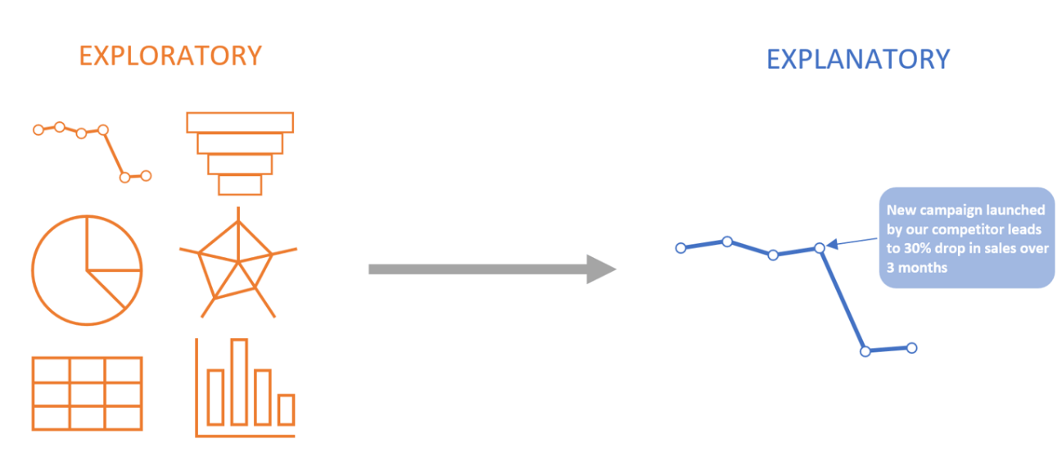
Storytelling vs data visualization
Purpose
  Exploratory: seeks to find insights
  Explanatory: seeks to make a specific insight clear and understandable
Notes:
Data Storytelling vs. Data Visualization: Key Differences
This means that during exploratory analysis, we may sift through a lot of data that is not relevant and eventually find important insights, at which point we move to the explanatory phase, where we make these insights clear to our target audience.
The goal of data storytelling is always explanatory, rather than exploratory, whereas data visualization can be used for both explanatory as well as exploratory analysis.

Slide 4
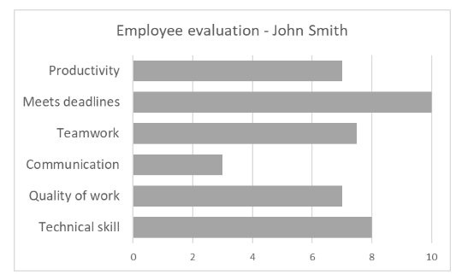
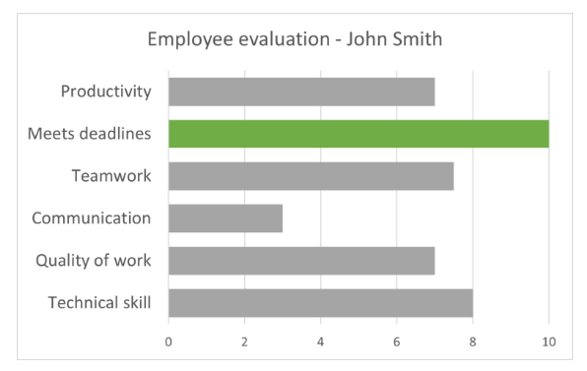
With storytelling, we already have a central insight which we want to elucidate.
Exploratory (visualization)
Explanatory (visualization/storytelling)
Notes:
It may be the case that John is the only member of his team who has consistently met deadlines, putting his performance ahead of his team’s. If this is the point that we wish to focus on, we may consider a chart like the one below, that highlights this metric.

Slide 5
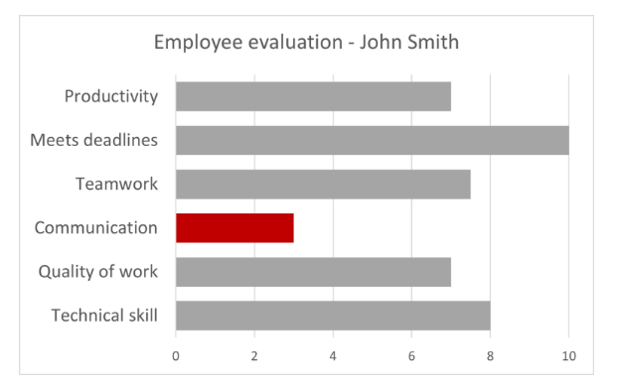
With storytelling, we already have a central insight which we want to elucidate.
Exploratory (visualization)
Explanatory (visualization/storytelling)
Notes:
Conversely, John’s lack of communication skills has perhaps had a significant adverse effect on the performance of his team. In this case, we may want to employ a chart like the one below to draw attention to the right metric.

Slide 6
Attention to a single insight is one of the characteristics of a good story
Besides, color, what other attributes can be used to draw the eye?
  Lenght
  Width
  Orientation
  Size
  Position
  Curvature

Slide 7
How to accomplish this using R
Live demonstration, using feb2026-storytelling.R

Slide 8
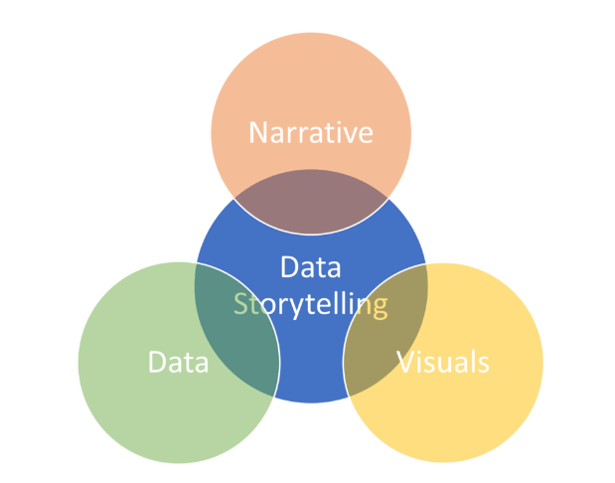
A narrative structure sets storytelling apart from just visualization
Notes:
Though data visualization forms an integral part of data storytelling, simply presenting a single insight using a chart does not make a story.

Slide 9
Why apply narrative structure to data?
A chart lays out all of the facts for the audience to take in all at once, instead of leading up to a main insight as in the case of a narrative.
Provide sufficient context around our insight in order to make it understandable.
Adds a causal structure that connects the facts that lead up to our central insight.
Add an emotional value to our insight, allowing us to engage and ultimately convinece our audience about the importance of our idea, and to spur them into appropriate action.
Notes:
People with analytical mindsets often overlook the emotional element, assuming that facts should speak for themselves or that data impacts everyone as it does them. However, this approach is rarely effective or useful in real-world scenarios, where each audience member has a unique background, motivation, and skill set. When crafting data stories, a crucial question to address is: Why should people care? Incorporating an emotional element provides a compelling reason for people to engage with your insights.

Slide 10
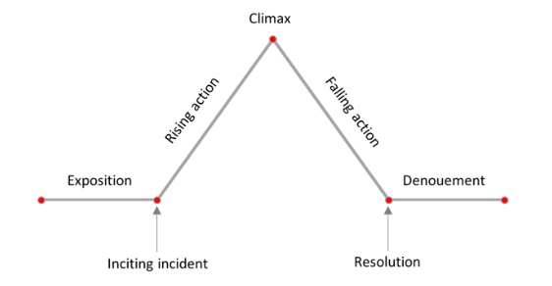
Freytag’s pyramid
Narrative structure can be defined as the order in which events occur in a story.
Notes:
Humans have always been storytellers, starting from our hunter-gatherer ancestors who told stories gathered around the fire, to modern employees who gather around the water cooler to exchange office gossip. Gustav Freytag proposed the narrative structure pictured below in 1863, known as Freytag’s pyramid.
Denouement = ontknoping

Slide 11
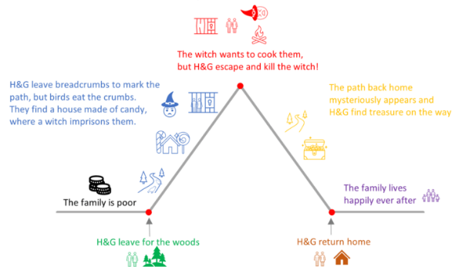
Understand Freytag’s pyramid using the story of Hans and Gretel
Notes:
The exposition is the setting and context of the story.
inciting incident, which is the spark that sets the story in motion and changes the course of our characters’ journeys – spurred by hunger, the siblings run away into the woods.
Now comes a series of events that constitute the rising action. The children decide to mark the path through the woods with breadcrumbs, so that they can follow the trail back, but the breadcrumbs are eaten by birds and the children are lost. Eventually, they happen upon a house made entirely of candy, and are lured in by an evil witch who locks them in a cage.
Then comes the exciting climax – as the witch is preparing to cook and eat the children, they escape from the cage and instead push the witch into the fire, killing her!
The story then goes through the falling action stage, where we see the reckoning and reversal. The path leading home mysteriously reappears and as the children walk back, they find gold and jewels which they take with them.
For the resolution and denouement, the children reach home and are safely reunited with their parents and the family lives happily ever after

Slide 12
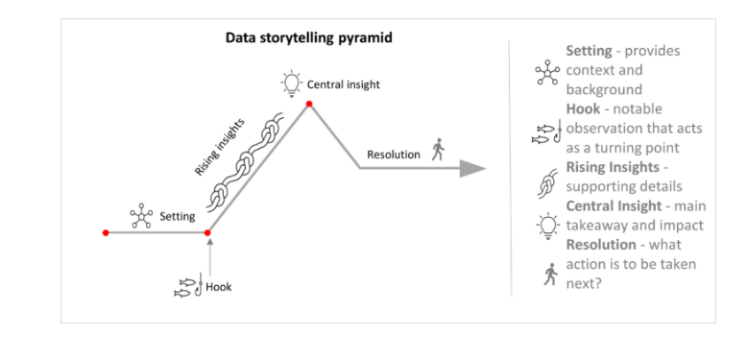
Apply Freytag’s pyramid to data storytelling:
The data storytelling pyramid
Notes:
Ad adapted diagram of Freytag’s pyramid, for data storytelling.

Slide 13
Apply Freytag’s pyramid to data storytelling:
The data storytelling pyramid
Setting: In presenting a data story, we always begin with the setting. The setting provides context to the central insight of our story. For instance, we could answer the question, what is “normal” for this set of data?
This could mean showing repeating or cyclical patterns from past periods, or showing what is expected to happen to establish a baseline expectation from which our audience can judge the current data.
Notes:
Ad adapted diagram of Freytag’s pyramid, for data storytelling.

Slide 14
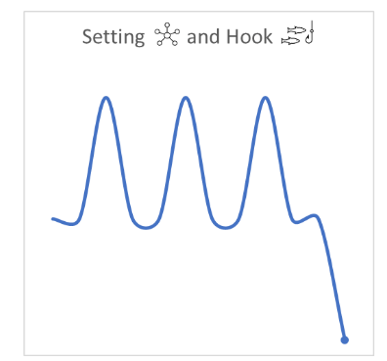
Apply Freytag’s pyramid to data storytelling:
The data storytelling pyramid
Hook: The hook is the spark that sets off the story. It answers the question, what changed?
This means that we address the departure from the usual pattern that our data has been exhibiting. What caught your attention while analyzing the data? For example, perhaps we have a cyclical trend in our sales data which repeats every year, but this year, sales have deviated sharply from the expected value in the last quarter.
Notes:
Ad adapted diagram of Freytag’s pyramid, for data storytelling.

Slide 15
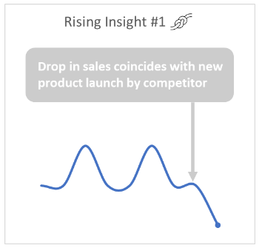
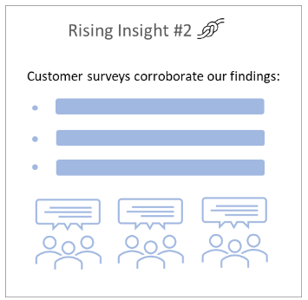
Apply Freytag’s pyramid to data storytelling:
The data storytelling pyramid
Rising insights: Rising insights constitute the supporting data and insights that add to the context around the anomaly that we noticed. We may try to answer the question, why did the change happen?
With our sales example, we may perhaps note how a competitor launched a new product, coinciding with the dip in sales. We may provide additional supporting details such as surveys detailing the reasons why customers switched to the competitor’s product.
Notes:
Ad adapted diagram of Freytag’s pyramid, for data storytelling.

Slide 16
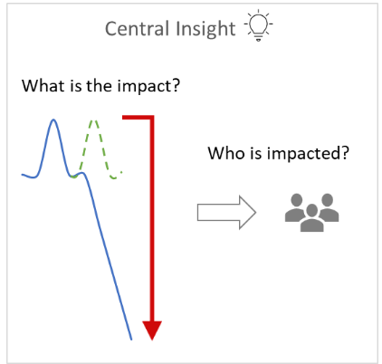
Apply Freytag’s pyramid to data storytelling:
The data storytelling pyramid
Central Insight: We have now built up to the “Aha! Moment”, which answers the question, why should people care?
This provides the impact factor – what happens if the current trend continues? Why is it important to your organization? For example, with our sales story, we may want to emphasize that a continuation of the current trend would lead to a loss of $5 million for the company over the next 6 months. This is also your chance to make use of a hero in your story. Now, many people assume that the data is the hero of a data story, but keep in mind that people should always be the heroes of your story.
Notes:
Business decisions ultimately affect people, whether it is the stakeholders, customers, or the teams involved, and adding a human impact factor can persuade your audience of the importance of your result.

Slide 17
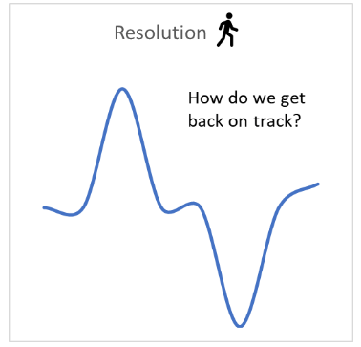
Apply Freytag’s pyramid to data storytelling:
The data storytelling pyramid
Resolution: The resolution of the story comes in terms of the next steps that need to be taken. It lies in answering the question, what do we do about it?
Now that you have convinced your audience about the credibility and importance of your insight, it is important to bring the story full circle by discussing what direction to take in light of what the data has shown. This gears our data story towards action, and prevents it from becoming just another “nice” or “interesting” story that is shortly forgotten.

Slide 18
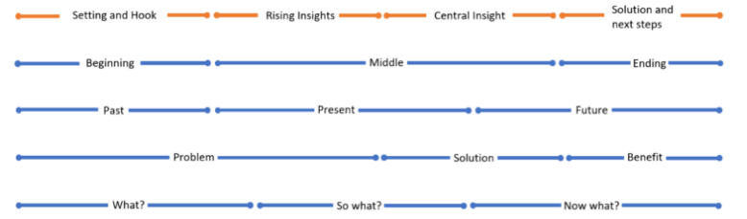
Other types of story structure
Many of these can be mapped alongside our data storytelling pyramid model:
Plot-twist-ending
  Plot: what is the context that is necessary?
  Twist: what is interesting about what the data shows?
  Ending: what action should your adience take?

Slide 19
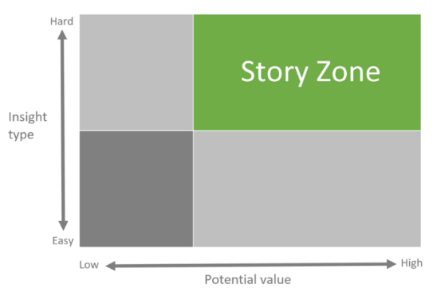
When to apply storytelling?
Not all insights require a story
Employ strategically, for only the most important insights
Notes:
In fact, applying a long-winded narrative to every single insight is likely to take an inordinate amount of time and cause the audience to lose interest. Instead, stories must be employed strategically, for only the most important insights.
This diagram must be read in terms of enacting change. The story zone represents the conditions in which it is most difficult to convince your audience to act on your insights. On the vertical scale, an insight can be hard when it is inherently hard to understand, or when it requires a substantial investment into change, or a risk that your audience may not be willing to take. On the horizontal scale, we have the potential value of the insight. As seen here, stories are best used for relatively difficult insights with medium to high value. Insights that are of high value, but easy to implement likely do not need storytelling. This is a case where data visualization is often an adequate tool to convince our audience.

Slide 20
Conclusion
To conclude, storytelling can be a powerful tool when used strategically to convey the right type of insights.
While data visualization is an essential part of the storytelling journey, the latter involves an essential narrative element that is missing from simple visualization. This lends emotional depth that can help the audience become invested in and ultimately convinced by our story.

Slide 21
References
Data Storytelling vs Data Visualization:
https://inforiver.com/insights/data-storytelling-vs-data-visualization/

