Slide 1
OMOP CDM in R
Rowdy de Groot

Slide 2

OHDSI
“The Observational Health Data Sciences and Informatics (or OHDSI, pronounced "Odyssey") program is a multi-stakeholder, interdisciplinary collaborative to bring out the value of health data through large-scale analytics”.
OMOP CDM (Observational Medical Outcomes Partnership Common Data Model)
Observational health data

Slide 3
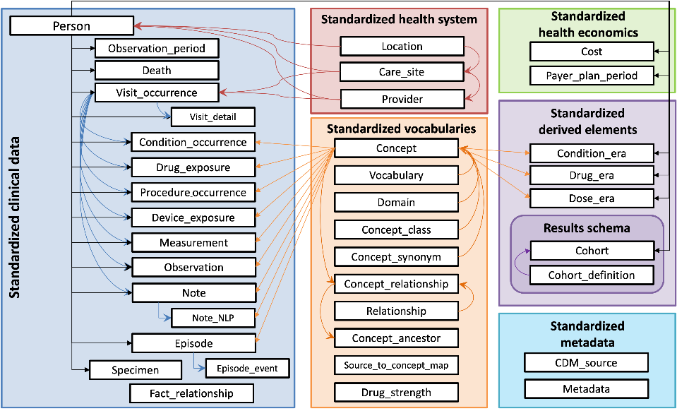

Slide 4
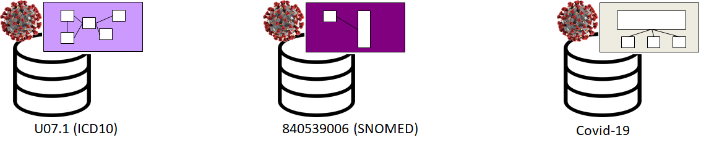
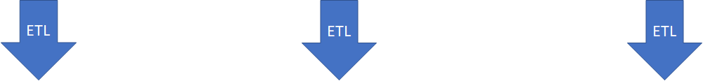
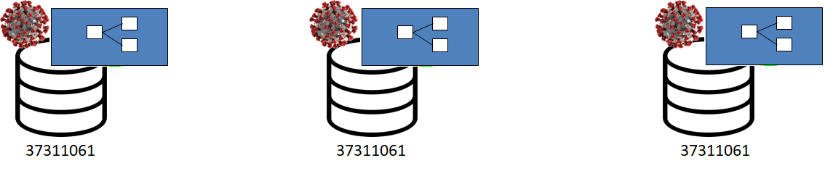
Input: One analysis script / OHDSI tooling
Output: Harmonized results
(Federated querying/analysis)
ATHENA: https://athena.ohdsi.org/search-terms/start
Covid-19 example in Athena: https://athena.ohdsi.org/search-terms/terms/37311061

Slide 5
OMOP summary
OMOP:
Relational database
Research – Observational health data
Not customizable (Although? 🤨)
Extensions
Custom mappings
Fact relationship table

Slide 6
R demo time!
Long/wide format
Source data CSV, Excel, Castor, SPSS

Slide 7
Download table structure
CommonDataModel/inst/ddl/5.4 at main · OHDSI/CommonDataModel · GitHub

Slide 8
OHDSI R-packages and tools
OMOP Common Data Model
Usagi: OHDSI/Usagi: Usagi is an application to help create mappings between coding systems and the Vocabulary standard concepts.
HADES: HADES
Athena: Athena

Slide 9
OHDSI studies
OHDSI Studies

Slide 10
EHDEN data portal
EHDEN Portal

Slide 11
EHDEN Academy
EHDEN Academy

Slide 12
Thank you for listening!
rowdy.degroot@amsterdamumc.nl

