Slide 1



DeviceGuardian AI
Track: AI-powered Predictive Maintenance
Team name: System Hackers
Team members:
Amudieshwar AG
Ashwin Kumaar B
Bharat T
Buvaneshvaran R

Slide 2
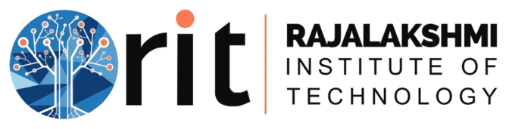
PROBLEM STATEMENT
Laptops and smartphones fail unpredictably — through battery degradation, overheating, storage failure, or heavy use. Existing tools (Lenovo Vantage, HWMonitor, Windows Task Manager) only show current status, not future risk.
Will my SSD fail in the next few months?
Why is my battery degrading faster than normal?
Is my laptop continuously overheating?
Left unanswered: unexpected failures, higher repair costs, data loss, device downtime. The gap isn’t monitoring — it’s foresight.

Slide 3
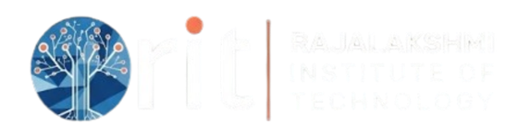
PROPOSED SOLUTION
DeviceGuardian is an AI-powered predictive device health platform that continuously monitors laptops and Android smartphones, analyzes real-time telemetry, predicts potential hardware failures before they occur, explains every prediction using Explainable AI (SHAP), and recommends preventive maintenance actions.
Instead of only displaying the current status (CPU usage, battery level, SSD health), DeviceGuardian calculates an Overall Device Health Score by combining three specialized AI models:🔋 Battery Health Model💾 Storage (SSD) Health Model🌡 Thermal Health Model.
The platform supports Windows laptops through a lightweight background monitoring agent and Android smartphones through Flutter's native APIs. Both devices send telemetry to a unified FastAPI + PostgreSQL backend, where AI models analyze the data and return predictions to a single Flutter application.
By shifting from reactive monitoring to predictive maintenance, DeviceGuardian helps users reduce unexpected failures, extend device lifespan, minimize downtime, and lower electronic waste.

Slide 4
TECHNICAL APPROACH
Architecture: Flutter (mobile UI) → REST API → FastAPI backend → PostgreSQL + AI engine. Telemetry ingested from Windows agent (psutil, WMI, pywin32, LibreHardwareMonitor) or Android Flutter APIs.
The backend acts as the central intelligence layer, receiving telemetry, storing historical data, executing AI models, and returning predictions to the Flutter application.
AI Pipeline: Data cleaning → Feature engineering (rolling averages, battery drain rate, SSD error growth, temperature trends) → XGBoost prediction → Isolation Forest anomaly detection → SHAP explainability → Recommendation engine.
Training datasets: NASA Battery Dataset, CALCE Battery Dataset, Backblaze SMART Dataset, AI4I 2020 Predictive Maintenance Dataset. Models trained offline; live telemetry feeds inference and future retraining.

Slide 5
TECHNOLOGY STACK & FUTURE STEPS
Technology Stack:
• Frontend: Flutter
• Backend: FastAPI
• Database: PostgreSQL
• Windows Monitoring Agent: Python (psutil, WMI, pywin32, LibreHardwareMonitor)
• AI & Analytics: XGBoost, Isolation Forest, SHAP
• Notifications: Firebase Cloud Messaging
Future Roadmap:
• Support macOS, Linux, Smart TVs, Routers, Printers, and IoT devices
• Enterprise fleet monitoring and centralized analytics
• Continuous AI model retraining using historical telemetry
• OEM and service center integration for predictive maintenance
• Support SDG 9 (Innovation) and SDG 12 (Responsible Consumption)

Slide 6
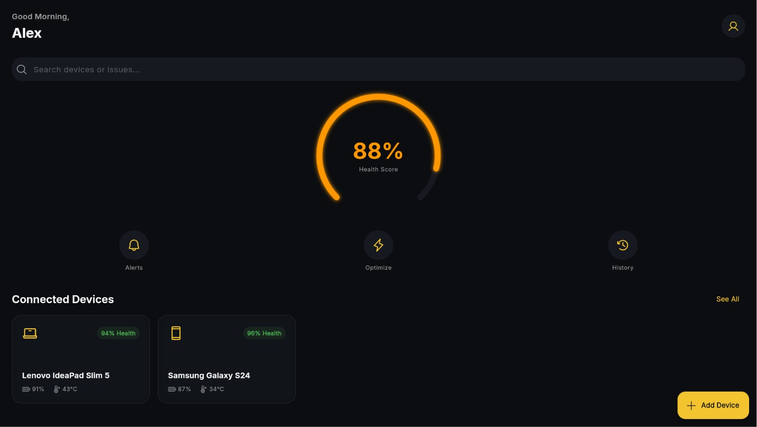
EXPECTED DELIVERABLE
Live Device Health Dashboard with Real-Time AI Prediction & SHAP Explanation

Slide 7
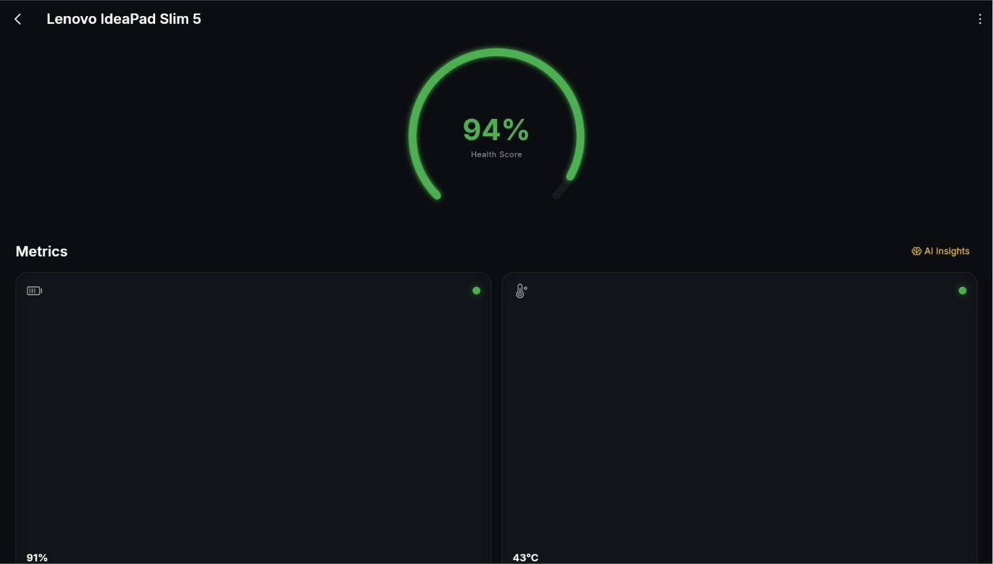
EXPECTED DELIVERABLE

Slide 8
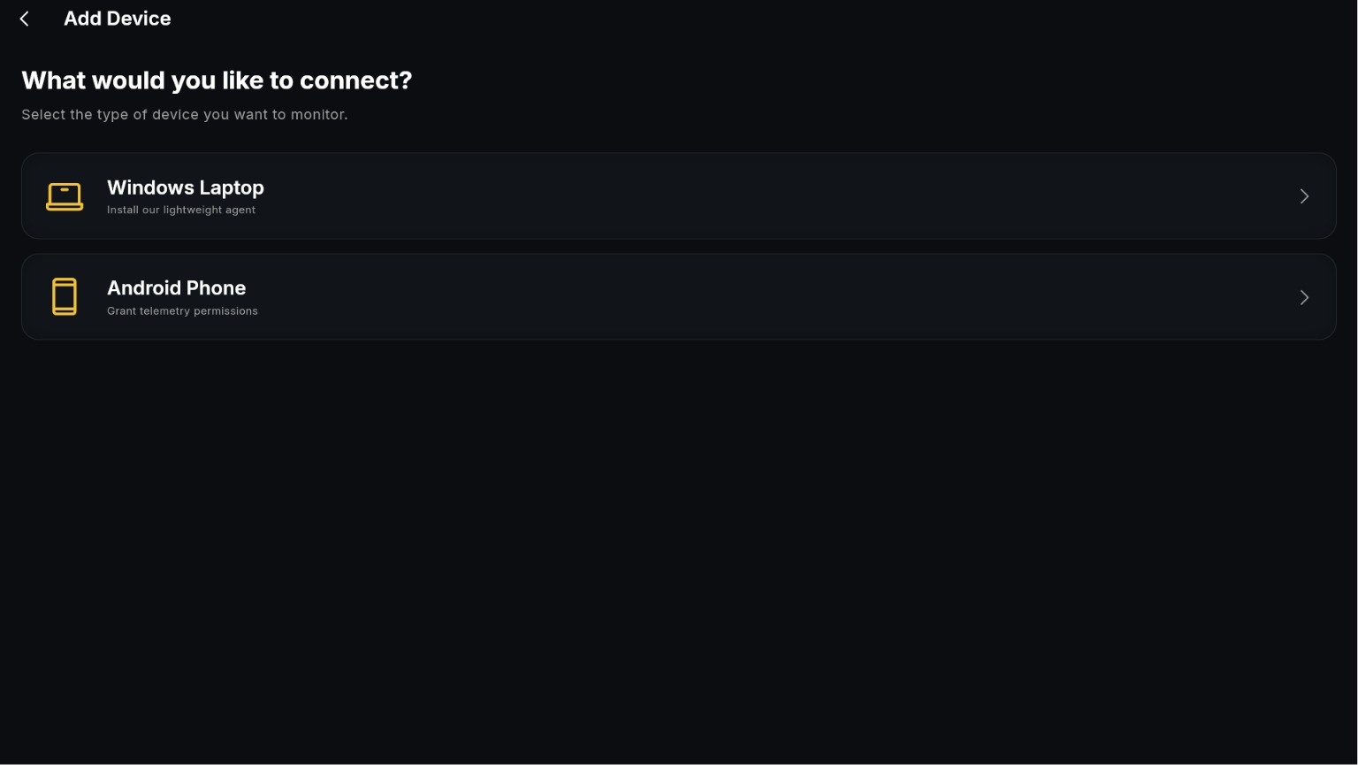
EXPECTED DELIVERABLE
│
▼

Slide 9
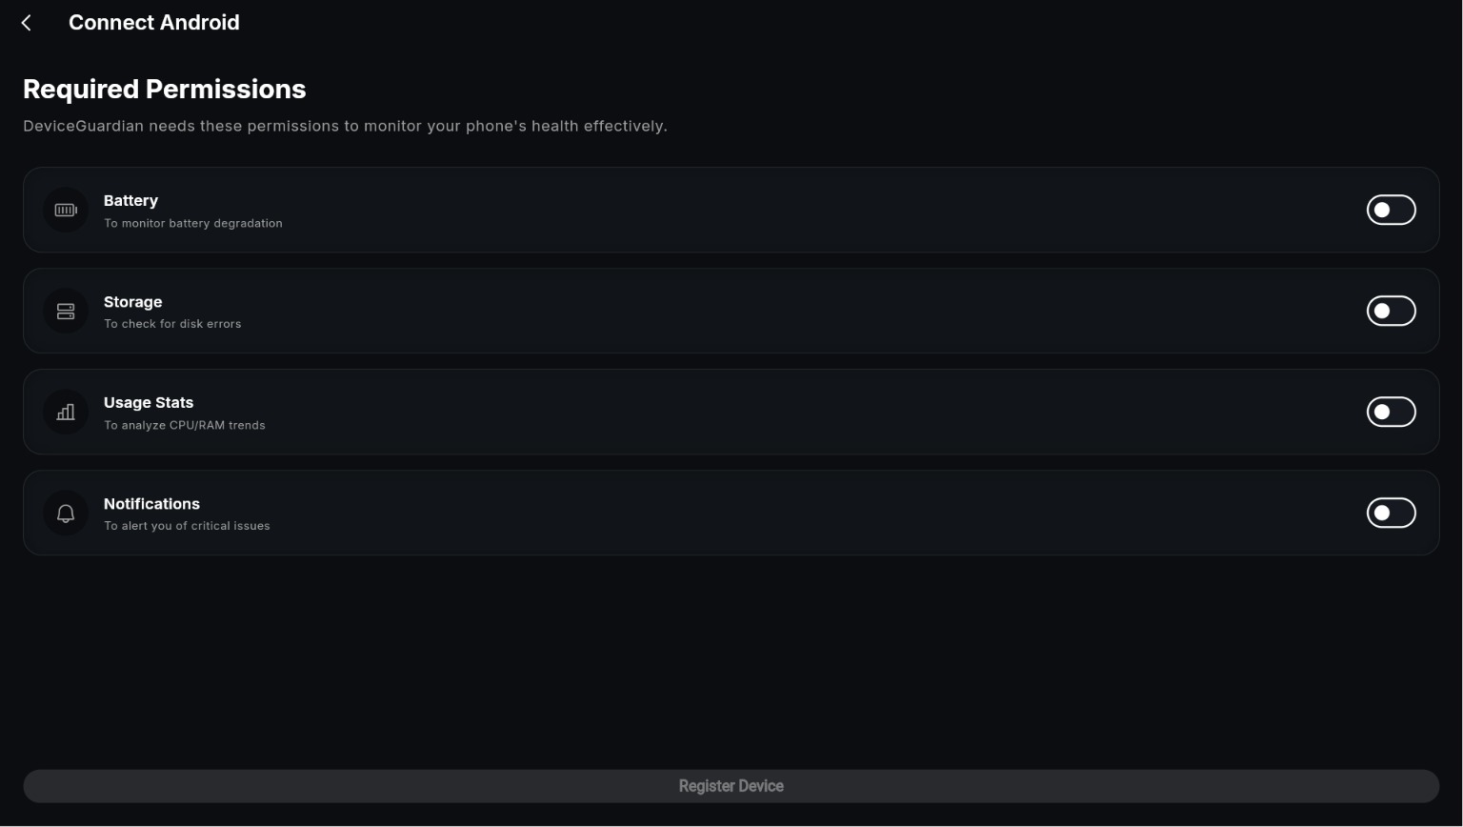
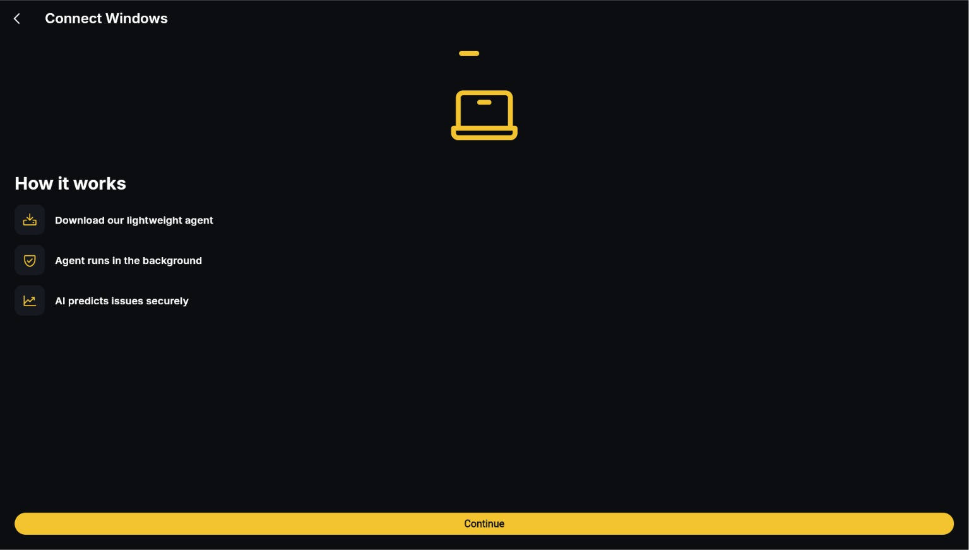
EXPECTED DELIVERABLE

Slide 10
REFERENCES
Datasets & Research:
NASA Battery Dataset — Battery aging and remaining-useful-life cycles (nasa.gov/battery)
CALCE Battery Dataset (Univ. of Maryland) — Cross-validation for battery degradation patterns
Backblaze SMART Dataset — Millions of real hard-drive/SSD SMART records with failure labels (backblaze.com/cloud-storage/resources/hard-drive-test-data)
AI4I 2020 Predictive Maintenance Dataset — UCI Machine Learning Repository (archive.ics.uci.edu)
Research Inspiration:
Predictive Maintenance using Machine Learning
Explainable AI (SHAP)
Battery Remaining Useful Life (RUL) Prediction
SMART-based Storage Failure Prediction

