Slide 1

DEPARTMENT OF ARTIFICIAL INTELLIGENCE AND DATA SCIENCE ACADEMIC YEAR 2025 - 2026 SEMESTER III ARTIFICIAL INTELLIGENCE LABORATORY MINI PROJECT REVIEW House Price Prediction Using Probabilistic Reasoning with Naive Bayes
REGISTER NUMBER | 2117240070018
NAME | Amudieshwar A G
YEAR | II
SECTION | A
FACULTY IN-CHARGE | Mrs. M. Divya

Slide 2
PROBLEM STATEMENT
Brief Overview of Artificial Intelligence Concepts:
Artificial Intelligence (AI) enables machines to learn, reason, and make decisions like humans.
It uses data-driven algorithms to find patterns and make intelligent predictions.
Probabilistic reasoning helps AI handle uncertainty and predict outcomes based on likelihood.
Naive Bayes, a simple yet powerful ML algorithm, applies this reasoning to real-world problems.
This project uses AI to predict house price categories using features like area, rooms, and furnishing.
Problem Statement:
To design a House Price Prediction System using Naive Bayes that classifies homes as Low, Medium, or High price based on input features and provides an approximate cost range.
Expected Result:
The model predicts price categories accurately from training data.
Displays approximate monetary range (e.g., ₹40–80 Lakhs).
Offers a simple, intelligent solution for buyers and property evaluators.
Can be extended with location and market trends for real-time pricing insights.

Slide 3
THEORETICAL BACKGROUND
Theoretical Background & Algorithm Overview:
AI predicts outcomes using data and probabilistic reasoning.
House price prediction estimates value from features like area, rooms, and furnishing.
Naive Bayes Algorithm applies Bayes’ Theorem, assuming feature independence for fast and simple classification.
Literature Survey & Alternatives:
Other methods: Linear Regression, Decision Trees, KNN, and SVM.
These require larger datasets or complex tuning.
Justification for Naive Bayes:
Works well with small, categorical datasets.
Fast, interpretable, and accurate for classification-based prediction.
Ideal for mini-projects with limited data.
Example:
A house with 3 Bedrooms, 2 Bathrooms, Semi-Furnished → Predicted Category: Medium → ₹40–80 Lakhs

Slide 4
IMPLEMENTATION AND CODE
Link to code in Git-hub Repository
List | Git-hub Repository Links
Implementation of Code Link | https://github.com/Amudieshwar-AG/House_price_prediction/blob/main/house_prediction_project.ipynb
Word Document Report Link | https://github.com/Amudieshwar-AG/House_price_prediction/blob/main/AILAB_MINI_PROJECT_TEMPLATE_AI%26DS.docx
PPT Link | https://github.com/Amudieshwar-AG/House_price_prediction/blob/main/AILAB_MINI_PPT_TEMPLATE_AI%26DS.pptx

Slide 5
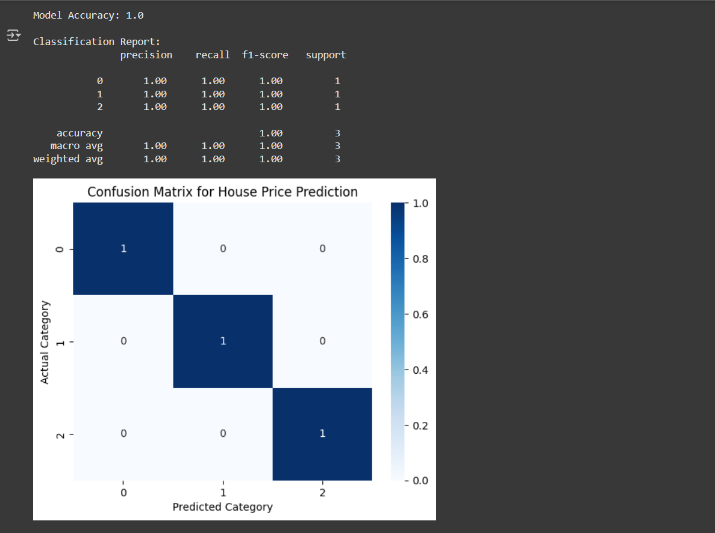
OUTPUT AND RESULTS
Model Accuracy & Confusion Matrix:
This image shows the classification performance of the Naive Bayes model.
Model Accuracy: 1.0 (100%) — meaning the model perfectly classified all test samples.
The Classification Report displays:
Precision, Recall, F1-score = 1.0 for all classes (Low, Medium, High).
Confirms excellent predictive performance.
The Confusion Matrix visualizes correct predictions:
Diagonal values = correctly predicted houses for each category.
No off-diagonal errors → perfect classification.
🧠 This proves that the Naive Bayes model learned the relationship between house features and their price category effectively.

Slide 6
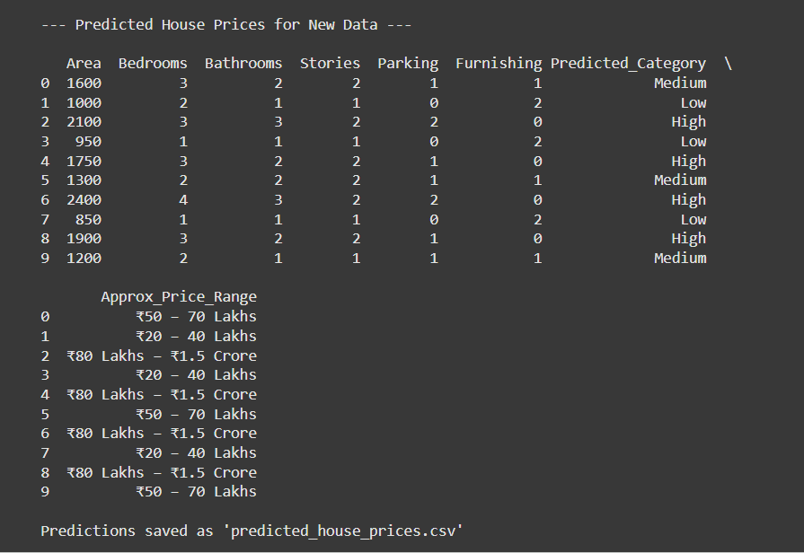
OUTPUT AND RESULTS
Predicted House Prices for New Data:
This image displays predictions made for the new_houses.csv dataset.
Each row represents a house with:
Features: Area, Bedrooms, Bathrooms, Stories, Parking, Furnishing
Predicted Category: Low / Medium / High
Approx. Price Range: e.g., ₹20–40 Lakhs, ₹50–70 Lakhs, ₹80L–₹1.5Cr
💡 This output demonstrates how the model can be used to estimate the probable price category and range for any new property using learned data.

Slide 7
REFERENCES
References:
“Artificial Intelligence: A Modern Approach” – Stuart Russell & Peter Norvig, Pearson Education, 4th Edition (2021). A standard textbook covering AI fundamentals, probabilistic reasoning, and machine learning basics.
“Python Machine Learning” – Sebastian Raschka & Vahid Mirjalili, Packt Publishing, 3rd Edition (2019). Explains Python implementations of Naive Bayes and other ML algorithms.
Scikit-Learn Official Documentation 🔗 https://scikit-learn.org/stable/modules/naive_bayes.html Detailed reference for GaussianNB and Naive Bayes classifier usage in Python.
Kaggle – House Price Prediction Datasets 🔗 https://www.kaggle.com/datasets Used for understanding dataset structure and preprocessing steps in house price prediction.
GeeksforGeeks – Naive Bayes Classifier in Machine Learning 🔗 https://www.geeksforgeeks.org/naive-bayes-classifiers/ Provides conceptual explanation and example codes for Naive Bayes algorithm.

