Slide 1
Recipe preparation ai agent
IBM HACKATHON PROJECT
Presented By:
Student name :Amudieshwar.A.G
College Name & Department :Rajalakshmi Institute of Technology & Artificial Intelligence Data and Science

Slide 2
OUTLINE
Problem Statement
Technology used
Wow factor
End users
Result
Conclusion
Git-hub Link
Future scope
IBM Certifications

Slide 3
Problem Statement
People often struggle to decide what meals to prepare with limited or leftover ingredients .This leads to food waste, poor meal planning, and inconvenience in daily cooking .There is a need for a smart way to utilize available groceries effectively.
Proposed Solution:
An AI agent that suggests recipes based on the user’s available ingredients using a RAG-based system .It generates step-by-step instructions, offers ingredient substitutions, and supports dietary preferences. This solution helps reduce food waste, save time, and simplify everyday cooking.

Slide 4
Technology used
IBM Watsonx Assistant
Used to build the conversational agent (chatbot UI).
Handles user input and output.
IBM Watsonx.ai (optional – for model experimentation)
Can be used for testing LLMs like Granite.
Enables prompt engineering and testing model behavior.
IBM Cloud Object Storage (optional)
To store your PDF dataset or recipe files if needed.
IBM Vector Database / Vector Store (Watsonx)
Handles embedding, semantic search, and retrieval.
Core part of RAG pipeline — retrieves recipe documents based on ingredients.
IBM Granite Foundation Models
Used for Natural Language Generation (NLG).
Generates personalized cooking instructions or responses.

Slide 5
IBM cloud services used
⚙️ IBM Cloud Watsonx AI Studio
For building, experimenting, and prompting LLMs like Granite
Used to test inputs, tune prompts, and check model output
🚀 IBM Cloud Watsonx AI Runtime
Executes your deployed models (Granite or custom)
Powers the chat agent by connecting to the runtime inference
🤖 IBM Cloud Agent Lab (Watsonx Assistant)
Provides the conversational interface for your agent
Where you build, design, and deploy your chatbot UI
🧠 IBM Granite Foundation Model
IBM’s proprietary Large Language Model (LLM)
Used for Natural Language Understanding and response generation

Slide 6
Wow factors
🔍 Semantic Search Superpower
Understands research intent and fetches conceptually relevant papers, not just keyword matches.
✂️ Auto-Summarization
Instantly compresses long papers into short, actionable summaries to save reading time.
🧭 Smart Citation & Reference Mapping
Tracks how ideas evolved through references; reveals foundational and trending works.
🎯 Personalized Paper Recommendations
Suggests research papers based on your current focus, like a personal academic assistant.
📊 Trend & Keyword Analytics
Shows how interest in a topic has changed over time — ideal for choosing research areas.
🤝 Collaboration Discovery
Identifies potential co-authors, labs, or institutions working on similar problems.
⚡ Accelerates Literature Review & Topic Selection
Cuts weeks of effort down to minutes, especially useful for early-stage researchers.

Slide 7
End users
👥 End Users
🎓 Academic Researchers
To speed up literature reviews, find relevant papers, and identify research gaps.
🏛️ Research Institutions & Universities
For institutional knowledge discovery, research assistance, and faculty support.
🧪 Industry R&D Teams
To explore technical literature, trace innovation trends, and support product research.
👩‍🏫 Educators & Teaching Faculty
To curate up-to-date reading material and track subject-specific developments.

Slide 8
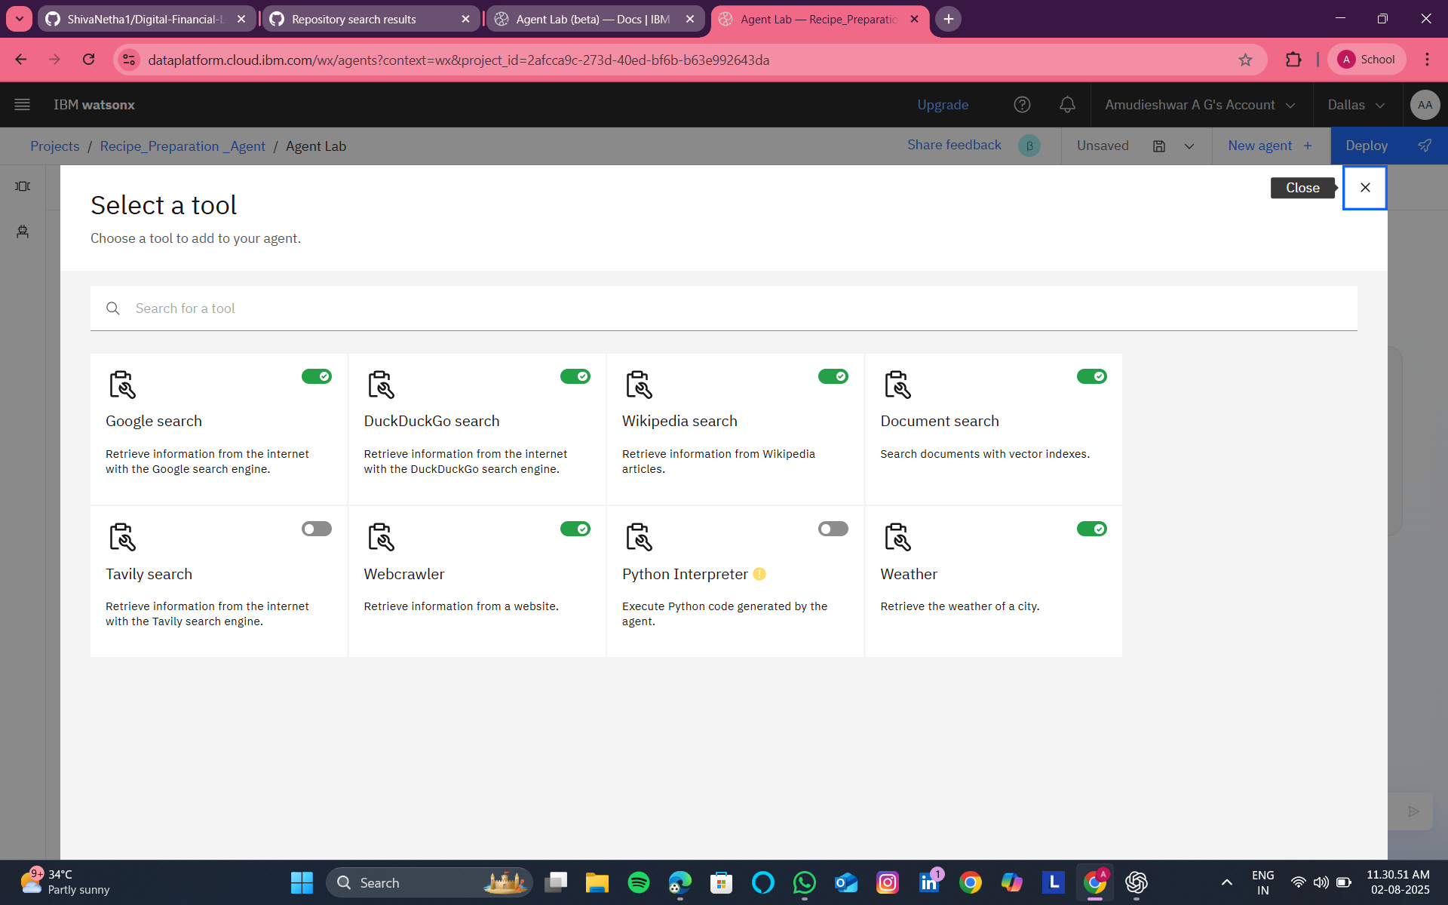
TOOLS USED:

Slide 9
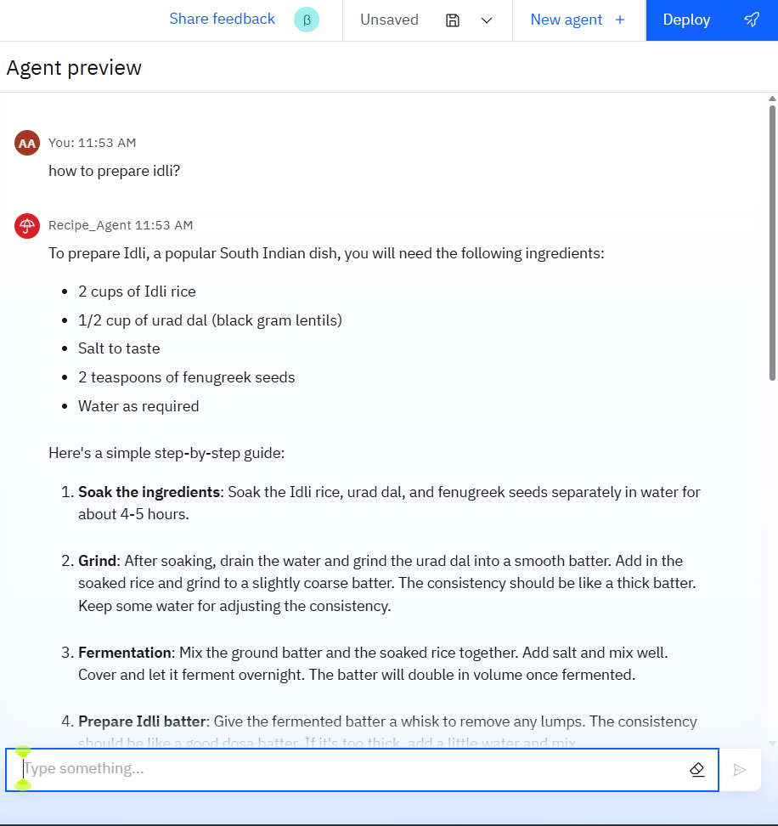
Results
This is my agent preview . If I ask how to prepare idli it gives ingredients and preparation steps by steps.

Slide 10
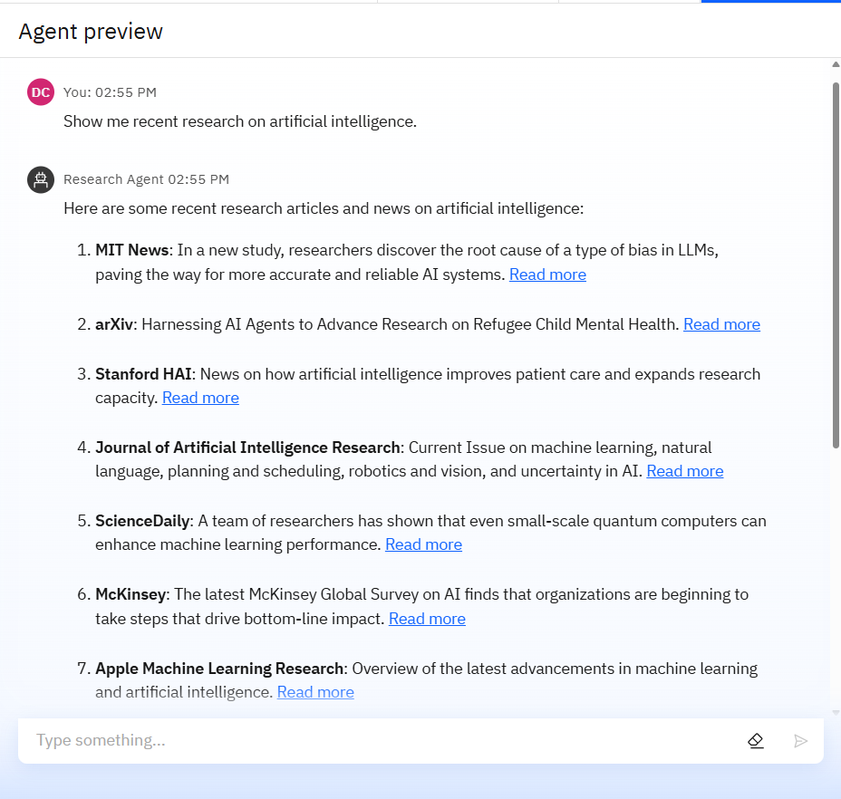
Results

Slide 11
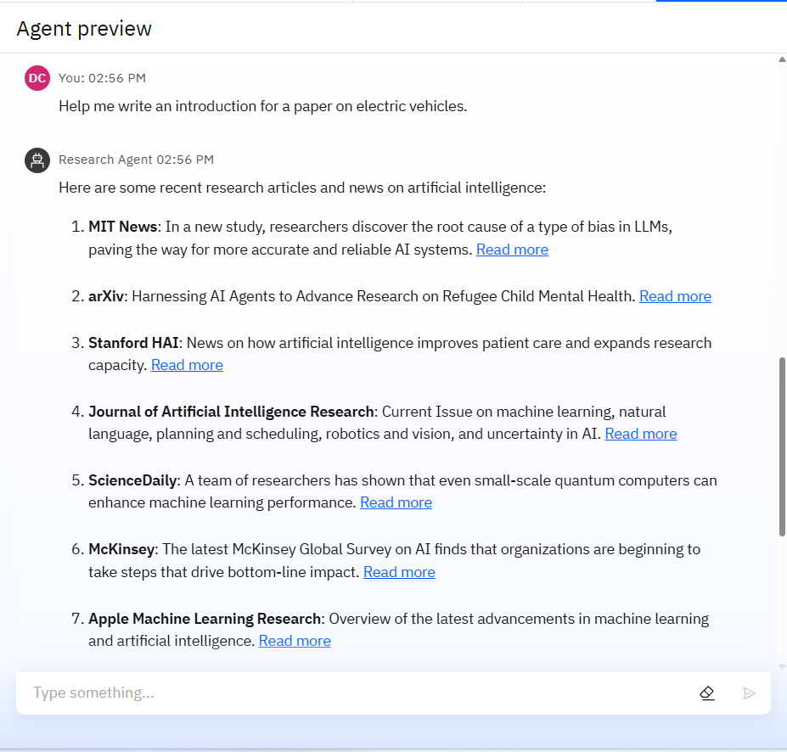
Results

Slide 12
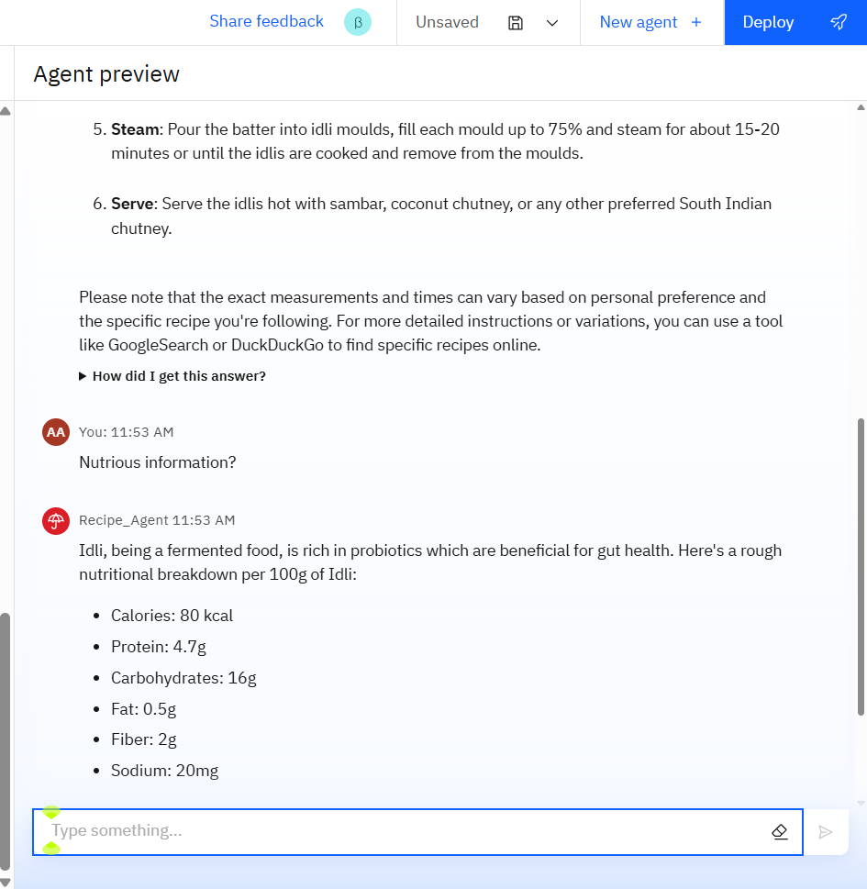
RESULTS
It also gives the details of nutrients and it benefits.

Slide 13
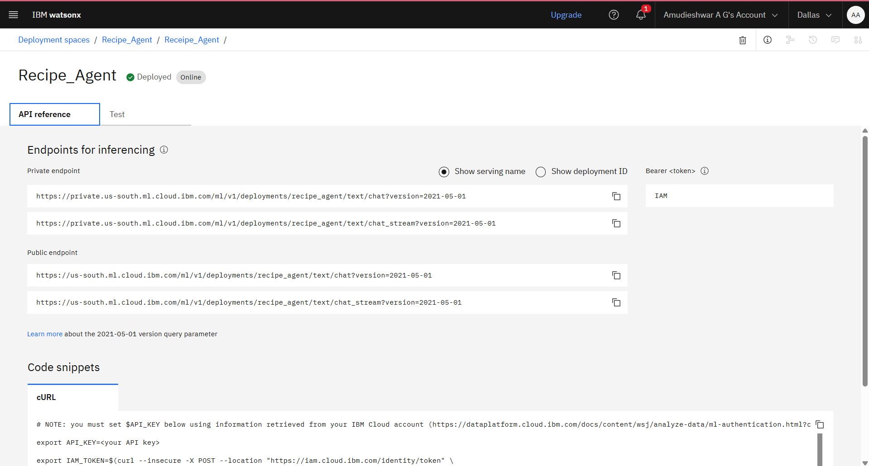
Results
Deployed AI Agent

Slide 14
Conclusion
The Research Agent revolutionizes how researchers interact with knowledge.
It automates repetitive tasks like data extraction and citation management.
Assists in generating hypotheses, drafting reports, and exploring new ideas.
By enhancing efficiency, accuracy, and creativity, it empowers both academic and industrial R&D.
This tool is not just a convenience — it's a next-gen assistant for research innovation.

Slide 15
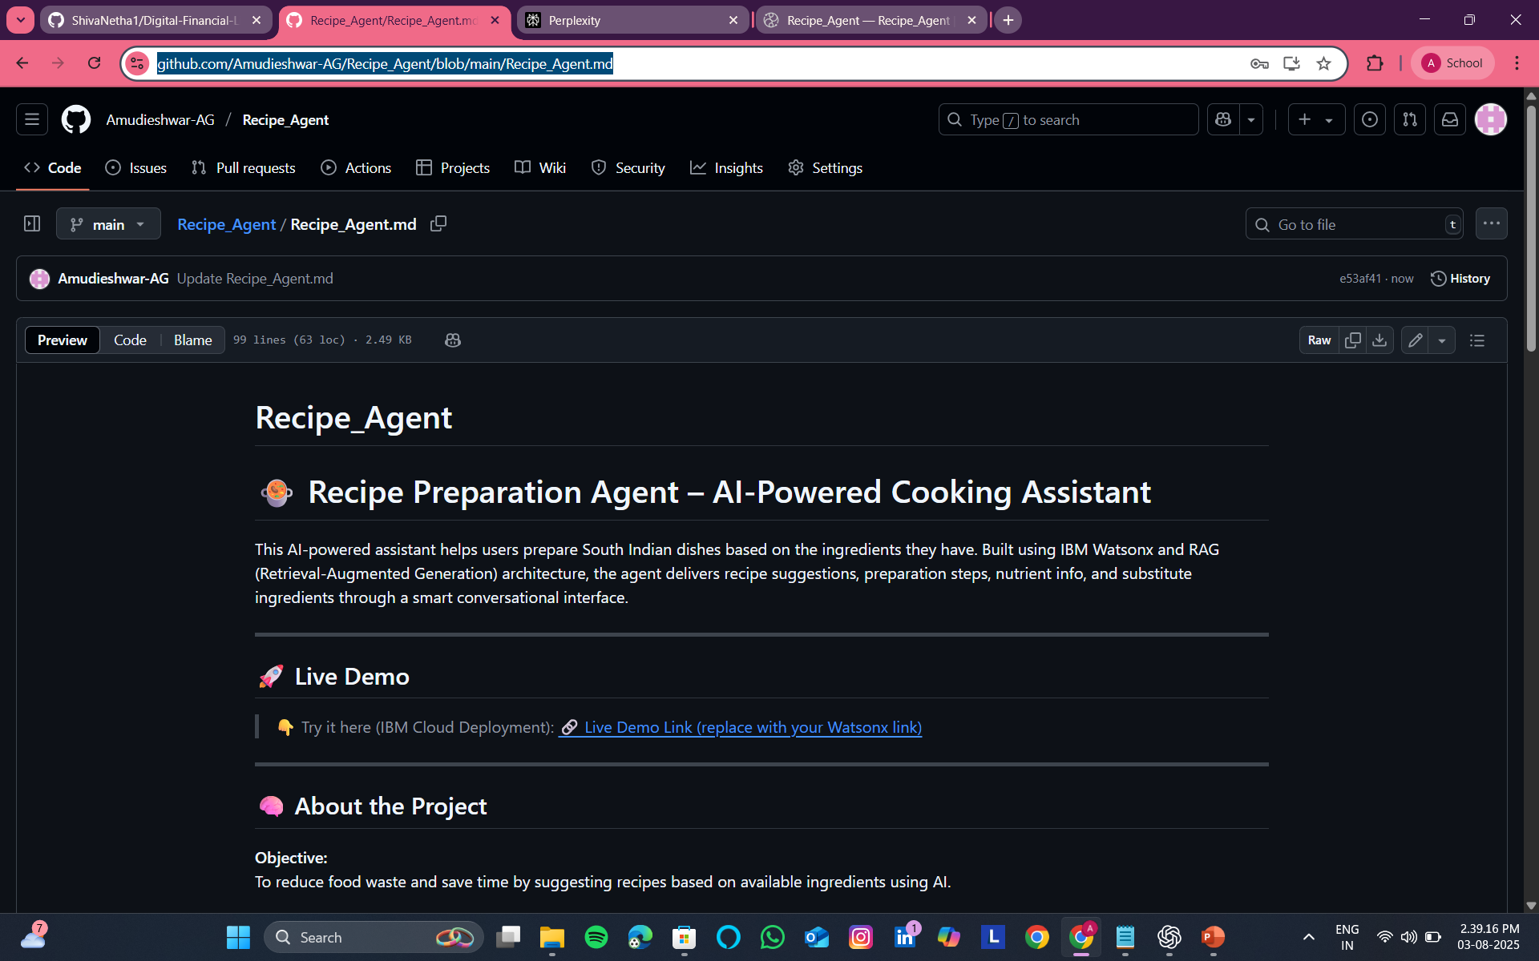
GitHub Link
https://github.com/Amudieshwar-AG/Recipe_Agent/blob/main/Recipe_Agent.md

Slide 16
Future scope
🧠 Multilingual Research Support
Expand to support research papers and queries in multiple languages.
📊 Integration with Research Databases
Connect with platforms like IEEE, PubMed, ArXiv, Springer, etc., for real-time access.
🤝 Real-time Collaboration Tools
Allow co-authors to share, annotate, and edit research drafts collaboratively within the agent.
🎤 Voice-Driven Interaction
Enable voice input for accessibility and hands-free use during experiments or fieldwork.
🧬 Domain-Specific Agents
Tailor agents for fields like Biotech, Physics, Social Science, with specialized vocab and datasets.
🧾 Automated Paper Submission Assistant
Help format, validate, and even submit papers to journals based on their guidelines.

Slide 17
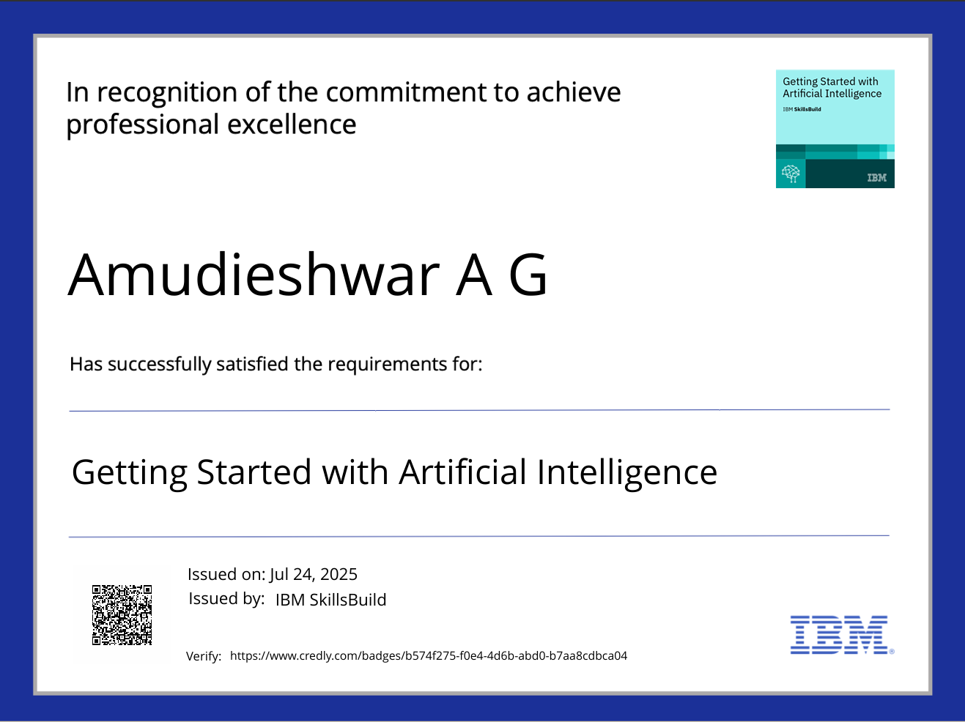
IBM Certifications

Slide 18
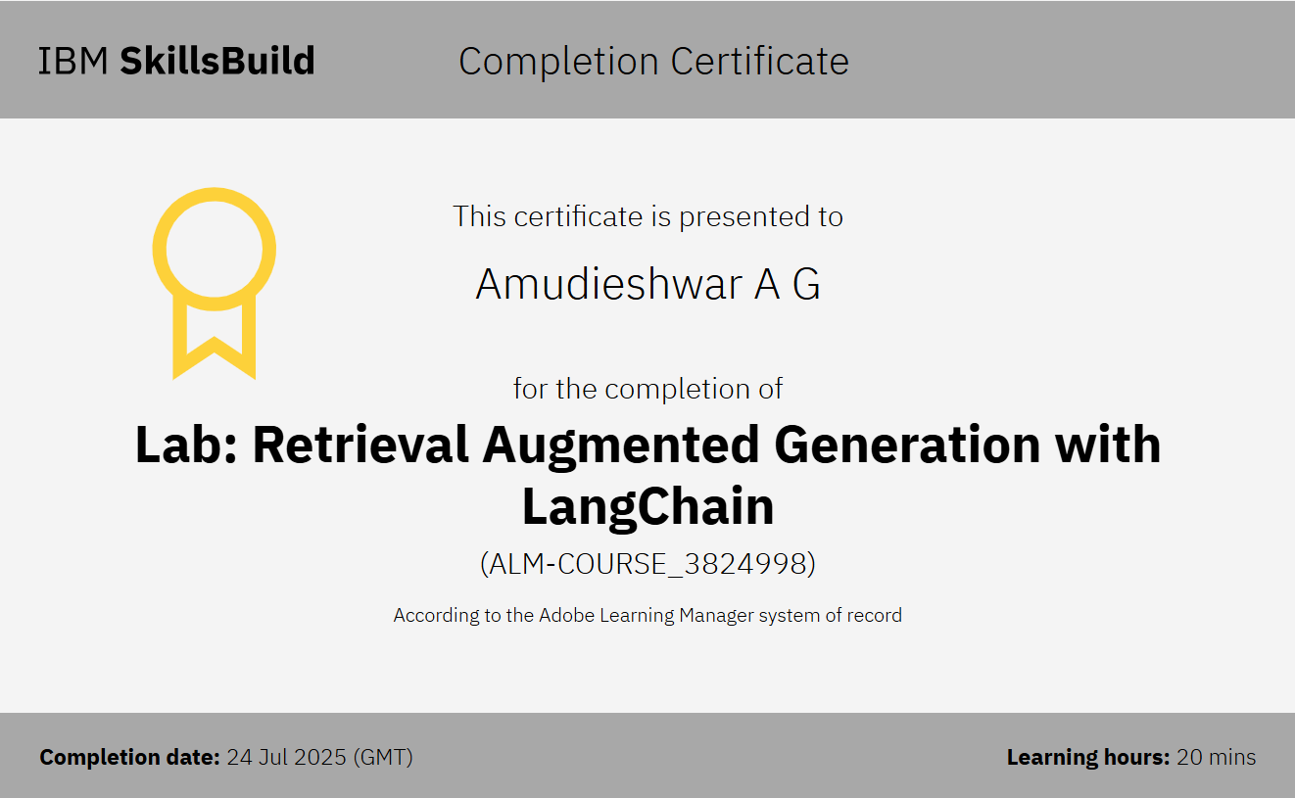

Slide 19
THANK YOU

