Slide 1


SARVAJANIK COLLEGE OF ENGINEERING AND TECHNOLOGY
Topic: Sequence Detector using Synchronous State Machines
Subject: Digital Electronics
Department: Computer Engineering (2110007)
Prepared by:
Name | Enrollment number
Muskan Agarwal | 160420107001
Darshit Akbari | 160420107002
Amul Luniya | 160420107003
Priya Bhagwakar | 160420107004

Slide 2
Contents
Introduction to State Machine
Synchronous State Machines
As a Sequence Detector
1. Non-overlapping
2. Overlapping
Examples

Slide 3
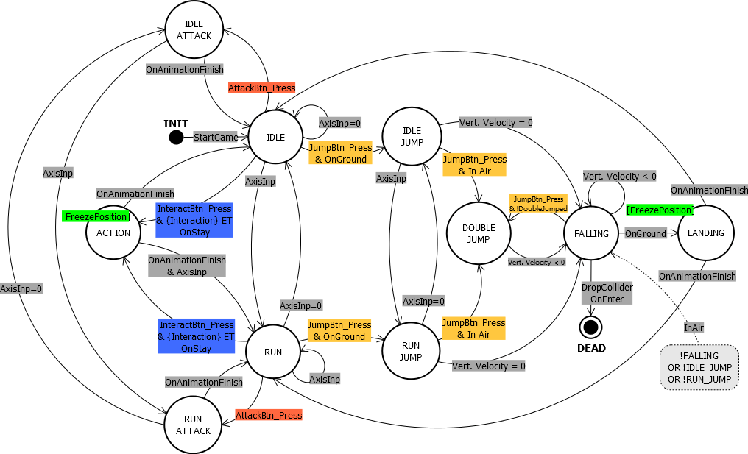

Slide 4
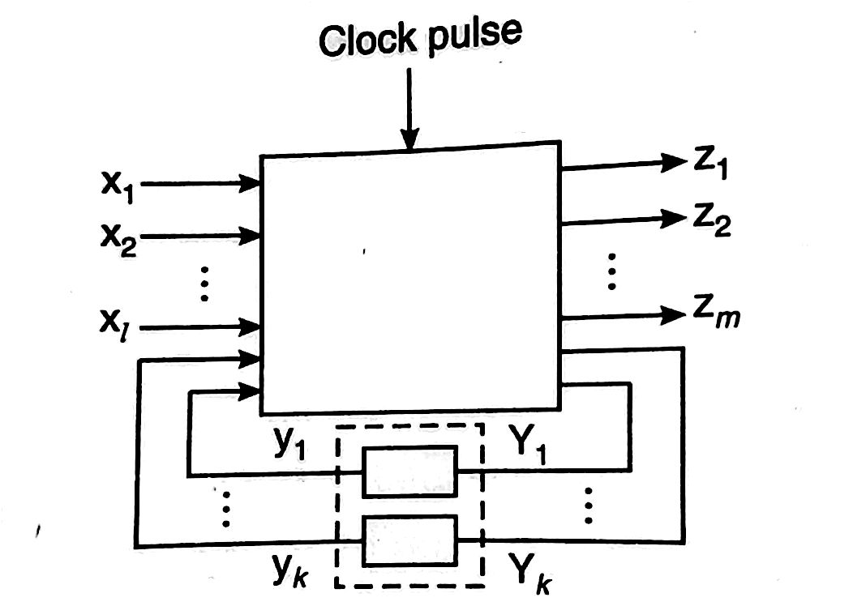
The State Machine
A state machine or finite state machine (FSM) is an abstract model describing the synchronous sequential machine.

Slide 5
State Machine Structure
State memory: n FFs to store current states. All FFs are connected to a common clock signal.
Next-state logic: determine the next state when state changes occur;
Output logic: determines the output as a function of current state and input.

Slide 6
Clocked Synchronous State-Machine
State machine: generic name for sequential circuits; (Finite State Machine: FSM)
Clocked: the storage elements (FFs) use a clock input;
Synchronous: all of the FFs in a circuit use the same clock signal.
Such a FSM changes states only when a triggering edge (rising or falling) on the clock signal.

Slide 7
Models of representing sequential circuits
The synchronous or clocked sequential circuits are represented by two models.
1. Moore circuit: In this model, the output depends only on the present state of the flip-flops.
2. Mealy circuit : In this model, the output depends on both the present state of the flip-flop(s) and the input(s).

Slide 8
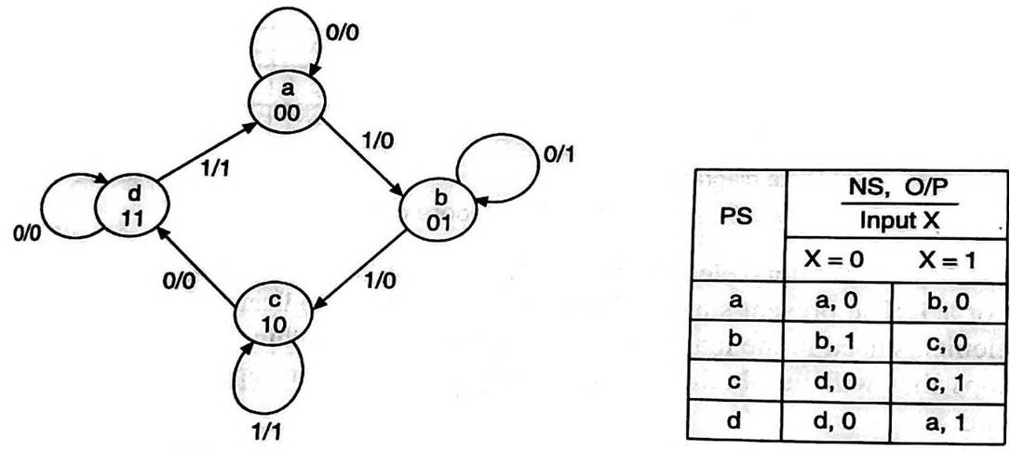
State Diagram
The state diagram or state graph is a pictorial representation of the relationships between the present state, the input, the next state, and the output of a sequential circuit, i.e. the state diagram is a pictorial representation of the behaviour of a sequential circuit.
State diagram and state table using mealy machine

Slide 9
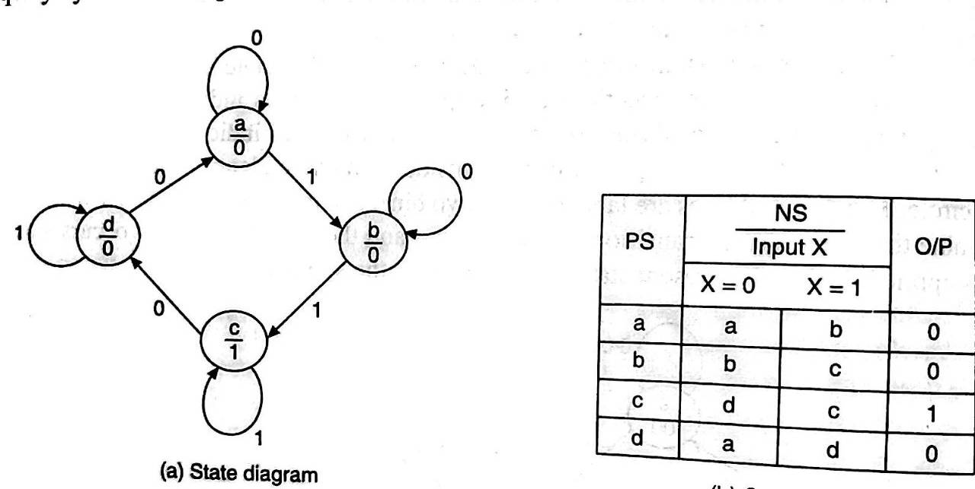
State Table
Even though the behaviour of a sequential circuit can be conveniently described using a state diagram, for its implementation the information contained in the state diagram is to be translated into a state table. The state table is a tabular representation of the state diagram.

Slide 10
Sequence Detector
A sequence detector detects a sequence which is an input string of 1 or 0 bits only.
The output of detector goes to 1 only when the input sequence is detected.
There are two basic types –
1. Overlapping
2. Non-Overlapping

Slide 11
Non - Overlapping
In a non-overlapping sequence detector, output will be decided once the desired pattern is received and no output will be there for any other pattern.
For example (detection of 100) –
Input sequence – 1001010001010
Output Sequence – 0010000100000
The Sequence detector resets itself to initial state after the sequence is detected.

Slide 12
Example
Input Sequence - 101
0/0
S1
1/1
1/0
0/0
1/0
S3
S2
0/0
State Diagram

Slide 13
Truth Table
Q1 | Q2 | I/P | Q1(n+1) | Q2(n+1) | O/P | D1 | D2
0 | 0 | 0 | 0 | 0 | 0 | 0 | 0
0 | 0 | 1 | 0 | 1 | 0 | 0 | 1
0 | 1 | 0 | 1 | 0 | 0 | 1 | 0
0 | 1 | 1 | 0 | 1 | 0 | 0 | 1
1 | 0 | 0 | 0 | 0 | 0 | 0 | 0
1 | 0 | 1 | 0 | 0 | 1 | 0 | 0
1 | 1 | 0 | X | X | X | X | X
1 | 1 | 1 | X | X | X | X | X
D1 = Q2 . (I/P)’
D2 = (Q1)’ . I/P
O/P = Q1 . I/P

Slide 14
Overlapping
In an overlapping sequence detector, some bits from the end part of input sequence may repeat/be included in the next sequence in beginning for sequence detection.
For example (detection of 1001) –
Input Sequence – 100100110
Output Sequence – 000100100
The sequence detector resets itself to some state than the initial state for the overlapping bit(s).

Slide 15
Example
Input Sequence - 1001001
0/0
S0
1/0
0/0
1/0
S3
1/1
S1
0/0
0/0
1/0
S2

Slide 16


