Slide 1


SARVAJANIK COLLEGE OF ENGINEERING AND TECHNOLOGY
Name: Amul Luniya
Enrollment no.: 160420107003
Semester: 3rd
Branch: Computer Engineering (Shift 1)
Topic: Money (EEM)
Submitted To: Dr. Mahesh Trivedi

Slide 2
Contents
Money – Introduction
Functions of Money
Types of Money
Monetary Policy
Fiscal Policy
Tools of Fiscal and Monetary Policy
Fiscal Policy versus Monetary Policy

Slide 3
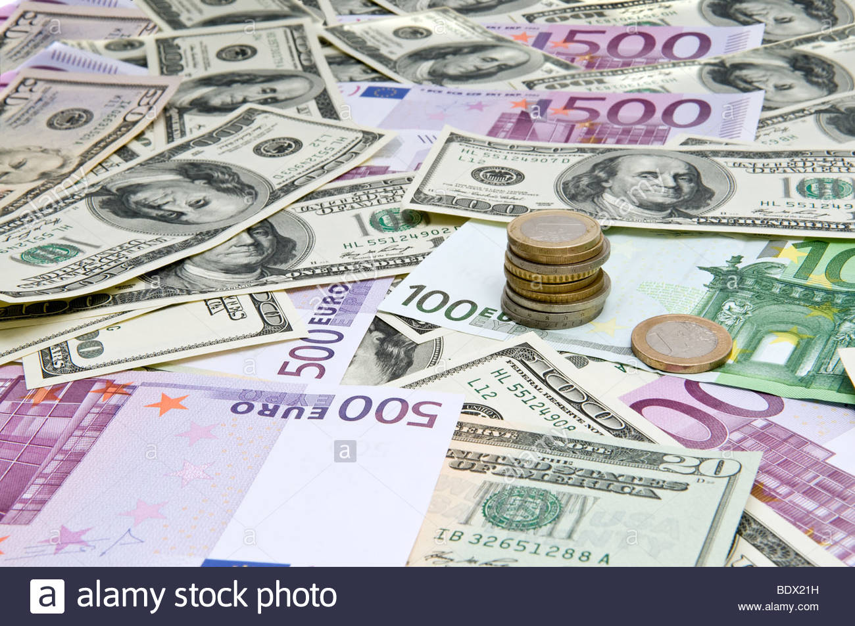
MONEY

Slide 4
Money – Introduction
Money is a medium of exchange developed to pay or accept any goods or services.
Since money is standard, it avoids the inefficiencies of a barter system.
It is either in the form of coins or cash. Amount of money with a person or institution determines its wealth.
Each country has its own currency

Slide 5
In economics…
Money is defined as something that serves as a medium of exchange, a unit of accounting, and a store of value. Money, as a medium of exchange, is accepted for making transactions all over. As a unit of accounting, money provides a simple device for identifying and communicating value.

Slide 6
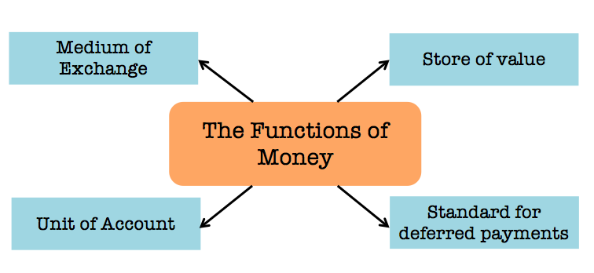

Slide 7
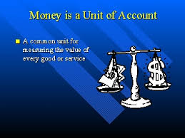
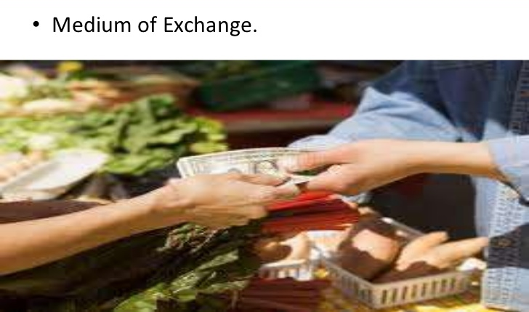
Functions of Money
A unit of account – money is the foundation of every transaction; everything in economy is quoted in terms of it.
A medium of exchange – used to buy goods & services

Slide 8

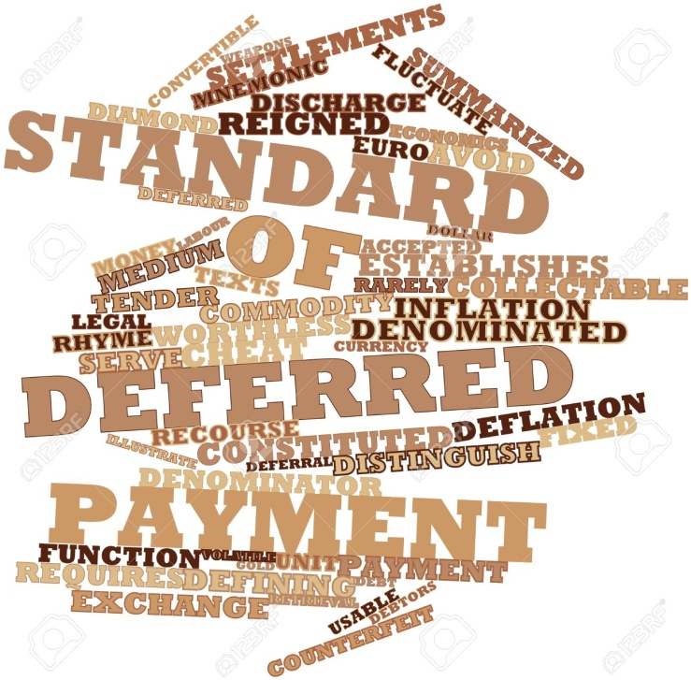
…Continued
A store of value – with saved money, goods and services could be bought in future
A standard of deferred payment – whatever be the debt today can be settled in future by exchanging money

Slide 9


Types of Money
Commercial Money – claim against financial institutions that can be used for the purchase of goods and services. Examples – credit money, electronic money, fractional money and representative money.
Commodity Money – used in barter system where the valuable resources fulfill functions of money. Certain types of such commodities are gold coins, beads, shells, pearls, stones, metal, etc.

Slide 10

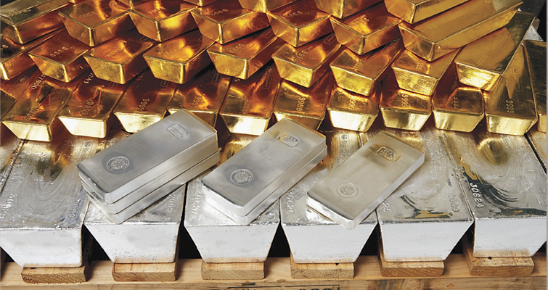
…Continued
3. Fiat Money – doesn’t has intrinsic value. Its value is determined by government order which makes it a legal instrument for transaction purposes and by the market forces of demand and supply. Examples are paper money and coins.
4. Fiduciary Money – is when a customer can sell the promise or transfer it to somebody else which was assured by the bank to pay in different types of money. It is generally paid in gold, silver, paper money, cheques and bank notes.

Slide 11
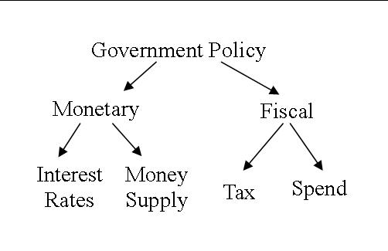
Government Policy Structure

Slide 12
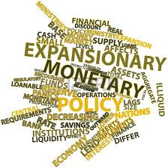
Monetary Policy
It is the policy by which the monetary authority of a country like the central bank or currency board, controls the supply of money, often targeting an inflation rate or interest rate to ensure price stability and general trust in the currency.
The purpose for change in rates is to promote economic growth The official goals usually include relatively stable prices and low unemployment.

Slide 13
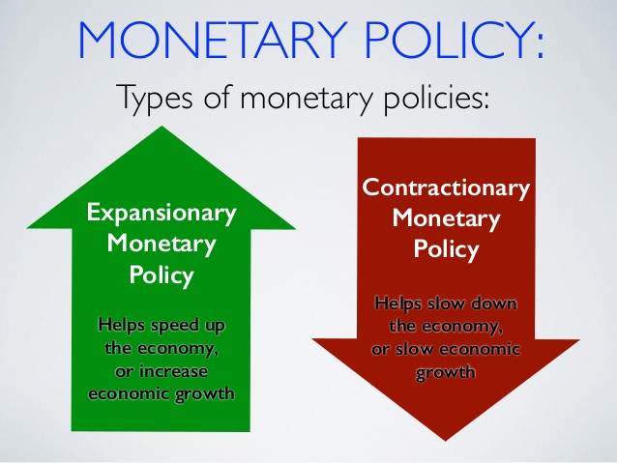

Slide 14
Objectives of Monetary Policy
Price Stability – tries to keep the value of money stable by reducing income and wealth inequalities and controlling interest rates. At times of inflation, tight monetary policy is adopted and vice versa.
Rapid Economic Growth – The policy influences the economic growth by controlling real interest rates and its resultant impact on the investment. If RBI adopts liberal credit policy by reducing interest rates, the investment level in the economy can be encouraged.

Slide 15
Balance of Payments Equilibrium - RBI tries to maintain equilibrium through monetary policy. The BoP has two aspects, BoP surplus (excess money supply in domestic economy) and BoP deficit (stringency of money). If the monetary policy succeeds the BoP equilibrium can be achieved.
Full Employment – refers to a situation in which everybody who wants jobs to get jobs. (but not zero unemployment). Monetary policy tries to attain the full employment through effective control.

Slide 16
…Continued
Equal Income Distribution – Economists believe that monetary policy helps in achieving income distribution. Effective control through monetary policy, equal income distribution can be achieved.
Exchange Rate Stability – It is the price at which home country’s currency is exchanged with currency of other country. If there is high volatility in the exchange values, foreign currency loses its faith and hence through maintaining money supply exchange rates are stabilized.

Slide 17
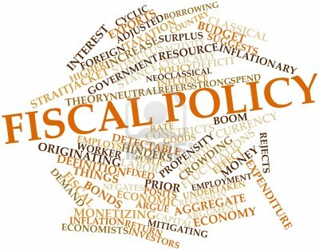
Fiscal Policy
Fiscal policy is the means by which a government adjusts its spending levels and tax rates to monitor and influence a nation's economy. It is the sister strategy to monetary policy through which a central bank influences a nation's money supply.
It is widely known as ‘Budgetary Policy’.

Slide 18
Objectives of Fiscal Policy
Mobilization of Resources – Financial resources are mobilized through taxation (direct and indirect), public savings and private savings.
Effective Allocation of Financial Resources – done in development activities such as railways, infrastructure, etc. and non-development such as defense, interest payments, subsidies, etc. which should be socially desirable to ensure production for generation of goods and services.

Slide 19
Attempt to Reduce Inequality – Through direct taxes (income tax), rich people are charged high tax and also through indirect tax on semi-luxury or luxury items which are mostly consumed by rich people. This way, fiscal policy reduces inequality.
Control the Inflation – By introducing tax saving schemes, productive of financial resources, etc. the government tries to reduce the fiscal deficits. And in this way it tries to control the problem of inflation.

Slide 20
…Continued
Employment Generation – This task is done by effective fiscal measures like employment generation programs and creating jobs.
Capital Formation – Another objective is to increase the rate of capital formation so as to accelerate the rate of economic growth. For this, fiscal policy must be efficiently designed to encourage savings and discourage and reduce spending.

Slide 21
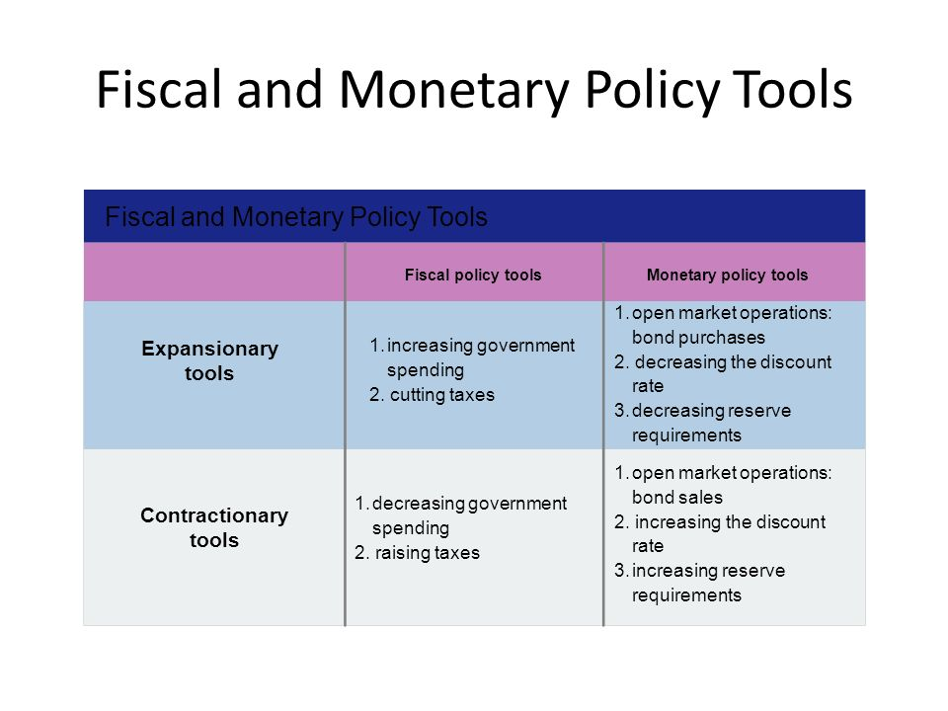

Slide 22
Fiscal Policy versus Monetary Policy
Fiscal policy can be distinguished from monetary policy, in that fiscal policy deals with taxation and government spending and is often administered by an executive under laws of a legislature, whereas monetary policy deals with the money supply, lending rates and interest rates and is often administered by a central bank.

Slide 23
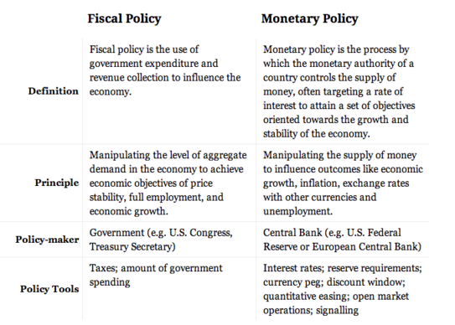

Slide 24


Slide 25


