Slide 1
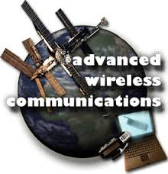

Slide 2
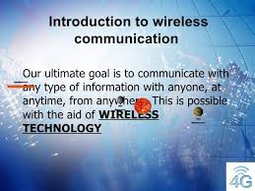
For what?

Slide 3
In Exact Terms
It’s the transfer of information b/w 2 points which aren’t physically connected.
It’s distance independent i.e. can be used for a few metres (e.g. TV remote) as well as for millions of kilometres (e.g. Deep-space radio communications).
Encompasses various types of fixed, mobile and portable applications.

Slide 4
Why WIRELESS?
Freedom from wires
No bunch of wires running from here and there
Global Coverage
Flexibility to connect multiple devices
“Auto Magical” instantaneous communication without physical connection setup
Cost and Time Effective

Slide 5
EXAMPLES
Bluetooth
Cellular Networks – 3G, 4G, 5G, GSM
Scatternets and Piconets
Sensors
Infrared Rays
Satellite & Broadcasting
GPS units
Cordless telephone
Radio Specification – Transmitters, Receivers
Wireless Computers
Wi-Fi and Li Fi

Slide 6
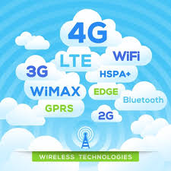
CELLULAR NETWORKS
Mobile phone networks
Subscriber identity module
3G, 4G, GPRS, HSPA, etc.

Slide 7
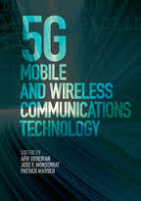
5G
Denotes higher internet connection speeds than the current 4G.
Estimated that 10 Mbps to be available for hundreds of thousands at the same time.
Spectral efficiency significantly enhanced compared to 4G
Coverage improved
Signalling efficiency enhanced
Latency reduced significantly compared to LTE

Slide 8
INFRARED COMMUNICATION
A short-ranged, bidirectional system
In this, an LED transmits the infrared signal as bursts of non-visible light. At the receiving end a photodiode or photoreceptor detects and captures the light pulses, which are then processed to retrieve the information they contain.

Slide 9
Applications
Augmentative communication devices
Car locking systems
Computers
Detect Temperatures
Emergency response systems
Windows, Doors, Lights, Bed, Radios
Headphones
Home security systems
Navigation systems
Sensors
Signage
Telephones
TVs, VCRs, CD players, stereos
Toys

Slide 10
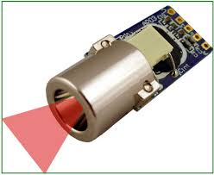
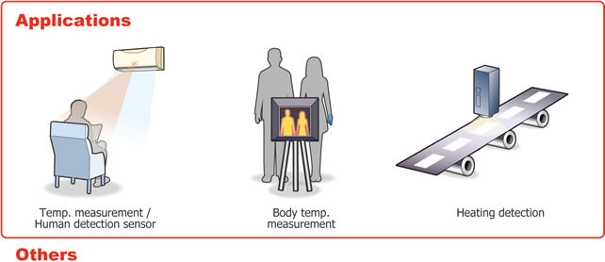
Applications
IR Sensor
Temperature/Heat Detectors

Slide 11
Advantages
Low power requirements (ideal for laptops, personal digital assistances)
Low circuitry cost
Simple circuitry
Higher Security
Portable
High noise immunity, i.e. doesn’t interfere with other signals

Slide 12
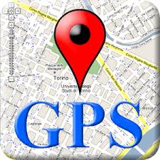
GPS
Global Positioning System provides location and time information in all weather conditions, anywhere on or near the Earth where there is an unobstructed line of sight to four or more GPS satellites. The GPS system operates independently of any telephonic or internet reception, though these technologies can enhance the usefulness of the GPS positioning information.

Slide 13
Working
The satellites carry very stable atomic clocks that are synchronized to each other and to ground clocks. GPS satellites continuously transmit their current time and position. A GPS receiver monitors multiple satellites and solves equations to determine the precise position of the receiver and its deviation from true time. At a minimum, four satellites must be in view of the receiver for it to compute four unknown quantities (three position coordinates and clock deviation from satellite time). In practice the receiver position (in 3D Cartesian coordinates) and the offset of the receiver clock relative to the GPS time are computed simultaneously, using the navigation equations to process the TOFs.

Slide 14
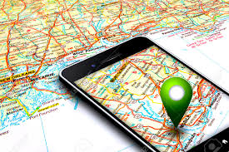
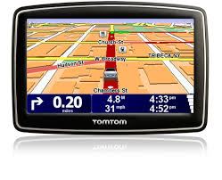
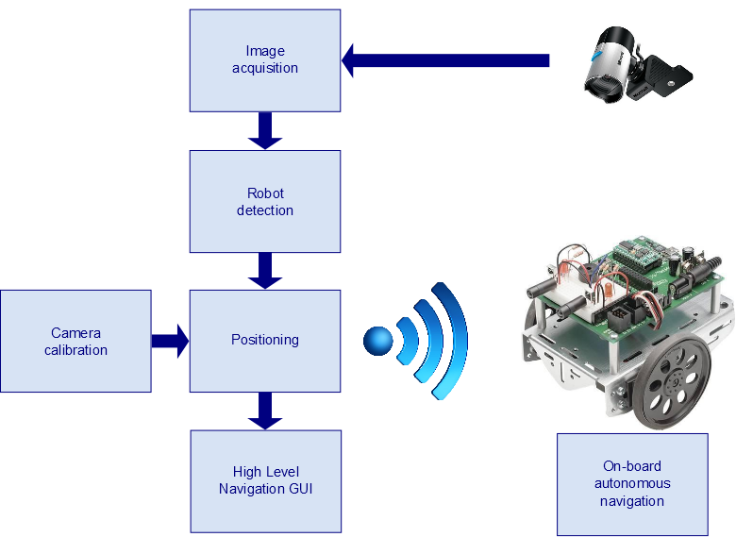
Applications
Tracking a device or a person
Navigation
Military purposes
Cellular Telephony
Automated Vehicle
Robotics
Disaster Prevention
Astronomy
Geotagging

Slide 15
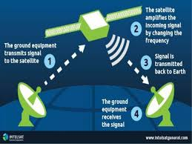
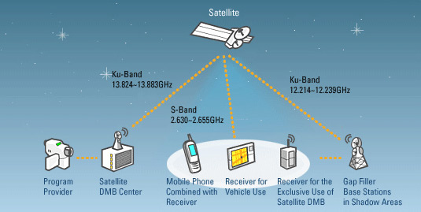
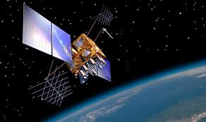
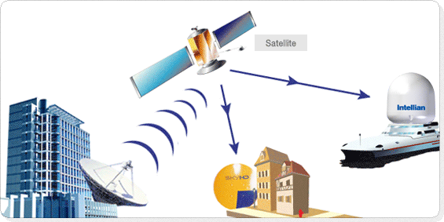
SATELLITE & BROADCASTING

Slide 16
SCATTERNET & PICONETS
Scatternet
Piconet
Device in one piconet may exist as master or slave in another piconet
Allows many devices to share same area
Makes efficient use of bandwidth
Master determines hopping sequence, slaves have to synchronize
Participation in a piconet = synchronization to hopping sequence
Each piconet has one master and up to 7 slaves
Basic unit of Bluetooth networking
Master and one to seven slave devices
Master determines channel and phase
Communication between piconets = devices jumping back and forth between the piconets

Slide 17
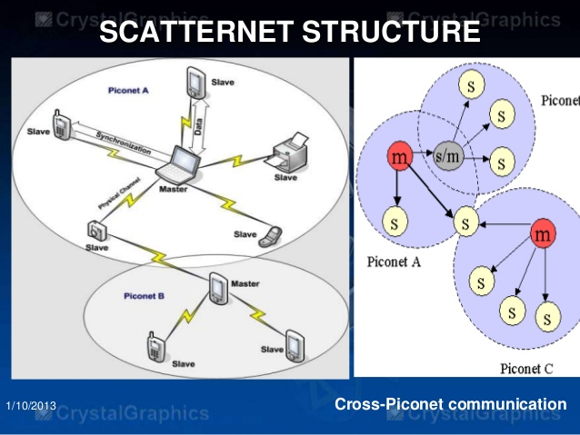
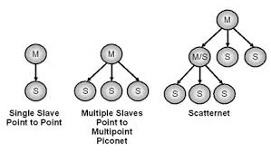
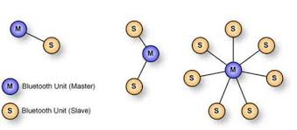

Slide 18
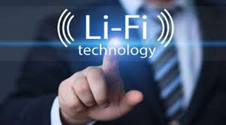


Slide 19
What’s this?
Li-Fi stands for Light Fidelity.
It’s a bidirectional, high speed and fully networked WC technology, similar to Wi-Fi.
It’s a form of visible light communication and a subset of optical WC.
It uses infrared and near-ultraviolet instead of radio-frequency spectrum, part of optical wireless communications technology, which carries much more information, and has been proposed as a solution to the RF-bandwidth limitations.
So it can be a complement to RF communication (Wi-Fi and cellular networks) or even as replacement to data broadcasting.

Slide 20
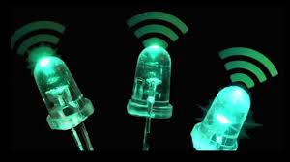
Working
Works in the presence of
VISIBLE LIGHT
In areas which are electromagnetically sensitive
Like aircraft cabins, hospitals, nuclear power plants, etc. without causing electromagnetic interference.

Slide 21
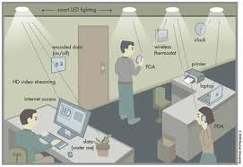
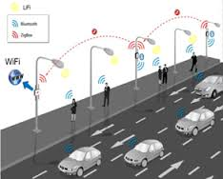
Usage
Can also be used in aircraft cabins, hospitals, nuclear power plants

Slide 22
Advantages
Very high speed connectivity. Researchers have reached data rates of over 10 Gbit/s.
Visible light spectrum used by it is 10,000 times larger than the entire radio frequency spectrum
Expected to be 10 times cheaper than Wi-Fi.
Has no limitations on capacity.

Slide 23
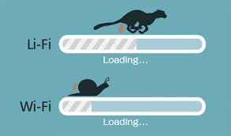
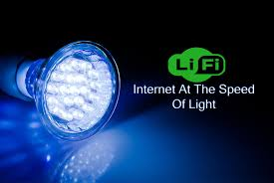
This would be the scenario
Internet at the speed of light

Slide 24
Other Examples
Sensors
Bluetooth
Cordless Telephones
Transmitters, Receivers
Wireless Computers
Wi-Fi, etc.

Slide 25

By: Amul Luniya and Nikhil Mulchandani
BE – CO(M) – 1st Year

